Slide 1
Sustainability Sub-Committee (SSC)
Update
7/11/2022
Dale Seed
SSC Convenor
Convida Wireless

Slide 2
Update
oneM2M sustainability case study [SSC-2022-0002R01]
  Identify oneM2M aspects/features well-aligned with IoT sustainability
    E.g., Aspects/features that can make IoT deployments more sustainable
  Identify new oneM2M opportunities for improve IoT sustainability
oneM2M White Paper [SSC-2022-0006]
  Share findings of oneM2M sustainability case study
  Target to complete by Oct 2022
Plans for White Paper
  Work with oneM2M MARCOM (oneM2M Website, other channels, …)
  IEEE 8th World Forum on Internet of Things - 26 Oct 2022

Slide 3
oneM2M Case Study
Update
Refer to SSC-2022-0002R01 for working draft

Slide 4
Summary of oneM2M features enabling more sustainable IoT deployments
Streamlining of IoT message sizes [<primitiveProfile>]
Offloading processes to IoT service layer [<state>, <processManagement>]
Time synchronization management [<timeSyncBeacon>]
Digital twins [<AE>, <node>, <container>, <contentInstance>, <flexContainer>, etc.]
Subscription and notifications [<subscription>, <crossResourceSubscription>]
Managing sleep schedules and wake-up of devices [<schedule>, <triggerRequest>]
IoT message delivery scheduling and aggregation [<schedule>, <delivery>]
Interworking to different IoT technologies [IPEs]
Performing optimized operations on groups of devices [<group>, <fanoutPoint>]
Managing end-to-end sessions between applications [<e2eQosSession>]
Offloading a software management campaign targeting a set of devices from an application to service layer [<softwareCampaign>, <mgmtObj>]
Assist with managing congestion in underlying network transports [<nwMonitoringRequest>]
Offloading semantic reasoning operations from applications to service layer [<reasoningRules>, <reasoningJobInstance>]
Offloading and managing data storage and brokering on behalf of devices and applications (e.g., storage, discovery, authorization, stats collection, charging of data) [data management resources, <accessControlPolicy>, <statsConfig>, <eventConfig>, <statsCollect>]
Offloading the execution of individual requests from applications to service layer [<mgmtCmd>, <action>, <dependency>, <transactionMgmt>, <transaction>]
Offloading data analytics operations from devices and applications to service layer [<timeSeries>, <timeSeriesInstance>]
Offloading semantic mashup operations from applications to service layer [<semanticMashupJobProfile>, <semanticMashupInstance>, <semanticMashupResult>]
Sending requests to 3GPP devices using Non-IP Data Delivery (use of 3GPP control plane to deliver messages)
Detect network congestion and throttle messages to help alleviate congestion
Managing network connectivity used to communicate with devices [CMDH]
* Additional Features under consideration

Slide 5

1. Streamlining IoT message sizes
Feature: A message profile is used to reduce the size of messages IoT devices transmit and receive. Message profile is used by service layer to enrich message with additional metadata after message is received from a device (e.g., static information elements in messages).
Sustainability Impact: Size of messages transmitted and received by devices can be reduced. Results in reduced energy consumption by devices and reduced load on networks without sacrificing useful information within messages.
Registration
Service Layer
Registration
Communication Management
Security
Discovery
Data Management & Repository
Semantics
Device Management
Subscription & Notification
Group Management
Application & Service Management
Location
Service Charging & Accounting
Network Service Exposure
Transaction Management
Time
Management
Session
Management
Process
Management

Slide 6

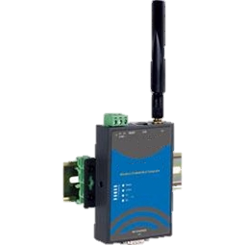
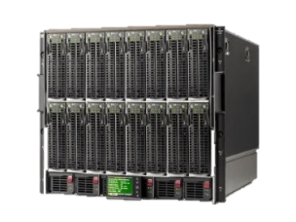
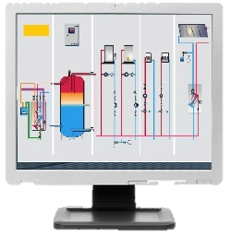


1. Streamlining IoT message sizes
1) Only bare minimal amount of info needed in request (i.e., just the sensor reading)
3) Request to Retrieve contentInstance
temp
1) Request to create contentInstance resource
[content = 32]
4) Response
[labels = temperature, creator = AE-1,
contentInfo = application/xml:1, content=32]
AE-1
AE-2
CSE
CSE
2) CSE uses primitiveProfile to add additional useful metadata to message.
A primitiveProfile is used by a CSE to add, modify and delete attributes of messages flowing to/from constrained IoT devices. This helps minimize size of messages without sacrificing useful info needed by apps interacting with these devices
4) Rich set of information needed by AE-2 included in response
CSEBase
AE-1
primitiveProfile
resourceTypes = contentInstance
operations = CREATE
additions =
labels=temperature,
creator=AE-1, contentInfo=application/xml:1 …
container
contentInstance
labels = temperature
creator = AE-1
contentInfo = application/xml:1 …
content=32
AE: Application Entity
CSE: Common Services Entity

Slide 7
oneM2M Sustainability White Paper
Refer to SSC-2022-0006 for working draft

Slide 8
How to participate
SSC email list - ONEM2M_SSC@LIST.ONEM2M.ORG
Upcoming Meeting Schedule
  SSC 14 - Thurs Aug 18 - 1-2pm UTC
  SSC 15 - Thurs Oct 20 - 1-2pm UTC
  SSC 16 - Thurs Dec 15 - 1-2pm UTC

