Slide 1

SDS Status Report to TP55
Group Name: oneM2M SDS
Source: Peter Niblett, Poornima Shandilya, SeungMyeong Jeong, Wei Zhou
Meeting Date: 2022-07-12 to 2021-07-15

Slide 2
Summary
13 new SDS contributions have been agreed against Rel-2,3,4
10 contributions to date have been agreed against Rel-5
  Recommend we start R5 TSs now
ITU-T feedback on TS-0003
  Decided that we don’t need to update the References section. One more face/face meeting is planned
Propose to remove resource mapping rules from TS-0001 rel 4
  See slide 6
List of outstanding Actions has been processed
  Need to reach a decision on IANA registration for CoAP
Issue tracking system is being used
  90 issues currently open, 44 have been closed

Slide 3
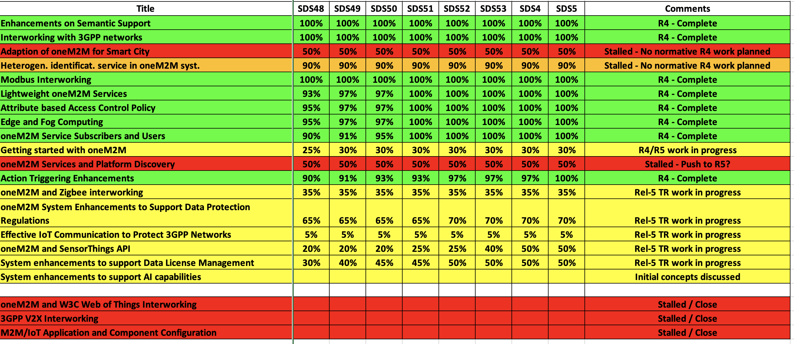
SDS WI Status
Complete
On track
Running behind schedule
Work has stalled

Slide 4
Rel-4 Progress
  Stage 3 work complete for all Rel-4 features
  Various maintenance/corrections needed before R4 is complete.
    Final review of TS-0004 against TS-0001 is needed to check that there are no further missing pieces
  Mapping rules have been removed from TS-0001 rel 4
Rel-4 XSDs have been generated
  Many thanks to Miguel

Slide 5
Rel-5 Progress
Progress on IPE/SDT-based Device Management
Ten contributions for R5 TS’s have now been agreed
  Will be added to a CR pack when the new versions of the TSs are started.

Slide 6
Items for Decision
CR Packs:
TS-0001 – TP-2022-0068 – 01-R2, 02-R3, 02-R4 = 5
TS-0004 – TP-2022-0069 – 02-R2, 02-R3, 04-R4 = 8
IANA registration question. IANA expert has pointed out that the CoAP option values we have chosen (since R1) don’t properly conform to the CoAP spec. We have to decide between the following options:
Keep the numbers as they are and tell IANA that we would like to proceed with them anyway
Change them in R4 to numbers that are compatible with the spec; this would mean we can’t interoperate between R3 and R4 CoAP
Abandon the idea of IANA registration

