Slide 1

oneM2M Standard in EU
Selected Examples
oneM2M
10 Years !
Roland Hechwartner
oneM2M TP Chair, Deutsche Telekom
Seoul, October 19th 2022
oneM2M 창립 10주년 기념 세미나

Slide 2












oneM2M Partnership Project
More than 200 member organizations in oneM2M
founded¹ July, 24th 2012
TP#1: Sep 24th-29th 2012
[1] Partnership Agreement V 2.0 (Approved March 2013)
Join forces
=> reduce fragmentation
=> Reuse e.g.
HGI
e.g. Release 2 transposition
ITU-T SG20 Y.4500.x
www.oneM2M.org All documents and specifications are publically available

Slide 3
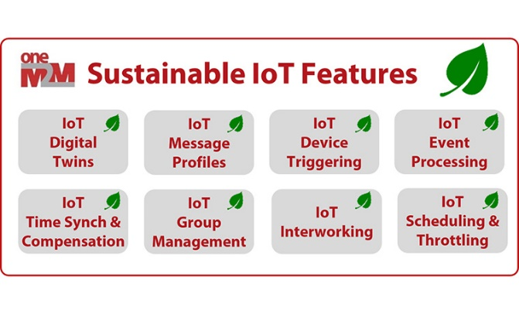
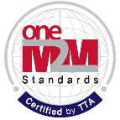

oneM2M Key-events Timeline
Interop 1
Interop 2
Interop 3
Interop 5
Interop 6
Interop 7
Interop 8
Interop 4
oneM2M
established
Release 5
initial plan
Release 1
Release 2
Release 2A
Release 3
Release 4
oneM2M Hack-a-Thon Events
2012
2015
2016
2017
2018
2019
2020
2021
2022
2023
2024
Industry
Day 1
Industry
Day 2
Industry
Day 4
Industry
Day 5
Industry
Day 3
oneM2M WS & Developers Training / China*
oneM2M White Paper
IoT for Sustainability
oneM2M White Paper
How oneM2M is Enabling
More Sustainable IoT
Deployments
oneM2M
Certification
launch
15+ products
certified
oneM2M
Certification
launch

Slide 4





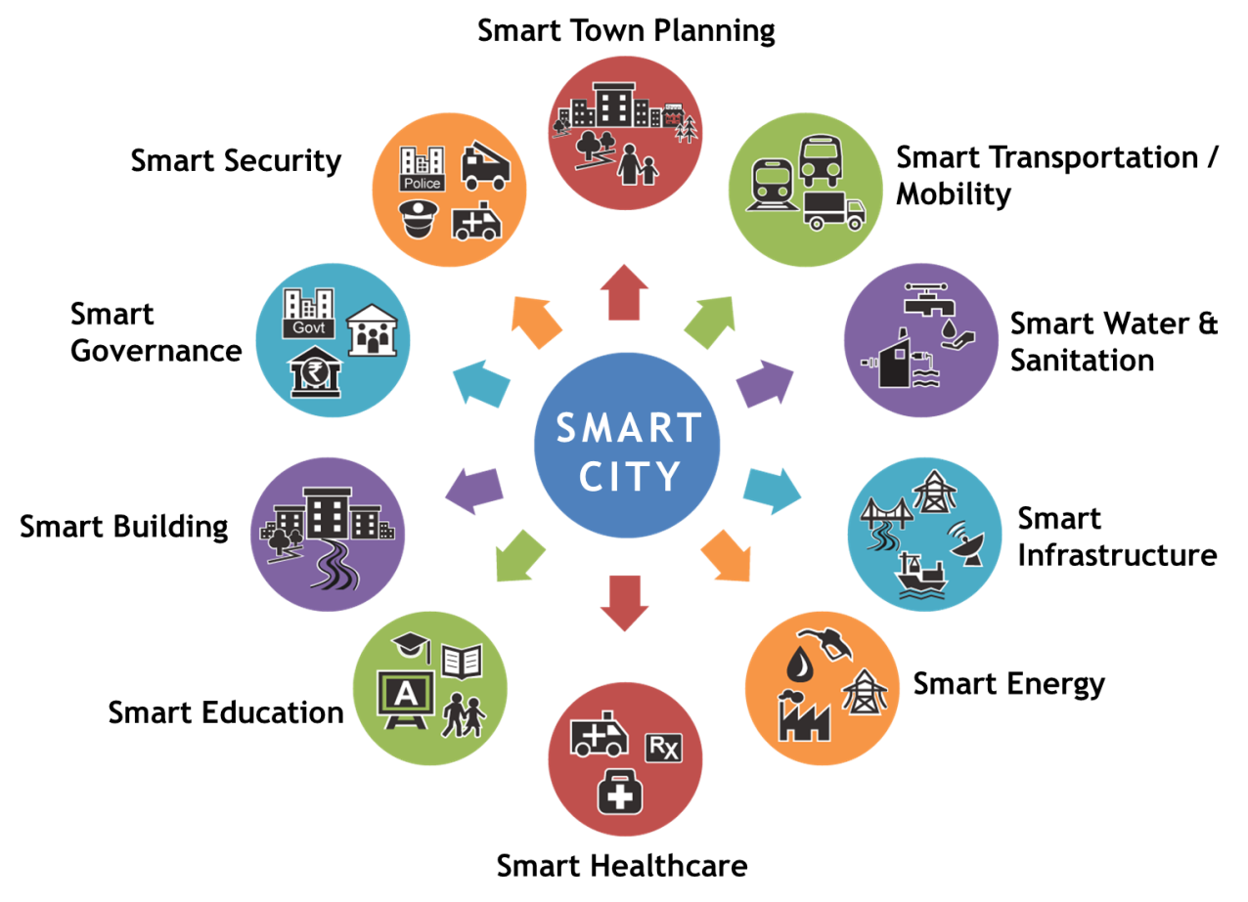



oneM2M Breaks Down the Silos
Horizontal
Information Flow
Smart
Emergency
Services
Smart
Transportation
Smart
Infrastructure
Smart
Emergency
Services
Smart
Transportation
Smart
Infrastructure
Vertical
Information Flow
Vertical
Information Flow
Vertical
Information Flow
…
Service Layer
…
…

Slide 5
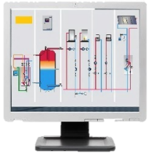

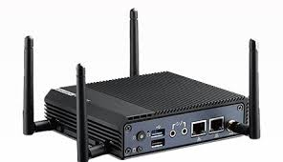
oneM2M Common Services Layer
Reference point;
http, MQTT, CoAP, WebSocket bindings
(Mcc: CSE - CSE)
Application
IoT Application Layer
Service exposure reference point;
http, MQTT, CoAP, WebSocket bindings
(Mca: CSE - application)
oneM2M CSE
oneM2M Common Services Entity
IoT Devices and Connectivity Layer
Connectivity Layer
Sensor/ Device
Middle Node/Gateway
Infrastructure Node / Cloud

Slide 6
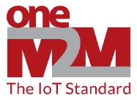

oneM2M Common Services “Toolkit”
Registration
Common Service Entity
Registration
Communication Management
Security
Discovery
Data Management & Repository
Semantics
IoT Application Layer
oneM2M Common Services Layer
Device Management
Subscription & Notification
Group Management
Application & Service Management
Location
Service Charging & Accounting
IoT Devices and Connectivity Layer
Network Service Exposure
Transaction Management
Time
Management
Session
Management
Process
Management

Slide 7











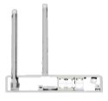















oneM2M enables interworking with domain specific technologies/Standards
Cloud products
Cloud Products
Infrastructure / Data Center
C
Automotive Domain
Industrial Domain
Home Domain

Slide 8
Enhance daily life through smart data
oneM2M in EU
Examples

Slide 9
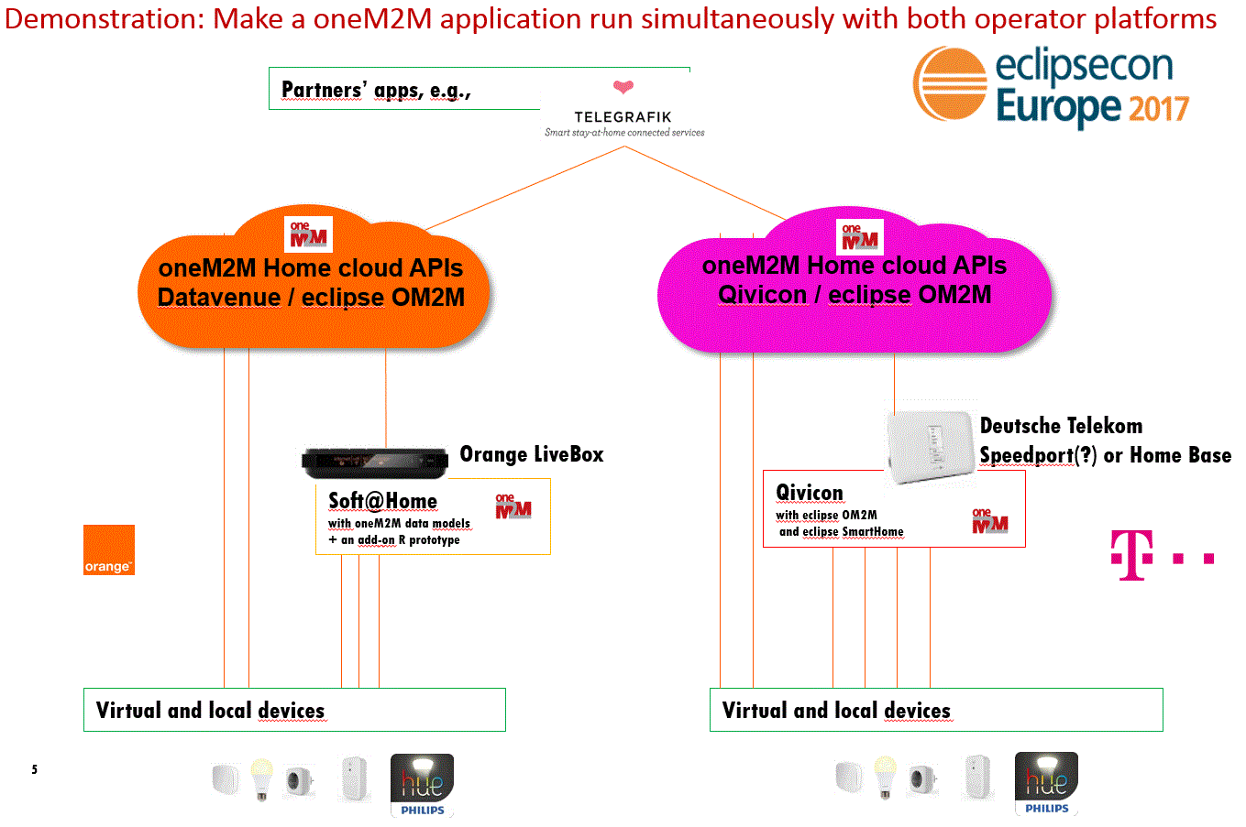
Example: Orange / DT Cloud API
oneM2M based CloudAPI for Consumer IoT & Smart Home
Hides from the app developer the complexities involved with interacting with a diverse set of IoT devices
Time to adapt Applications < 2 days
Showcase 2017
SCOPE: Features supported over the Mca reference point (IN-AE ⬄ IN-CSE)

Slide 10
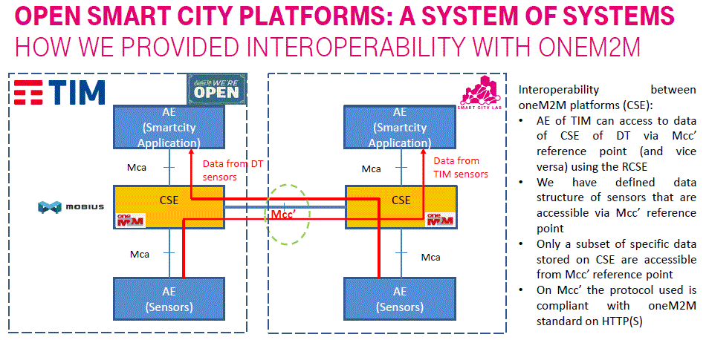
Example: IoT Platform Interoperability
ETSI IoT Week 2017

Slide 11
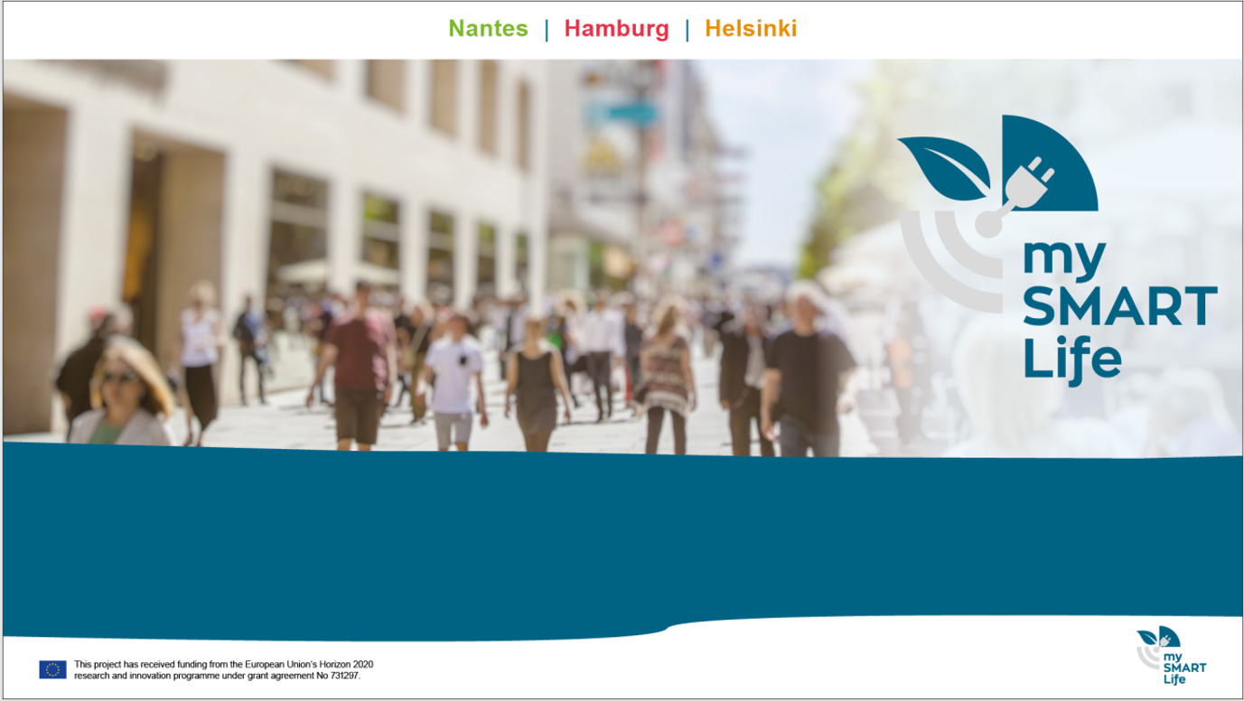
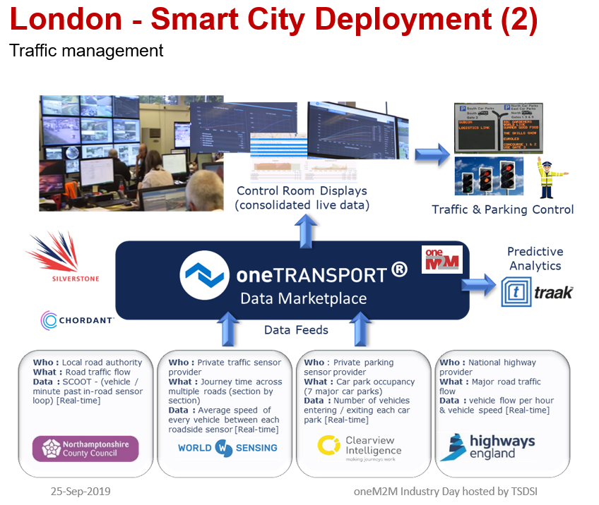
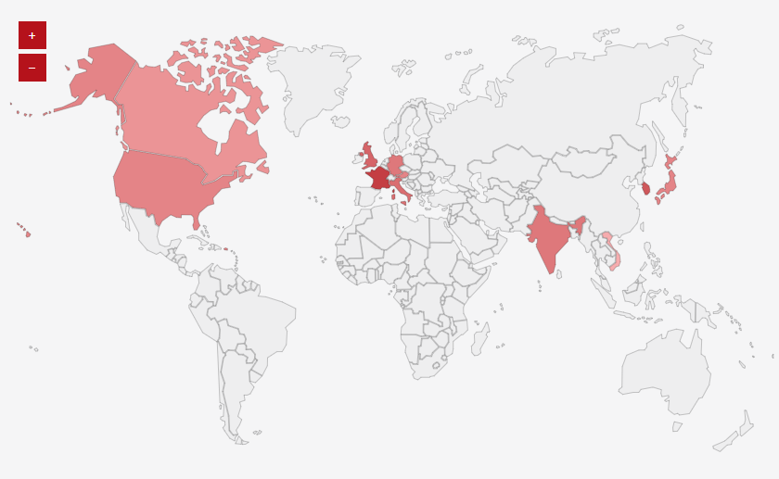

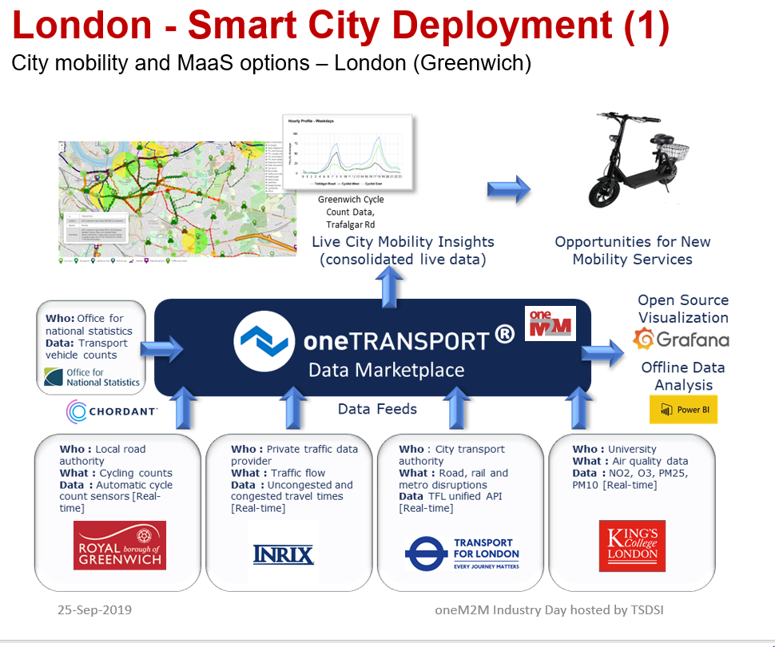
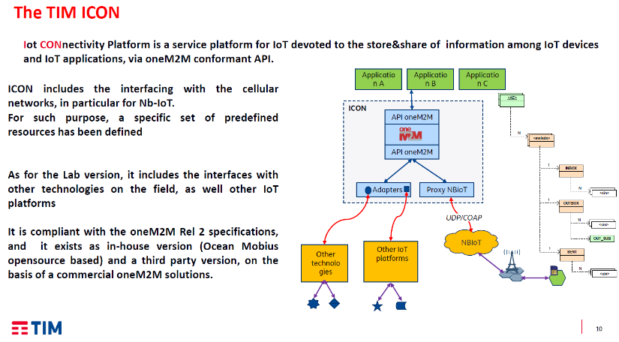
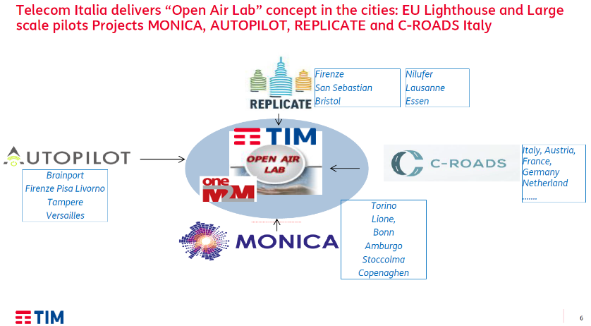
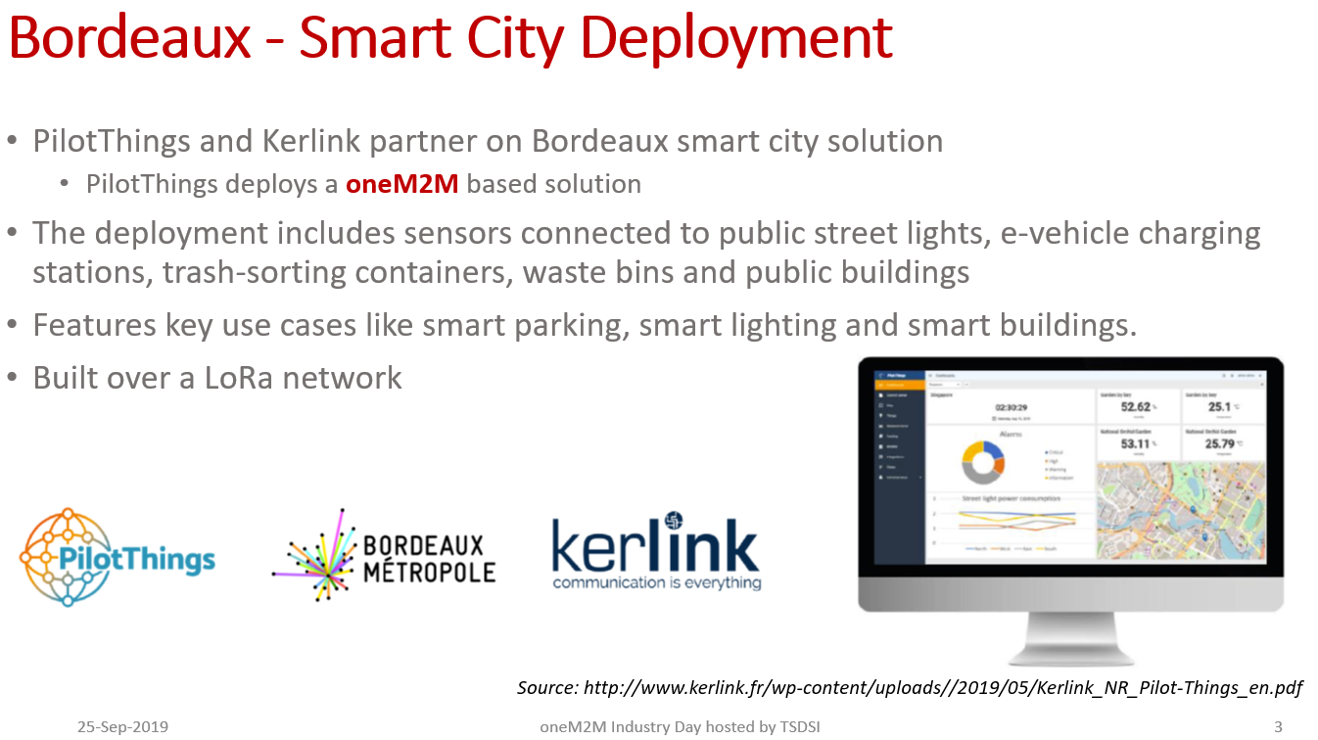
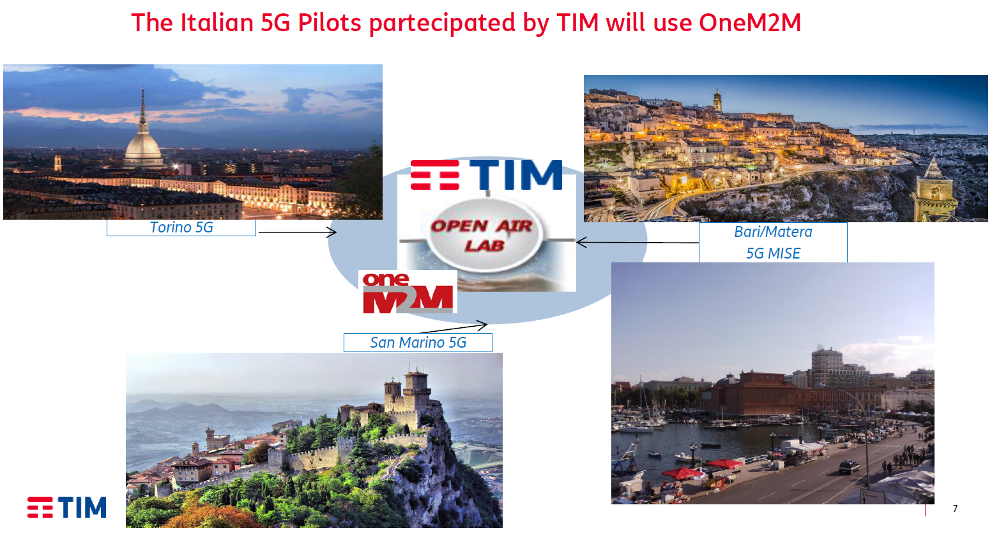
oneM2M in European Smart Cities
Source: https://www.onem2m.org/harmonization-m2m/list-of-deployments/
Source: Dr. Scarrone, TIM: Industry_Day-2018-0006-oneM2M_for_Smartcities.pdf

Slide 12
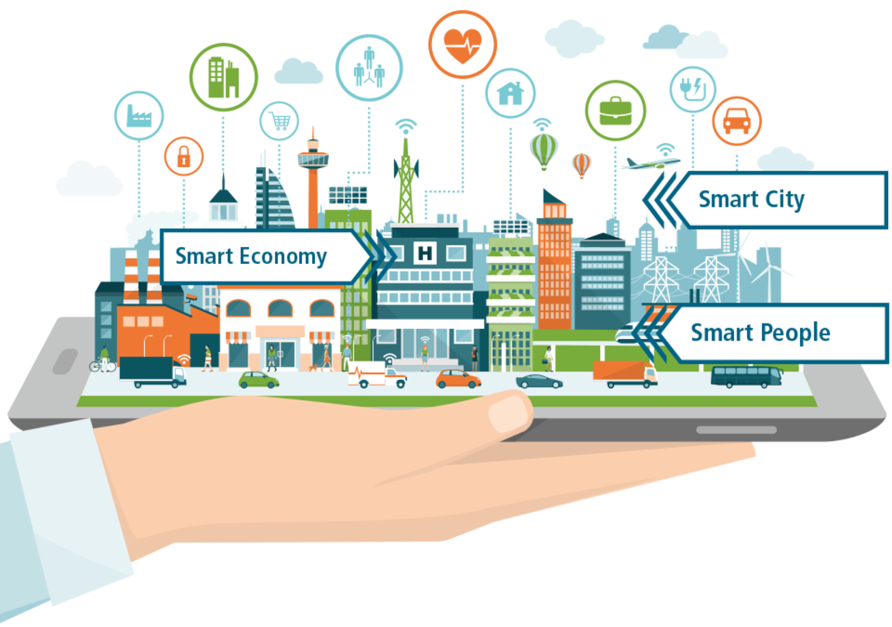
MySMARTLife
Transition of EU cities towards
a new concept of Smart Life and Economy
Lighthouse Cities
Nantes
Helsinki
Hamburg
Source: https://www.mysmartlife.eu/mysmartlife/
Notes:
What is mySMARTLife about?
The mySMARTLife project aims at making the three Lighthouse Cities of Nantes, Hamburg and Helsinki more environmentally friendly by reducing the CO₂ emissions of cities and increasing the use of renewable energy sources.
Activities are focusing on "Inclusive Cities", offering a high quality of life to residents. "Smart People" are playing a vital role in their city’s development. "Smart Economy" is an innovative and dynamic economic concept aiming at guaranteed employment and an adequate income, attracting talents and providing goods and services according to the actual requirements.
The interventions planned and carried out in the three Lighthouse Cities also include innovative technological solutions in connection with refurbishments of buildings, usage of renewable energies, clean transport and supporting ICT solutions.

Slide 13
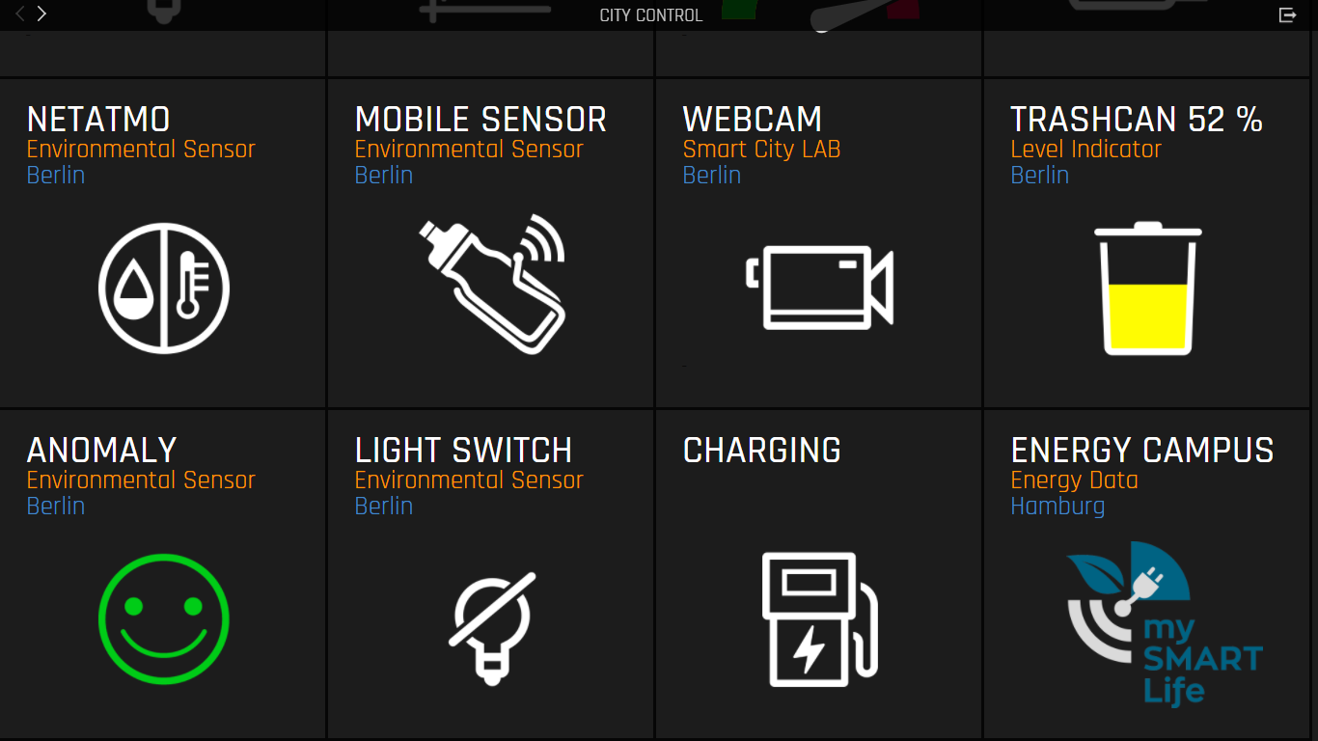
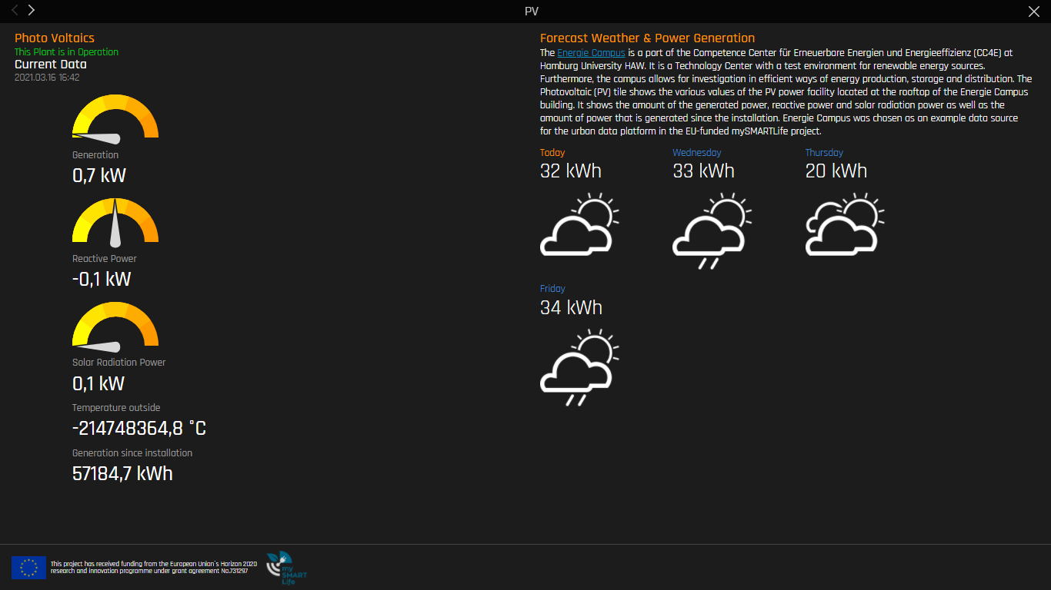
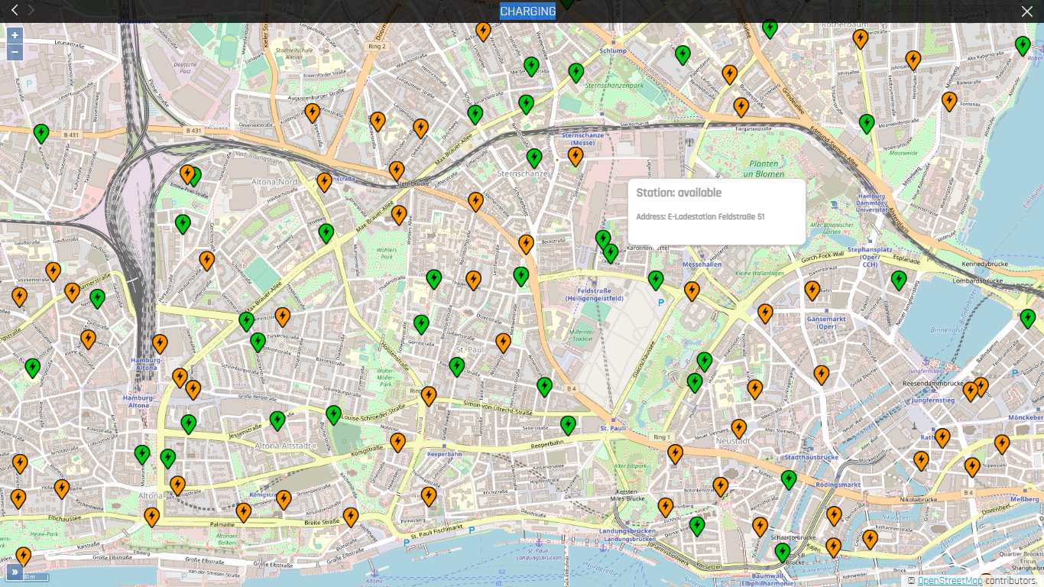
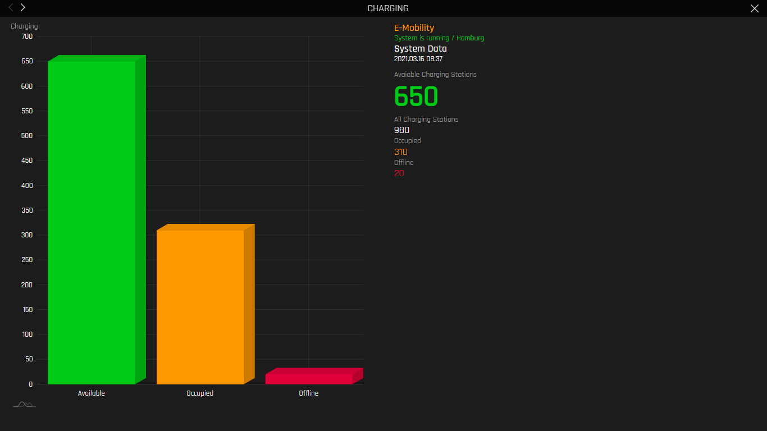
TRANSPARENCY IS KEY
City of Hamburg as a role model
City Control
photo voltaic
power generation & weather forecast
Station available
Charging Station Status
13

Slide 14






OPEN URBAN PLATFORM
A PART OF A SMART CITY ECOSYSTEM
Smart city platform ecosystem
Smart City Application
Data Intelligence
Open Urban Platform
Infrastructure Backends
IoT Connectivity
Devices (Hardware, Sensors)

Slide 15





“If you can’t have one - support them all”
Bridging OGC / STA and oneM2M standard
The MySMARTLife ICT platform for the City of Hamburg
“Our team focuses on applied innovation, so we were looking for a standardized architecture rather than developing something one-off or new”
Ingo Friese,
Deutsche Telekom
(onem2m.org)
Source: our-lighthouse-city-hamburg-deploys-onem2m-smart-city-standards-to-go-greener
TP-2019-0186-Introduction_into_OGC_SensorThings_API;
WI-100- oneM2M and SensorThings API

Slide 16
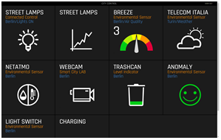





Urban Data core
ACTS AS A BRIDGE
Citizens, Authorities, Industry, Communities
Applications of 3rd parties, cities, Telekom, Streetlight vendors etc.
oneM2M API
oneM2M Standard Platform
based on Microservice Architecture
DB
oneM2M
Standard
Platform
Connectors
Owlet
Backend
Paradox Backend
Flashnet Backend
Breeze Backend
weitere Backends
Various
Backend
Systems
various
Schreder
Zumtobel
Solentis
Breeze
Source: our-lighthouse-city-hamburg-deploys-onem2m-smart-city-standards-to-go-greener

Slide 17
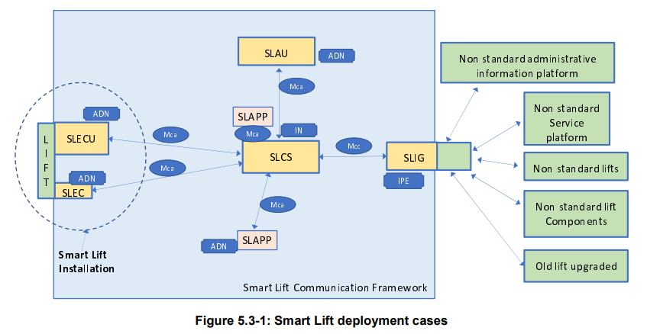
Example: ETSI SmartM2M and oneM2M
Smart Lifts IoT System
Relying on the oneM2M standard suite the Smart Lift System was quickly specified in ETSI SmartM2M.
See below, the Smart Lift System (SLS) mapped on oneM2M Entities and reference points (APIs).
Members of the SME Alliance saw value in standardizing the collection of lift data to:
create a platform for collecting data from different manufacturers.
create innovative services for building managers and tenants
Enhancements to SAREF were specified in SAREF4LIFT
Source: ETSI TS 103 735 V1.1.2 (2021-07)

Slide 18
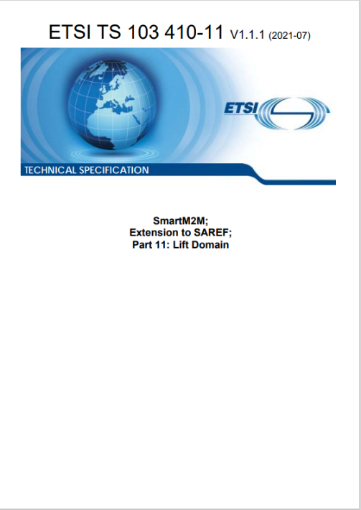
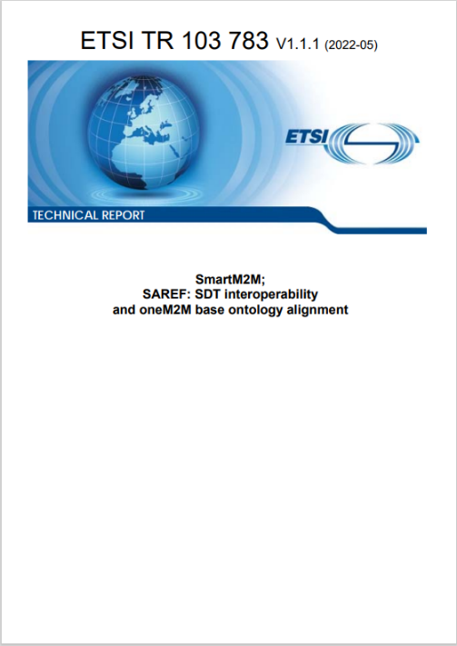
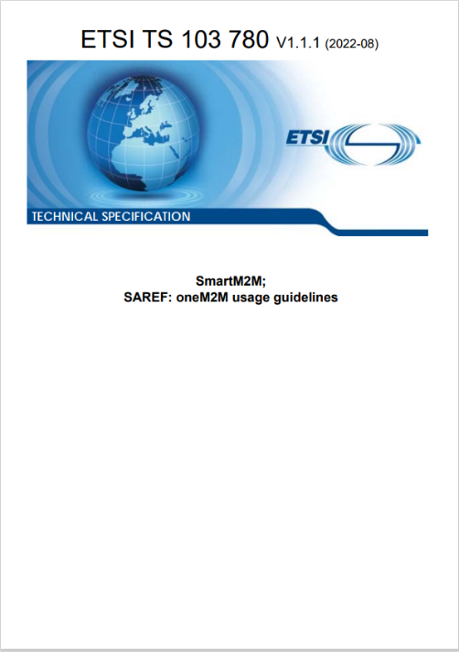
Collaboration of Standards
SAREF* – ETSI SmartM2M – oneM2M
Cross-domain usability of IoT devices for humans and machines
i.e. Special Task Force STF - 602
extends the SAREF application domains
  reference to ETSI TS 103 735 Smart Lifts IoT System in TC SmartM2M
  assure cross-sector semantic interoperability
  field test for the SAREF Specification framework and workflow using the SAREF Portal**
supports the synergic use of SAREF and oneM2M
  assuring full alignment between SAREF and the oneM2M semantic support (equivalence of core SAREF and the oneM2M base ontology)
  providing normative guidelines for the usage of SAREF over the oneM2M system
  assuring interoperability with the oneM2M SDT (mart Device Template) and the SAREF devices.
Deliverables (Rapporteur: Mauro Dragoni)
  TS 103 410-11: SAREF4LIFT published July 2021
  TR 103 783: SAREF: SDT interoperability and oneM2M base ontology alignment published May 2022
  TS 103 780: SAREF: oneM2M usage guidelines. Published August 2022
*SAREF.. Smart Applications REFerence Ontology
Source: https://portal.etsi.org/STF/STFs/STF-Homepages/STF602
**SAREF Portal.. Official ETSI portal for SAREF contains pointers to the SAREF ontologies and SAREF-related work items: https://saref.etsi.org/

Slide 19
Takeaways
oneM2M
is a global open standard, not controlled by a single private company
specifies a common set of horizontal IoT services
  architecture, common services functions,
enables data interoperability
  Information model, semantics, ontology-based interoperability
interworks with existing IoT technologies
has interoperability testing and a certification program
  standardized APIs simplify the life for the IoT ecosystem
  minimize development, deployment & maintenance costs
is a mature and a commercially deployed technology
oneM2M release 4
Ratification: Q4 2022
Work in progress on
oneM2M Release 5

Slide 20
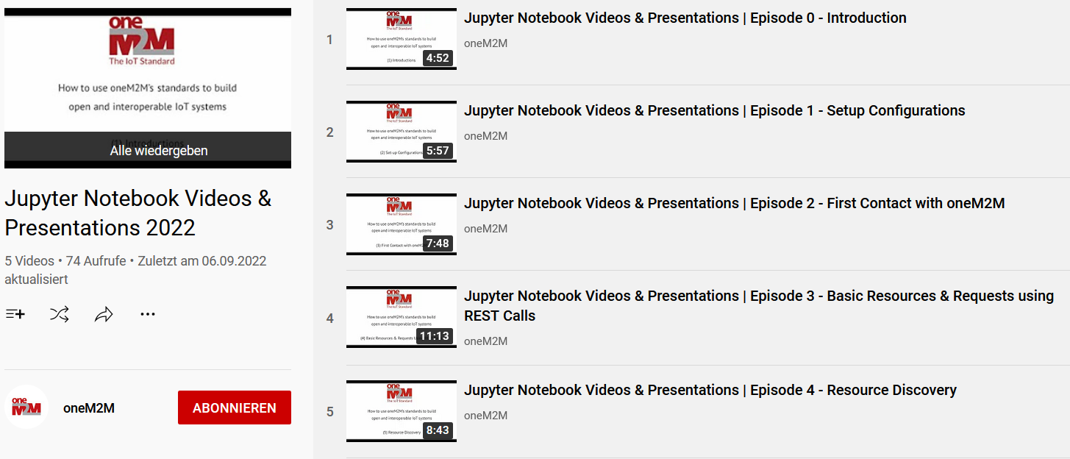
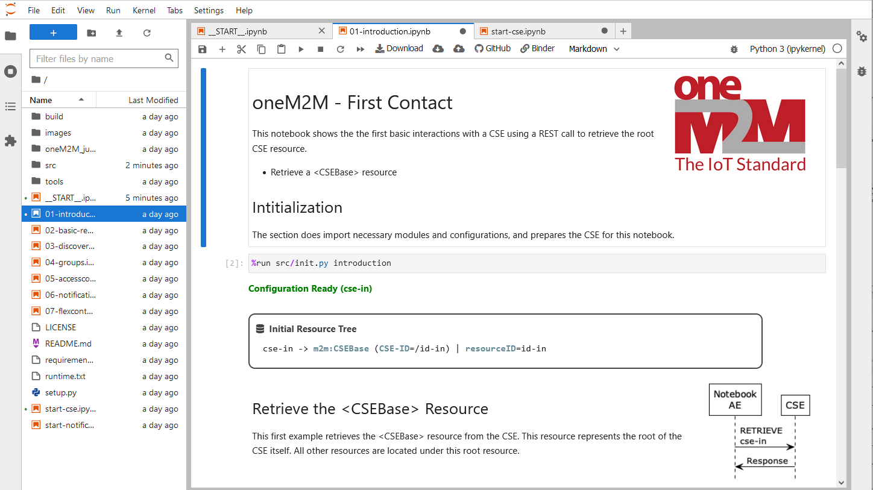
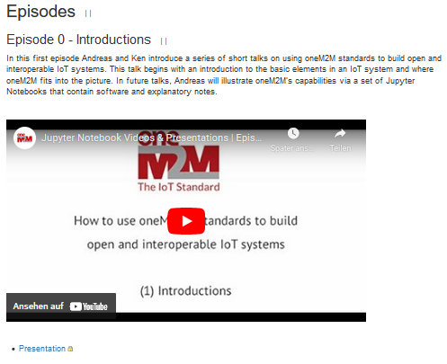
oneM2M Tutorials
The first set of the oneM2M Tutorials using Jupyter Notebooks is now online!
oneM2M Wiki
https://wiki.onem2m.org/index.php?title=OneM2M_Jupyter_Notebooks
YouTube
https://www.youtube.com/playlist?list=PLDd4EJmw5gUnA_d1RgYnxrOrYeYuHdH5u
GitHub & Discussions
https://github.com/oneM2M/onem2m-jupyter-notebooks
https://github.com/oneM2M/onem2m-jupyter-notebooks/discussions
MyBinder Runtime
https://mybinder.org/v2/gh/oneM2M/onem2m-jupyter-notebooks/master?urlpath=lab/tree/__START__.ipynb

Slide 21
For more information …
visit www.oneM2M.org
Executive Viewpoints - https://onem2m.org/insights/executive-viewpoints
oneM2M in the News - https://onem2m.org/news-events/newsmenu/onem2m-in-the-news
Technical Specifications - https://onem2m.org/technical/published-drafts
Roland Hechwartner – roland.hechwartner@magenta.at

Slide 22






Thank You!
Roland Hechwartner
roland.hechwartner@magenta.at

