Slide 1
Metaverse IoT and its use cases
2022-11-29
Andrew Min-gyu Han, Hansung University
(andyhan@hansung.ac.kr)

Slide 2

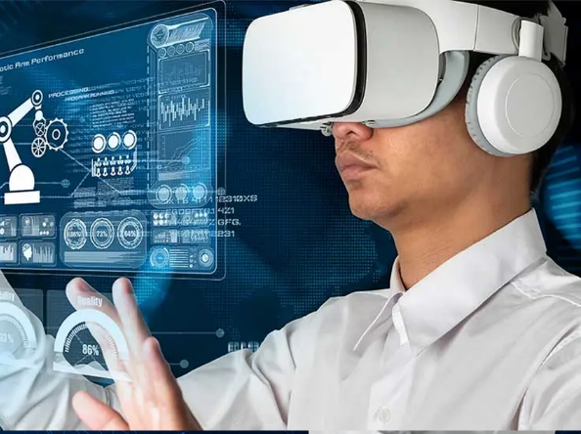
Why oneM2M and Metaverse?
Current Metaverse services are focusing contents. It looks like the early stage of internet.
As the internet has been extended to Internet of Things, the Metaverse will expand its scope to O2O. It means oneM2M could be the connecting point between the Metaverse services and the real world.
oneM2M adopts its new features of IoT now, e.g. AIoT. Metaverse is good keyword as an additional new features.
Metaverse IoT is the one of key features of oneM2M Rel-5.

Slide 3
3GPP Metaverse 5G
WI: Study on Localized Mobile Metaverse Services (FS_Metaverse)
Objective:
  Support of interactive XR media shared among multiple users in a single location, including:
    performance (KPI) aspects; e.g. latency, throughput, connection density
    efficiency and scalability aspects, for large numbers of users in a single location.
  Identification of users and other digital representations of entities interacting within the metaverse service.
  Acquisition, use and exposure of local (physical and digital) information to enable metaverse services, including:
    acquiring local spatial/environmental information and user/UE(s) information (including viewing angle, position and direction);
    Exposing local acquired spatial, environmental and user/UE information to 3rd parties to enable metaverse services.
  Other aspects, such as privacy, charging, public safety and security requirements.
Rapporteur: Erik Guttman (Samsung)
Supporting Members: AT&T, Charter Communications, China Mobile, China Telecom, China Unicom, Convida Wireless, Dish Network, Ericsson, ETRI, FirstNet, Futurewei, Hansung University, Huawei, Intel, InterDigital, Kyonggi University, KDDI, KPN, KT Corp, Lenovo, LG Uplus, Motorola Mobility, OPPO, Orange, Qualcomm, Samsung, Sony, SK Telecom, Tencent, TNO, Verizon UK Ltd., vivo, Xiaomi, ZTE (34)

Slide 4
3GPP Metaverse 5G
Doc: TR 22.856
Use Cases:
  Localized Mobile Metaverse Service Use Case
  Mobile Metaverse for 5G-enabled Traffic Flow Simulation and Situational Awareness
  Spatial Anchor Enabler Use Case
  Spatial Mapping and Localization Service Enabler Use Case
  Mobile Metaverse for Immersive Gaming and Live Shows
  AR Enabled Immersive Experience
  Supporting multi-service coordination in one metaverse
  Synchronized predictive avatars
  Use case on Metaverse for Critical HealthCare Services

Slide 5
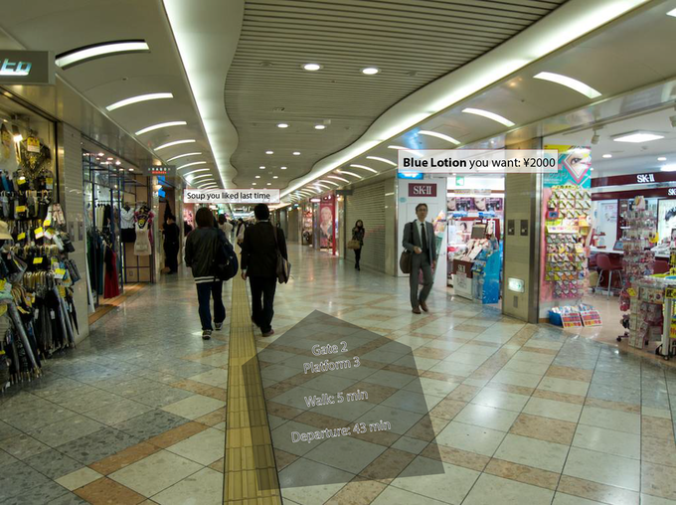
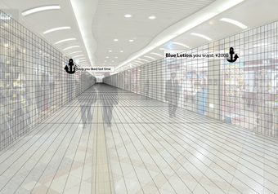
Localized Mobile Metaverse Service Use Case
Spatially defined access points
The application [service] associated with 'shopping' has stored a shopping list. When a local 'shopping service access point' has been identified, the shopping application queries the service provider directly. If there is success, the result is displayed. Here: "Blue Lotion you want ¥2000."

Slide 6
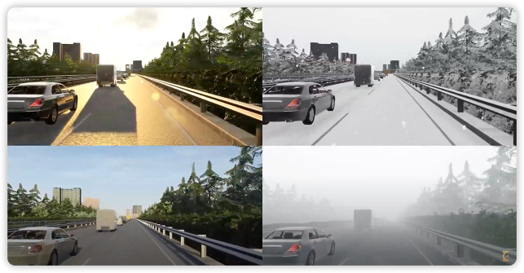
Mobile Metaverse for 5G-enabled Traffic Flow Simulation and Situational Awareness
There are virtual objects which actually represent the physical objects including vehicle, road and also pedestrians. This is the basis to enable smart transport applications like traffic flow simulation and situational awareness.

Slide 7
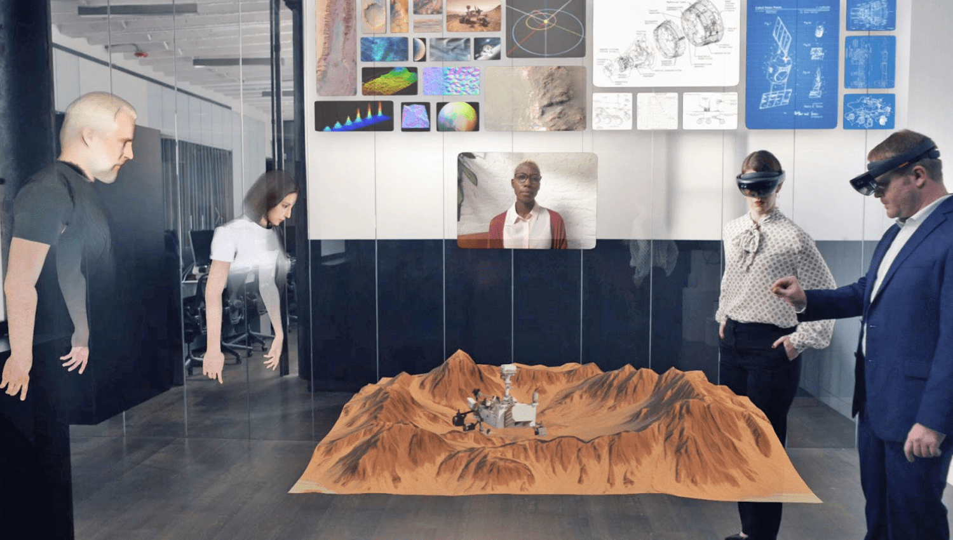
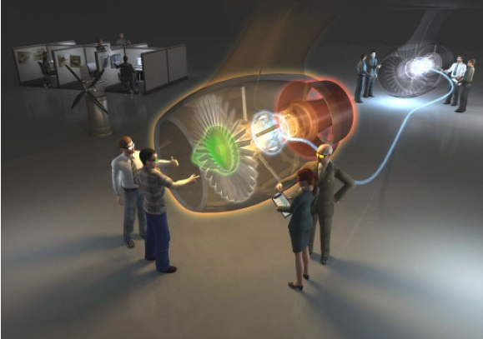
Collaborative and concurrent engineering in product design using metaverse services
The range of technologies include reality theatres, power walls, holographic workbenches, individual immersive systems, head mounted displays, tactile sensing interfaces, haptic feedback devices, multi-sensational devices, speech interfaces, and mixed reality systems

Slide 8
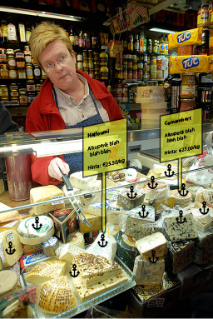
Spatial Anchor Enabler Use Case
The 'spatial anchor producer' determines what to share and its location, and any constraints (e.g. who to share the spatial anchor with) and additional information, most importantly the 'resource' associated with the anchor (e.g. AR media, service to access, etc.).
The 'spatial anchor consumer' is able to recognize anchors associated with locations, and use the spatial anchor to obtain the associated information.

Slide 9
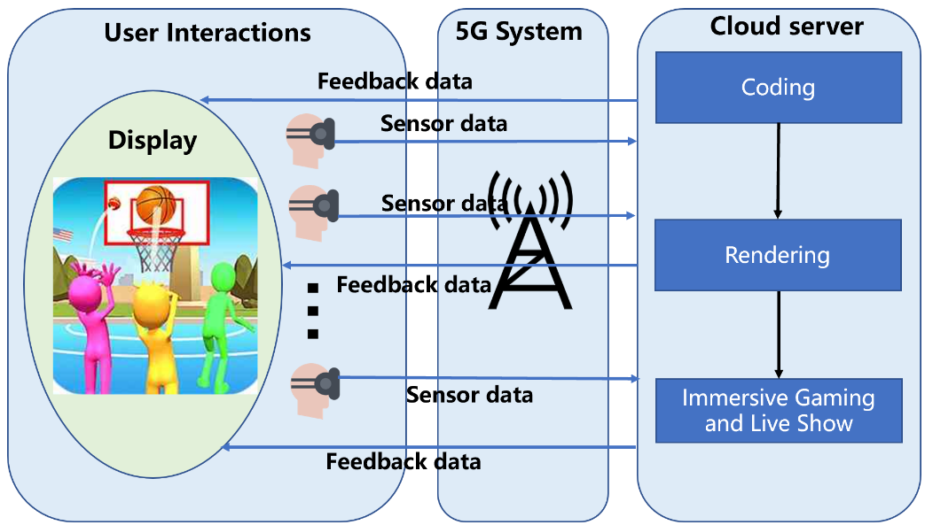
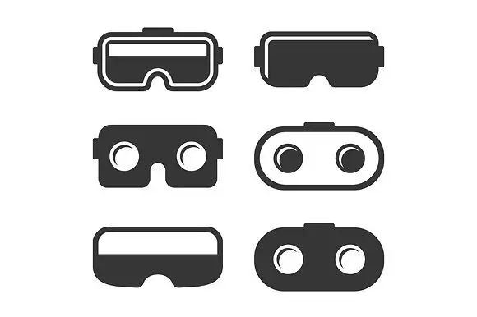
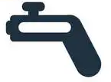

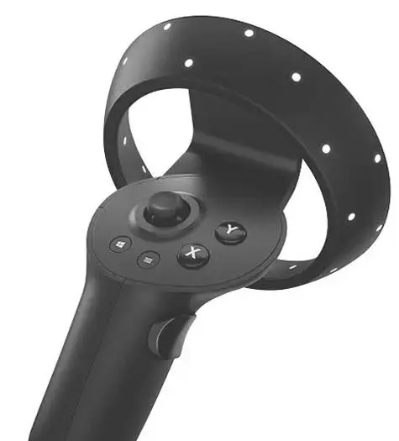

Mobile Metaverse for Immersive Gaming and Live Shows
When the players are playing the basketball game, they may achieve an immersive experience with their avatars, and the avatars can interact with each other, whether the players are in proximity or non-proximity. Meanwhile, other players in the metaverse can join in this digital world as spectators to watch the live show.
metaverse

Slide 10
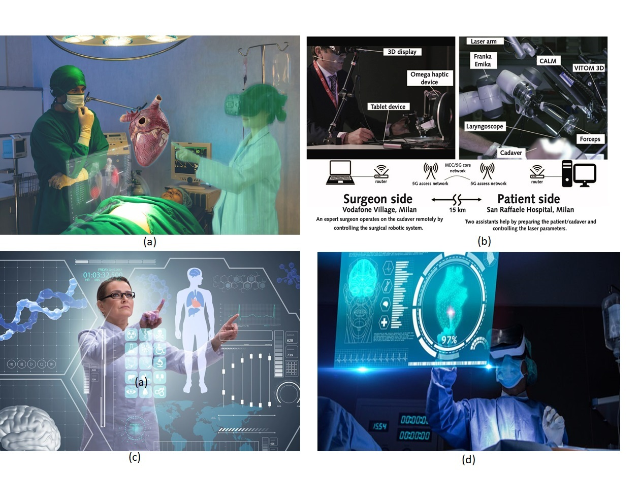
Metaverse for Critical HealthCare Services
Metaverse for Critical HealthCare Services
Metaverse-Surgeries
Metaverse-Physician Consultation
Metaverse-Body scan and vitals.

Slide 11
oneM2M MetaIoT
WI-0110: Enablement of IoT in the metaverse (MetaIoT)
Objective:
  Definition of “IoT in the metaverse” in the context of oneM2M
  Use cases to show clearly that the metaverse services based on IoT
    Potential Common Service Functions that enable metaverse services based on IoT
    Interworking with considering the status of other SDOs
    Information Model of metaverse devices
    Cooperation with other SDOs, forums, etc., e.g. ETSI ARF, Metaverse Standards Forum
Rapporteurs:
  Andrew Min-gyu Han (Hansung University)
  Shane He (Nokia FR)

Slide 12
Thanks!

