Slide 1






Welcome to oneM2M
TP-2022-0104-oneM2M Introduction to New Members
Roland Hechwartner, TP Chair
Karen Hughes, ETSI
2022-11-17

Slide 2
What is oneM2M?
It is a software/middleware layer
It sits between applications and underlying communication networking HW/SW
It typically rides on top of IP protocol stack
It provides functions that applications across different industry segments commonly need
It exposes common set of functions to applications via developer friendly APIs
It is integrated into devices/gateways/servers and allows distributed intelligence
It hides complexity of NW usage from apps
It controls when communication happens
It stores and shares data
It supports access control
It notifies applications about events
Application Layer
partnership
organization
how to do the work
rules and procedures
portal
Service Layer
Network Layer

Slide 3









oneM2M Partnership Project
https://onem2m.org/
More than 200 member organizations in oneM2M
founded¹ July, 24th 2012
TP#1: Sep 24th-29th 2012
Partner Type 1
Partner Type 2
[1] Partnership Agreement V 3.0 (Approved 2019)

Slide 4
oneM2M Participants
Partner Type 1
provides strategic direction to oneM2M
convert/transpose/publish all relevant Technical Specifications and Technical Reports into its own deliverables through its normal processes
has the right to:
  Attend, participate and vote in meetings of the Steering Committee
  Admit organizations as oneM2M Members to facilitate the technical work
  Attend meetings of the Technical Plenary and its subgroups
Partner Type 2
provides strategic direction to oneM2M
has the right to:
  Attend, participate and vote in meetings of the Steering Committee
  Attend, participate and vote in meetings of the Technical Plenary and its subgroups
Market Representational Organization
offers advice and bring a consolidated view of market requirements
commits itself to promotion activities
has the right to:
  Attend and participate in meetings of the Steering Committee
  Attend and provide input to meetings of the Technical Plenary and its subgroups
    input shall be limited to clarifications of market requirements and informational contributions
MRO .. ADM-0002 oneM2M Partnership Agreement v3.0 (2019)

Slide 5
oneM2M Participants
Member
admitted through affiliation with a Partner Type 1
has the right to:
  attend & provide input to the Technical Plenary and its subgroups
  have one vote per admitting Partner Type 1 in meetings of the Technical Plenary and its subgroups
Associate
any government or regulatory agency with interest in oneM2M work
has the right to:
  attend and provide input to the Technical Plenary and its subgroups
    input shall be limited to clarifications on regulatory matters and informational contributions
Observers
Invited to attend for a limited duration and they may not provide any technical input to the Technical Plenary or its subgroups

Slide 6
Organization
http://onem2m.org/about-onem2m/organisation-and-structure
Finance
SC Chair:
Enrico Scarrone, Telecom Italia (ETSI)
Vice Chairs:
Uday B. Desai (TSDSI)
Secretariat support: Victoria Mitchell (TIA)
Steering
Committee
Industry Liaison
Partners
Legal
Marketing
Methods/Procedures
Sustainability
TP Chair:
Roland Hechwartner, Deutsche Telekom (ETSI)
Vice Chairs:
JaeSeung Song, KETI (TTA)
Secretariat Support:
Karen Hughes, ETSI
Technical
Plenary
Work Programme
Coordination Group
Methods of Work
RDM
SDS
TDE
Members / Partners
Working Groups
Requirements and Domain Models
System Design and Security
Testing and Developers Ecosystem
WG1 – RDM Chair:
Shane He, Nokia (ETSI)
Vice Chairs:
TaeHyun Kim, SyncTechno Inc (CCSA)
Secretariat Support:
Michael Kim (TTA) & Akash Malik (TSDSI)
WG 2 SDS Chair:
Peter Niblett, IBM (ETSI)
Vice Chairs:
SeungMyeong Jeong, KETI (TTA)
Wei Zhou, Datang Telecom (CCSA)
Poornima Shandilya, C-DOT (TSDSI)
Secretariat Support:
Karen Hughes (ETSI) & Victoria Mitchell (TIA)
WG3 – TDE Chairman:
Andrew Min-gyu Han, Hansung University (TTA)
Vice Chairs:
Bob Flynn, Exacta (ETSI)
Sherzod Elamanov, SyncTechno Inc (ETSI)
Secretariat Support:
Michelle Kelley (ATIS) & Akash Malik (TSDSI)

Slide 7
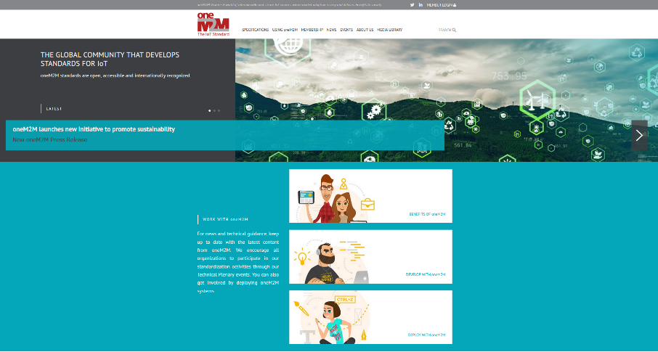

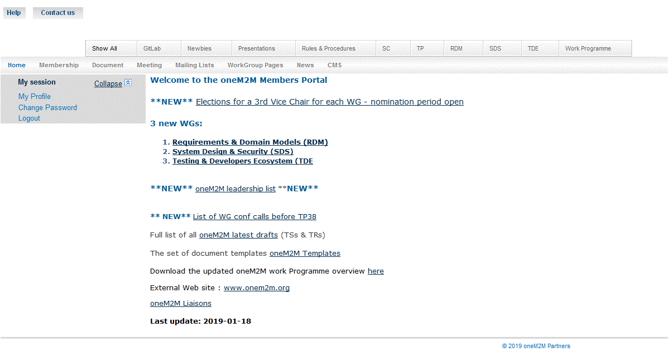
How to work in oneM2M
Detailed information can be found
on the public webpage http://onem2m.org/
and on the members portal http://member.onem2m.org/WebSite/homepage.aspx
drafting rules
work item
Working Groups
Meetings
documents
meeting registration
working procedures
voting list
Contributions
voting rights
templates
Rules and procedures
rapporteurs’ checklist
permanent documents
temporary documents
mailing list

Slide 8
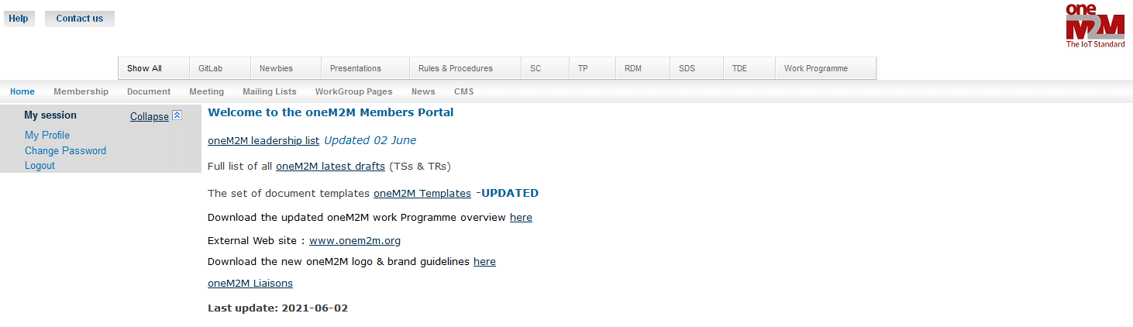
Members’ Portal
http://member.onem2m.org/WebSite/homepage.aspx
Create your account
Subscribe to mailing lists
Find all documents, templates, meetings, work programme status

Slide 9
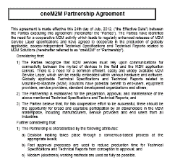
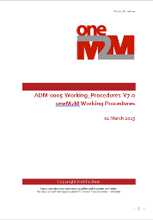
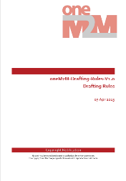
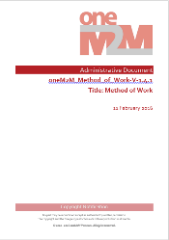
Rules and Procedures (I)
source: https://member.onem2m.org/website/Procs.aspx

Slide 10
Partnership Characteristics
Openness - opportunity for broad and equitable participation
Consensus-based decision making process - General agreement, characterized by the absence of sustained opposition. “consensus” does not imply “unanimity”
Fast approval processes to reduce production time for Technical Specifications and Technical Reports from conception to approval
Modern (electronic) working methods
Contribution Driven
FRAND Fair, Reasonable, and Non-Discriminatory – based IPR Policies
http://onem2m.org/about-onem2m/intellectual-property-rights
Source: Partnership Agreement V3.0

Slide 11
Meetings
Meetings – are decision making (unless otherwise stated e.g. adHoc sessions)
  Progress the work
  All meetings are created on the portal in advance
    Meeting registration via the portal allows to register, de-register, re-register
  Contributions to be submitted seven calendar days in advance
    Late contributions can be considered with the consensus of the group
  Naming convention - Technical Plenary meetings are numbered up as far as TP52 (Dec 2021)
    Interim meetings should be numbered according to the TP meeting that they follow eg. SDS 49.1
Physical Meeting
  Face to face meeting (in 2023 four f2f-meetings are planned)
  Face to face meetings are organized as hybrid meetings – allowing remote participations
  invitation must be sent at least 30 days in advance of the start
    Current practice: two meeting cycles in advance
    Are created on the portal using local (meeting) time
Virtual Meeting
  Web-meetings / conference calls
  GoToMeeting is used for virtual meetings
    require a software download, the first time you log-on to a meeting.
  announced 14 days in advance
    Are created on the portal using GMT

Slide 12
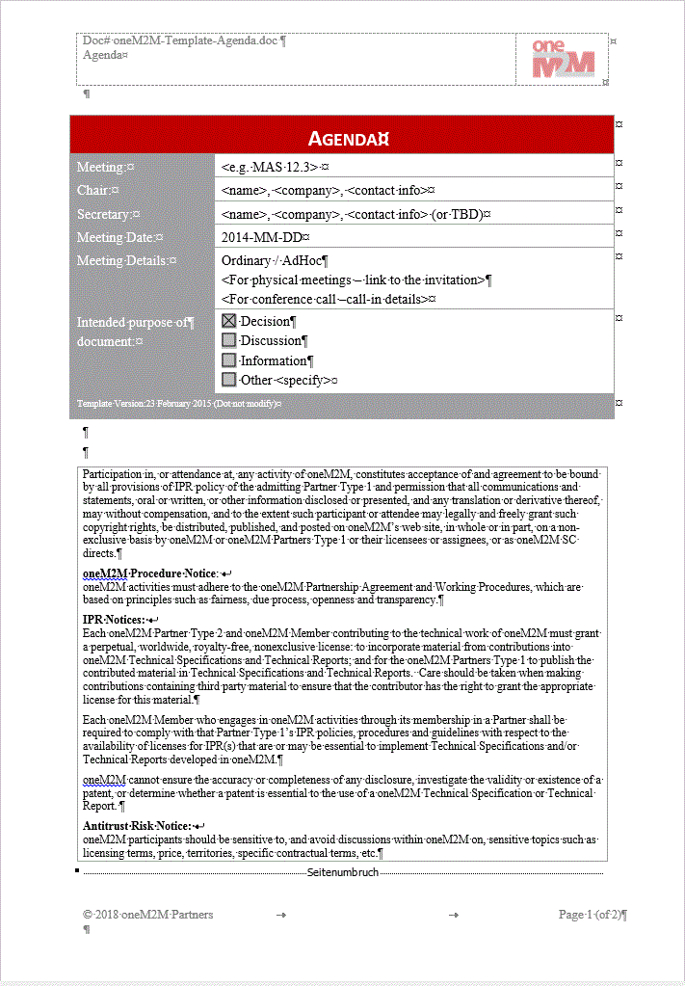
Meeting Agenda – legal notices
Participation in, or attendance at, any activity of oneM2M, constitutes acceptance of and agreement to be bound by all provisions of IPR policy of the admitting Partner Type 1 and permission that all communications and statements, oral or written, or other information disclosed or presented, and any translation or derivative thereof, may without compensation, and to the extent such participant or attendee may legally and freely grant such copyright rights, be distributed, published, and posted on oneM2M’s web site, in whole or in part, on a non-exclusive basis by oneM2M or oneM2M Partners Type 1 or their licensees or assignees, or as oneM2M SC directs.
oneM2M Procedure Notice:
oneM2M activities must adhere to the oneM2M Partnership Agreement and Working Procedures, which are based on principles such as fairness, due process, openness and transparency.
IPR Notices:
Each oneM2M Partner Type 2 and oneM2M Member contributing to the technical work of oneM2M must grant a perpetual, worldwide, royalty-free, nonexclusive license: to incorporate material from contributions into oneM2M Technical Specifications and Technical Reports; and for the oneM2M Partners Type 1 to publish the contributed material in Technical Specifications and Technical Reports. Care should be taken when making contributions containing third party material to ensure that the contributor has the right to grant the appropriate license for this material.
Each oneM2M Member who engages in oneM2M activities through its membership in a Partner shall be required to comply with that Partner Type 1’s IPR policies, procedures and guidelines with respect to the availability of licenses for IPR(s) that are or may be essential to implement Technical Specifications and/or Technical Reports developed in oneM2M.
oneM2M cannot ensure the accuracy or completeness of any disclosure, investigate the validity or existence of a patent, or determine whether a patent is essential to the use of a oneM2M Technical Specification or Technical Report.
Antitrust Risk Notice:
oneM2M participants should be sensitive to, and avoid discussions within oneM2M on, sensitive topics such as licensing terms, price, territories, specific contractual terms, etc.

Slide 13

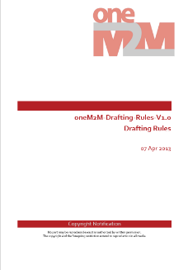
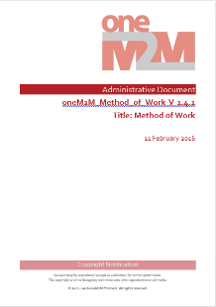
Rules and Procedures (II)
Steering Committee – Methods and Processes Committee
  oneM2M Partnership Agreement ADM-0002-oneM2M Partnership Agreement V3.0
    Purpose, Scope, Objectives, Intellectual Property Rights and Copyright Ownership
    undertakings and rights to participate in the collaboration
  Working Procedures ADM-0005-Working Procedures V8.0
    Structure, SC, TP, WGs, Work Programme and Technical Coordination, deliverables, external relations, guidance on meeting organization, voting …
  oneM2M Drafting Rules ADM-0003-oneM2M Drafting Rules V1.0
    applicable to Technical Specifications and Technical Reports that are delivered to the Partners Type 1 for potential transposition
    Use of normative language Shall, May, Should
Technical Plenary – Method of Work Committee
  Method of Work ADM-0004-Method of Work V1.4.1
    Handling Deliverables, Deliverables and Release Management, conducting a meeting, Work Items and CR through Releases: Guidelines, Test Event Requirements, Technical Forum on the oneM2M website, Meeting Guidelines, Annex A - Rapporteurs Checklist for Draft Deliverables

Slide 14
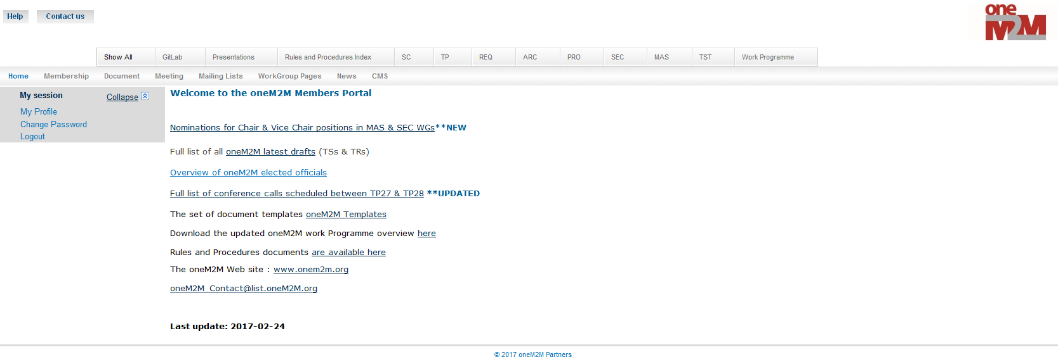


Development of Deliverables
Temporary documents
  Agenda, Input Contribution, Invitation, Liaison Statement, Minutes, Status Report
Permanent documents
  Work Items (WI), Technical Reports (TR), Technical Specifications (TS),
  Administrative (ADM) - the only permanent document which can be created in a Working Group
Change Requests (CR)
  Contribution that suggests a change to an existing draft or published deliverable
Document Status
  Draft, Noted, Withdrawn, Agreed, Approved (the latter for permanent documents only)
    NOTE: Document dispositions are only updated by the Secretariat
    Revisions
use Gitlab issue tracker
use Gitlab to develop Specs

Slide 15
Normative Language
Source: ADM-0003-oneM2M Drafting Rules V1.0 [1]
Proper development of useful requirements is dependent upon a common understanding of normative verbs.
The verb pairs in use in oneM2M are:
  Shall/Shall not
  May/Need not
  Should/Should not
The usage of these three verb pairs is reserved for Technical Specifications to express normative statements and shall not be used otherwise.
In the annex you find a copy of the text in table 5, section 7 in [1] that briefly describes the effect of each verb pair and shows examples of proper usage.

Slide 16
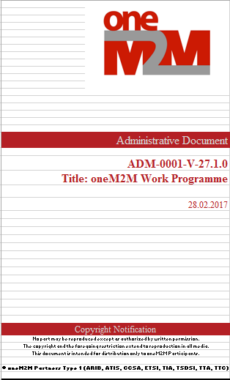
Technical Plenary Approves
Work Items
  documented record of a specific technical activity
  Technical scope of output deliverables (TSs, TRs) and their impact
  Four supporting companies (minimum)
  Rapporteur, may be assisted by editor(s) as needed
  TS and TR development cycle
    Milestones defined in WI: start, change control, freeze, approval
Technical Specifications / Technical Reports => Release
  Once approved only the change control applies to progress TSs, TRs
  A set of deliverables (TSs, TRs) which is technically consistent at the time of the freeze is called a Release
    A new release is triggered by approval of a CR to the new release
  Release freeze
    A Technical Plenary (TP) action on a Release, restricting further technical input to essential changes and corrections
and RATIFIES
  the approved deliverables to be made available to the Partners Type1 for publication
Work Programme: documented record of all technical activities
Source: ADM-0004-Method_of_work-V1_4_1

Slide 17

Members’ Portal
http://member.onem2m.org/WebSite/homepage.aspx
work item status
Elections
Working Groups
work items
Work programme
documents
Meetings
meeting registration
Input Contributions
Technical Specifications
templates
Technical Reports
Mailing lists

Slide 18
Q&A

Slide 19
Backup
FRAND-based IPR Policies (1 slide)
Terms Of References of Working Groups
Normative verbs – use and examples (2 slides)
Voting (3 slides)
oneM2M Releases (3 slides)
Links to publicly accessible information (2 slides)

Slide 20
FRAND-based IPR Policies
Fair, Reasonable, and Non-Discriminatory
All the Partners Type 1 of oneM2M have IPR policies that support a FRAND IPR regime.
  The IPR policies of each of the Partners Type 1 of oneM2M also recognize the importance of respecting the rights of owners of essential/potentially essential IPRs.
  The IPR policies seek to balance such rights with the ability of implementers to access essential IPRs under Fair, Reasonable and Non-Discriminatory (FRAND) terms and conditions.
Partners Type 2 make its IPR Policy available for consideration for compatibility by the other Partners or provide written assurance that:
  its oneM2M contributions are made in accordance with a Partner Type 1 IPR Policy
  its members are bound by such an IPR Policy relative to any oneM2M contributions
Each oneM2M Member is required to comply with the disclosure obligations of that admitting Partner’s IPR policies, procedures and guidelines with respect to IPRs that are, or may be, essential to Technical Specifications and/or Technical Reports developed in oneM2M.
  If a Member engages in oneM2M activities through more than one Partner, then the Member shall be required to comply with the IPR policies, procedures and guidelines of all Partners which have admitted such a Member.
http://onem2m.org/about-onem2m/intellectual-property-rights
Source: Partnership Agreement V3.0

Slide 21
WG Terms Of Reference
Requirements & Domain Models
RDM
Collect and document use cases that are relevant for oneM2M, including both domain-specific and cross-domain ones
Identify and specify service and system requirements, including interworking aspects to other systems
Conduct studies, including aggregation and analysis of requirements, leading to identification of key issues for development of the oneM2M system
Elicit ecosystem engagement and gather IoT/M2M service requirements from vertical industry groups and fora
Identify and specify information and data models and ontologies to support harmonisation and interworking with vertical domains and to enable cross domain data exchange.
System Design & Security
SDS
Definition of the oneM2M system architecture including the oneM2M functional entities, resources, reference points and related message flows.
Definition of oneM2M system management including device management aspects.
Definition of the oneM2M protocol aspects including the oneM2M data types, request and response message primitives, procedures, schema definitions, serialization and bindings to underlying transport protocols.
Definition of the oneM2M security framework including means for identity, credential management, data privacy and security functions (authentication, confidentiality, integrity verification and authorization).
Development of specifications that clearly capture the definitions of the oneM2M architecture, protocol and security framework.
Testing & Developers Ecosystem
TDE
Identify and define test requirements for oneM2M System and services related to it.
Develop and maintain a set of specifications to support conformance tests, interoperability tests, and developers guides
Specify and maintain standard feature catalog and product profiles
Cooperate with other working groups to define the proper testing scope and strategy
Initiate and supervise test related events (such as Plugtests) as well as developer related events (such as hackathons and developers tutorials)
Coordinate interoperability events in collaboration with other organizations
Support the implementation of oneM2M Certification Program and its maintenance

Slide 22
Normative Verbs
Shall/Shall not
Requirement
1.) effect on standard:
The oneM2M standard needs to describe the required feature (i.e. specify a technical solution for the requirement)
2.) effect on products:
every implementation (M2M Solution that complies to the oneM2M standard) must support it
3.) effect on deployments: every deployment (M2M Service based on the oneM2M standard) must use the standardized feature where applicable – otherwise e.g. interoperability problems with other services could arise.
Example 1:
The M2M System shall be aware of the scheduling delay tolerance needed by the M2M Application and …
An unconditional “shall” (as in example 1) occurs often in architecture- and protocol specifications but rarely in requirements specifications. In requirements it would imply that every compliant M2M Solution must implement the required feature and every deployment must use it.
Example 2:
M2M Applications, requesting reliable delivery of a message, shall be notified by the M2M System of any failures to deliver the message.
A “shall” often is bound to a condition (example 2) to express that only if the condition is met the required feature must be implemented and must be used:
“If [condition is met] then … shall …”.
Example 3:
The oneM2M System shall support a mechanism for allowing M2M Applications or Connected Objects to subscribe and being notified of changes
To mandate a feature in the M2M System but allow freedom to the individual deployment whether to use it or not it is better use a phrase like:
“The M2M System shall support a mechanism [function, capability...] to …”, “…shall be able to …”.
This does not mandate usage of the required feature in a M2M Solution.
Source: ADM-0003-oneM2M Drafting Rules V1.0

Slide 23
Normative Verbs
May/Need not - Should/Should not
Permission/Option
1.) effect on standard:
The oneM2M standard needs to describe a solution that allows the presence and the absence of the required feature
2.) effect on products:
an implementation may or may not support it
3.) effect on deployments:
A deployment may or may not use it
Example 4:
The M2M Gateway may be capable of interfacing to various M2M Area Network technologies
“may” allows implementations of M2M Solutions (that comply to the oneM2M standard) that may or may not include a feature.
e.g. in example 4 a gateway that cannot interface to various M2M Area Network technologies could still be compliant to the oneM2M standard
Recommendation
1.) effect on standard:
The oneM2M standard needs to describe a solution that allows the presence and the absence of the feature.
2.) effect on products:
an implementation may or may not support it, however support is recommended
3.) effect on deployments:
A deployment may or may not use it, however usage is recommended
Example 5:
The oneM2M System should abstract the underlying network structure including any network addressing mechanism used
The effect of “should” is similar to “may” but additionally recommends to implement and use the feature.
Source: ADM-0003-oneM2M Drafting Rules V1.0

Slide 24
Voting List
The TP shall maintain a voting list for ordinary meetings:
  a list of Members eligible to vote in TP. The voting list shall be published and made available to the members at least 7 days in advance of each meeting.
How does an organization get added to the voting list? (Article 26)
  A Member or Partners Type 2 shall be added to the voting list at the end of the second consecutive meeting at which that Member or Partners Type 2 is represented.
When is an organization removed from the voting list? (Article 26)
  A Member or Partners Type 2 shall be removed from the voting list if they are not represented at three consecutive meetings. The removal shall take place at the end of the third consecutive meeting at which that Member or Partner Type 2 has not been represented.
Role of the Secretariat (Article 20)
  The Secretariat shall be responsible for the voting process and shall ensure that confidentiality is maintained.
Source: ADM-0005-Working Procedures V8.0

Slide 25
Who is eligible to vote?
Only organizations on the voting list may cast a single vote
  See latest voting list in TP-2018-0283 Voting List TP38
One person per eligible organization may cast a vote
  There is no concept of ‘official voting contact’
  First come – first served
A person can only vote for the organization and partner that they have registered with
  This can not be changed after signing in for the meeting
A ballot paper will only be given out when the meeting badge is shown
Source: ADM-0005-Working Procedures V8.0

Slide 26
How does it work?
Election Result (Article 20)
  If no candidate obtains 71% or more of the votes cast in the first ballot, a second ballot shall be held between the two candidates who have obtained the highest number of votes in the first ballot.
  The candidate obtaining the higher number of votes in the second ballot is elected.
  For multiple positions, the above process is applied sequentially for each position to be filled.
Quorum
  is established if the number of Members and Partners Type 2 present exceeds 50% of the number of Members and Partners Type 2 on the voting list.
Source: ADM-0005-Working Procedures V8.0

Slide 27
oneM2M Releases.
Release 2
Ratification
Release 3
Ratification
Release 5
Ratification
Release 1
Ratification
Release 2A
Ratification
Release 4
Ratification
Founded July, 2012
Jan 30, 2015
Aug 30, 2016
Mar 12. 2018
Q4, 2022
Q2, 2024
Dec 3, 2018

Slide 28
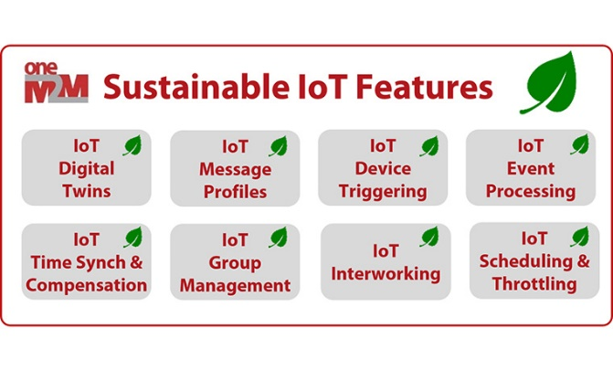


oneM2M Key-events Timeline
Interop 1
Interop 2
Interop 3
Interop 5
Interop 6
Interop 7
Interop 8
Interop 4
oneM2M
established
Release 5
initial plan
Release 1
Release 2
Release 2A
Release 3
Release 4
oneM2M Hack-a-Thon Events
2012
2015
2016
2017
2018
2019
2020
2021
2022
2023
2024
Industry
Day 1
Industry
Day 2
Industry
Day 4
Industry
Day 5
Industry
Day 3
oneM2M WS & Developers Training / China*
oneM2M White Paper
IoT for Sustainability
oneM2M White Paper
How oneM2M is Enabling
More Sustainable IoT
Deployments
oneM2M
Certification
launch
15+ products
certified
oneM2M
Certification
launch

Slide 29
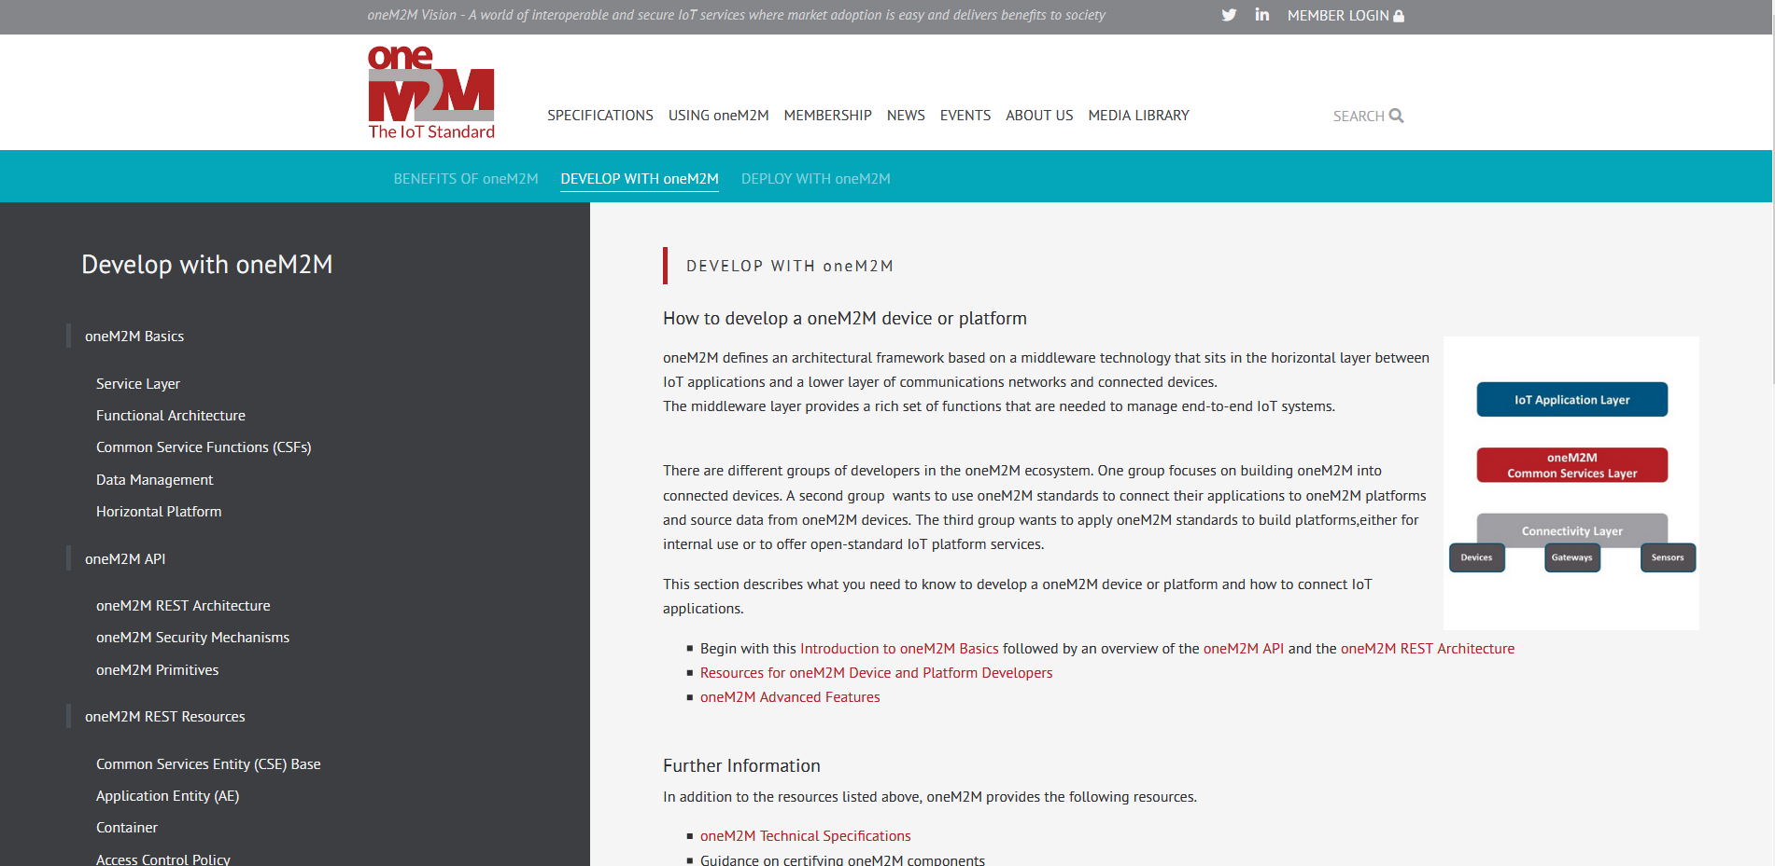
Developer Guides
accessible via the public link:
https://onem2m.org/using-onem2m/developers

Slide 30
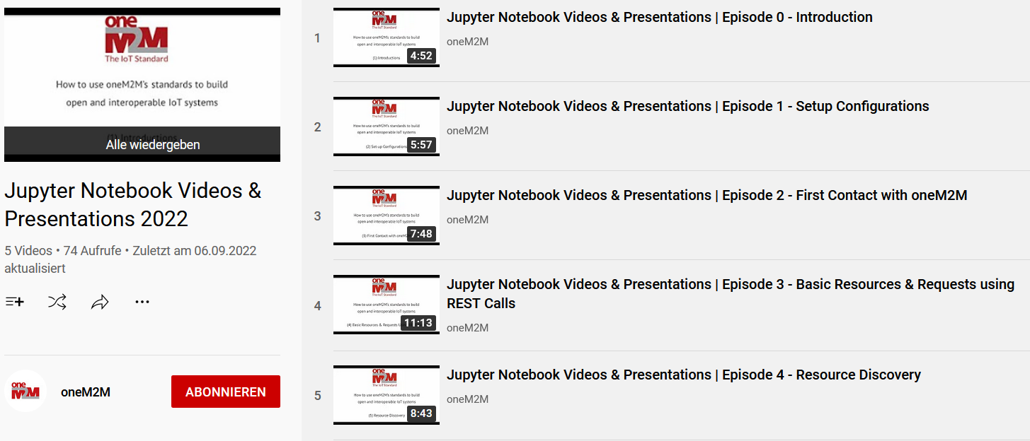
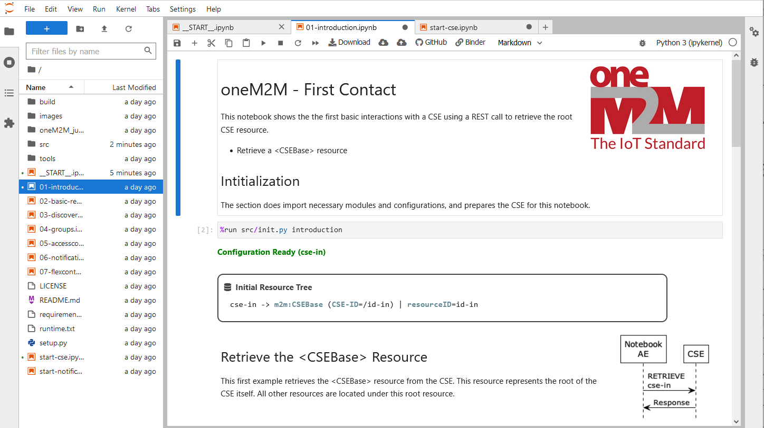
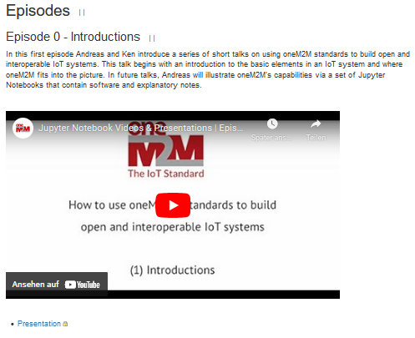
oneM2M Tutorials
The first set of the oneM2M Tutorials using Jupyter Notebooks is now online!
oneM2M Wiki
https://wiki.onem2m.org/index.php?title=OneM2M_Jupyter_Notebooks
YouTube
https://www.youtube.com/playlist?list=PLDd4EJmw5gUnA_d1RgYnxrOrYeYuHdH5u
GitHub & Discussions
https://github.com/oneM2M/onem2m-jupyter-notebooks
https://github.com/oneM2M/onem2m-jupyter-notebooks/discussions
MyBinder Runtime
https://mybinder.org/v2/gh/oneM2M/onem2m-jupyter-notebooks/master?urlpath=lab/tree/__START__.ipynb

Slide 31
For more information …
visit www.oneM2M.org
Executive Viewpoints - https://onem2m.org/insights/executive-viewpoints
oneM2M in the News - https://onem2m.org/news-events/newsmenu/onem2m-in-the-news
Technical Specifications - https://onem2m.org/technical/published-drafts
Roland Hechwartner – roland.hechwartner@magenta.at

Slide 32
Thank You

