Slide 1

SDS Status Report to TP58
Group Name: oneM2M SDS
Source: Peter Niblett, Poornima Shandilya, SeungMyeong Jeong, Wei Zhou
Meeting Date: 2023-02-20 to 2023-02-23

Slide 2
Summary
15 new SDS contributions have been agreed against Rel-2,3,4
9 contributions to date have been agreed against Rel-5
Issue tracking system is being used
  98 issues currently open, 69 have been closed
Baselines now available for all R4 TS documents
TR status to be reviewed
Discussion topics
  Inter and Intra-release versioning
  Future of XML schemas and XML protocols
  Gitlab document control process

Slide 3
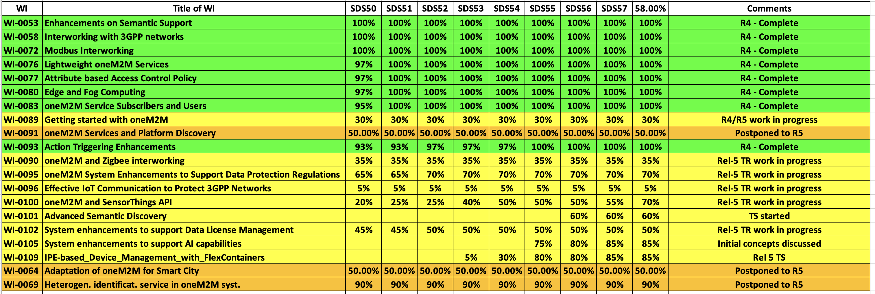
SDS WI Status
Complete
On track
Running behind schedule
Work has stalled

Slide 4
Rel-4 Progress
  Stage 3 work complete for all Rel-4 features
  TS-0001 and TS-0040 have been reviewed by editHelp.
  Other baselines are now ready for editHelp
  TS-0004 and TS-0008 to follow
TS | Title | Version
TS-0003 | Security Solutions | 4.7.0
TS-0005 | Management Enablement (OMA) | 4.0.0
TS-0006 | Management Enablement (BBF) | 4.0.0
TS-0009 | HTTP Binding | 4.4.0
TS-0010 | MQTT Binding | 4.0.0
TS-0014 | LWM2M Interworking | 4.0.0
TS-0016 | Secure Environment Abstraction | 4.0.0
TS-0020 | WebSocket Binding | 4.0.0
TS | Title | Version
TS-0022 | Field Device Configuration | 4.5.0
TS-0024 | OCF Interworking | 4.0.0
TS-0026 | 3GPP Interworking | 4.7.0
TS-0030 | Ontology Based Interworking | 4.0.0
TS-0032 | MAF/MEF Interface | 4.0.0
TS-0033 | Interworking Framework | 4.0.0
TS-0034 | Semantics Support | 4.2.0
TS-0035 | OSGi Interworking | 4.0.0
TS-0040 | Modbus Interworking | 4.0.0

Slide 5
Rel-5 Progress
3 CRs agreed for Rel 5.
TR-0065 (STA / OGC) has progressed
TS-0001 5.1.0 R5 Baseline is Agreed
CRs For other TSs- TS-0004, TS-0022, TS-0033, TS-0034
  Will be added to CR packs when the new versions of the TSs are started.

Slide 6
Items for Decision
CR Packs:
TS-0001 – TP-2023-0017 – 02-R2, 02-R3, 04-R4, 03-R5 = 11
TS-0004 – TP-2023-0018 – 00-R2, 01-R3, 02-R4, 00-R5 = 3
TS-0008 – TP-2023-0019 – 01-R2, 01-R3, 01-R4, 00-R5 = 3
TS-0026 – TP-2023-0020 – 00-R2, 01-R3, 00-R4, 00-R5 = 1

Slide 7
Conference Calls
Meeting | Date | Time (UTC)
SDS 58.1 | Tue 14-Mar-2023 | 12:00 – 13:30
SDS 58.2 | Tue 21-Mar-2023 | 12:00 – 13:30
SDS 58.3 | Tue 28-Mar-2023 | 12:00 – 13:30
SDS 58.4 | Tue 11-Apr-2023 | 12:00 – 13:30
Dates subject to confirmation

