Slide 1
Marcom Report to TP58
Bindoo Srivastava, Marcom Chair
23 February 2023

Slide 2
Outline
Summary from the oneM2M International Conference
Summary Highlights till date- CY’23
How to leverage interest from regions ?
MWC 2023
Plans for CY’23

Slide 3

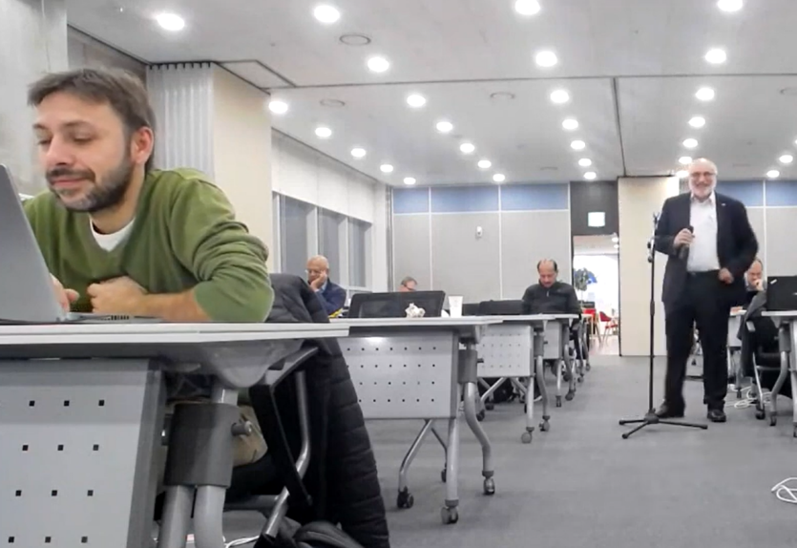
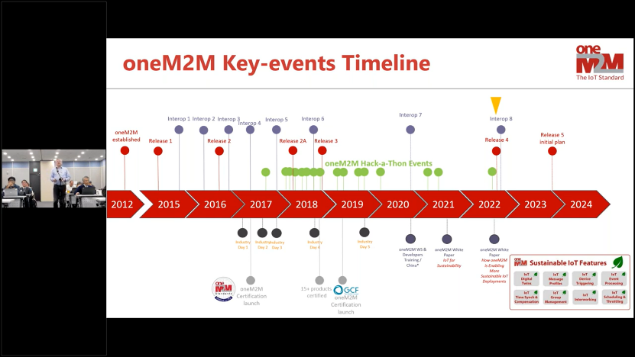
oneM2M Conference @ TP57
1st oneM2M International conference in hybrid mode.
Organized by TTA – oneM2M co-located with TP57
Presenters shared experiences of developing oneM2M based solutions, devices and platforms.
Common thread from representative implementations from India, Europe and Korea: one can start with a small core set of features that can then be enhanced as per need.
Session on certification journey of oneM2M and the role of various players was very well received.

Slide 4
Key Takeaways from the Conference
A very fast development of a solution based on oneM2M Specs for smart lifts could be done at the request of European Lifts Association(ELA)/EFESME
This model can be replicated? –
  Equipment O&M Service Providers
  Agritech
  PoS vending machines,
  Ancillary industries with multivendor applications
    cranes-forklifts et al
    Supply Chain Management
hyperscaler context

Slide 5
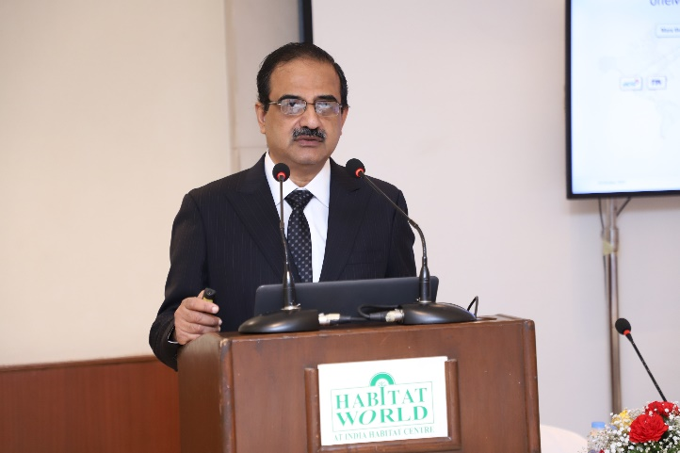
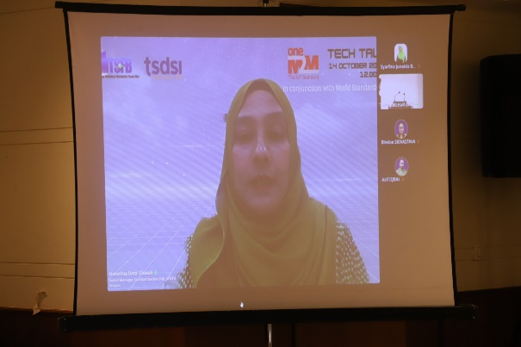
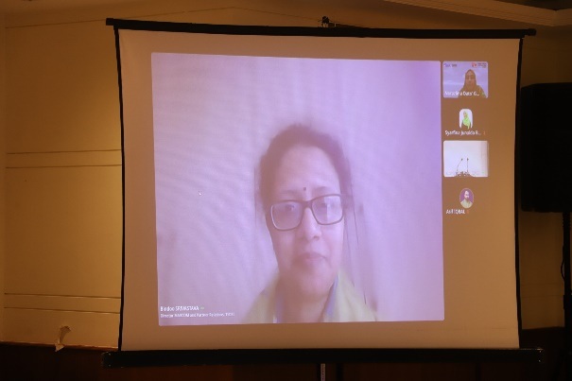
Malaysia (MTSFB) interest in oneM2M
oneM2M Tech Talk delivered to audiences in Malaysia through MTSFB (hybrid) on 14th October 2022
Mr Aurindam Bhattacharya, oneM2M MARCOM Vice Chair (CDOT) delivered a lecture on oneM2M

Slide 6
Key Highlights - Jan’23
External Publications:
2 articles in ETSI Enjoy (Jan=Feb 23)
The Fast Mode - Metaverse standards (Jan’23),
Pipeline Magazine (2023 predictions) (Feb’23)
Articles: 2023 IoT trends for A&G via PPR; Opening for article on Metaverse for Connected and Automated Vehicles and ITS (IEEE VT magazine)
Engagement: Executive insights 2 in Jan’23, 1 on 1st Feb’23
MWC 2023 Engagement
Luis @ GIO Round Table will cover oneM2M Sustainability
https://www.journaldunet.com/ request for interview with a oneM2M expert on sustainability
Visibility:
Total Events organized (0@oneM2M, 0@Partner, 0@Regional):: TSDSI’s oneM2M Stakeholders’ Day (24th Feb
Speaking Opportunities: Refer oneM2M Promotions Tracker :: IoT Tech Expo, Convergence India, ETSI IoT Week; Korea IoT week
Social Media: 1455 Twitter followers, 13 posts; 1307 LinkedIn followers, 5 posts
Communiques & PRs: oneM2M in the News – 1206 followers; PRs issued - NIL
Notes:
Potential Articles:
CFP - Special Issue on Metaverse for Connected and Automated Vehicles and
Intelligent Transportation Systems https://www.ieeevtc.org/vtmagazine/specisu--Metaverse-CAVS.php
IEEE VT Magazine (Impact Factor: 13.609). http://www.ieeevtm.org;
- Manuscript Submission deadline: 15th April 2023
- First Round Reviews by: 15 June 2023
- Second Round Submissions by: 1st August 2023
- Final Editorial Decision: 15 September 2023
- Published: December 2023
Potential Speaking Opportunities –
1. oneM2M Stakeholders Day (co-located with TP 58 in Delhi, India)
2. IoT Tech Expo & Edge Computing Expo - North America (17-18 23) – Santa Clara, CA
3. IoT Tech Expo & Edge Computing Expo - Europe (26-27 Sept) – Amsterdam
4. IoT Tech Expo - Global (30th November – 1st December) – London

Slide 7
Website – Visits Jan ‘23
Website Visits
&
Top 10 countries

Slide 8
CY’23 Activities
Activities around TP61 (Penn State Univ) and TP62 (Tokyo)?
Profiling oneM2M Stalwarts as Role models
oneM2M icons library
oneM2M Brochure
Microcertifications mechanism
Explore Regional engagements – Malaysia, others?
Capacity Building on oneM2M - In the wake of ITU-T SG20 endorsement?
University outreach :
  hackathons (3rd international Mar-Apr-May ’23?)/
  Outreach at TP61 with Penn State university (Aug-Sep?
  developer series? Q2-Q3
oneM2M White paper on MEC (JaeSeung Song)- Q1 ‘CY 23
Retain mindshare in the ecosystem and keep promoting new information around relevant oneM2M TP/SSC milestones through Regular features/media interactions/speaking opportunities - Metaverse, Rel 5 etc.

Slide 9
Reference Slides

Slide 10
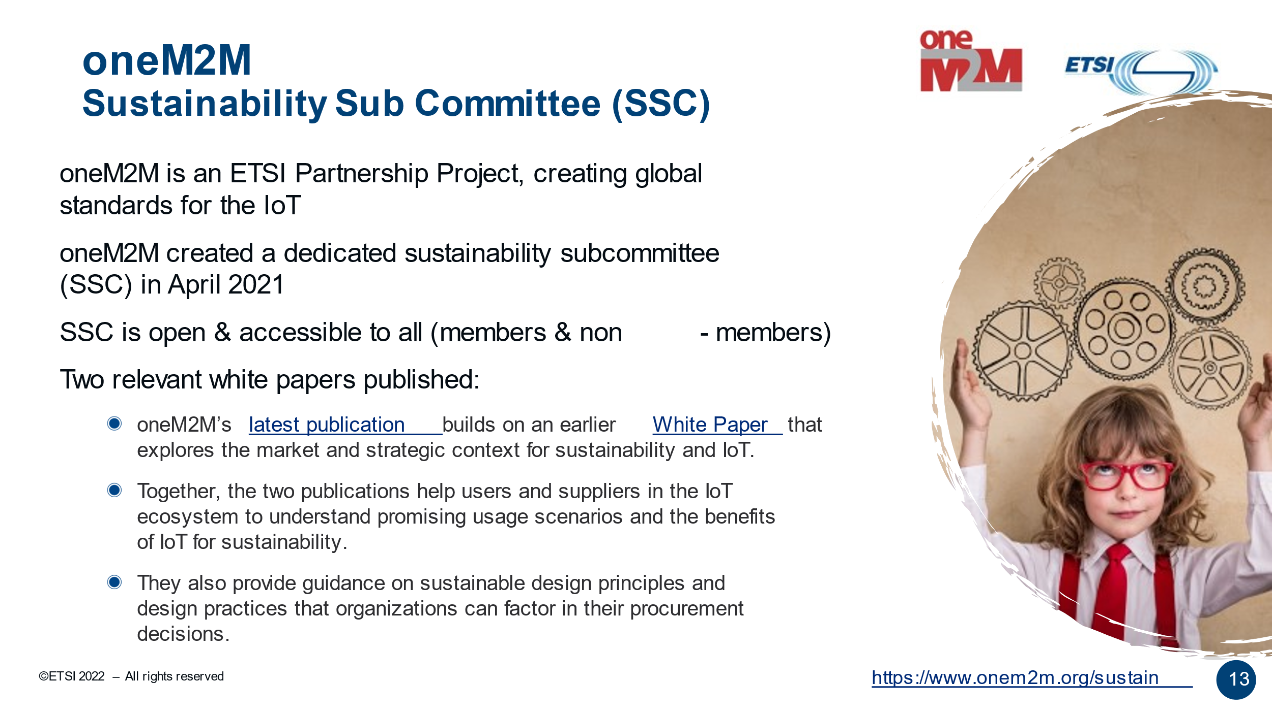

Slide 11
Thought Leadership – Articles CY’23
  Global Journals
  The Fast Mode - Metaverse standards
  Pipeline Magazine (2023 predictions)
  Trade Journals
  Regional
  Partner Communiques
  ETSI Enjoy Jan
Activities Tracker link
Notes:
2023 IoT trends for A&G via PrPR

Slide 12
Engagement – Executive Insights (CY23):
oneM2M in the News – 1206 Subscribers
Press Releases – 2
Media queries to oneM2M_PressMedia@list.onem2m.org being forwarded to Bindoo, Aurindam, Ken, Akash
  Executive Insights
  Indian industry interest in training on CDOT’s oneM2M platform (22 Feb’ 23
  IoT systems and the evolution of solution requirements by nTels – 9th Jan’23
  Standardization in Smart Elevator by Patrick Cox (TRE-E scrl)
  Standardization in Smart Lift Sector by Marco Cogliati (TRE-E scrl)
Activities Tracker link
Notes:
Interview in pipeline –
https://futureiot.tech/

Slide 13
Thought Leadership – Articles CY’22
  Global Journals
  Paper in IEEE Internet of Things Journal
  IEEE paper on CDAC's CoSMiC Platform for Intelligent Transportation System
  Trade Journals
  oneM2M and sustainability - IoT Business News;
  Open Standards article for Interoperability News EU
  ABI Research interview with oneM2M for their Smart Cities research program
  Comments on Industrial IoT submitted to AI Magazine
  Pipeline Magazine - Making IoT Intelligent
  IoTforAll - "efficient IoT messages"
  Regional
  Feature in National Post, Canada)
  Voice & Data, India Smart Cities Edition
  oneM2M in context of smart cities for tele.net, India
  Partner Communiques
  ETSI Enjoy - Addressing Societal Challenges with IoT
  ETSI Enjoy - IoT data for industrial verticals
  ETSI Enjoy: Standards to Support AI/ML Services
  SDO Interviews, 10-year celebration, oneM2M deployments and Market Impact for ETSI Enjoy!
Activities Tracker link
Notes:
2023 IoT trends for A&G via PrPR

Slide 14
Engagement – Executive Insights (CY22):
oneM2M in the News – 1206 Subscribers
Press Releases – 2
Media queries to oneM2M_PressMedia@list.onem2m.org being forwarded to Bindoo, Aurindam, Ken, Akash
  Executive Insights
  Roland on TP#52 – 5th Jan’22
  Roland on TP#53 - 9th Mar’22
  IoT and 6G interview with Onel Alcaraz López (Finland) 16th Mar’22
  Interview about UCL standardization study 7th Apr’22
  SMARTM2M study on IoT data for AI - Michelle W 25th May’22
  Roland on TP#54 – 3rd Jun’22
  Interview with TCS (DigiFleet) – 23rd Jun’22
  Mauro Dragoni – his activities in IoT industry and his project related to SAREF – 27th Jul’22
  Roland on TP#54 – 7th Sep’22
  IUDX-oneM2M pilot – 12th Sep’22
  Roland on TP#56 – 25th Oct’22
  Roland on TP#57 – 14th Dec’22
Activities Tracker link
Notes:
Interview in pipeline –
https://futureiot.tech/

Slide 15
oneM2M in Press
IoT expectations in 2023 | November 2022 | What to Expect with IoT in 2023 - Architecture & Governance
ETSI Enjoy! | October 2022 | The latest ETSI Enjoy! publication devotes three articles to IoT and the impact of oneM2M standardization, ten years after the launch of oneM2M
IoT for all | October 2022 | The IoT for All community recently published an article on the need for efficient message payload techniques to improve the performance of constrained IoT devices and sensors. It presents the benefits of common service functions (CSFs)
IoT devices & cyber threats | August 2022 | This is how enterprises can protect their IoT devices from cyber threats - BizzBuzz
Making IoT Intelligent | July 2022 | Internet of Things (IoT) systems involve combinations of connected devices and sensors.
IoT and Sustainability | April 2022 | IoT technologies provide the building blocks to address sustainability goals
Notes:
International Institute of Information Technology (Hyderabad)
blog post (January 2023) - IITH's Smart City team wins Best Technology award in Korean hackathon ETSI Enjoy! January 2023Research and Innovation in IoT Standardization
ETSI Enjoy! January 2023Research and Innovation in IoT Standardization

Slide 16
oneM2M in News
17 December 2022 | oneM2M Ends 2022 on a High in Korea
18 October 2022 | IOT STANDARDIZATION FOR DIGITAL AND GREEN TRANSFORMATION: SPEAKER PRESENTATIONS FROM ETSI IOT WEEK 2022
17 October 2022 | INVITATION FOR oneM2M 8TH INTEROPERABILITY EVENT
10 October 2022 | oneM2M OUTLINES 8 TECHNIQUES FOR SUSTAINABLE IOT
August 2022 | This is how enterprises can protect their IoT devices from cyber threats – BizzBuzz
July 2022 | Internet of Things (IoT) systems involve combinations of connected devices and sensors.
April 2022 | IoT technologies provide the building blocks to address sustainability goals

Slide 17
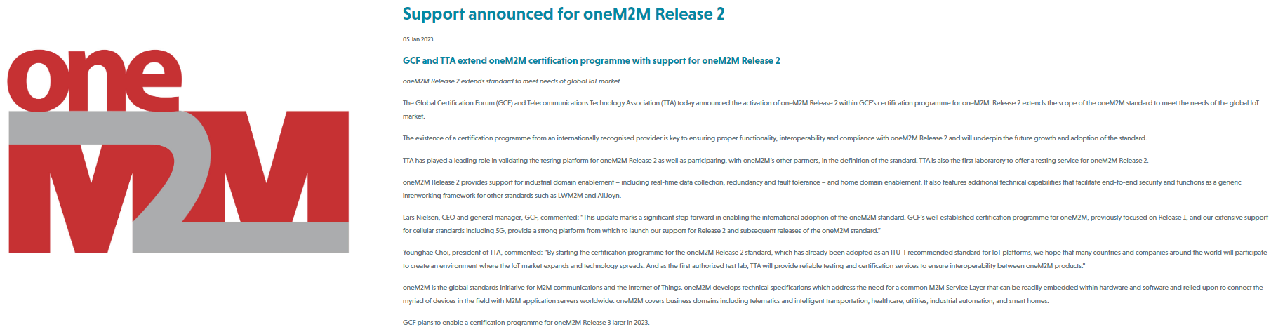
GCF – oneM2M Rel 2 Certification
Global Certification Forum (GCF) and Telecommunications Technology Association (TTA) announced activation of oneM2M Release 2 within GCF’s certification programme for oneM2M
“By starting the certification programme for the oneM2M Release 2 standard, which has already been adopted as an ITU-T recommended standard for IoT platforms, we hope that many countries and companies around the world will participate to create an environment where the IoT market expands and technology spreads. And as the first authorized test lab, TTA will provide reliable testing and certification services to ensure interoperability between oneM2M products.“ - Younghae Choi, president of TTA

Slide 18






Thank You

