Slide 1

SDS Status Report to TP59
Group Name: oneM2M SDS
Source: Peter Niblett, Poornima Shandilya, SeungMyeong Jeong, Wei Zhou
Meeting Date: 2023-04-17 to 2023-04-21

Slide 2
Summary
5 new TS contributions have been agreed against Rel-4 and 5
2 new contributions have been agreed against TR-0065
10 agreed contributions pending against Rel-5 specs
  TS-0004, TS-0022, TS-0026, TS-0033, TS-0034
101 issues currently open, 69 have been closed
Restarted conversation with IANA about CoAP code registration
TS-0031 (Feature Catalog) has not been updated for Rel-4
  Propose that this is done in SDS
Concerns
  Need Rapporteur for TS-0001

Slide 3
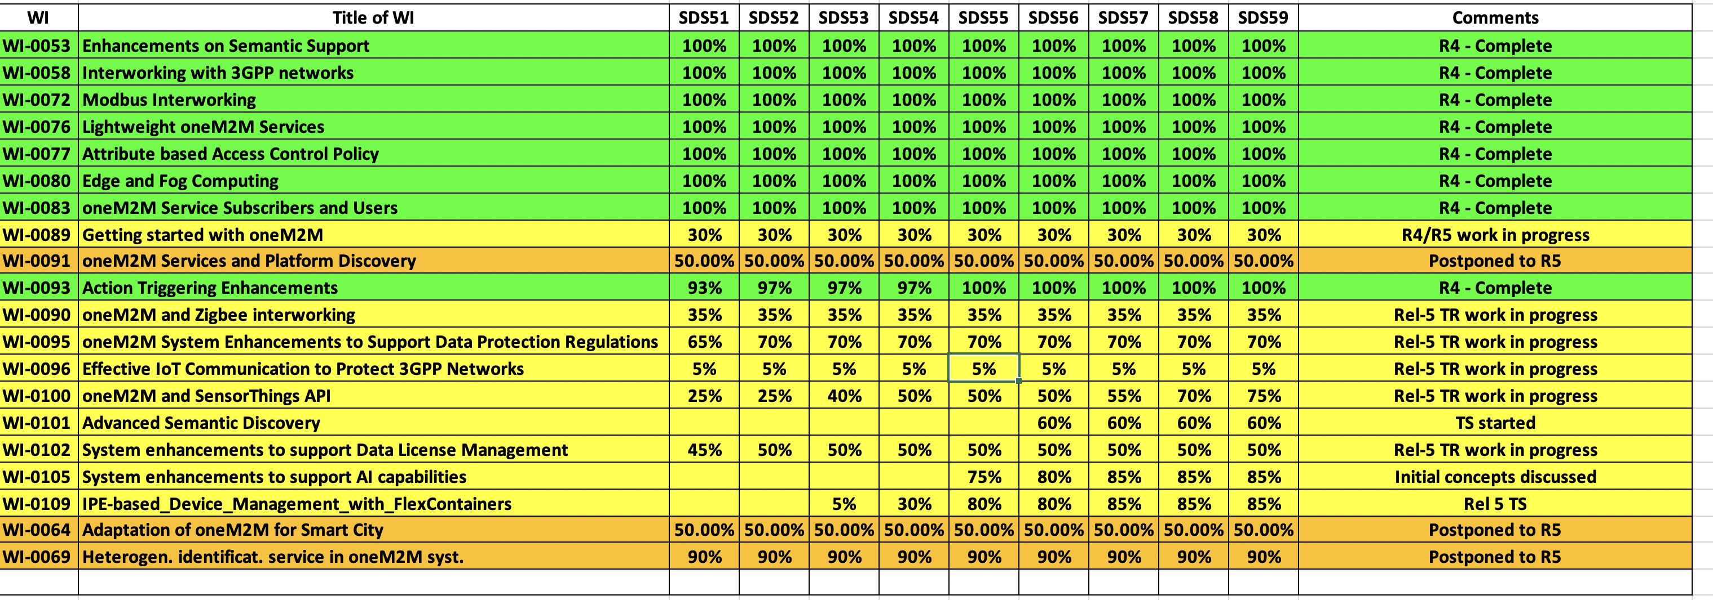
SDS WI Status
Complete
On track
Running behind schedule
Work has stalled

Slide 4
Rel-4 Progress
  Stage 3 work complete for all Rel-4 features
  TS-0001 and TS-0040 have been reviewed by editHelp.
  Other baselines are now ready for editHelp
TS | Title | Version
TS-0003 | Security Solutions | 4.7.0
TS-0004 | Core Protocol | 4.14.0
TS-0005 | Management Enablement (OMA) | 4.0.0
TS-0006 | Management Enablement (BBF) | 4.0.0
TS-0008 | CoAP Binding | 4.4.0
TS-0009 | HTTP Binding | 4.4.0
TS-0010 | MQTT Binding | 4.0.0
TS-0014 | LWM2M Interworking | 4.0.0
TS-0016 | Secure Environment Abstraction | 4.0.0
TS-0020 | WebSocket Binding | 4.0.0
TS | Title | Version
TS-0022 | Field Device Configuration | 4.5.0
TS-0024 | OCF Interworking | 4.0.0
TS-0026 | 3GPP Interworking | 4.7.0
TS-0030 | Ontology Based Interworking | 4.0.0
TS-0032 | MAF/MEF Interface | 4.0.0
TS-0033 | Interworking Framework | 4.0.0
TS-0034 | Semantics Support | 4.2.0
TS-0035 | OSGi Interworking | 4.0.0
TS-0040 | Modbus Interworking | 4.0.0

Slide 5
Rel-5 Progress
3 CRs agreed for Rel 5.
TR-0065 (STA / OGC) has progressed
CRs For other TSs- TS-0004, TS-0022, TS-0026, TS-0033, TS-0034
  Will be added to CR packs when the new versions of the TSs are started.

Slide 6
Items for Decision
CR Pack:
TS-0004 – TP-2023-0040 – 00-R2, 00-R3, 02-R4, 00-R5 = 2

Slide 7
Conference Calls
Meeting | Date | Time (UTC)
SDS 59.1
SDS 59.2
SDS 59.3
SDS 59.4
TBD

