Slide 1
Consideration of using Blockchain in oneM2M
TP-2023-0079
Group Name: TP#61
Source: JiHo Lee, JiEun Lee, JaeSeung Song (Sejong Univ. )
Meeting Date: 2023-08-14

Slide 2

Background
Notes:
블록체인에 대한 간략한 소개 및 관심이 높아지고 있다 들어가는말?사진??

Slide 3
Background
No data management through linkage with IoT standard platforms where actual data is collected and managed
The threat of tampering with IoT platform data
Adoption of blockchain technology to counter the threat of falsification of data in international standard IoT platforms
  Introduction of blockchain technology, which is more transparent and secure than existing centralized databases
Notes:
제안에 대한 목적 설명

Slide 4
Benefits of Using blockchain in oneM2M
Reduces the risk of data tampering
  Blockchain transparency and security
  Applying the benefits of blockchain technology to IoT technology
Categorizing data that can be managed through the blockchain network among the various data collected by the IoT platform
  Interworking technology that allows data to be stored, managed, and used as blocks on a blockchain network
Notes:
제안에 대한 이점을 설명. (이점으로 작성? 필요성으로 변경? IoT 플랫폼의 블록체인 활용에 대한 표준이 필요하다.)

Slide 5
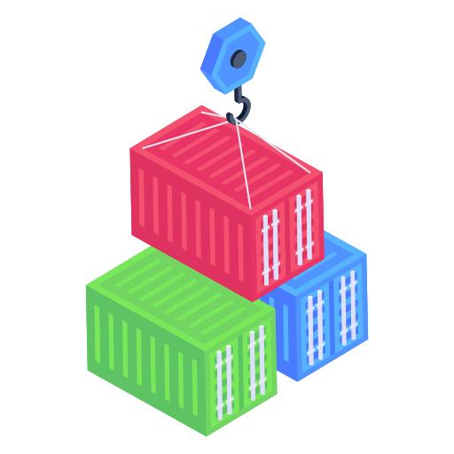



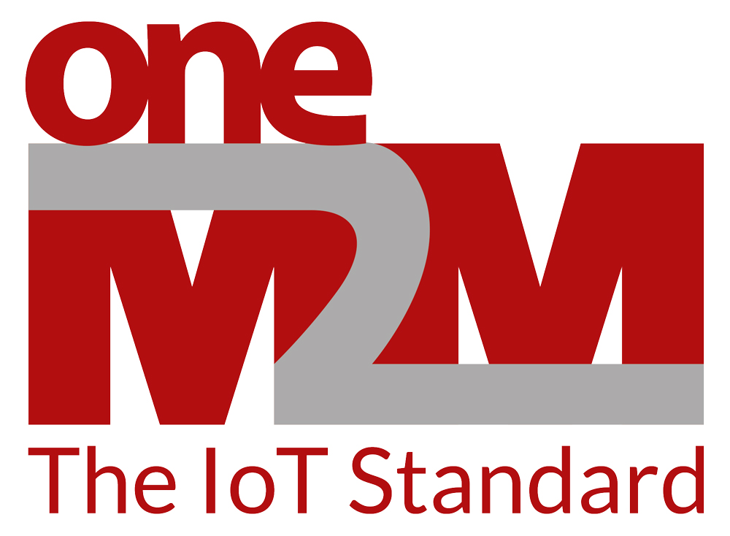
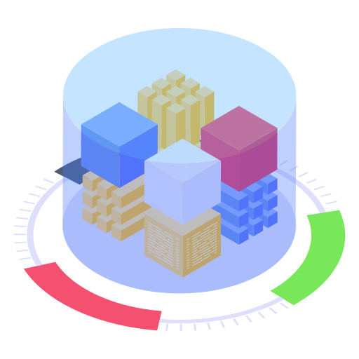
Conceptual Idea
Stored by oneM2M AE on a specific blockchain network.
  Require an information to indicate blockchain management
  Require a function to support interworking to blockchain network
  Usage of smart ledge for oneM2M
Blockchain
APIs
MCA
Blockchain IPE
IoT Platform
(oneM2M IN-CSE)
oneM2M AE
Blockchain network
Notes:
표준 제안의 핵심??
특정 데이터를 블록체인에 저장함으로써 IoT platform인 oneM2M에 블록체인을 활용하는 표준 제안.
- 필요성을 강조
이점을 강조
표준이 아직 없음을 강조
사용 예시?
표준 적용 예시?

Slide 6
Conceptual Idea
Identify data to be stored to blockchain
An interworking proxy feature managing oneM2M data via blockchain
  Targeted blockchain networks
  Block Address
  Smart Contract Address
  Transaction Hash (ID)
Notes:
표준 제안의 핵심??
특정 데이터를 블록체인에 저장함으로써 IoT platform인 oneM2M에 블록체인을 활용하는 표준 제안.
- 필요성을 강조
이점을 강조
표준이 아직 없음을 강조
사용 예시?
표준 적용 예시?

Slide 7
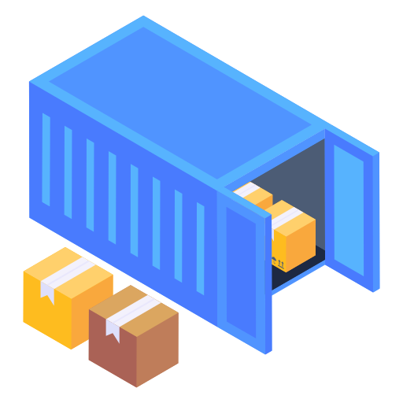


System Architecture Example
IoT Platform
(oneM2M IN-CSE)
oneM2M AE
Blockchain
APIs
MCA
Common Functions
Data with
Blockchain tag
Blockchain IPE
IoT Blockchain network
BC tag Data
Data
Data without
Blockchain tag
Conventional DB

Slide 8

Introduction to ETSI ISG PDL (1/2)
INDUSTRY SPECIFICATION GROUP (ISG) PERMISSIONED DISTRIBUTED LEDGER (PDL)
  Analyzes and sets foundation for permissioned distributed ledgers.
  Leverages existing knowledge to verify participant nodes.
  Automates ledger and node lifecycles.
  Enables actions on transactions via smart contracts.
Notes:
INDUSTRY SPECIFICATION GROUP (ISG) PERMISSIONED DISTRIBUTED LEDGER (PDL)
Analyzes and sets foundation for permissioned distributed ledgers.
Permissioned Distributed Ledgers (PDLs) stand out for their restricted access, enhancing security and control. ISG PDL is pivotal in shaping the core principles of these ledgers, ensuring adaptability, and robustness.
Leverages existing knowledge to verify participant nodes.
Node credibility is crucial for a PDL's reliability. Using accumulated knowledge, ISG PDL meticulously verifies each participant node, ensuring trustworthiness and alignment with the ledger's objectives.
Automates ledger and node lifecycles.
ISG PDL emphasizes efficiency, streamlining operations by automating both the overarching ledger lifecycle and that of individual nodes. This approach reduces errors and heightens operational speed.
Enables actions on transactions via smart contracts.
Beyond recording, ISG PDL introduces the execution of smart contracts. These automated, predefined protocols act upon set criteria, adding a dynamic response layer to the ledger.
Collaborates with the oneM2M platform for enhanced capabilities. Understanding the value of synergy, ISG PDL has forged a collaboration with the oneM2M platform. This partnership merges the strengths of both, creating a holistic, expansive, and potent system.

Slide 9
Introduction to ETSI ISG PDL (2/2)
Key benefits of PERMISSIONED DISTRIBUTED LEDGER (PDL)
  Enhanced Security
  Scalability
  Efficiency & Automation
  Interoperability
The Imperative of PDL and Collaboration in Integrating Blockchain with the oneM2M Platform
  Enhanced Security with PDL
  Scalability Benefits
  Role-based Access and Data Privacy
  Streamlined Operations with Smart Contracts
Notes:
Enhanced Security: Permissioned nature ensures only verified entities can participate, drastically reducing malicious activities.
Scalability: Designed for growth, PDLs can accommodate increasing transactions without compromising performance.
Efficiency & Automation: With features like smart contracts, processes that once required manual oversight can now be automated, speeding up operations and reducing errors.
Interoperability: Collaboration with platforms like oneM2M allows for seamless interaction with other systems and platforms.
Enhanced Security with PDL:
Blockchain inherently offers an immutable ledger where transactions, once recorded, cannot be altered. This ensures data integrity.
PDL amplifies this by ensuring only verified entities can add to the ledger. Given that oneM2M platforms might be handling sensitive data from various industries (from healthcare to transportation), a permissioned approach ensures data is not only immutable but also secure from unauthorized access or malicious intent.
Scalability Benefits:
oneM2M's goal is to create a scalable platform that caters to a wide range of industries. A public blockchain can become slow with increased usage, but a PDL, by design, can manage a larger number of transactions more efficiently.
Role-based Access and Data Privacy:
PDL allows for role-based access controls. This is vital for platforms like oneM2M where different stakeholders (e.g., device manufacturers, application developers, end-users) have varied access needs. Not every participant needs to see every piece of data, and PDL can enforce these access restrictions.
Streamlined Operations with Smart Contracts:
PDL’s ability to use smart contracts means automated processes for certain predefined conditions. For a vast platform like oneM2M, which might deal with numerous automated devices and processes, having smart contracts can streamline operations significantly.
Conclusion:
The integration of blockchain with the oneM2M platform is a step forward in ensuring scalability, security, and efficiency. However, to maximize these benefits, leveraging the unique advantages of Permissioned Distributed Ledgers and fostering collaborations in the blockchain domain are not just beneficial, but essential. With PDL's unique features and through strategic collaborations, the oneM2M platform can truly harness the transformative potential of blockchain technology.

Slide 10
Next steps
Introduce a new use case enabling Blockchain to oneM2M
Collaboration with ISG PDL
  Exchange information
  Write up a whitepaper together
  Investigate the relationship between Access control policy in oneM2M & Permissions in PDL
Notes:
Enhanced Security: Permissioned nature ensures only verified entities can participate, drastically reducing malicious activities.
Scalability: Designed for growth, PDLs can accommodate increasing transactions without compromising performance.
Efficiency & Automation: With features like smart contracts, processes that once required manual oversight can now be automated, speeding up operations and reducing errors.
Interoperability: Collaboration with platforms like oneM2M allows for seamless interaction with other systems and platforms.
Enhanced Security with PDL:
Blockchain inherently offers an immutable ledger where transactions, once recorded, cannot be altered. This ensures data integrity.
PDL amplifies this by ensuring only verified entities can add to the ledger. Given that oneM2M platforms might be handling sensitive data from various industries (from healthcare to transportation), a permissioned approach ensures data is not only immutable but also secure from unauthorized access or malicious intent.
Scalability Benefits:
oneM2M's goal is to create a scalable platform that caters to a wide range of industries. A public blockchain can become slow with increased usage, but a PDL, by design, can manage a larger number of transactions more efficiently.
Role-based Access and Data Privacy:
PDL allows for role-based access controls. This is vital for platforms like oneM2M where different stakeholders (e.g., device manufacturers, application developers, end-users) have varied access needs. Not every participant needs to see every piece of data, and PDL can enforce these access restrictions.
Streamlined Operations with Smart Contracts:
PDL’s ability to use smart contracts means automated processes for certain predefined conditions. For a vast platform like oneM2M, which might deal with numerous automated devices and processes, having smart contracts can streamline operations significantly.
Conclusion:
The integration of blockchain with the oneM2M platform is a step forward in ensuring scalability, security, and efficiency. However, to maximize these benefits, leveraging the unique advantages of Permissioned Distributed Ledgers and fostering collaborations in the blockchain domain are not just beneficial, but essential. With PDL's unique features and through strategic collaborations, the oneM2M platform can truly harness the transformative potential of blockchain technology.

Slide 11
Thank you!

