Slide 1
integration of NGSI-LD
Group Name: TP
Source: Bob Flynn
Meeting Date: 2023-08-18

Slide 2
Background of Integration Discussion
Discussions have made good progress when we have met in person at ETSI IoT week. Martin Bauer and Bob Flynn led discussions that we propose to integrate NGSI-LD features into oneM2M.
ETSI IoT Week Oct 2022 (see previous slides and discussions)
ETSI IoT Week Jul 2023 (this presentation)

Slide 3

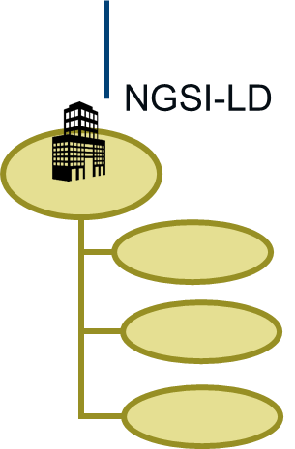
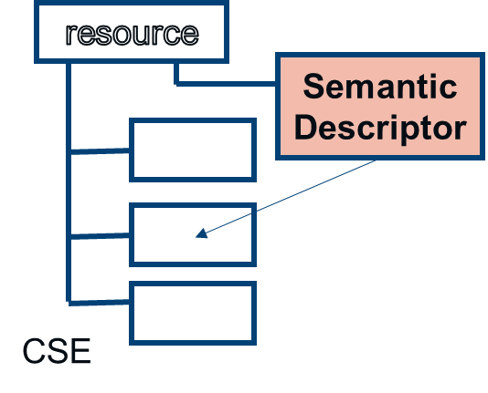
/3/ oneM2M and NGSI-LD: mapped
This is a proposal to give the Mca reference point an additional protocol, NGSI-LD,
AND to define in oneM2M a method to map data resources to NGSI-LD linked data.
API is updated with every release of oneM2M, to progress the mapping
Server Applications
AE
Server Applications
AE
CIM(22)023010_Discussion_oneM2M_and_NGSI-LD
Server
IN-CSE
NGSI-LD
Mca
Mcc’(sometimes Mca)
Mca
IPE
Mapping of oneM2M resources to an Information Model
(here assuming NGSI-LD core info model)
Field devices
Other standards
/proprietary

Slide 4

/3/ oneM2M and NGSI-LD: mapped
This is a proposal to give the Mca reference point an additional protocol, NGSI-LD,
AND to define in oneM2M a method to map data resources to NGSI-LD linked data.
Server Applications
AE
Server Applications
AE
New CSF
NGSI-LD
NGSI-LD
Server
IN-CSE
Mca
Mcc’(sometimes Mca)
Mca
Registration
Common Service Entity
IPE
Registration
Communication Management
Security
Discovery
Data Management & Repository
Semantics
Device Management
Subscription & Notification
Group Management
Application & Service Management
Location
Service Charging & Accounting
Network Service Exposure
Transaction Management
Time
Management
Session
Management
Process
Management
Field devices
Other standards
/proprietary

Slide 5
/3/ oneM2M and NGSI-LD: mapped
This is a proposal to give the Mca reference point an additional protocol, NGSI-LD,
AND to define in oneM2M a method to map data resources to NGSI-LD linked data.
Server Applications
AE
Server Applications
AE
{CSEbase}/ngsild/…
Server
IN-CSE
Mca
Mca
Mcc’(sometimes Mca)
Mca
NGSI-LD features are accessed via a virtual URI at CSE Base
IPE
Field devices
Other standards
/proprietary

Slide 6
/3/ oneM2M and NGSI-LD: mapped
This is a proposal to give the Mca reference point an additional protocol, NGSI-LD,
AND to define in oneM2M a method to map data resources to NGSI-LD linked data.
Server Applications
AE
Server Applications
AE
Server
IN-CSE
Mca
Mca
Mcc’(sometimes Mca)
Mca
IPE
Uses a oneM2M defined primitive.
Payload is extended to include NGSI-LD payloads / parameters
Field devices
Other standards
/proprietary

Slide 7
Outcome
oneM2M gains some features that are really beneficial to application developers
  creation of custom data models
  Potentially applicable to work in progress
NGSI-LD gains some important features that are out of scope of current definitions
  Access Control
  Security
  …

Slide 8
Thank you!

