Slide 1
Discussion on ROS-oneM2M interworking
Seokjun Lee (KETI)
2023.12.04

Slide 2
What is ROS?
“The Robot Operating System (ROS) is a set of software libraries and tools that help you build robot applications. From drivers to state-of-the-art algorithms, and with powerful developer tools, ROS has what you need for your next robotics project. And it's all open source.” (from ROS official website)
To operate robot, many processes are required
  Motion: motor status monitoring, motor control, …
  Navigation: sensor data acquisition, location estimation, waypoint generation, …
  Service: object detection, various algorithms, …
Before ROS, these are not modularized, so developers should generate redundant code whenever new project is started
ROS provides wide range of modules for robot operation

Slide 3
What is ROS?
https://player.vimeo.com/video/639236696?h=740f412ce5

Slide 4
Major Components of ROS
Package
  The main unit for organizing software in ROS
  It contains node, service, message, and other libraries or data
Node
  The unit of module in ROS
  Node provides various functionalities for its purpose (Motor control node, object detection node, …)
Service
  Server/client model of data communication
Topic
  Publish/subscribe model of data communication
Message
  Actual data transferred among nodes

Slide 5
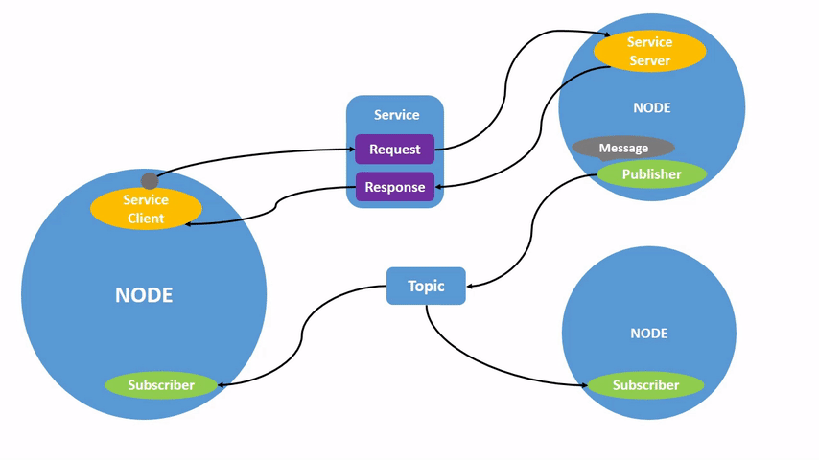
Major Components of ROS
https://docs.ros.org/en/foxy/_images/Nodes-TopicandService.gif

Slide 6
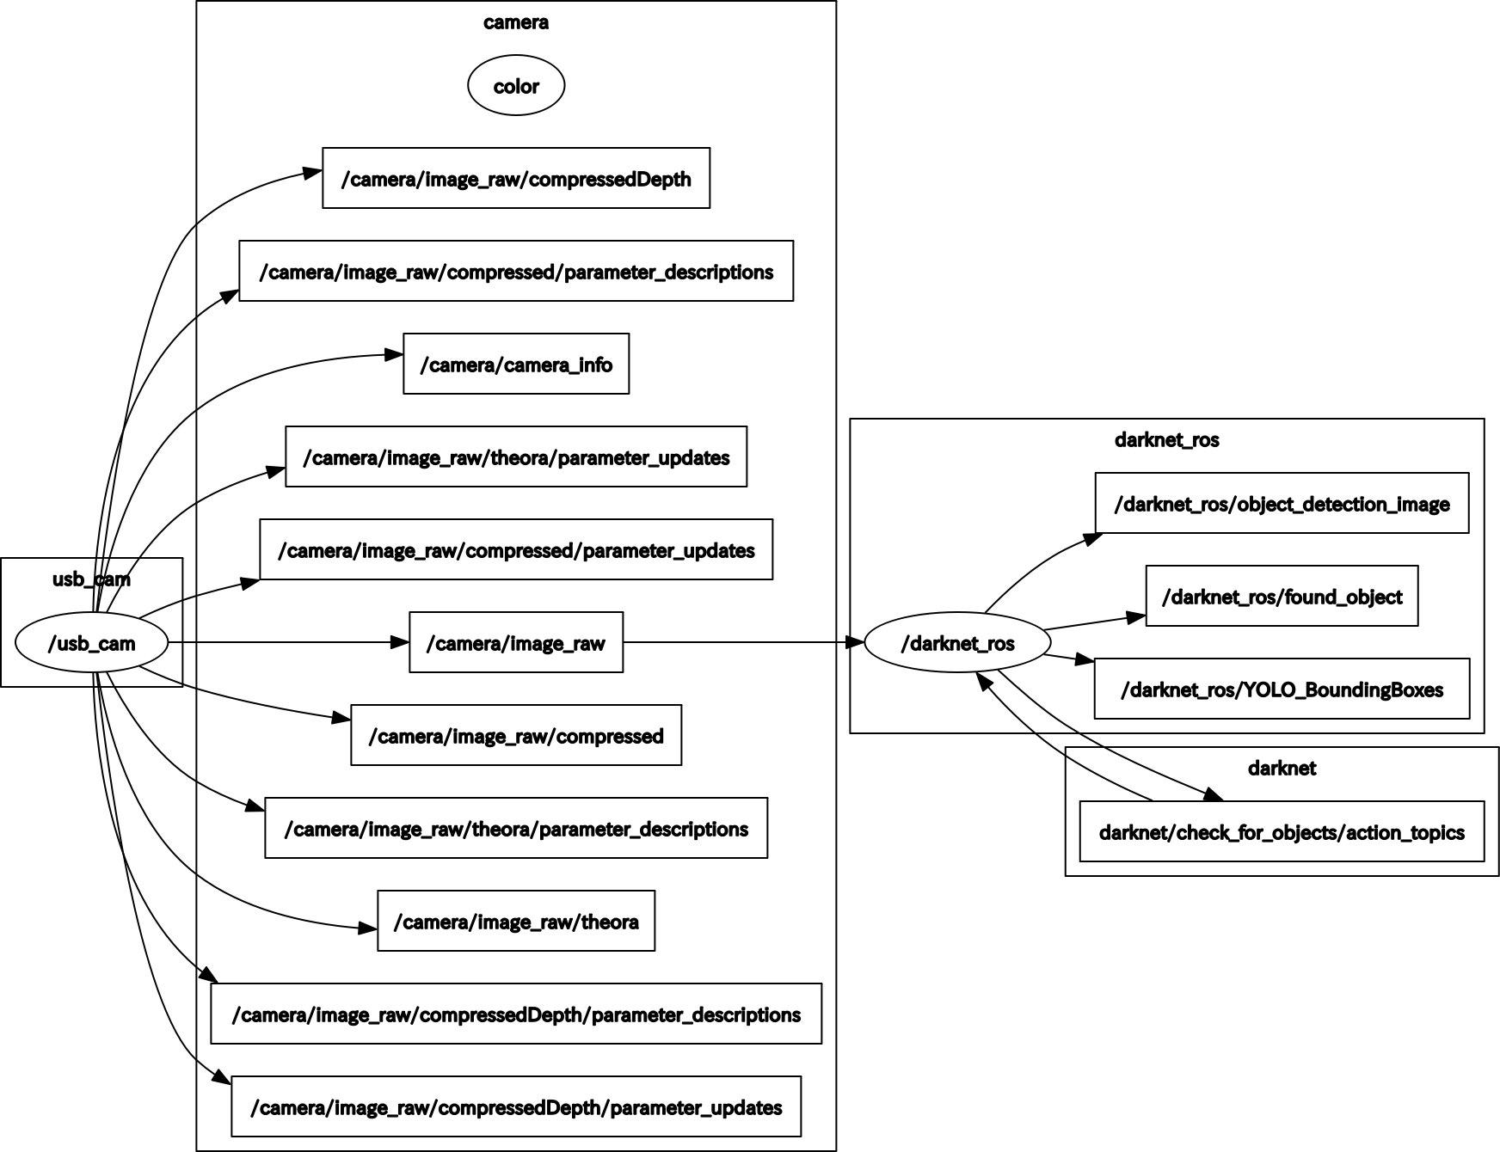
Example of ROS Application
usb_cam Package
  This package provides a configurable ROS interface to the kernel API of libv4l2 library that implements a common driver for standard USB web cameras.
darknet_ros package
  Custom package for integrating YOLO with ROS
https://qiita.com/nnn112358/items/d696681d5b0577d633b6

Slide 7
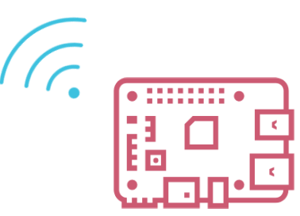
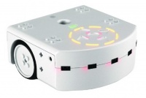
Why ROS-oneM2M Interworking is Needed?
There are 2 reasons for interworking ROS with oneM2M
1. ROS is designed for communication among robots in narrow range
  The ROS nodes are connected in p2p manner, so local area network environment is required
  To develop management system for multi site, other data platform is needed
  Interworking ROS and oneM2M is a nice way to utilizing oneM2M as robot data platform
MQTT Broker
Other Data Platform
ROS
ROS
Site 1
Site 2
Site 1
Site 2

Slide 8
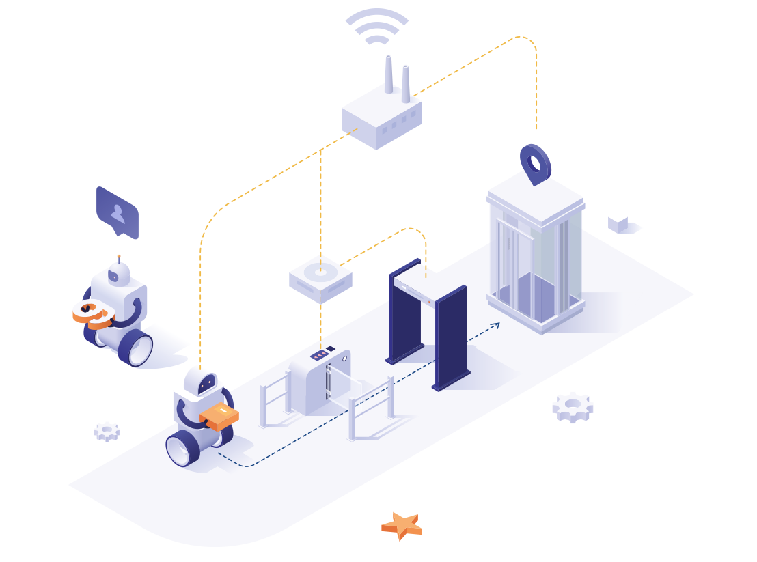
Why ROS-oneM2M Interworking is Needed?
2. To increase service coverage of robot, utilizing IoT infra is mandatory
  For example, monitoring and controlling automatic door or elevator enables delivery robot to move whole area in building
  ROS-oneM2M interworking makes this much easier
https://m2mtech.co.kr/static/robotImg-7e60c90122cf70ff5b8948e640a23954.png

Slide 9
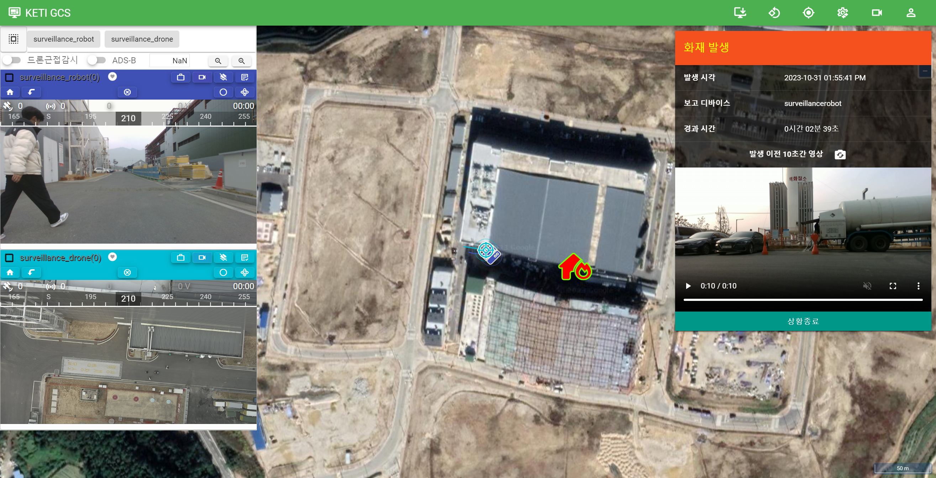
Drone-Robot Management System
KETI has been developed the web-based drone-robot management system

Slide 10
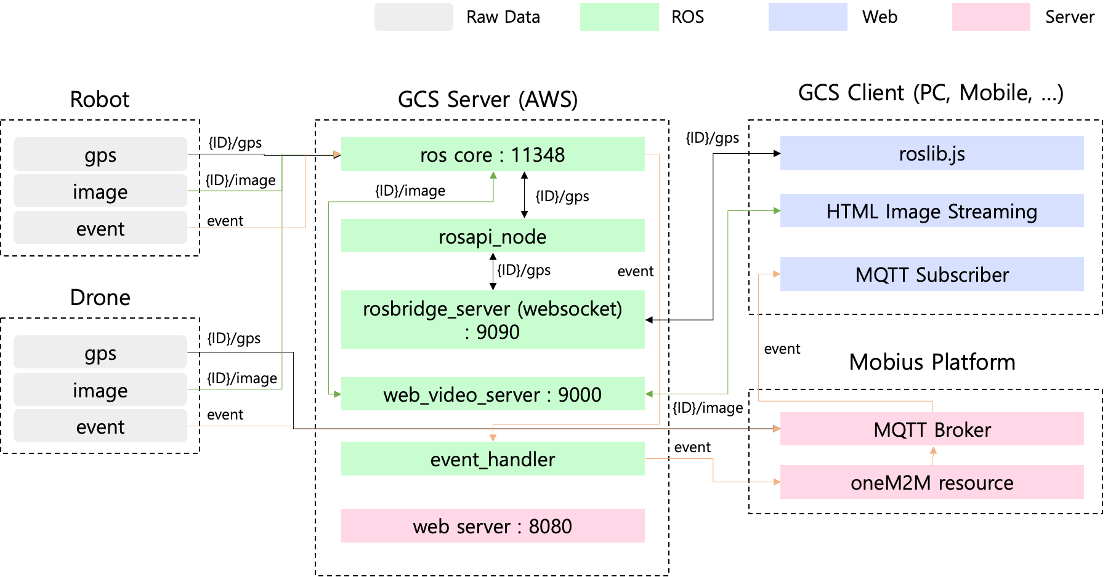
Drone-Robot Management System
The drone data is stored in Mobius (oneM2M platform) but robot data is collected through ROS
It should be better to have ROS-oneM2M interworking module (as IPE), so it can be re-used
Drone-Robot Management System Architecture

Slide 11
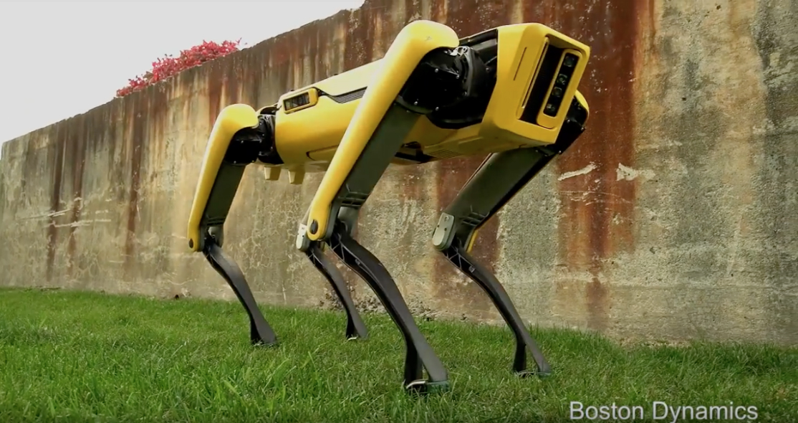


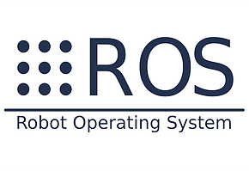


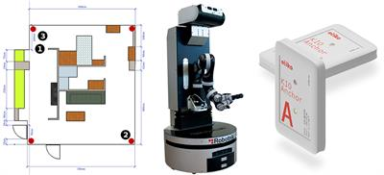
Overall Interworking Architecture
Introducing ROS-oneM2M interworking architecture
  Please note that the following contents are going to be published in the forum standard (IoTFS-0274, Internet of Things Forum) in December
ROS-oneM2M IPE translates ROS request to oneM2M protocol and vice versa.
Content Instance
Retrieval/Creation
ROS-oneM2M IPE
Service Call / Response
AE
CSE
Container Subscription /
Content Instance Creation
Topic Subscription /
Publish

Slide 12
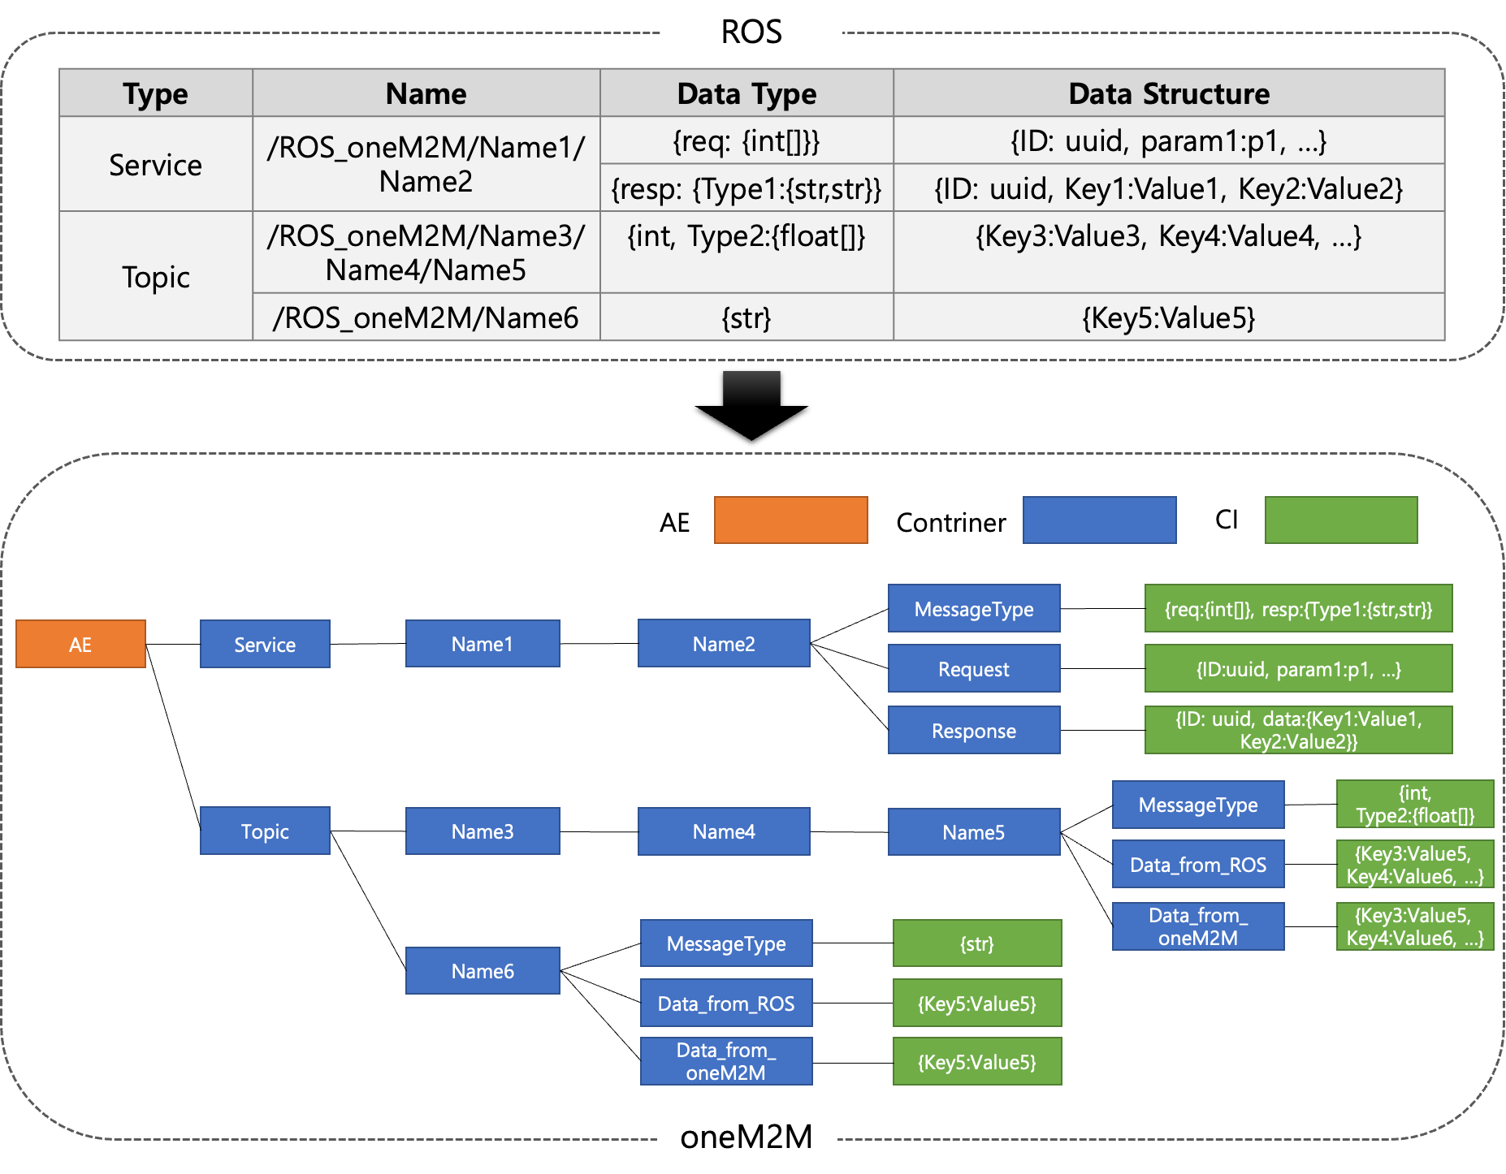
Data Model
ROS resources with ‘/ROS_oneM2M’ prefix are stored in oneM2M platform
  oneM2M container is generated according to ROS resource name’s hierarchy
  Service: message type, request, response container
  Topic: message type, data container
  Message type helps user to read data from ROS and write data to ROS
  Topic supports two-way communication whereas service supports only oneM2M→ROS

Slide 13
Initialization
oneM2M resource is generated at the beginning
ROS
ROS-oneM2M IPE
oneM2M AE
1
ROS Resource Information Request
2
Resource Information Response
3
oneM2M Resource Init
4
Container/CI Creation

Slide 14
Data Synchronization
When ROS resource changes, oneM2M resource is synchronized to reflect it
ROS
ROS-oneM2M IPE
oneM2M AE
1
ROS Resource Information Tracking
2
ROS Topic/Service Add/Remove
3
oneM2M Resource Synchronization
4
Container/CI
Creation/Remove

Slide 15
AE calls ROS Service
oneM2M call the ROS service and get response in asynchronous manner
ROS
ROS-oneM2M IPE
oneM2M AE
1
Request ID Generation
2
Register Request CI to Request Container
3
Parsing Request and Service Call
4
Response to Service Call
5
Make Response CI containing Request ID
6
Register Response CI to Response container
7
Check Response CI with Request ID

Slide 16
AE Subscribes ROS Topic
ROS-oneM2M IPE subscribes the ROS topic and register the data to oneM2M container
ROS
ROS-oneM2M IPE
oneM2M AE
1
Subscribe Data_from_ROS container
2
ROS Topic Subscribe
3
Message Publish
4
Message Retrieval
5
Register Data CI to Data_from_ROS container
6
Get Data

Slide 17
AE Sends Data to ROS
ROS-oneM2M IPE subscribes the ROS topic and register the data to oneM2M container
ROS
ROS-oneM2M IPE
oneM2M AE
1
Subscribe Topic
2
Subscribe Data_from_
oneM2M container
3
Register Data CI to Data_from_oneM2M container
4
Get Data
5
Publish Message
6
Message Retrieval

Slide 18
Conclusion
ROS-oneM2M interworking should be very useful when developing robot service cooperating with IoT infra
  Since IoT infra is very useful to widen the service area, robot and IoT infra cooperation is essential
  Providing a standard interworking method reduces development cost and increases interoperability
We may consider to have a new work item with deployed solutions already having
  Interworking architecture, protocols
  and also data model definitions with SDT
This could be a good item for oneM2M dissemination to other domains (e.g. delivery service, manufacturing)

Slide 19
Thank You for Listening

