Slide 1

SDS Status Report to TP62
Group Name: oneM2M SDS
Source: Peter Niblett, SeungMyeong Jeong, Wei Zhou
Meeting Date: 2023-12-04 to 2023-12-08

Slide 2
Summary
11 new CRs have been agreed for TS-0001, TS-0004 and TS-0022
11 agreed contributions are still pending waiting for Rel-5 specs to be started:
114 issues currently open, 72 have been closed
There has been renewed interest in TS-0020 (WebSocket) so the group has been looking at issues in the current TS.
The group also discussed NGSI-LD and made decisions on the CoAP option question
  See next slide
SeungMyeong has kindly agreed to become TS-0001 Rapporteur
SDS-2023-0227R06 | SDS 62 Document Allocation

Slide 3
CoAP options and IANA
Releases 2 to 4 will continue to map the Primitive Parameters to CoAP options as defined in TS-0008
We will prepare a CR for TS-0008 R5 to map all the primitive parameters into the message payload (apart from the To parameter which stays in the URI-Path option) and to specify the use of CoAP Fetch instead of CoAP Get.
This CR will permit a few frequently-used Parameters (e.g. RVI, ReqId and RSC) to be carried as CoAP options instead of being the in the payload. [This topic can be discussed further when reviewing the CR]
Release 5 implementations should be prepared to interoperate with R2, R3 and R4 implementations
  They should accept incoming requests with the oneM2M defined CoAP options in them, and they should respond in kind.
  When sending a request or a notification to a receiver that is R2, R3, R4 they should use the oneM2M options defined in that version of TS-0008
We will continue with IANA registration for the options that are in the current TS-0008, but tell the IANA experts that some of them will not be used in R5 onwards

Slide 4
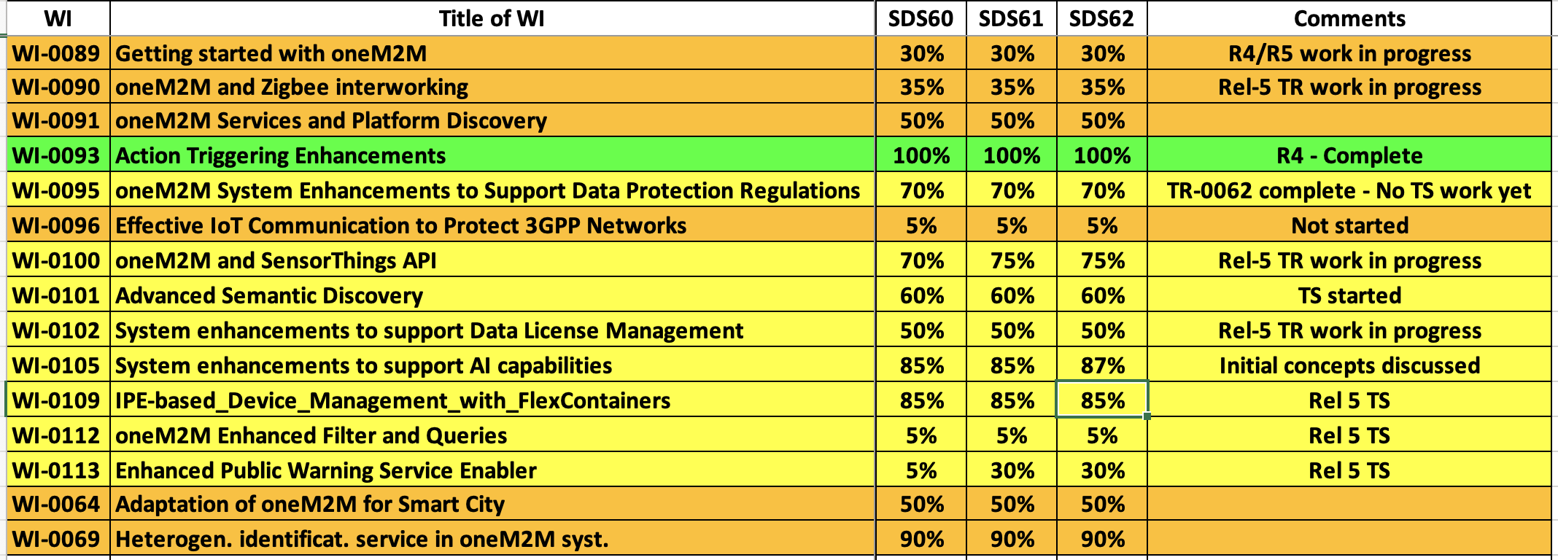
SDS WI Status
Complete
On track
Running behind schedule
Work has stalled

Slide 5
Rel-5 Progress
5 CRs have now been agreed for TS-0001 Rel 5.
CRs for TS-0004, TS-0022, TS-0026, TS-0033, TS-0034
  Will be added to CR packs when the new versions of the TSes are started
TR-0071 (AI enablement – stage 2) has progressed
  agreed on AI/ML model management capability

Slide 6
Items for Decision
CR Pack:
TS-0001 – TP-2023-0106 – 00-R2, 01-R3, 02-R4, 02-R5 = 5
TS-0004 – TP-2023-0107 – 00-R2, 02-R3, 02-R4, 00-R5 = 4
TS-0022 – TP-2023-0108 – 00-R2, 00-R3, 02-R4, 00-R5 = 2

Slide 7
Conference Calls
Meeting | Date | Time (UTC)
SDS 62.1 | Tue 19 Dec 2023 | 12:00-13:30
SDS 62.2 | Mon 15 Jan 2024 | 12:00-13:30
SDS 62.3 | Mon 29 Jan 2024 | 12:00-13:30
SDS 62.4 | Mon 5 Feb 2024 | 12:00-13:30

