Slide 1
Marcom Report to TP63
Bindoo Srivastava, Marcom Chair
26 February 2024

Slide 2
Outline
oneM2M Submission to NIST’s Public consultation on Smart City Strategy
Promoting oneM2M in Agritech space
TP hosting in Malaysia
Potential Speaking Opps – Edge Computing Tech Expo
Brochure
Call for MARCOM Chair and Vice chairs now open

Slide 3
oneM2M’s submission to NIST’s public consultation on their Smart City Strategy
NIST have issued a public consultation call on their Smart City Strategy, open till 1 Mar 2024.
Ken drafted a submission from oneM2M on the same – which was approved over email by TP Chair and SC.
The same is being submitted to NIST.

Slide 4

Promoting oneM2M in Agritech Space
An Executive Insight Interview with Manuel Gorius, Founder- Digisaar has been published on 21 Feb 2024.
A Sponsored LinkedIn Promotion Campaign to promote this interview is planned in the week of 26 February 2024
Refer oneM2M Promotions Tracker

Slide 5
oneM2M TP in Malaysia?
TSDSI is exploring interest from Malaysia for hosting a TP in the country
Expecting a response on the same mid week

Slide 6
Potential Speaking Opp.: Edge Computing Expos in CY’24
Edge Computing Expo is part of the TechEx brand which sees 7 co-located events, 700+ speakers, 30,000+ attendees, and some of the world’s leading brands as partners
Conferences in 2024:
5-6 June 2024 at the Santa Clara Convention Center, California – North America
1-2 October 2024 at the RAI in Amsterdam, Europe
Media partnership Enquiry received - exploring speaking slots in the above conferences

Slide 7
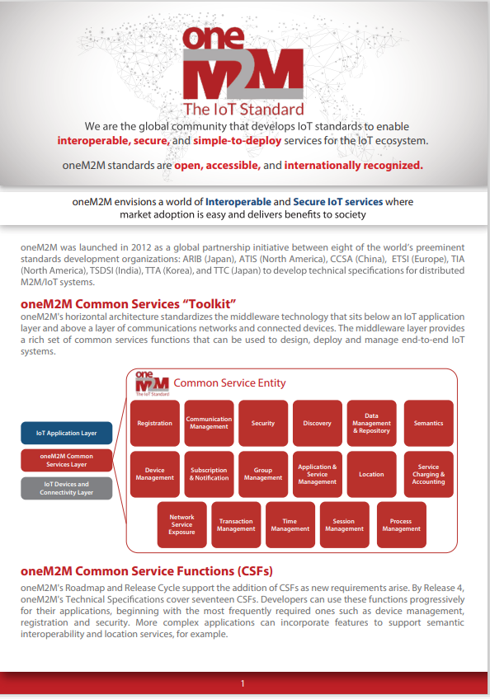
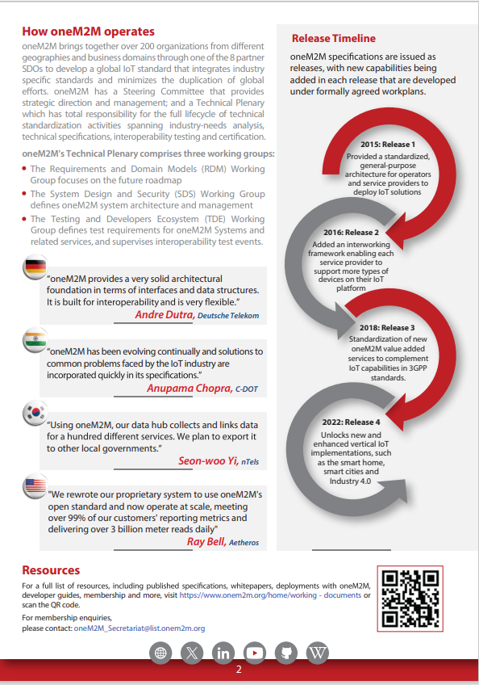
oneM2M Brochure
Being uploaded on the website

Slide 8
MARCOM leadership Positions open
MARCOM Chair position open through 12 March 2024. Please send your nominations to Ms Victoria Mitchell by is noon (UTC) on Tuesday, 12 March 2024
3 Vice Chair positions are also open

Slide 9






Thank You

