Slide 1






Once upon a time ... in ETSI STF 589
(subtitle renew oneM2M WI-101)
Luigi Liquori, Inria
Bob Flynn, Exacta
2024-02-2X

Slide 2
STF 589 funded by ETSI 2020-2022
INRIA
KETI
UPM
Exacta (B. Flynn)
JKC (J. Koss )
TIM
...

Slide 3
STF 589 funded by ETSI 2020-2022
4 STF Working Packages leads to 4 ETSI TR
  103714: Study for oneM2M; Discovery and Query use cases and requirements
  103715: Study for oneM2M; Discovery and Query solutions analysis & selection
  103716: Study for oneM2M; Discovery and Query solution(s) simulation and performance evaluation
  103717: Study for oneM2M; Discovery and Query specification development
~ 200+ pages ETSI documentation
~ 5K OMNeT++ simulation code available on ETSI github

Slide 4
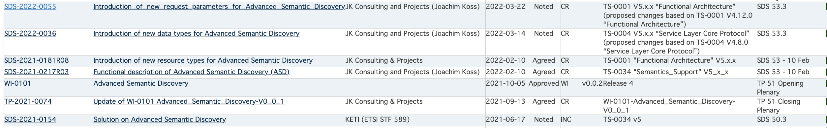
On oneM2M intranet
ASD presented in TP 45, then approved in TP 51, named WI 101
Since TP 54 stalled ...

Slide 5
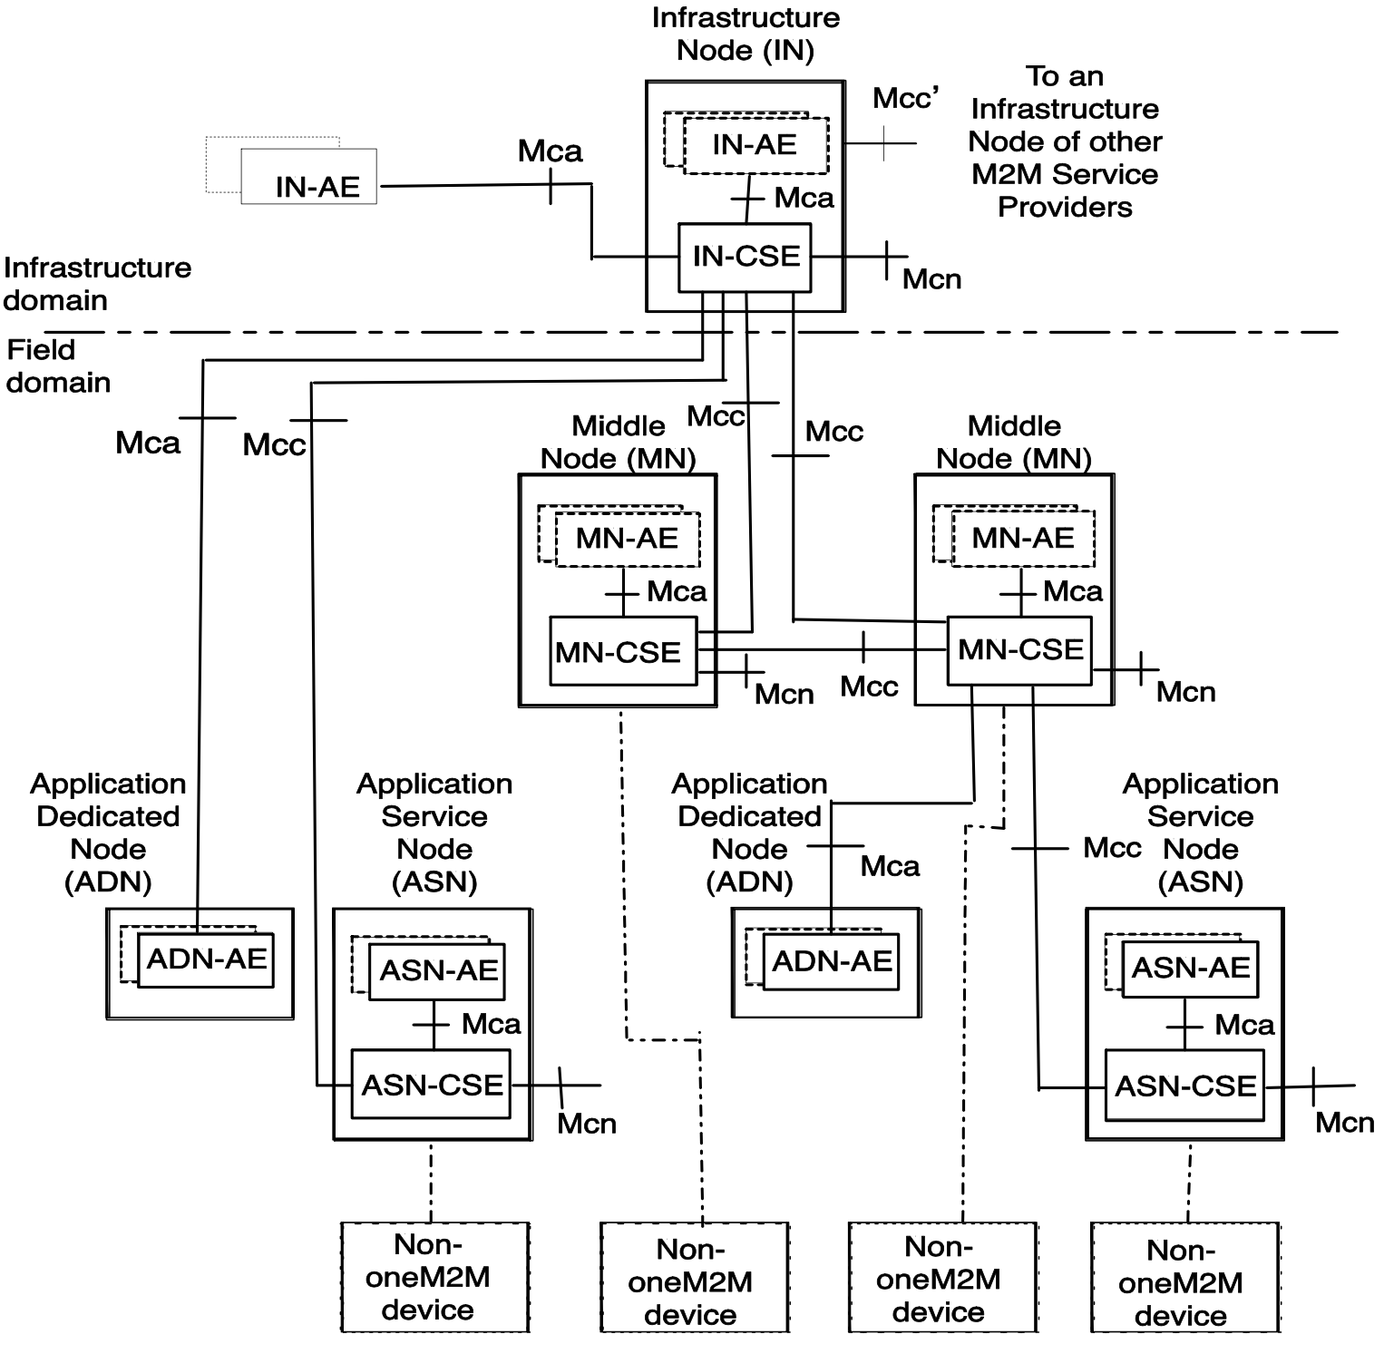
Semantic Discovery in oneM2M
Resources are typically Application Entities (AE)
Discovering resources according to Filter Criteria
Ontologies can be used as Filter Criteria
Forwarding of the request is very limited inside the tree-network of the infrastructure node (IN-CSE)

Slide 6
Scaling up to a Network of Infrastructure Nodes
Infrastructure nodes (IN-CSE) are interconnected via Mcc’ nodes
Discovery Forwarding now scale-up to Discovery Routing
Routing of the request is very limited inside the tree-network of the Infrastructure node (IN-CSE)

Slide 7
A simple use case that can be found in
TR 103714
AE_Smart_Energy
AE_Wearable
AE_eHealth
AE_Building_System
Notes:
Formal Graph Topologies to capture most common scenarios involving networks of M2MSP;
Formal Semantic Discovery Routing Mechanism (SDRM) to route a Semantic Query between M2MSP with exhaustivity/non exhaustivity constraints and iterative vs. recursive routing modality;
Formal Semantic Discovery Query Language (SDQL) to express a large type of queries;
Formal Semantic Resolution Query Mechanism (SRQM) necessary to reduce locally a complex query into a number of simpler queries.

Slide 8
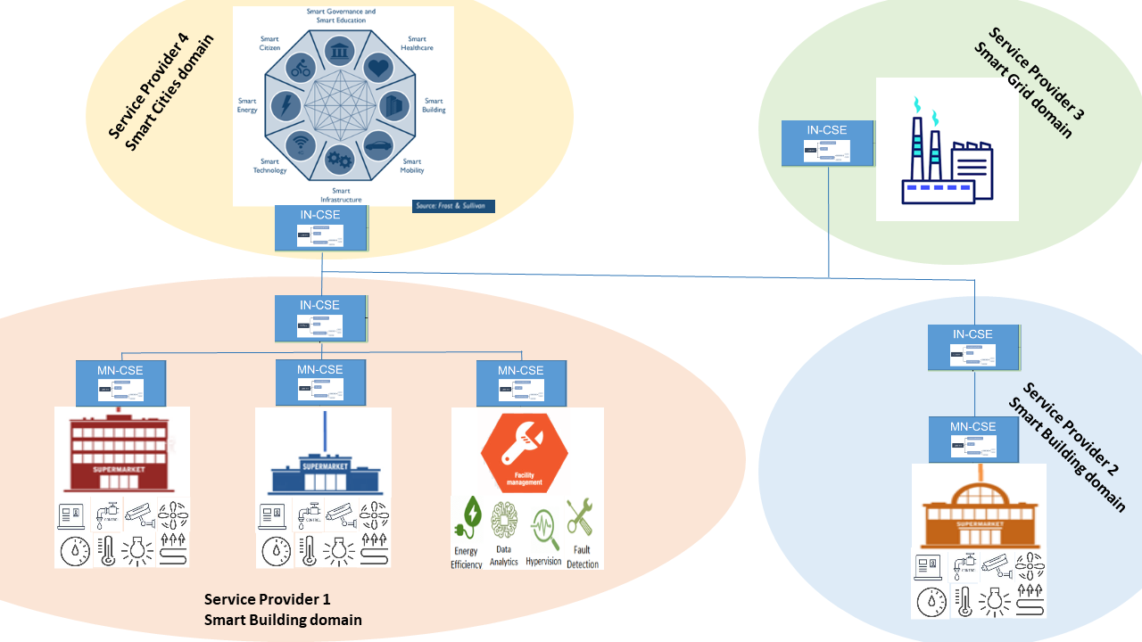
Another one in TR 103714
Notes:
Formal Graph Topologies to capture most common scenarios involving networks of M2MSP;
Formal Semantic Discovery Routing Mechanism (SDRM) to route a Semantic Query between M2MSP with exhaustivity/non exhaustivity constraints and iterative vs. recursive routing modality;
Formal Semantic Discovery Query Language (SDQL) to express a large type of queries;
Formal Semantic Resolution Query Mechanism (SRQM) necessary to reduce locally a complex query into a number of simpler queries.

Slide 9
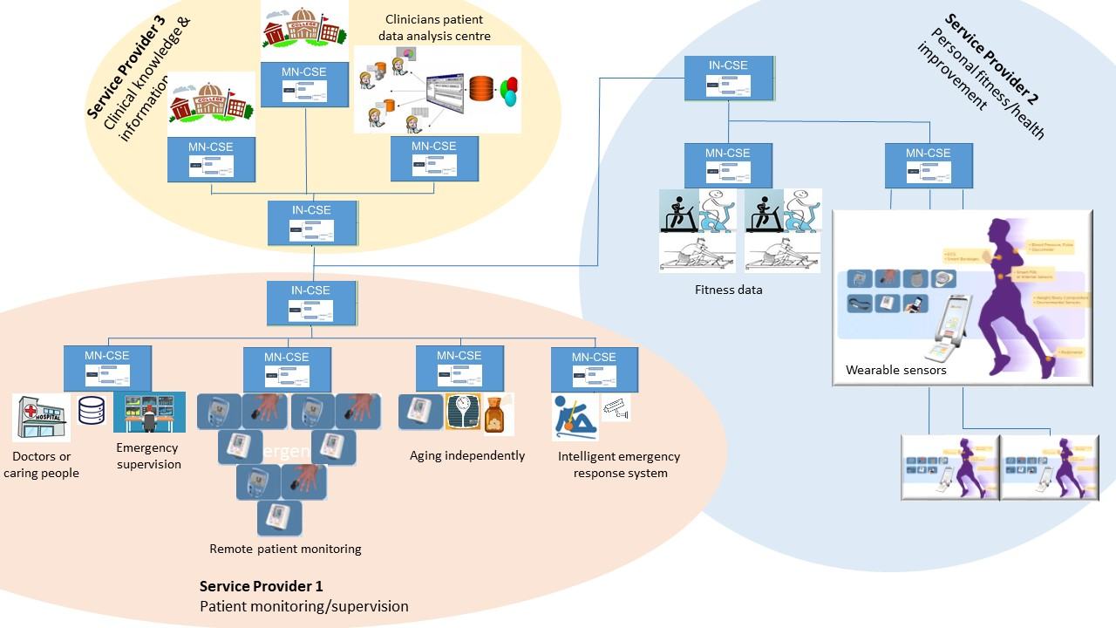
Another one in TR 103714
Notes:
Formal Graph Topologies to capture most common scenarios involving networks of M2MSP;
Formal Semantic Discovery Routing Mechanism (SDRM) to route a Semantic Query between M2MSP with exhaustivity/non exhaustivity constraints and iterative vs. recursive routing modality;
Formal Semantic Discovery Query Language (SDQL) to express a large type of queries;
Formal Semantic Resolution Query Mechanism (SRQM) necessary to reduce locally a complex query into a number of simpler queries.

Slide 10
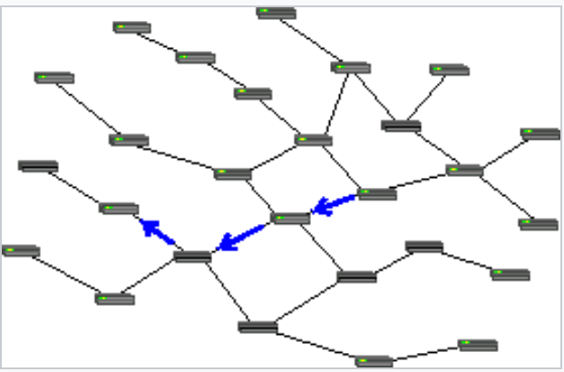
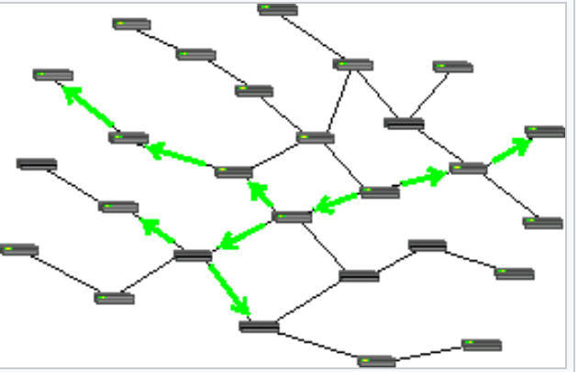
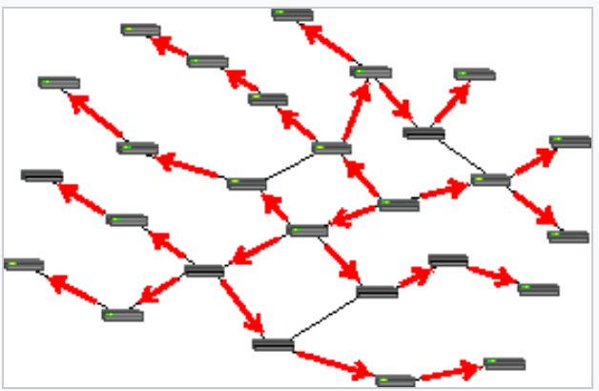
Routing: as simple as in Wikipedia TR 103715
Routing : select a path across networks (read CSE) and s/r packets/messages
Many kind of routing: circuit switching (old telephone), message switching (ASD), packet switching (Internet)
Message = control information + payload
Message routing relaying of packets from one network segment to another
Many kind of routing: unicast, multicast (ASD), broadcast

Slide 11
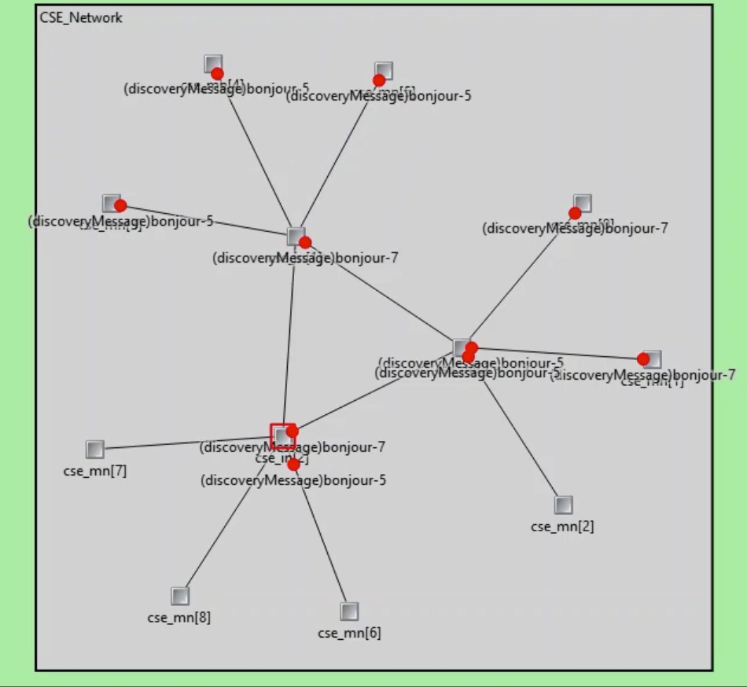
OMNeT++ ASD routing TR 103716

Slide 12
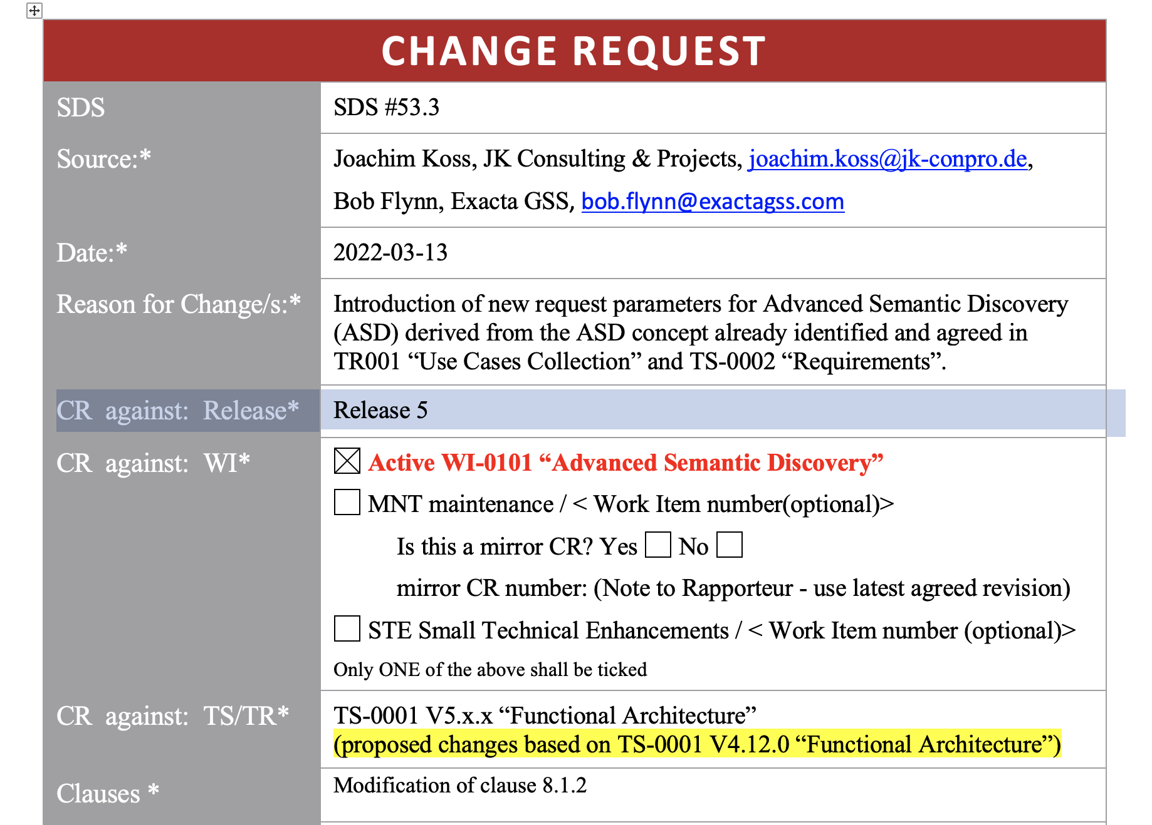
ASD routing as per WI 101 TR 103716

Slide 13
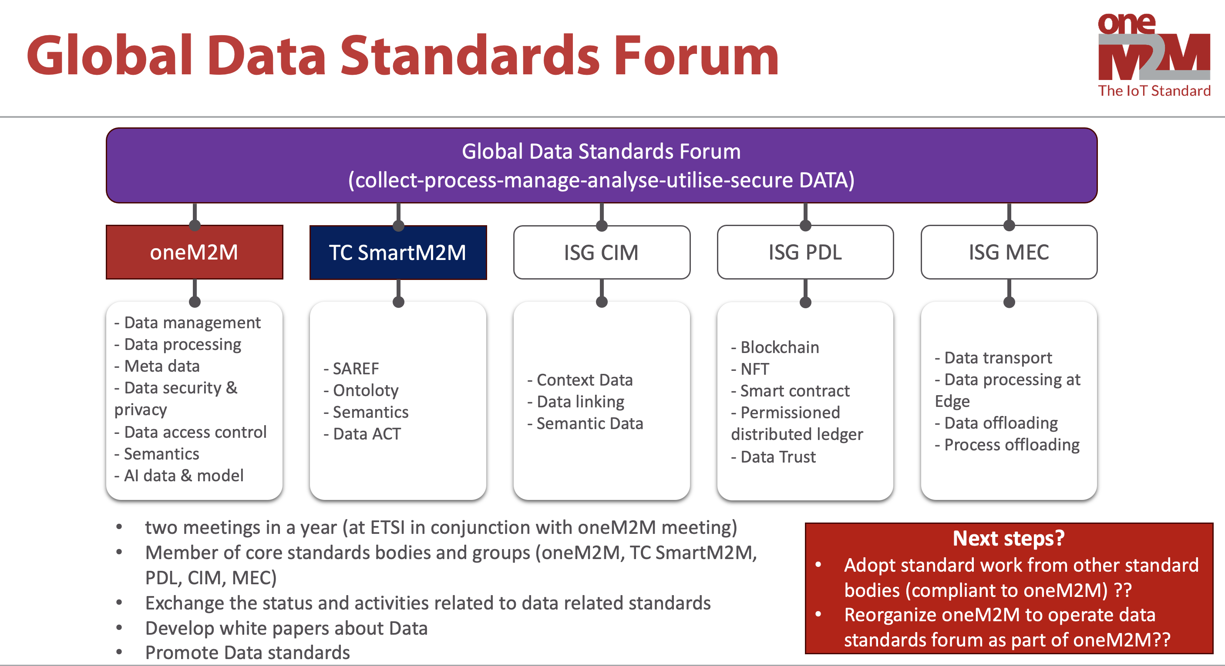
Consideration of Data-centric Standards Activities (JS. Song, KETI)

Slide 14
WI 101 would affect at least the following
TR 0001 Use cases collections
TS 0002 Requirements
TS 0001 Functional architecture
TS 0034 Semantic support

Slide 15
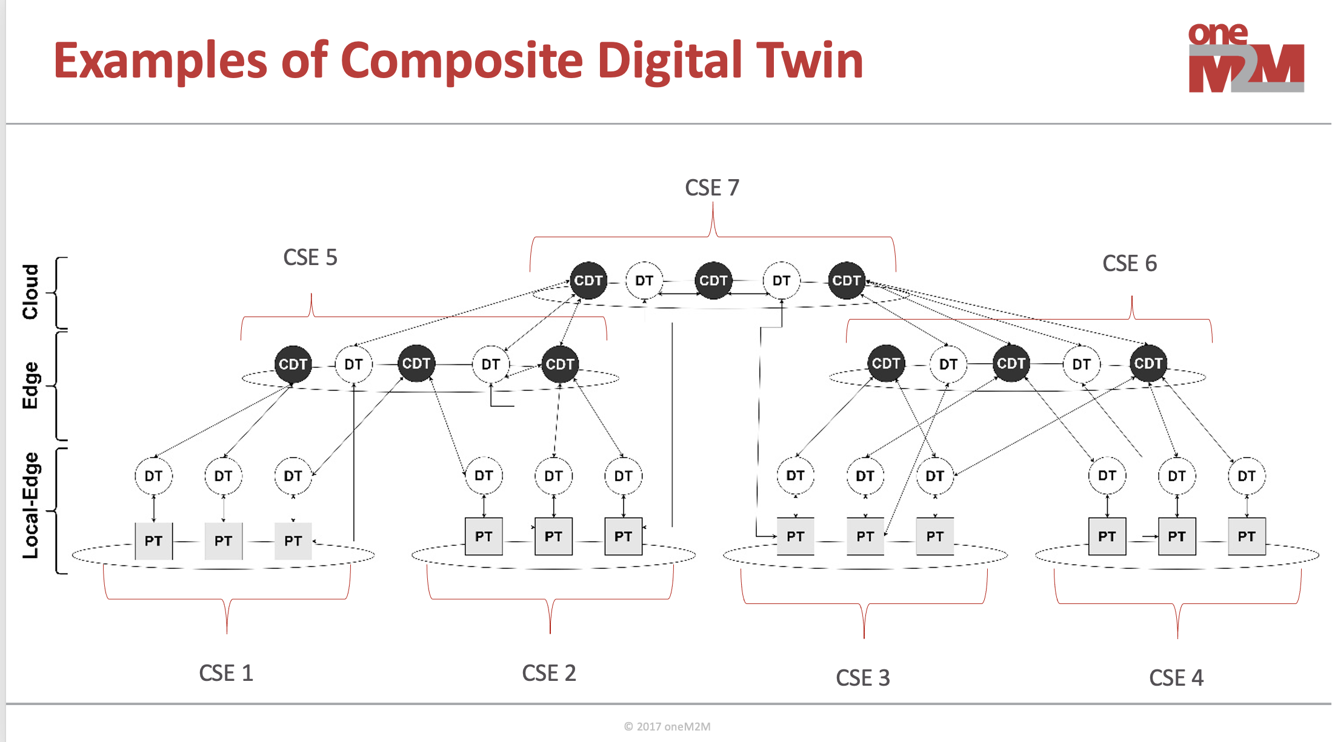
Support for Composite Digital Twins (B. Flynn)

Slide 16
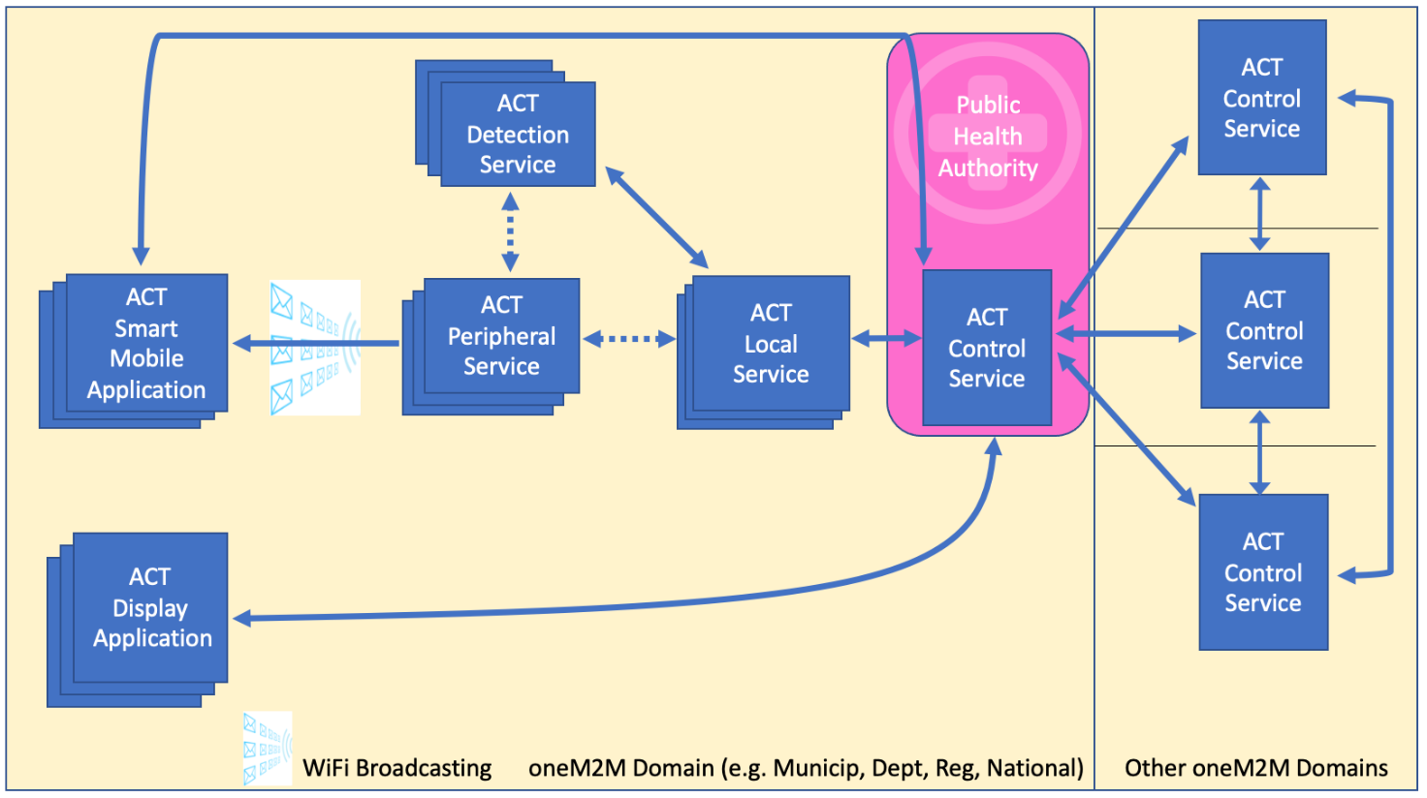
Asynchronous Contact Tracing (TS 103757)

Slide 17
Thank You

