Slide 1






oneM2M Releases
Definitions and Process
A Brief Introduction / Reminder
Roland Hechwartner, TP Chair
2025-03-31

Slide 2
Why this Introduction / Reminder?
In oneM2M we are deciding on the final milestone plan for release 5 and will soon start the next release – release 6
  What is the process?
Discussions during the last TP meetings on clarifications of the process steps: approval of a release, ratification and publication by partners.
  How and where are these process steps defined?
oneM2M Release 2A was transposed by ITU-T. Stron ginterest by TSDSI and TTA to transpose oneM2M release 3 and 4
  Which documents were transposed to ITU-T?
  How to proceed with release 3 and release 4 and who takes the lead?

Slide 3


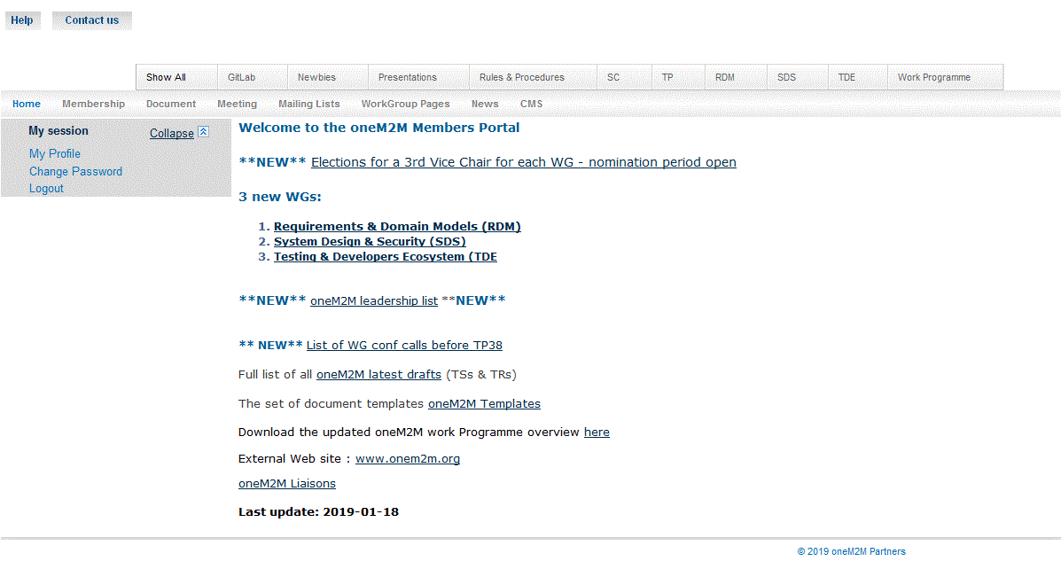
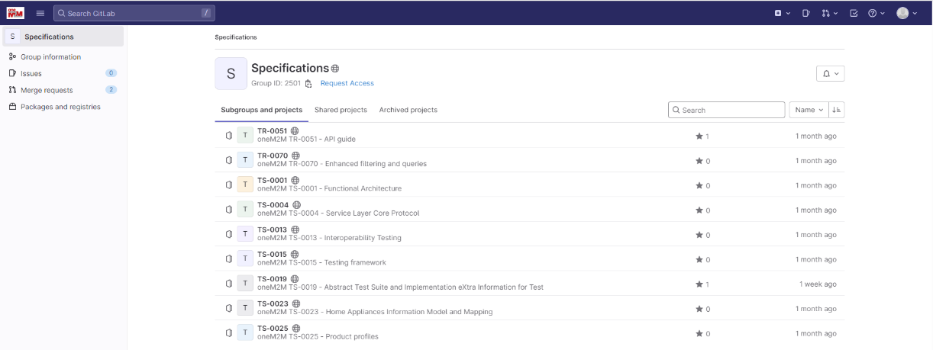
How to work in oneM2M?
drafting rules
work item
Working Groups
Detailed information can be found
on the public webpage http://onem2m.org/
on the members portal http://member.onem2m.org/WebSite/homepage.aspx
Meetings
documents
meeting registration
working procedures
voting list
Contributions
voting rights
templates
Rules and procedures
rapporteurs’ checklist
permanent documents
temporary documents
mailing list
On oneM2M GitLab: https://git.onem2m.org/specifications

Slide 4
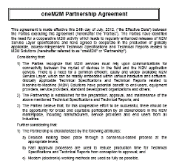
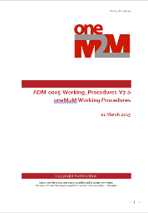

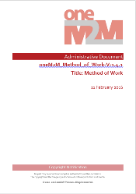
Rules and Procedures (I)
source: https://member.onem2m.org/website/Procs.aspx

Slide 5



Rules and Procedures (II)
Steering Committee – Methods and Processes Committee
  oneM2M Partnership Agreement ADM-0002-oneM2M Partnership Agreement V3.0
    Purpose, Scope, Objectives, Intellectual Property Rights and Copyright Ownership
    undertakings and rights to participate in the collaboration
  Working Procedures ADM-0005-Working Procedures V8.0
    Structure, SC, TP, WGs, Work Programme and Technical Coordination, deliverables, external relations, guidance on meeting organization, voting …
  oneM2M Drafting Rules ADM-0003-oneM2M Drafting Rules V1.0
    applicable to Technical Specifications and Technical Reports that are delivered to the Partners Type 1 for potential transposition
    Use of normative language Shall, May, Should
Technical Plenary – Method of Work Committee
  Method of Work ADM-0004-Method of Work V1.4.1
    Handling Deliverables, Deliverables and Release Management, conducting a meeting, Work Items and CR through Releases: Guidelines, Test Event Requirements, Technical Forum on the oneM2M website, Meeting Guidelines, Annex A - Rapporteurs Checklist for Draft Deliverables

Slide 6
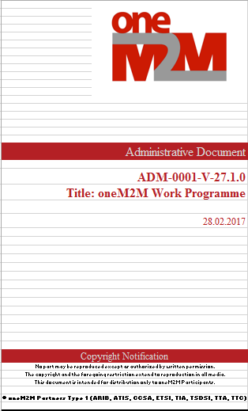
Technical Plenary Approves
Work Items
  documented record of a specific technical activity
  Technical scope of output deliverables (TSs, TRs) and their impact
  Four supporting companies (minimum)
  Rapporteur, may be assisted by editor(s) as needed
  TS and TR development cycle
    Milestones defined in WI: start, change control, freeze, approval
Technical Specifications / Technical Reports => Release
  Once approved only the change control applies to progress TSs, TRs
  A set of deliverables (TSs, TRs) which is technically consistent at the time of the freeze is called a Release
    A new release is triggered by approval of a CR to the new release
  Release freeze
    A Technical Plenary (TP) action on a Release, restricting further technical input to essential changes and corrections
and RATIFIES
  the approved deliverables and/ or releases to be made available to the Partners Type1 for publication
Work Programme: documented record of all technical activities
Source: ADM-0004-Method_of_work-V1_4_1

Slide 7
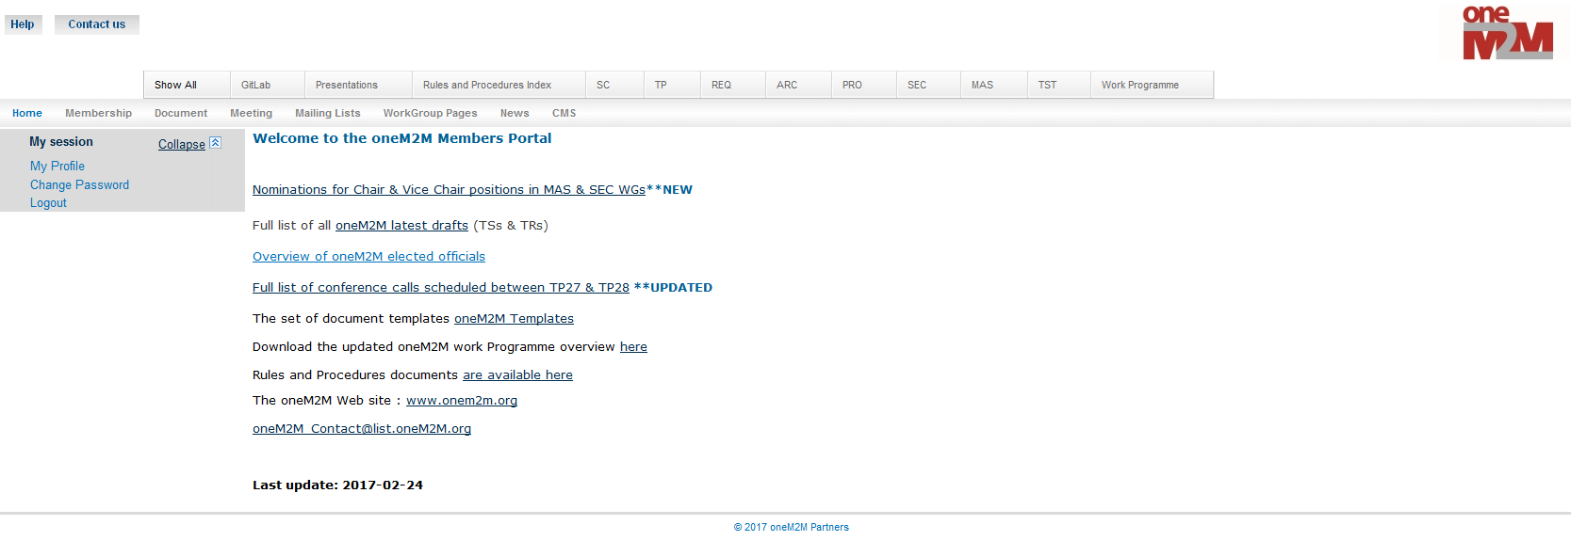


Development of Deliverables
Temporary documents
  Agenda, Input Contribution, Invitation, Liaison Statement, Minutes, Status Report
Permanent documents
  Work Items (WI), Technical Reports (TR), Technical Specifications (TS),
  Administrative (ADM) - the only permanent document which can be created in a Working Group
Change Requests (CR)
  Contribution that suggests a change to an existing draft or published deliverable
Document Status
  Draft, Noted, Withdrawn, Agreed, Approved (the latter for permanent documents only)
    NOTE: Document dispositions are only updated by the Secretariat
    Revisions
use Gitlab issue tracker
use Gitlab to develop Specs

Slide 8
Method of Work
Deliverables Management
ADM-0004-Method of Work V1.4.1
Step 7 Ratification of a deliverable
Ratification means a deliverable is available for publication by the partners (type 1)
TP determines that an approved deliverable is a candidate for ratification.
Based on both content and timing considerations, the TP by consensus may declare the Deliverable Ratified.
A deliverable will be considered ratified following checks for IPR status for external references and a consistency check with other deliverables.
Following ratification, the deliverable is considered finalized and available to the Partners for publication.

Slide 9
Method of Work
Release Management
ADM-0004-Method of Work V1.4.1
Step 0: first release
TP determines that the technical content of a Release is complete and freeze that Release. The decision of freezing a Release could be based on both content and timing considerations.
When all the deliverables of the Release are TP approved, based on both content and timing considerations, the TP by consensus may declare the Release as Ratified. Following ratification, the Release is then considered available to the Partners for publication.
Step 1 : Open of a subsequent release:
A new release is opened by the approval of first CR targeting the new release. Such CR should target a deliverable that it is in TP approved state. The new release may be open before the previous one is ratified.
Each CR shall clearly indicate if is intended to be applied to a new release (in addition to the version of the deliverable that is targeted).
For each deliverable, the first CR approved by the TP and intended to be applied to the new release, generates a version of the deliverable belonging to the indicated new release. The new version is in TP Approved state. Both version are subject to Change Control process.
The Working Group and Technical Plenary may determine that the technical content of a deliverable in the release is complete and may freeze the deliverable for technical input.
The Technical Plenary may determine that the technical content of a Release is complete and decide to freeze the Release.
Based on both content and timing considerations, the TP by consensus may declare the Release ratified. Following ratification, the Release is then considered finalized and available to the Partners for publication.

Slide 10
Transpositions to other SSO/SDO
Documents of oneM2M Release 2A transposed by ITU-T SG20

Slide 11
ITU-T SG20 Transposed Documents
ITU-T SG 20: Y.4500.x series |  | oneM2M version
Y.4500.1 | oneM2M - Functional architecture
Y.4500.2 | oneM2M - Requirements
Y.4500.3 | oneM2M - Security solutions
Y.4500.4 | oneM2M - Service layer core protocol specification
Y.4500.5 | oneM2M management enablement (OMA)
Y.4500.6 | oneM2M management enablement (BBF)
Y.4500.8 | oneM2M - CoAP protocol binding
Y.4500.9 | oneM2M - HTTP protocol binding
Y.4500.10 | oneM2M - MQTT protocol binding
Y.4500.11 | oneM2M - Common terminology
Y.4500.12 | oneM2M base ontology
Y.4500.13 | oneM2M - Interoperability testing
Y.4500.14 | oneM2M - LwM2M interworking
Y.4500.15 | oneM2M - Testing framework
Y.4500.20 | oneM2M - WebSocket protocol binding
Y.4500.22 | oneM2M - Field device configuration
Y.4500.23 | oneM2M - Home appliances information model and mapping
Y.4500.32 | oneM2M - MAF and MEF interface specification

Slide 12
Transposition to ITU-T
Next Steps - Discussion
Define next steps in oneM2M for the transposition
  Clarify the how, what and who
    transposition process?
    time and resource planning?
    volunteers?
  Initial contact to ITU-T to kick off the process
Possible accompanying document:
  TR-0056-Summary_of_Differences_between_Rel-2A_&_Rel-3-V0_2_0
Anything else?

Slide 13
Transposition to ITU-T
Next Steps - Clarify the How, What and Who
Define next steps in oneM2M for the transposition
  List of candidate TSs for Release 3 and Release 4
  Transposition process: Submit
      an LS accompanied by
      A.25 per each transposed TSs and
      A.1 per each “new” TSs
  Resources –Volunteers for preparing and contributing the oneM2M input
    ?
  Tentative Timeline
    TP#69 - Initial discussion and action item plan
    Between TP69 -> TP70 – schedule one or two interim webmeetings to check progress
    TP#70 – finalize input and agree LS and content package / send to ITU-T SG20
    TP#71 – revisions if required
    Sep 13 ITU-T SG20 meeting

