Slide 1

SDS Status Report to TP70
Group Name: oneM2M SDS
Source: Peter Niblett, SeungMyeong Jeong, Wei Zhou
Meeting Date: 2025-06-23 to 2025-06-27

Slide 2
Summary
TS-0041 / WI 100 (SensorThings) has been completed
  Final baseline will be created and sent to editHelp!
TS-0022 and TR-0079 have been converted to Markdown
Two new work items - WI-0120 (STF685) and WI-0122 (MCP)
Made progress on WI-105 (AI/ML), WI-0120 and WI-121 (ROS)
1 new CR agreed for TS-0004
Discussions on Service Subscription management details
Copyright statements have been updated to meet new policy
132 issues currently open, 92 have been closed

Slide 3
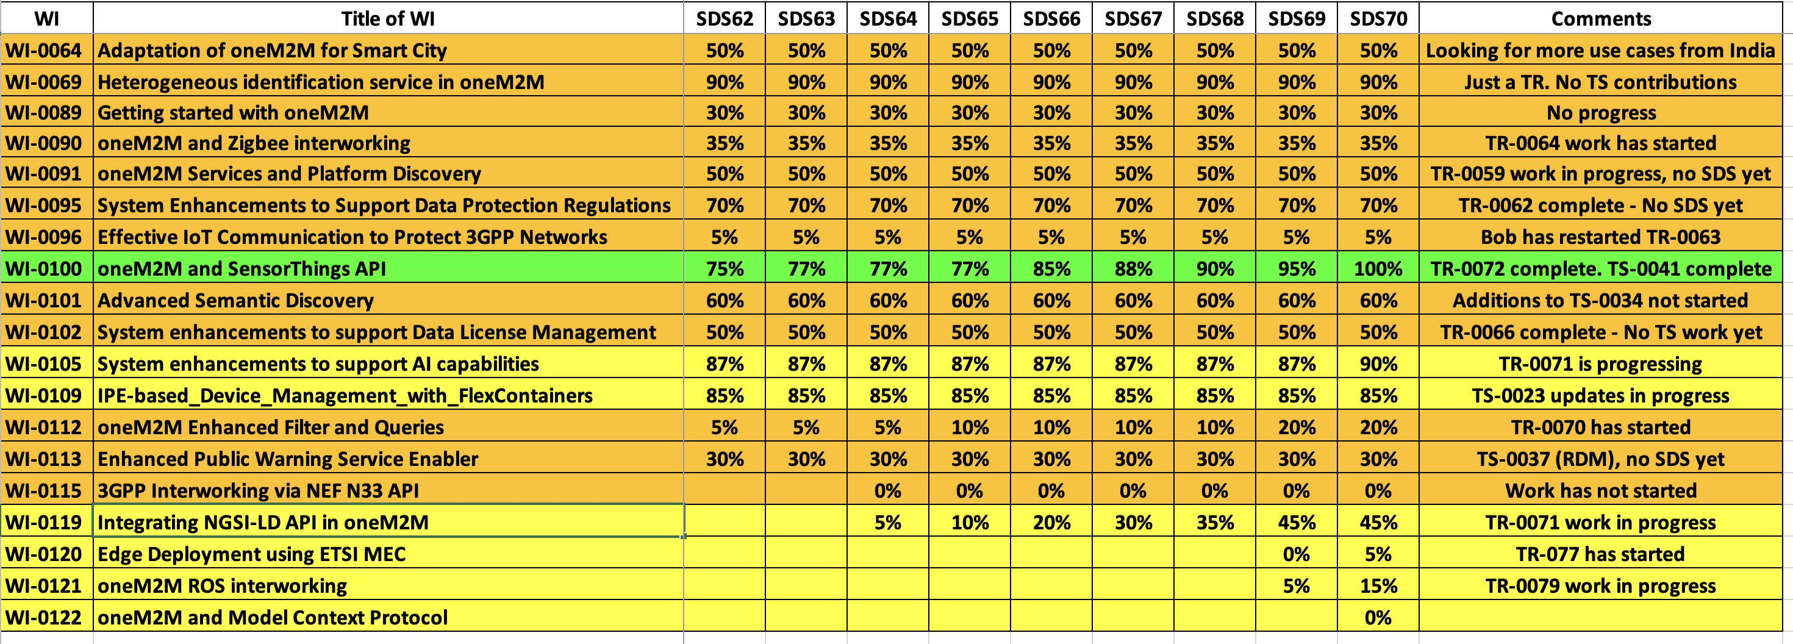
SDS WI Status
Complete
On track
Running behind schedule
Work has stalled

Slide 4
Items for Decision
CR Packs:
TS-0004 – TP-2025-0056 – 00-R2, 00-R3, 01-R4, 00-R5 = 1

Slide 5
Conference Calls
Meeting | Date | Time (UTC)
SDS 70.1 | Mon 7 July 2025 | 09:00-10:30
SDS 70.2 | Mon 21 July 2025 | 09:00-10:30
SDS 70.3 | Mon 4 Aug 2025 | 09:00-10:30
Subject to confirmation

