Slide 1

SDS Status Report to TP72
Group Name: oneM2M SDS
Source: Peter Niblett, SeungMyeong Jeong, Wei Zhou
Meeting Date: 2025-11-10 to 2025-11-13

Slide 2
Summary
WI 120 – STF65 is progressing
  TR-0080 has been completed
  Work is continuing on TR-0077
  A new TS (for MEC-IPE) has been added to the WI
We have agreed directions for enhancing attribute announcement and editing of list attributes.
Progress on WI-0105 (AI enablement) and WI-0122 (MCP)
3 new CRs agreed on TS-0001, TS-0004, TS-0010
141 issues currently open, 92 have been closed

Slide 3
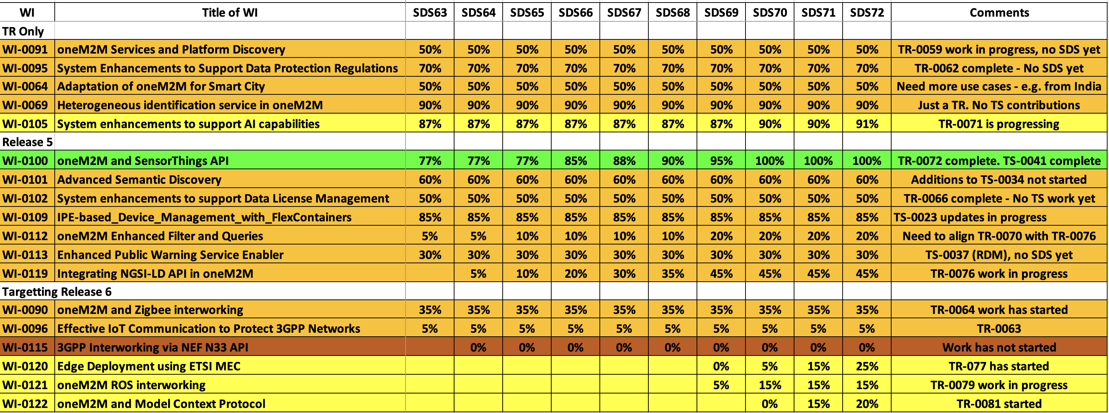
SDS WI Status
Complete
On track
Running behind schedule
Work has stalled

Slide 4
Items for Decision
Approve CR Packs:
TS-0001 – TP-2025-0093 – 00-R2, 00-R3, 01-R4, 01-R5 = 1
TS-0004 – TP-2025-0094 – 00-R2, 00-R3, 00-R4, 01-R5 = 1
TS-0010 – TP-2025-0095 – 00-R2, 00-R3, 01-R4, 00-R5 = 1

Slide 5
Conference Calls
Meeting | Date | Time (UTC)
SDS 72.1 | Mon 24 Nov 2025 | 11:00-12:30
SDS 72.2 | Mon 8 Dec 2025 | 11:00-12:30
SDS 72.3 | Mon 15 Dec 2025 | 11:00-12:30
Subject to confirmation

