Slide 1

Semantics interop event checking interest of oneM2M members to support a first interop event
Group Name: TP
Source: Philippe Cousin, Mengxuan Zhao Easy Global Market
Meeting Date: <2016-10-17>

Slide 2
Importance of semantics interoperability
Internet of Things (IoT) features a tremendously large number of diverse devices and resources that report resource status, provide observations and measurements, and communicate with other resources or even applications. The distributed and heterogeneous nature of the IoT makes interoperability among “Things” a challenging task and necessitates techniques that can facilitate automated machine processing. The use of semantic technologies, in particular ontologies, for domain modelling and knowledge representation has been seen as a promising approach to address these challenges.
oneM2M is active in this domain through MAS
Semantic interoperability is the key topic of the AIOTI WG3 on standardisation

Slide 3
oneM2M ontologies maturing
Availability of oneM2M base ontology (TS-0012)
Availability of other important related ontologies where mapping is in progress
  W3C SSN
  ETSI SAREF
  EU FIESTA , other ones ..
Some data models available which could also be addressed: DCAT
Time to help implementing and checking conformity to specs

Slide 4
Call for support of an oneM2M semantic interop event (before or after spring EU oneM2M meeting)
oneM2M has organised several interop events but not in semantic area
Semantic area is also important
One interop event can be organised with a first « low profile » event to start progressing the matter of semantic interoperability
Even can be a mixed of tutorial to understand the oneM2M ontology and technical part to check conformity to oneM2M ontology
Interoperability with other semantics from other parties ( eg IIC) can be adressed
EGM can provide its « ontology validator » as one of the tool to help checking (http://www.eglobalmark.com/white-paper-flexible-approach-semantic-validation-context-internet-things/
Some experience in the matters already gained in 2 past semantic interop events (http://www.probe-it.eu/?p=1305 ; http://www.probe-it.eu/?p=1106

Slide 5
Check members interest for a first (low profile) interop event
An event can be organised 2-3 days before or after the oneM2M#28 , 27-31 march 2017
Can run 2-3 days over the week end ( eg 24-26 March or 1-3 April)
Can be organised also with « tutorials »
EGM also thanks to the EU projects FIESTA (http://fiesta-iot.eu/ ) -, FESTIVAL (http://www.festival-project.eu/ ) WISE-IoT (www.wise-iot.eu ) which can provide some support and tools

Slide 6
Some ideas for the event
Tutorial/discussion:
  Tutorial on oneM2M base ontology or SAREF (if needed)
  Discussions on data modelling and representation, specific sensor data exchange and interoperability methods
Interoperability event part : From preparation organized prior to the events, participants would:
  Validate ontologies against TS0012 (using ontology validator)
  Try to understand ontologies or semantically annotated data sets from other project’s environment, leading to demonstrate some level of semantic “interoperability”.
  Check Interoperability through common understanding can be demonstrated at semantic level (semantic matching) or data level (data aggregation)
  Exchange experience, built ontologies, adapt data to a given data model/schema

Slide 7
Introduction to ontology validator
Group Name: TP
Source: Mengxuan Zhao, Easy Global Market, mengxuan.zhao@eglobalmark.com
Meeting Date: 2016-10-17~21 @ TP#25

Slide 8
Use case in oneM2M
Check ontology XYZ (ontology validation)
Check semantic descriptor (annotation validation)

Slide 9
Basic aspects to be validated on semantic information
Lexical validation
  Ill-formed RDF serialization format (XML, JSON, etc.)
Syntactic validation
  Untyped resources and literal
  Ill-formed URIs and language tags on literals
  Problematic prefix namespaces
  Unknown properties and classes
Semantic validation
  Inheritance relationships for classes and properties
  Consistency of classes and individuals

Slide 10
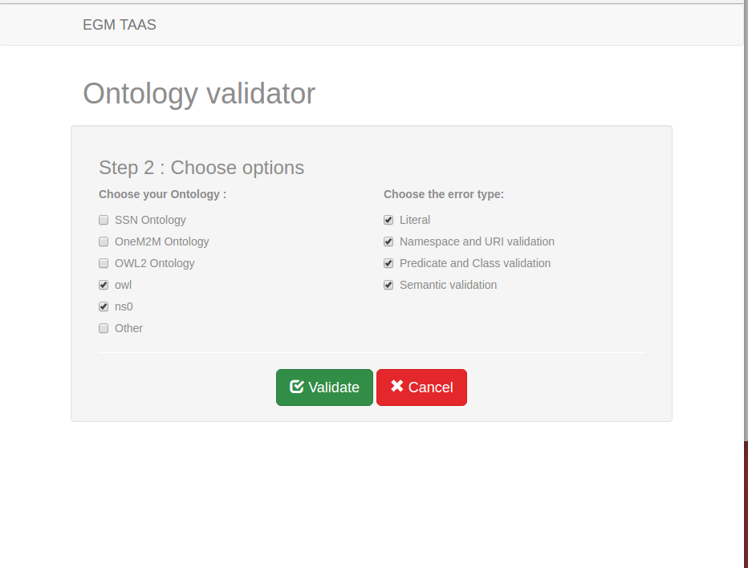
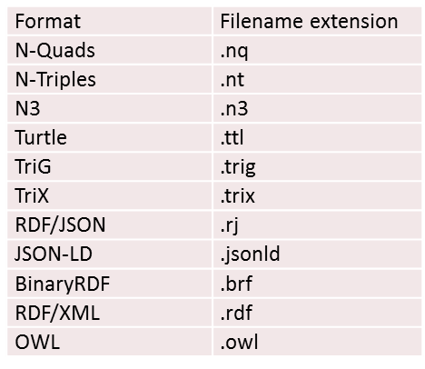
Popular reference ontologies are integrated in the tool
Multiple serialization formats supported
Choose the types of validation to be performed

Slide 11
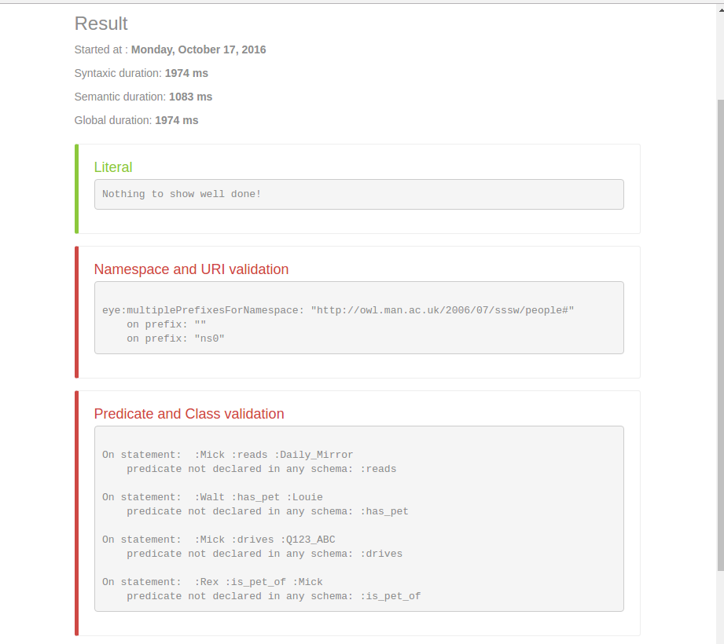
Errors categorized according to checked validation option by user

Slide 12
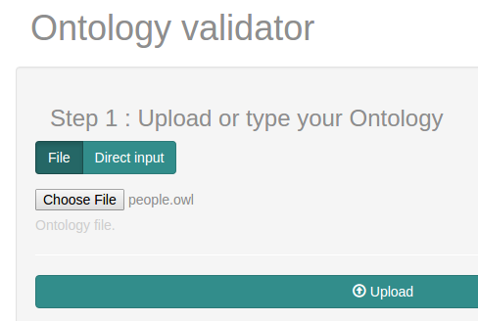
Summary
Web-based
Upload or text-based input
Popular formats supported
Popular reference ontologies available
Additional reference ontology automatic detection
Customize validation option
Detailed report regrouping errors by their nature
All functions available in M2M approach

