Slide 1
editHelp! service
Presented by Antoinette van Tricht for oneM2M

Slide 2
What is editHelp!?
editHelp! is part of the Document Production Centre team (DPC) in the ETSI Operations division (OPS)
There are currently 7 editors and 1 director in the DPC processing team and we share a common editHelp! mailbox.
There is also 1 Algorithms and Codes administrator.
We aim to provide an efficient and extensive service to the ETSI Technical Bodies and ETSI Paternship Projects which require prompt editing and document management support.

Slide 3
What do we do?
We provide editing assistance by phone, e-mail and on-line via the editHelp! website.
Editorial processing of deliverables to ensure they comply with the ETSI or oneM2M or 3GPP Drafting Rules.
When requested, we organise specific trainings and/or presentations for rapporteurs and experts.

Slide 4
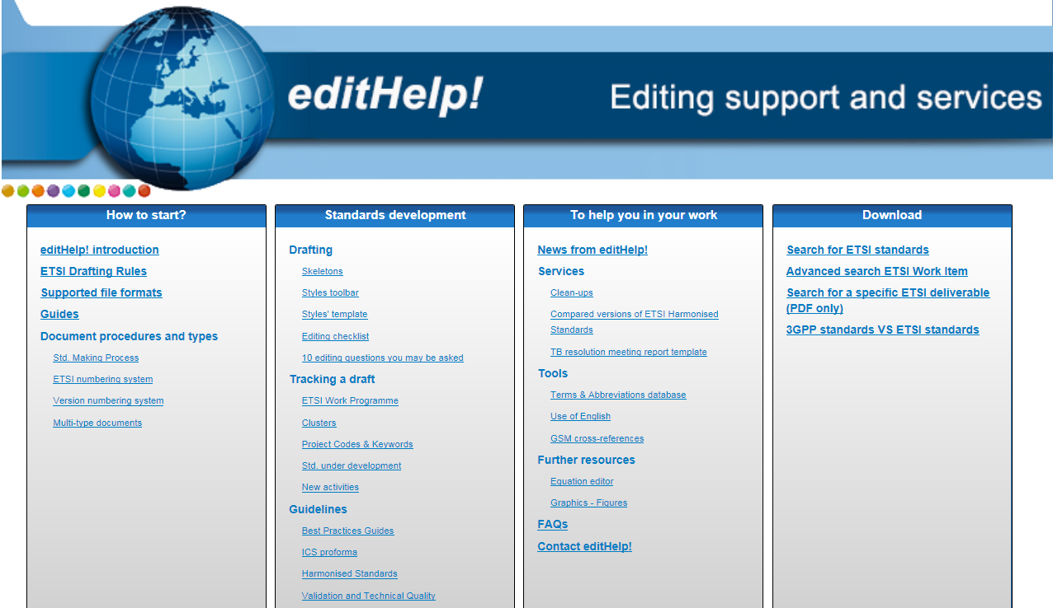
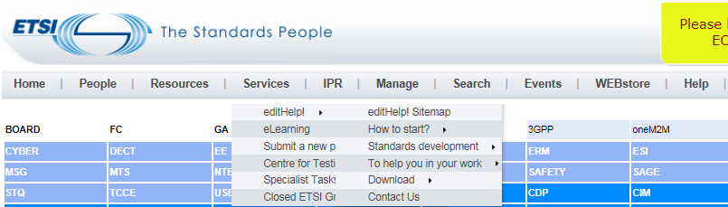
Where to find editHelp!?
https://portal.etsi.org/Services/editHelp!.aspx

Slide 5
Start drafting

Slide 6
oneM2M Drafting Rules
The oneM2M Drafting Rules are available at http://www.onem2m.org/images/files/oneM2M-Drafting-Rules.pdf
  The oneM2M Drafting Rules will guide you in what you can or cannot do when you draft a oneM2M deliverable.

Slide 7
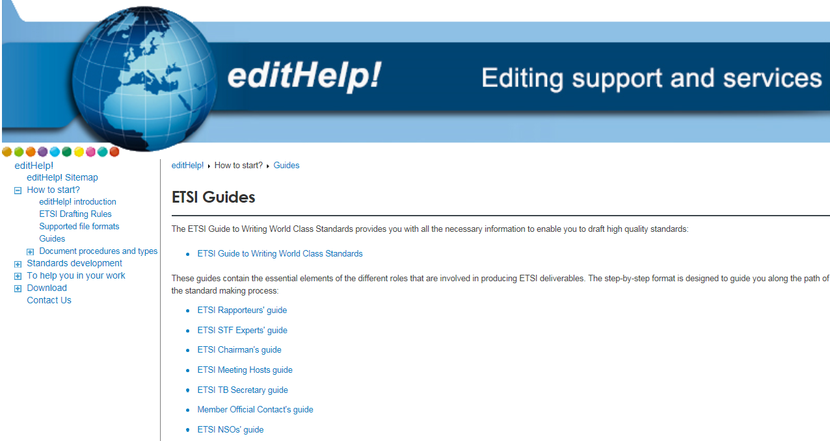
ETSI writing World Class Standards
Available on the editHelp! website, the ETSI Writing World Class Standards guide which will help you during the drafting of your document.
  Be more proficient by using this guide as an easy reference when writing your document(s).

Slide 8
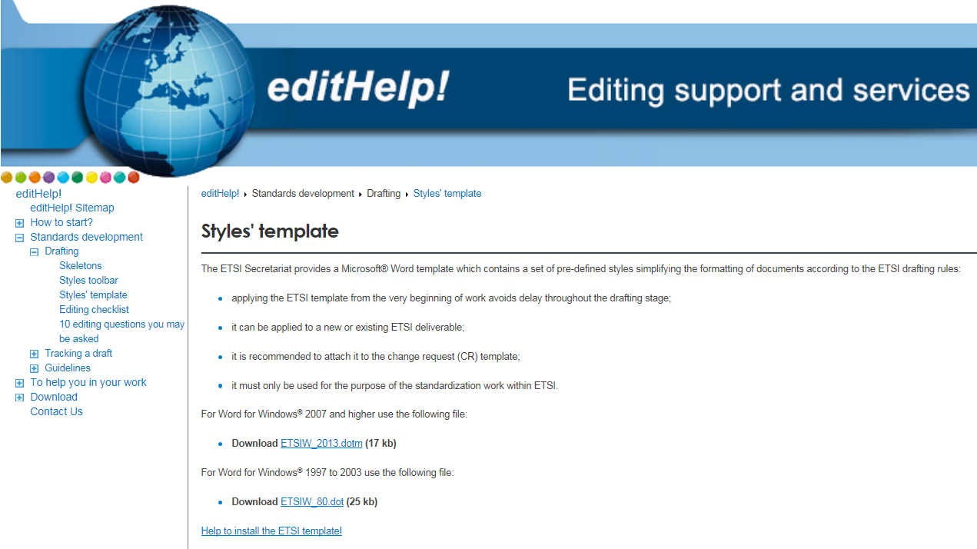
Styles’ template
The Styles’ template file is available via the section « Standards development » on the editHelp! website.
  To be able to use the correct styles, you have to attach this template to each oneM2M document you are working on.

Slide 9
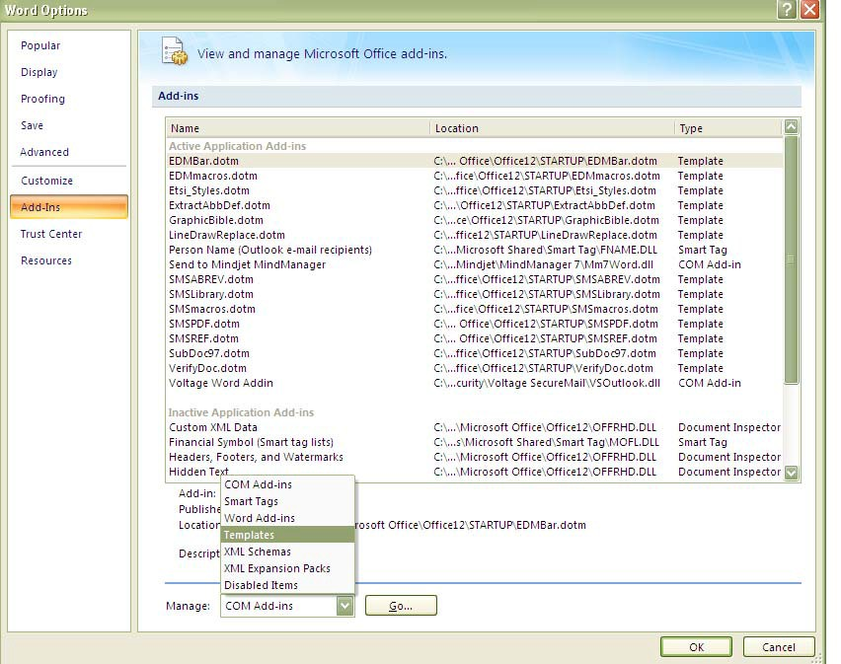
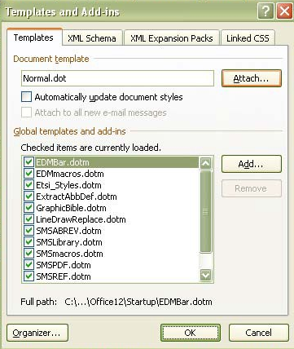
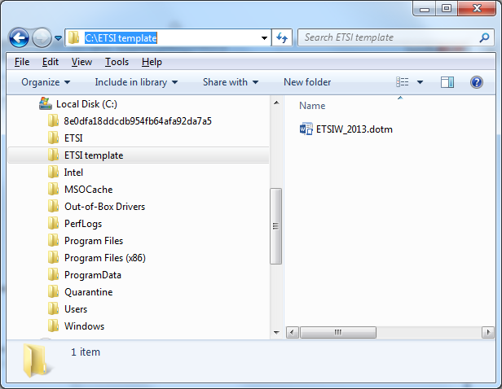
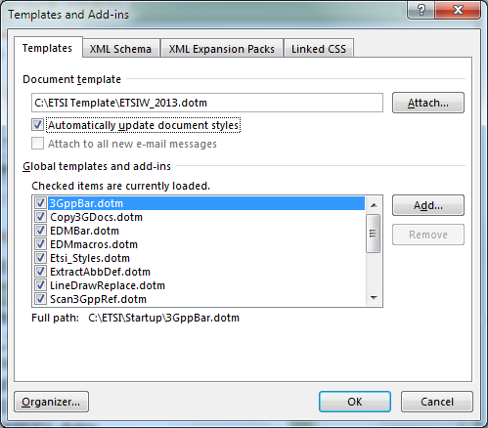
How to attach the styles’ template?
Save the .dot OR .dotm file on your [C:] drive and create a new folder entitled "ETSI template".
  .dot OR .dotm, depending on your Word version.
To attach the template:
  Open your Word® document.
  For 2013 and higher: click on File/Options

Slide 10
oneM2M deliverables
When working on a revision please use the last published version on your server.
  This will avoid any problems and delay during the editing.
Quality of the deliverable:
  Good quality:
    editors will spend less time editing it; and
    it will be given back to the Secretariat (Karen) on time.
  Poor quality:
    editors will spend more time editing it (changing the styles, problems with figures, etc.); and
    the deliverable will be delayed and not reach the target dates given by the Secretariat (Karen).

Slide 11
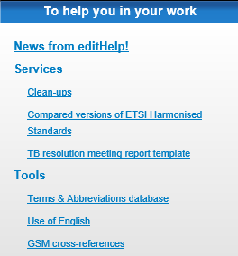
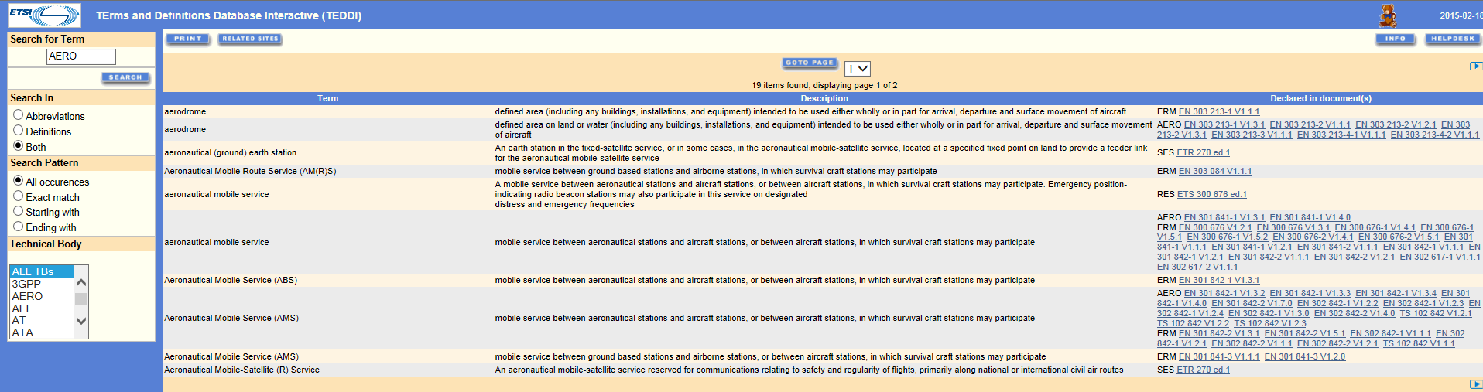
Terms and Definitions Database Interactive
TEDDI
  Search in TEDDI’s database of terms and abbreviations for the related definitions and click on the link to the free download of each of the deliverables where the term has been used.

Slide 12
editing

Slide 13

Procedure
oneM2M draft
Editing
Technical editing
Doc sent with questions
Document updated by editHelp!
Final doc. sent back to Karen
oneM2M server
Work on the
baseline stops*
Locked doc
with comments
& revision marks
Doc with answers
Revision marks
& comments removed
Version # upgraded
Work on the baseline stops: it is important to remember that whilst the document is with editHelp! no further work may be carried out on it until the final version is returned to you.
Last but not least, please ensure that the version used for any further work is the edited version from editHelp!.

Slide 14
Editing
Editing on non-ratified documents:
  Version number updated (e.g. V0.2.0 will become V0.2.1).
  Attach the style template if needed.
  Check and apply the oneM2M styles if necessary.
  Check the titles of references, their availability, in English and also whether or not they are mentioned in the document.
  The definitions, symbols, abbreviations and trade names.
  Requirements (must not used).
  Hanging paragraphs (e.g. text between clauses 8.2 and 8.2.1).
  Spell check.
  And many other things…
Revision marks are used to show the changes.
Comments are used for the questions (e.g. hanging paragraphs, requirements, etc.).

Slide 15
Ratified document
Once the Partners have been informed that the deliverables are available for publication editHelp! will:
  Convert the oneM2M document to an ETSI deliverable (e.g. TS-0001 => TS 118 001).
  Attach the style template if needed.
  The ETSI cover page will be added with the oneM2M logo.
  2nd page with the Work Item and the keywords will be added.
  Check that the title, version and keywords are aligned with the ETSI Work Programme.
  The ETSI IPR and Foreword will be added.
  Update the references text blocks (add the ETSI note and link).
  In the references clause and in the document: change the oneM2M and 3GPP deliverable to ETSI deliverable, when possible.
  Add the ETSI History Box.
  Update the Table of Content.
  Create the PDF file.
  Publication of the ETSI oneM2M deliverable.

Slide 16
Contact us
Contact Details:
Web: https://portal.etsi.org/Services/editHelp!.aspx
Phone: +33 4 92 94 43 43
Mail: editHelp@etsi.org
In ETSI: Einstein building, ground floor
Thank you!

