Slide 1

Conformance Test Development Process discussion
Group Name: TST WG
Source: InterDigital
Meeting Date: 2015-11-9
TST-2015-0216-Conformance_Test_Development_Procedures

Slide 2
ISO 9646 – Conformance Testing Methodology
(from TST-2015-0190)
Base Specifications -> Standards experts (SDO) specify requirements
Test Suite Structure and Test Purposes -> Testing experts (SDO) specify test purposes (WHAT TO TEST!), with each test purpose focused on a single requirement
(Optionally) Test Descriptions -> Testing experts specify (in prose) the necessary steps to achieve a specific test purpose (HOW TO TEST!)
Abstract Test Cases -> Testing engineers specify test cases (on a specific test notation) which are to be standardized by a SDO
Means of testing, Test Execution -> Test labs convert the standardized ATS into executable test cases in order to perform the tests against IUTs
A fair amount of discussion on step 3 during TP18/19.
This discussion is about the step 1.
TST-2015-0216-Conformance_Test_Development_Procedures

Slide 3
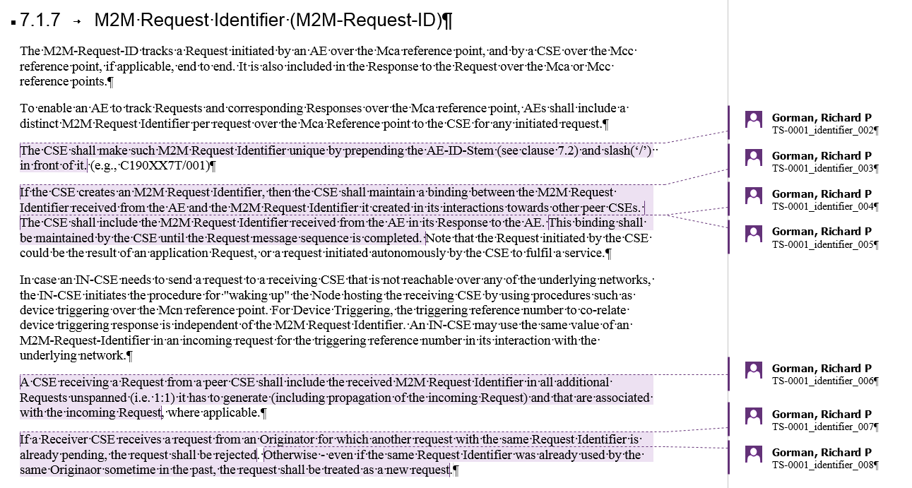
oneM2M TD discussion
Step 1: Identify requirements in the SPEC by adding a comment in MS word.
Step 2: Assign a requirement ID – We need a naming convention that aligns with the structure in TS-0018. Store these in “annotated” spec.
Step 3: Create Test Purposes, IAW ISO 9646 Conformance Testing methodology.
Create a traceability spreadsheet or table (similar to those discussed already) to track requirements and test purposes.
TST-2015-0216-Conformance_Test_Development_Procedures

Slide 4
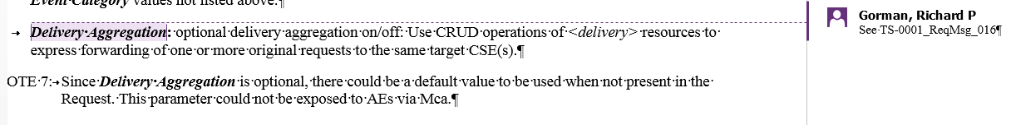
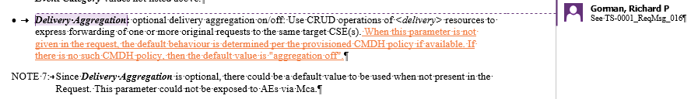
Requirements Maintenance
As the Specifications continue to improve through additions and CRs, we need to continuously monitor the TP’s written to see if they remain accurate.
  Using MS Word Combine Document function, an “Annotated” Specification document can be combined with an updated version to highlight changes.
  This will help identify when test requirements / test purposes need to be modified to remain aligned with changes in the spec.
Without this functionality, traceability between the TS-0018 and the oneM2M specification documents becomes time consuming and error prone.
Annotated Spec
TP written based on TS-0001 v1.8.0
The need to revaluate TP is clearly identified in “combined” version of TS-0001 v1.11.0
Combined Annotated - Updated Spec
TST-2015-0216-Conformance_Test_Development_Procedures

Slide 5
Benefits
By annotating the specifications in this manner,
  It is easier to review the completeness of the conformance test plan by visual review of the “Annotated” specification document.
  We can visually track modifications to the specification to see if updates require corresponding changes/additions/removals of requirements and test purposes.
TST-2015-0216-Conformance_Test_Development_Procedures

