Slide 1

Handling of new Test Purposes (security, interworking, …)
Group Name: TST WG
Source: Easy Global Market (EGM) (supported by EC funded H2020 ARMOUR project)
Meeting Date: 2016-05-16

Slide 2
Situation
Development of Test Purposes currently based on requirements collected from
  TS001 “Functional Architecture”
  TS004 “Service Layer Core Protocol Specification”
Developed TPs are collected within TS-0018 TSS&TP Baseline v0.1.0
This follows WI-032 which
  Define the methodology
  But do not precise the scope
What about other TSs (TS003 “Security Solutions”, TS008-10 “xxx Protocol Binding”, …) ?

Slide 3
Questions
Should other TSs be considered when developping TPs ?
How to select the « eligible » one ?
Which role for TS002 « Requirements »
  Provide high level requirements to be covered by the test objectives
Which mapping between TS002 and requirements extracted from TS001 and TS004?
  Need for traceability ?

Slide 4
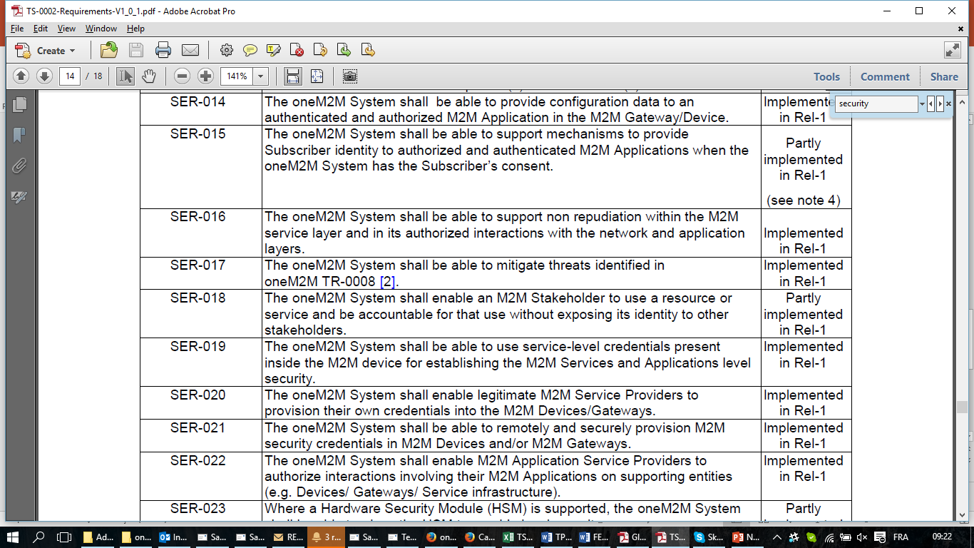
Situation in respect with security
TS002 identifies
  18 SER requirements implemented in Rel.1
  6 SER requirements partly implemented in Rel. 1
TST-2016-0091R01 identifies 161 requirements from TS003
  90 are not testable as such
  80 are testable, at least as pre-conditions
Exemple of TS002 high level requirement

