Slide 1

Allow tool-specific code in TTCN-3 as well in conformance test suite
Group Name: TST 31
Source: oneM2MTester
Meeting Date: 2017-09-20
Agenda Item: TST-2017-0242R01-allow_TTCN-3_tool_extensions

Slide 2
Test architecture today-target
The ATS contains the test cases for the Common Service Layer
The test tool SA-s implement the protocol bindings, connection setup/tear down etc.
  SA becomes more-and-more complex with the increasing number of bindings
  The same functionality is implemented several times
  Difficult, at some tools impossible to re-use already proven, robust generic-purpose SAs
TTCN-3 ATS
Creates
Starts test steps
PTC
AE
MTC
(coordi-nates)
PTC
CSE
TRI
oneM2M
Primitives
Test tool-specific code
(Java, C#, C++,…)
oneM2M SA

Slide 3
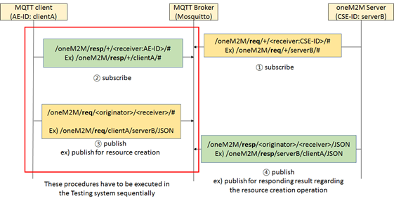
MQTT example of connectivity handling
Primitive sending/receiving is not a simple mapping of the primitives and encoding/decoding the content
The same situation will occur in the future e.g. for WebSocket

Slide 4
Proposed updated test architecture
Make it possible to develop part of the tool-specific code in TTCN-3 (not part of the ATS!)
  Could simplify SA code by making it a simple forwarder (no need for state machine)
  Allows sharing code between TTCN-3 tools (like MQTT subscribe)
Insertion points already exists in the test cases
  SUT address, protocol binding etc. are module parameters, thus accessible to the tool-specific TTCN-3 code extension
TTCN-3 ATS
Creates
Starts test steps
PTC
AE
MTC
(coordi-nates)
PTC
CSE
TRI
Test tool-spec.code TTCN-3
oneM2M
Primitives
TRI
Test tool-specific code
(Java, C#, C++,…)
oneM2M or generic SA

Slide 5
Proposal, alternative1 (example)
function f_CSE_GEN_CRE_001(in PrimitiveScope p_primitiveScope) runs on AeSimu {
…
// Test adapter configuration
// Preamble
v_aeIndex := f_cse_preamble_registerAe();//c_CRUDNDi);
Current
code
function f_CSE_GEN_CRE_001(in PrimitiveScope p_primitiveScope) runs on AeSimu {
…
// Test adapter configuration
f_ta_config_registerAe();
// Preamble
v_aeIndex := f_cse_preamble_registerAe();//c_CRUDNDi);
Extended
code

Slide 6
Proposal, altern.1 (example contd.)
function f_CSE_GEN_CRE_001(in PrimitiveScope p_primitiveScope) runs on AeSimu { …
// Postamble
f_cse_postamble_deleteResources();
// Tear down
f_cf01Down();
}//end f_CSE_GEN_CRE_001
Current
code
function f_CSE_GEN_CRE_001(in PrimitiveScope p_primitiveScope) runs on AeSimu { …
// Postamble
f_cse_postamble_deleteResources();
// Test adapter deconfiguration
f_ta_config_tearDownAe();
// Tear down
f_cf01Down();
}//end f_CSE_GEN_CRE_001
Extended
code

Slide 7
Proposal, alternative2 (example)
function f_CSE_GEN_CRE_001(in PrimitiveScope p_primitiveScope) runs on AeSimu {
…
// Test adapter configuration
// Preamble
v_aeIndex := f_cse_preamble_registerAe();//c_CRUDNDi);
Current
code
function f_CSE_GEN_CRE_001(in PrimitiveScope p_primitiveScope) runs on AeSimu {
…
// Test adapter configuration
f_ta_config_preamble();
// Preamble
v_aeIndex := f_cse_preamble_registerAe();//c_CRUDNDi);
Extended
code

Slide 8
Proposal, altern.2 (example contd.)
function f_CSE_GEN_CRE_001(in PrimitiveScope p_primitiveScope) runs on AeSimu { …
// Postamble
f_cse_postamble_deleteResources();
// Tear down
f_cf01Down();
}//end f_CSE_GEN_CRE_001
Current
code
function f_CSE_GEN_CRE_001(in PrimitiveScope p_primitiveScope) runs on AeSimu { …
// Postamble
f_cse_postamble_deleteResources();
// Test adapter deconfiguration
f_ta_config_postamble();
// Tear down
f_cf01Down();
}//end f_CSE_GEN_CRE_001
Extended
code

Slide 9
Proposal
Add dummy Test Adapter configuration/de-configuration functions to the ATS; two alternatives may be possible
  Test case behaviour specific empty setup/tear down functions
  As test case name, transport etc. can be retrieved in TTCN-3 code, there may be just one TA setup and one and tear down function. In this case tool-specific code is more complex, ATS code is simpler
Dummy test configuration functions shall be in separate modules, which can be replaced by tool-specific (or generic, use-able with all tools) modules of the same name
Callback functions could also be used
  More complex technical solution
  At least one tool supports, no complete picture from all tools
  Example can be provided if this is considered the preferred solution

