Slide 1

Certification Process
Group Name: TST
Source: Bob Flynn, Convida Wireless, Flynn.Bob@convidawireless.com
Meeting Date: TST 33.1
Agenda Item: TST-2018-00xx-oneM2M_Certification_Process

Slide 2
Background
In Nov 2017 we captured the perceived state of the certification process – confusing at best, possibly incomplete.
At TP#24 (July 2016) we had a CT contribution from Qualcomm proposing a method or process for certification.
At IAG#6 Webconference (Tue, 23 Jan 2018 14:30 - 16:00 GMT) oneM2M was asked to provide clarity

Slide 3
Issues Highlighted
TS-0031
  Not complete ← completed for Release 1 at TP33
  Hard to find due to lack of contributions← Publication requested at TP33
  WI states that this is where mandatory/option features are described ← Better text to describe what we have already done in TS-0025. For example,

Slide 4
Issues Highlighted
TS-0025
  Fundamental Features and Extendable Features are confusing terms that are meant to mean “Required / Mandatory” and “Optional”
  No description of a data model is described therefore two sensors can place contentInstances in different locations. A monitor application would not work with both of those sensors (unless discovery is required AND additional requirements for the sensor profile).
  Expected to see linkage to test cases based on the WI description.
TS-0018
  No way to link to tests to features

Slide 5
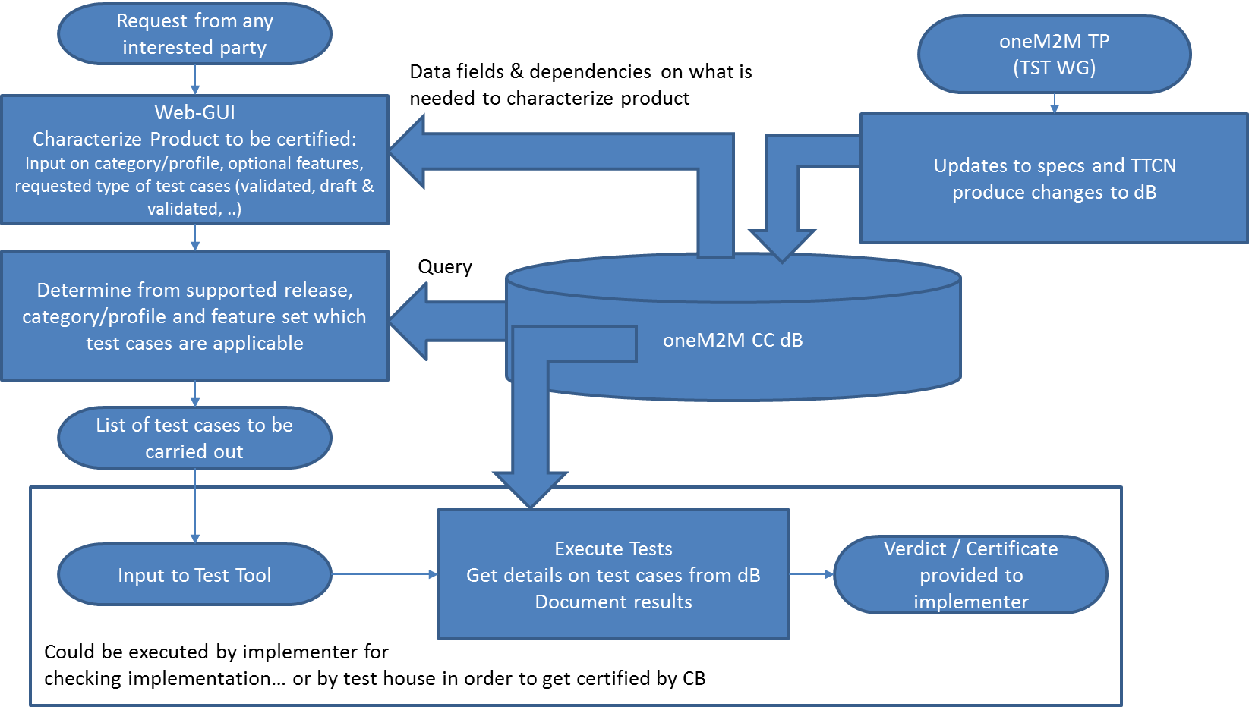
Proposed Solution
Product
Company
oneM2M
Store the following in a database
  Features
  Product categories/profile
  Test Cases
  Feature versus Test Cases
Refer to CT-2016-0031-data_base_for_certification_criteria.doc
Certification

Slide 6
Features
Proposed
Implemented
TS-0031
Good correlation between proposed solution and the current state.
Do we want to add references?
  I think it is not needed.

Slide 7
Product categories/profile
Good correlation between proposed solution and the current state (address confusing terms)

Slide 8
Test Cases
Good correlation between proposed solution and the current state.

Slide 9
Feature versus Test Cases
We don’t have this anywhere at this point.
Seems like a Critical Component

Slide 10
Proposed Solution
Product
Company
Based on our current state, do we want to target this solution or something different
oneM2M
Store the following in a database
  Features
  Product categories/profile
  Test Cases
  Feature versus Test Cases
Refer to CT-2016-0031-data_base_for_certification_criteria.doc
Certification

Slide 11
What’s missing
To realize the proposed solution
  Import data from our specifications into a database
    I suggest MongoDB
    TTA preference?
    GCF could suggest their infrastructure
  Create the Feature to Test Cases Mapping
    Suggest making this part of the Test Purpose Header information
  Web Interface (for product company) and Record of Results
    Certification Body and Test Lab responsibility
    Need to define the interface they will need to access the data
oneM2M CC dB

Slide 12
Response to IAG
These slides with a timeline to complete what is depicted
  End of July WG (TST 36) meeting?
  Database interface by End of TP 35?
Allow them to plan for the non-oneM2M components (Web and Results database)
Need commitments from volunteers to help with the tasks from the previous page.
  Prepare existing data for import
  Scripts to input “prepared” data
  Define external interface queries
  Feature to Test Case Mapping (Update all TPs)

