Slide 1

Response to GCF regarding Certification Process
TST-2018-0050-Response_to_GCF
Group Name: TST
Source: Bob Flynn, Convida Wireless, Flynn.Bob@convidawireless.com
JaeSeung Song, KETI, jseungsong.sju@gmail.com
Meeting Date: TST 34

Slide 2
Background
In Nov 2017 we captured the perceived state of the certification process – confusing at best, possibly incomplete.
At TP#24 (July 2016) we had a CT contribution from Qualcomm proposing a method or process for certification.
At IAG#6 Webconference (Tue, 23 Jan 2018 14:30 - 16:00 GMT) oneM2M was asked to provide clarity

Slide 3
Issues Highlighted
TS-0031
  Not complete ← completed for Release 1 at TP33
  Hard to find due to lack of contributions ← Publication requested at TP33
  WI states that this is where mandatory/option features are described ← Better text to describe what we have already done in TS-0025. For example,

Slide 4
Issues Highlighted
TS-0025
  Fundamental Features and Extendable Features are confusing terms that are meant to mean “Required / Mandatory” and “Optional” ← Not appropriate to overwrite any meanings in TS-0025.
  No description of a data model is described therefore two sensors can place contentInstances in different locations. A monitor application would not work with both of those sensors (unless discovery is required AND additional requirements for the sensor profile). ← ATS mentions this
  Expected to see linkage to test cases based on the WI description. ← We already have this link
TS-0018
  No way to link to tests to features ← You have to link profiles so that you can link features

Slide 5
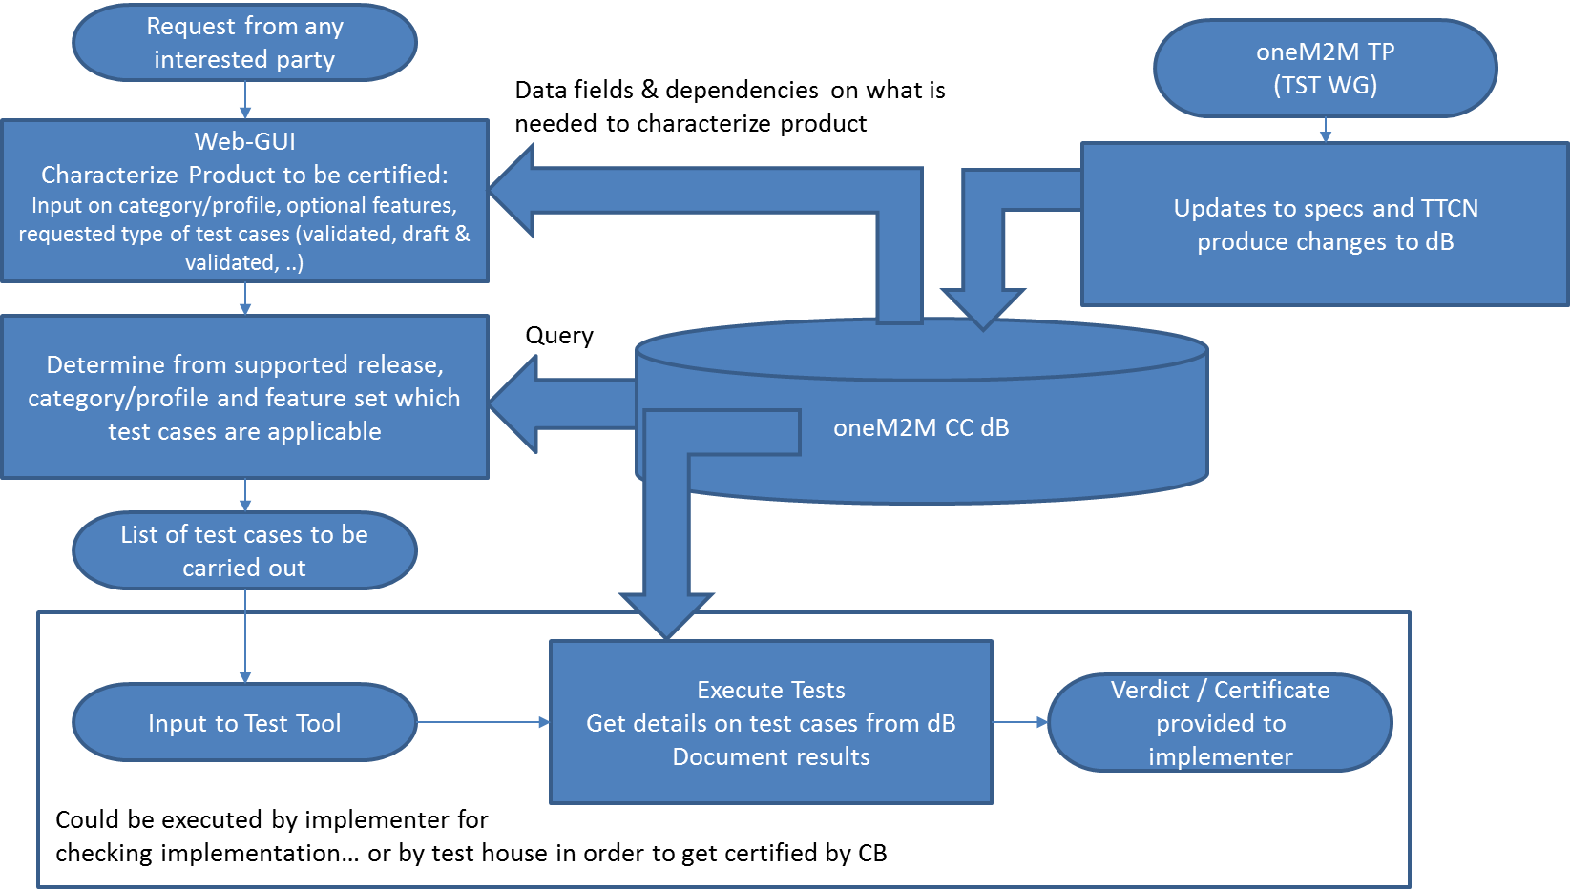
Proposed Solution
Product
Company
oneM2M
CB Database
CB can refer items defined in oneM2M and store these in a CB’s database
  Features
  Product categories/profile
  Test Cases from oneM2M ATS repository
  Feature versus Test Cases
Refer to CT-2016-0031-data_base_for_certification_criteria.doc
Certification

Slide 6
Feature versus Test Cases
Test Cases are mapped to profiles which have links to features

Slide 7
Suggestions
To realize the proposed solution
  Import data from our specifications into a database
    GCF can decide whatever they want
    TTA can provide their experiences
  Use Profiles and Features to Test Cases Mapping (Already done in ATS)
  Web Interface (for product company) and Record of Results
    Certification Body and Test Lab responsibility
    Need to define the interface they will need to access the data

Slide 8
Response to IAG
Suggest to participate oneM2M TST meetings to be updated and collaborate
Need commitments from volunteers to help with the tasks from the previous page.
  Establish CB’s DB
  Develop scripts to input “prepared” data
  Define external interface queries
  Use updated ATS to Test Case Mapping

