Slide 1
SDT 4.0
Development Update
Andreas Kraft – Deutsche Telekom

Slide 2
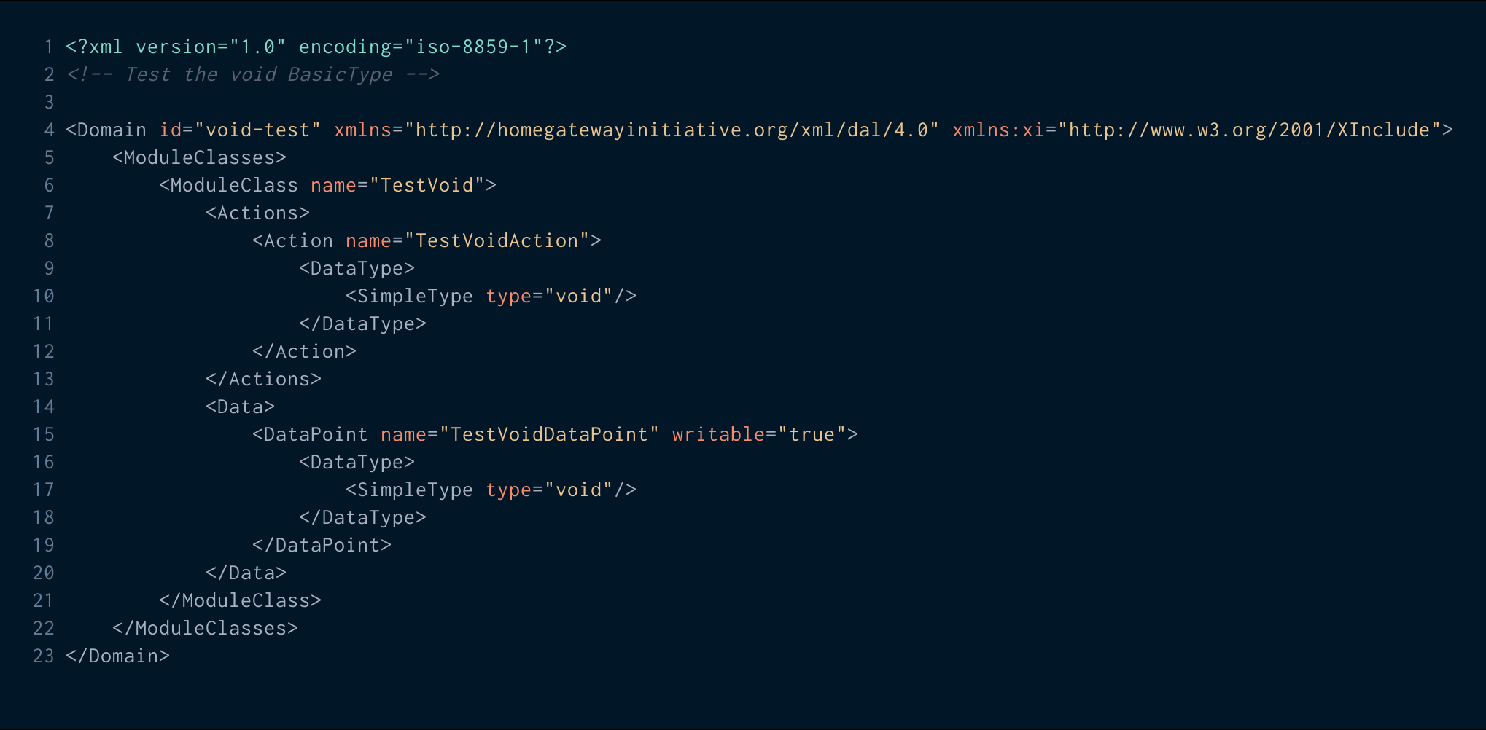

SDT Namespace Naming

Slide 3
SDT Namespace Naming
Should we change the name space?
To what?
  http://www.onem2m.org/xml/sdt/4.0
Notes:
https://carbon.now.sh/?bg=rgba(0%2C0%2C0%2C1)&t=night-owl&wt=sharp&l=xml&ds=false&dsyoff=20px&dsblur=68px&wc=false&wa=true&pv=0px&ph=0px&ln=true&fm=Inconsolata&fs=15px&lh=128%25&si=false&code=%253C%253Fxml%2520version%253D%25221.0%2522%2520encoding%253D%2522iso-8859-1%2522%253F%253E%250A%253C!--%2520Test%2520the%2520void%2520BasicType%2520--%253E%250A%250A%253CDomain%2520id%253D%2522void-test%2522%2520xmlns%253D%2522http%253A%252F%252Fhomegatewayinitiative.org%252Fxml%252Fdal%252F4.0%2522%2520xmlns%253Axi%253D%2522http%253A%252F%252Fwww.w3.org%252F2001%252FXInclude%2522%253E%250A%2509%253CModuleClasses%253E%250A%2509%2509%253CModuleClass%2520name%253D%2522TestVoid%2522%253E%250A%2509%2509%2509%253CActions%253E%250A%2509%2509%2509%2509%253CAction%2520name%253D%2522TestVoidAction%2522%253E%250A%2509%2509%2509%2509%2509%253CDataType%253E%250A%2509%2509%2509%2509%2509%2509%253CSimpleType%2520type%253D%2522void%2522%252F%253E%250A%2509%2509%2509%2509%2509%253C%252FDataType%253E%250A%2509%2509%2509%2509%253C%252FAction%253E%250A%2509%2509%2509%253C%252FActions%253E%250A%2509%2509%2509%253CData%253E%250A%2509%2509%2509%2509%253CDataPoint%2520name%253D%2522TestVoidDataPoint%2522%2520writable%253D%2522true%2522%253E%250A%2509%2509%2509%2509%2509%253CDataType%253E%250A%2509%2509%2509%2509%2509%2509%253CSimpleType%2520type%253D%2522void%2522%252F%253E%250A%2509%2509%2509%2509%2509%253C%252FDataType%253E%250A%2509%2509%2509%2509%253C%252FDataPoint%253E%250A%2509%2509%2509%253C%252FData%253E%250A%2509%2509%253C%252FModuleClass%253E%250A%2509%253C%252FModuleClasses%253E%250A%253C%252FDomain%253E&es=2x&wm=false

Slide 4
SDT Integration of CRs so far
RDM-2019-0003-SDT_4_0_–_Proposed_Changes_to_XSD
https://git.onem2m.org/MAS/SDT/tree/RDM-2019-0003-SDT_4_0_–_Proposed_Changes_to_XSD

