Slide 1
SDT 4.0
Proposed Changes to XSD
Andreas Kraft – Deutsche Telekom
Andreas Neubacher – Deutsche Telekom

Slide 2
Status May, 2019
URL to GitLab: https://git.onem2m.org/MAS/SDT (master)
Branches for SDT 4.0
  WI-0081-Smart_Device_Template_4_0
    For integrating agreed changes / CRs
    Will be finally merged into master branches
  RDM/MAS-201x-1234- …
    One branch per CR
    Will be integrated into WI-0081-Smart_Device_Template_4_0
  RDM-2019-0003-SDT_4_0_–_Proposed_Changes_to_XSD
    Branch for integrating changes from WI-0081-Smart_Device_Template_4_0 into the XSD
    Added new test cases and examples

Slide 3
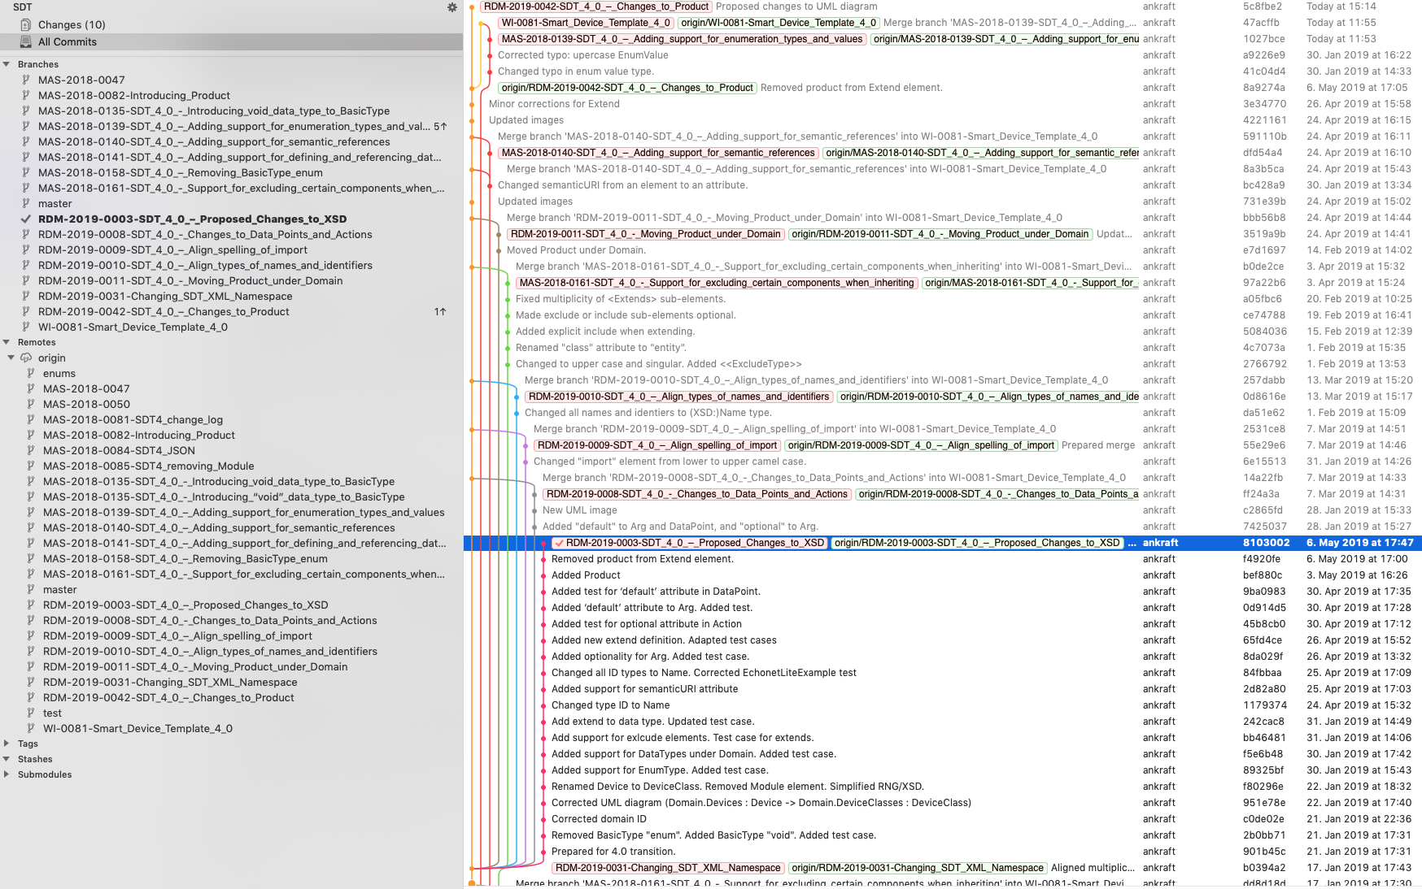
Git Source Tree

Slide 4
XSD
Source: Relax NG definition
XSD generated with SDT build tool
  Located in „src“ directory
Added test cases and examples for new features
  Validation after build
  Located in „test“ directory

Slide 5
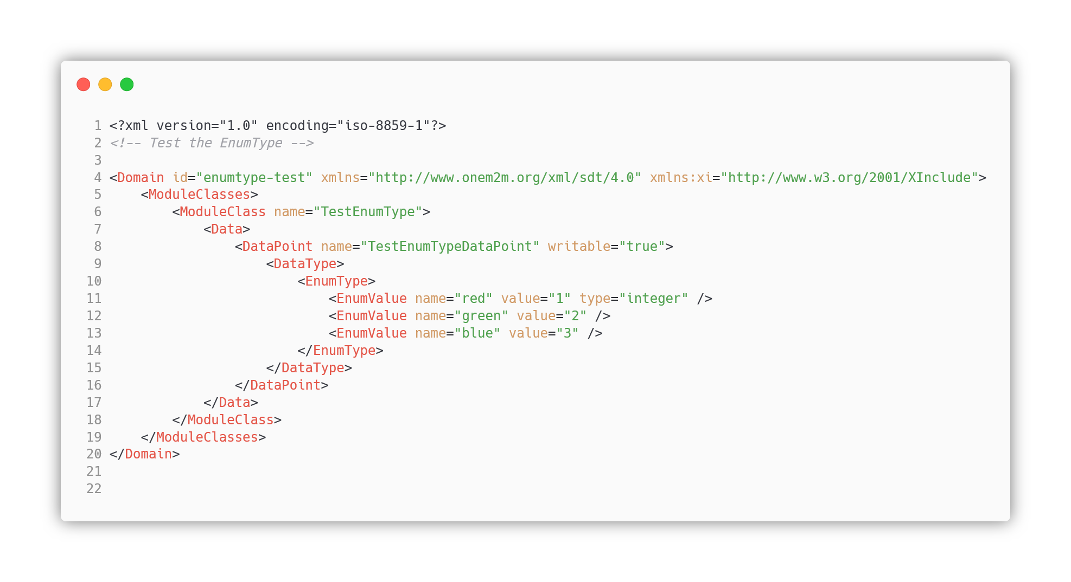
Example: Test EnumType

Slide 6
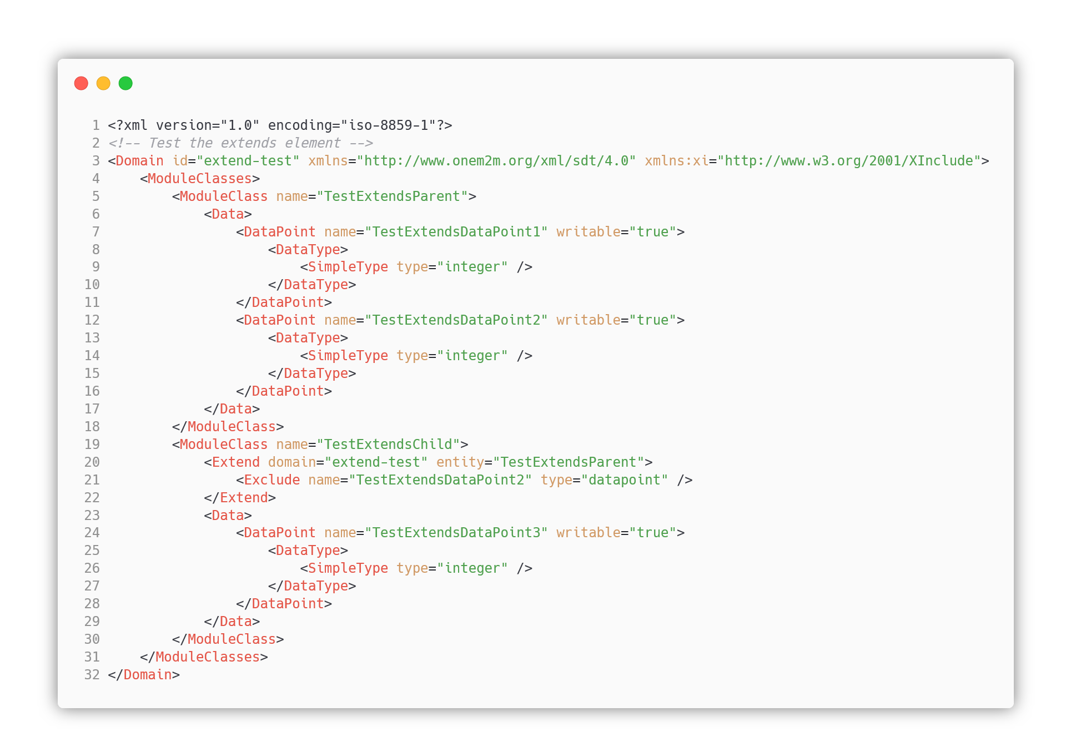
Example: Test Extend

Slide 7
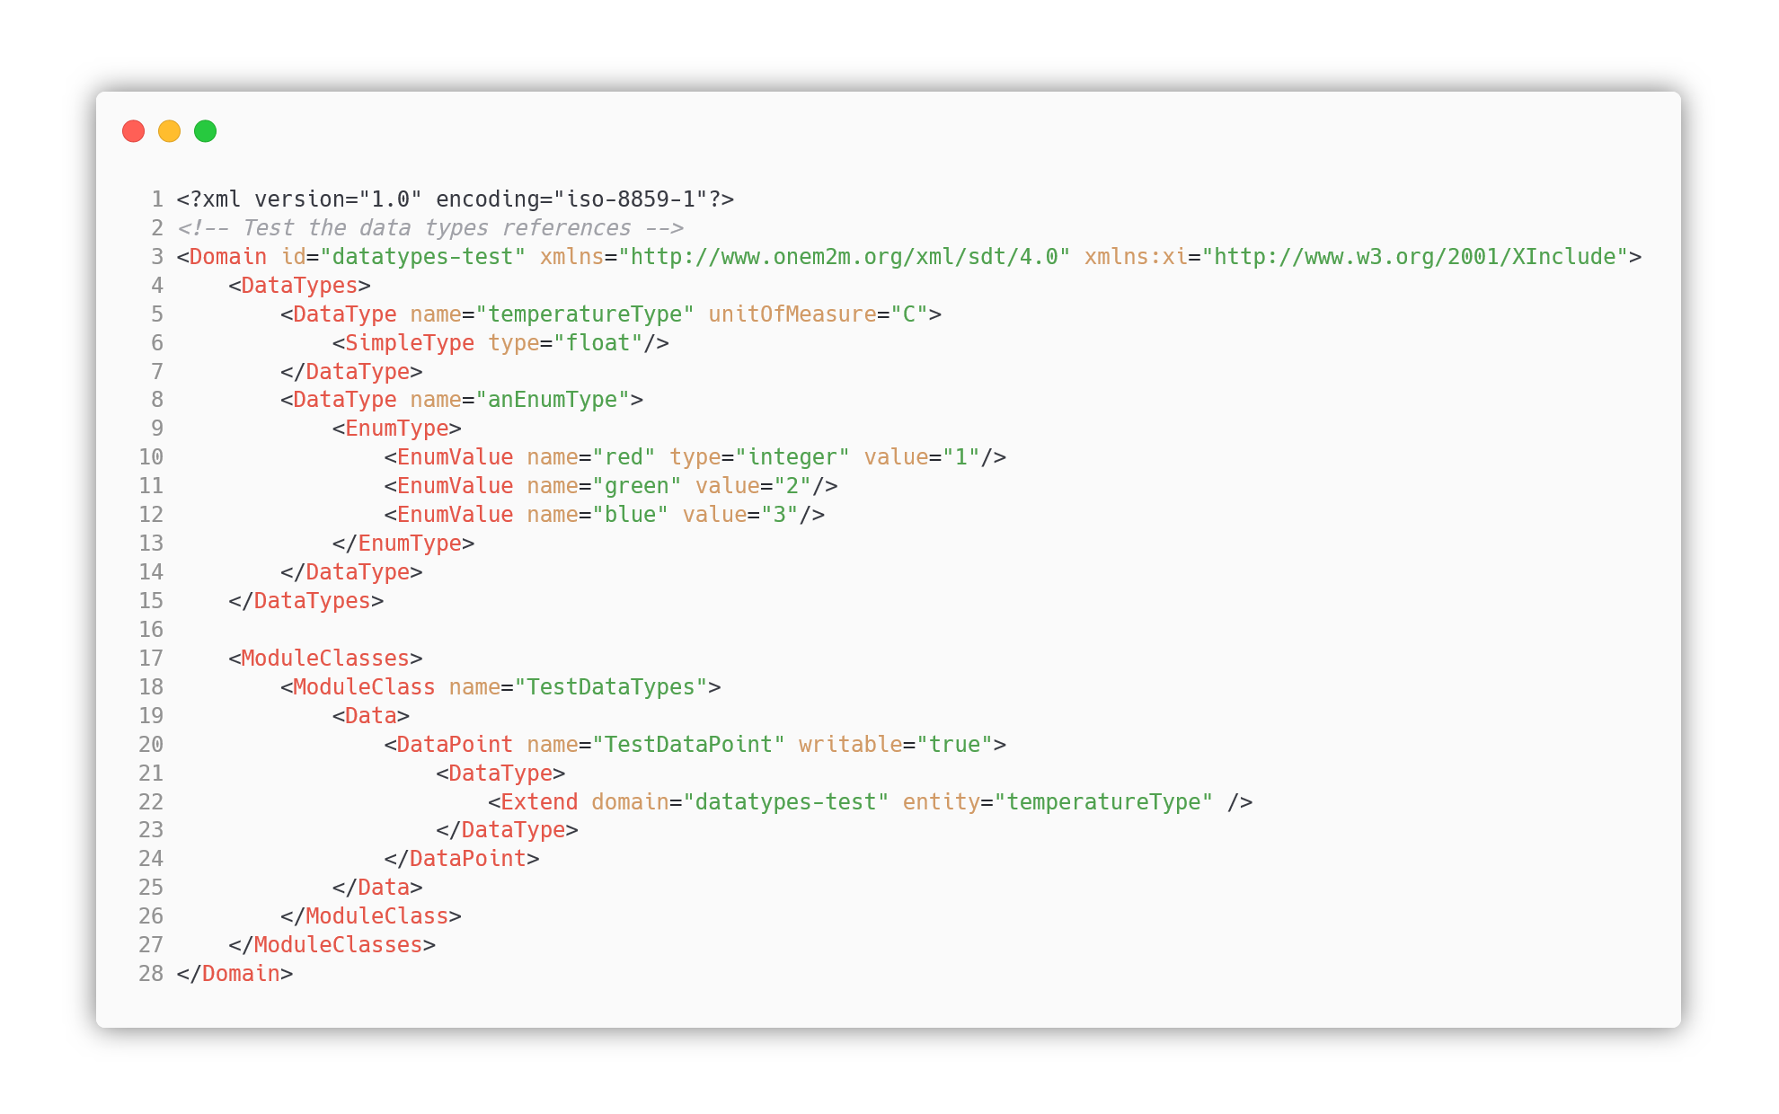
Example: Test DataType

