Slide 1
Handling privacy data protection related regulations
RDM-2019-0066-Handling-privacy-related-regulation
Group Name: RDM
Source: Youngjin Na, Min-Byeong Lee / HYUNDAI Motor (TTA)
JaeSeung Song (KETI)
Meeting Date: 2018-07-16 to 2018-07-20

Slide 2
Motivation and Background
GDPR
  The General Data Protection Regulation is a regulation in EU law on data protection and privacy for all individual citizens of the European Union and the European Economic Area.
  Business processes that handle personal data must be designed and built with consideration of the principles and provide safeguards to protect data (for example, using pseudonymization or full anonymization where appropriate), and use the highest-possible privacy settings by default, so that the data is not available publicly without explicit, informed consent, and cannot be used to identify a subject without additional information stored separately.

Slide 3
Motivation and Background
Korea Personal Information Protection Act (PIPA)
  The Personal Information Protection Act (PIPA) is
  a framework act on data protection both in the public sector and private sector in Korea.
  the Act on Promotion of Information and Communications Network Utilization and Information Protection, etc
  the Act on the Use and Protection of Credit Information
  the Act on the Protection, Use, etc. of Location Information
  the Act on the Development of Cloud Computing and the Protection of its Users
  and so on..
IoT platforms as a place holder to collect and manage data (including personal and private data) is a subject to Privacy-related regulations such as PIPA and GDPR

Slide 4
Key issues on handling data protection related regulations
Key issues
  How to detect data to be handled as privacy data?
    by administrator
    by users manually
    automatic
  What to do with the detected or marked privacy data?
    decide which regulation should be applied
    decide which data processing techniques should be used
  How to apply privacy protection techniques such as Pseudonymization or Anonymization?
Current oneM2M
  Supports pseudonymized URI
  Limited mechanisms on data handling based on different regulations mandated by each country

Slide 5
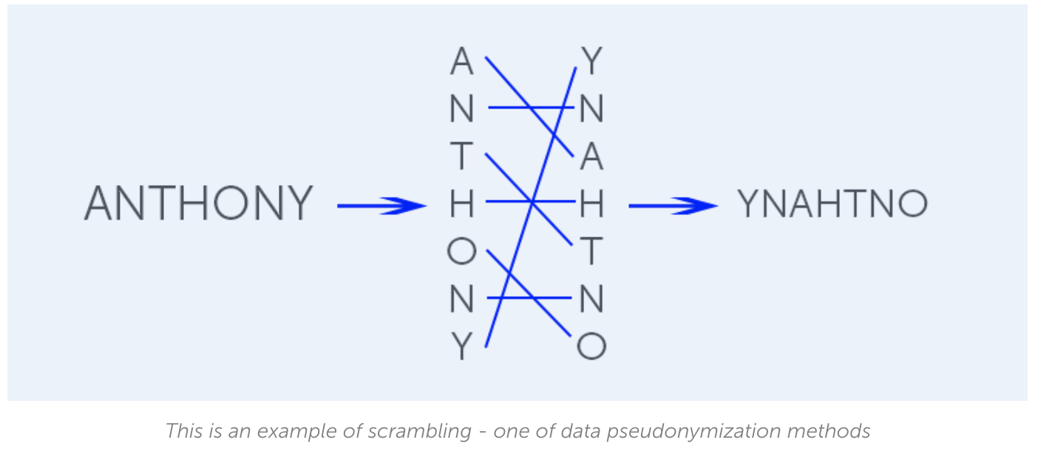
Background Knowledge
pseudonymisation means the processing of personal data in such a manner that the personal data can no longer be attributed to a specific data subject without the use of additional information, provided that such additional information is kept separately and is subject to technical and organisational measures to ensure that the personal data are not attributed to an identified or identifiable natural person.

Slide 6
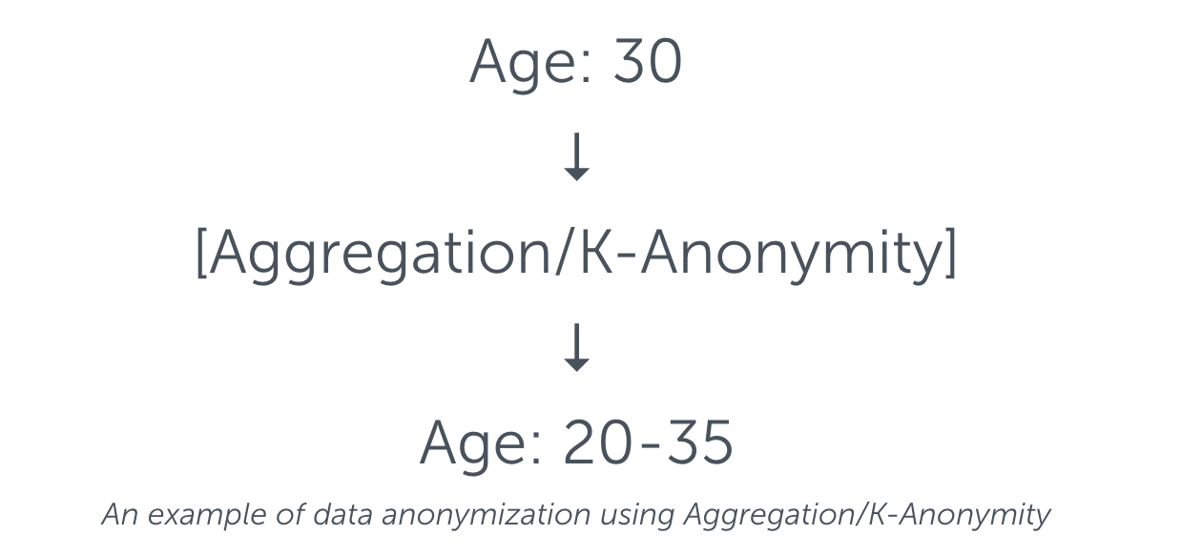
Background Knowledge
Anonymisation Techniques:
the data must be stripped of sufficient elements such that the data subject can no longer be identified. More precisely, that data must be processed in such a way that it can no longer be used to identify a natural person by using ‘all the means likely reasonably to be used’ by either the controller or a third party. An important factor is that the processing must be irreversible.

Slide 7
Privacy Data Handling
Raw input data
An indication to inform personal data
Is privacy data?
oneM2M
Information to decide which technique to use
Which techniques?
oneM2M
Process as usual
Pseudonymization
Anonymization
Resource should provide relevant information
oneM2M
Store data

Slide 8
Use Case – Wearable IoT service
User A who is living in France purchases a body temperature sensor and stores measured temperature to IoT platforms with his personal information
  User A’s name
  User A’s ID
  User A’s body temperature
URI of a newly created resource for this wearable IoT service is also formatted using User A’s name
The name and contents of the resource are all subject to the GDPR regulation
How to be handled by IoT service layer platform:
  Either user or administrator or service provider should indicate the GDPR regulation
  A resource for this service should contain information about privacy regulation and data processing
  When a measured data from the sensor is sent to IoT platform, proper data processing should be applied (IoT platform should know which algorithm to apply → an implementation issue)
  Other IoT applications having access to the resource only see processed data

Slide 9
Potential requirements for handling privacy data protection related regulation
High-level use cases
  IoT systems consider regulations of different countries on handling privacy related data and apply proper data protection techniques (such as anonymization and pseudonymization)
Additional requirements should be considered

Slide 10
Thank you!

