Slide 1
Smart Tourism Services and Data Model
RDM-2020-0070-Smart_Tourism_Data_and_Ontology
Group Name: WG1
Source: JaeSeung Song (KETI), Namdon Kim (GSIF)
Meeting Date: 2020-10-13
Agenda Item: TBD

Slide 2
Contents
A smart city project focusing on Smart Tourism
Planned IoT services
A way forward

Slide 3
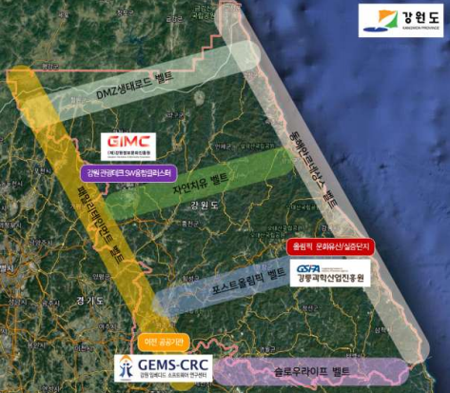



Smart Tourism
Gangneung where 2018 Winter Olympic was held has started a smart city project that focus on Smart Tourism.
The Gangneung area is specialized in tourism
Started a new project
  SW Convergence Cluster for Smart Tourism
  Duration: April. 2020 ~ Dec. 2024 (57 months)
  Participants: GSIPA, GICA, Gangneung wonju univ.
  Budget: $16,000,000
  Description
    Trial smart tourism services
    Global networking (joint research, smart tourism forum, etc.)
    Smart tourism open labs
    Open calls for smart tourism services

Slide 4
Planned IoT services
Flagship data platform for smart tourism
  Develop open APIs for smart tourism services
  Support mashup service
  Collect data from various smart tourism services as well as legacy systems
  Device and platform will follow oneM2M
Smart luggage tracking service for tourists
  Carrier storage system
  IoT infrastructure using LoRa
  Dashboard for carrier storage and movements
Cultural heritage protection service
  Collect data from cultural heritage (e.g., location, temperature, etc.)
  Develop training data set from collected data for AI
Customized smart tourism service
  Develop IoT enabled AP
  Develop and provisioning of personalized smart tour service
Notes:
통합 경보 서비스에 대한 개념 설명

Slide 5
Planned IoT services
Smart crowd sensing for the usability of tourists
  Collect crowd data from tourist
  Develop heatmap
  Provide recommendation services
Smart IoT platform for DMZ tourists
  Collect data from accommodation around DMZ
  Dashboard for DMZ tourism management
  Managing products, contents, security, and foods
Smart accommodation service
  Collect data from accommodations (e.g., Hotel, Lodge)
  AR/VR services
  Connect various data and contents
  Convert data and adding semantics for AI services
  Integrate with location and crowd sensing services
  Recommendation services
Notes:
통합 경보 서비스에 대한 개념 설명

Slide 6
Data model in oneM2M
oneM2M has a couple of specifications on domain specific work items
  WI-0046: Vehicular domain enablement
  WI-0064: Adaption of oneM2M for Smart City
  WI-0070: Public Warning Service Enabler
  WI-0075: Industrial Domain Information Model Mapping & Semantics Support
  WI-0084: SDT based Information Model & Mapping for Vertical Industries
  WI-0092: Railway Domain Enablement
  WI-0094: Ontologies for Smart City Services
  WI-0098: IoT for Smart Lifts
Notes:
WI 최초 목표/일정 설명
TR 완성 했고, TS 시작해야 한다

Slide 7
A way forward
Two parallel activities are expected
  Derive new use cases from smart tourism services
  Analysis of smart tourism services in terms of data
Depending on the data set collected from Smart Tourism services, we can consider various work
  Ontologies for Smart Tourism
  Smart Tourism Service Enablement
  Information model for Smart Tourism

