Slide 1
Introduction to AI-enabled IoT use cases
RDM-2021-0029_Introduction_to_AI-enabled_IoT_use_cases
Mr. Lee Minbyeong, Hyundai Motor Group, minbyeong.lee@hyundai.com
Prof. Song JaeSeung, Sejong University, jssong@sejong.ac.kr
Nargis Khatoon , Sejong University, nargis.gulab110@gmail.com

Slide 2
Benefit to use combine IoT and AI applications
As the volume of the collected data from IoT increases, AI (like ML) techniques are applied to further enhance the intelligence and the capabilities of an application.
Major vendors of IoT platform software now offer integrated AI capabilities such as machine learning-based analytics. The value of AI in this context is its ability to quickly wring insights from IoT collected data
Machine learning, an AI technology, brings the ability to automatically identify patterns and detect anomalies in the data that smart sensors and devices generate information such as temperature, pressure, humidity, air quality, vibration, sound and more.
AI-powered IoT can also help improve operational efficiency. Just as machine learning can predict equipment failure, predict operating conditions and identify parameters to be adjusted on the fly to maintain ideal outcomes, by crunching constant streams of data to detect patterns invisible to the human eye
Enhancing IoT with AI can also directly create new products and services, e.g. AI-controlled drones and robots
The impact of AI on our daily lives is extraordinary. Yet the combined effect of IoT and artificial intelligence can be game-changing for many industries and organizations.
IoT enables a indefinite of different business applications. Knowing some those examples and use cases can help businesses integrate IoT technologies with AI into future investment decisions

Slide 3



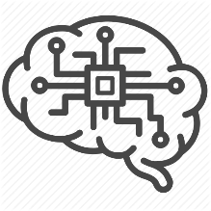


Use Case 1: Fault Management & Isolation for IoT Field Devices
Fault detection aims to identify defective states and conditions within IoT systems, based on measurements from field devices
In this use case, an IoT module will be prototyped for fault detection and isolation in a smart building environment using both a rule-based and a self-learning fault detection algorithms
The main goal is to extend oneM2M with fault detections capability to make it possible for oneM2M developers and users to detect malfunctions in real time, as soon and as surely as possible.
UC1: Overview
User
Compute
Deviation
Send
Alerts
Models
4
Receive
prediction
5
3
2
1
Perform Prediction
Fault Detection
Service
Sensor
Send
Measurement
UC1: Fault Management Architecture
Application
Configure fault detection
Receive notification when anomalies are detected
AE
CSE
MCA
Accept Fault detection configuration parameters from AEs
Fault detection service: Rule-based/ML-based
Send notification to AEs
Common Services Layer
MCA
MCA
Data
AE
Sensor
Send measurements
Manufacturer worksheets

Slide 4


Use Case 2: Detection of patterns in video streams
Visual recognition represents a relative understanding of visual environments and their context involving many academic subjects, such as computer science, mathematics, engineering, physics, biology and cognitive science.
In this use case, an IoT module performs image classification using machine learning and trained data. A camera periodically reads images from a data store and pushes them to the oneM2M platform and receive notifications when trained categories are recognized.
The main goal is to extend the oneM2M architecture with visual recognition capabilities to make it possible for oneM2M developers to gain high-level understanding from digital images through the construction of explicit, meaningful descriptions of physical objects, and scenes and use them to make relevant decisions.
UC2: Overview
User
Verify
Classification
Score
Send
Alerts
Send classification Report
Models
5
4
3
2
1
Perform classification
Visual Recognition
Service
Camera
Send
Measurement
UC2: Video Patterns Detection Architecture
Application
Visual recognition configuration and training
Receive notification related to relevant scenes, objects, and situations.
AE
MCA
Accept classification configuration and training data from AEs
Perform predefined-classification / Custom classification
Send notification to AEs
CSE
Common Services Layer
MCA
MCA
AE
MCA
Training Data
Camera
Classifier CSF
Smart City images
AE

Slide 5
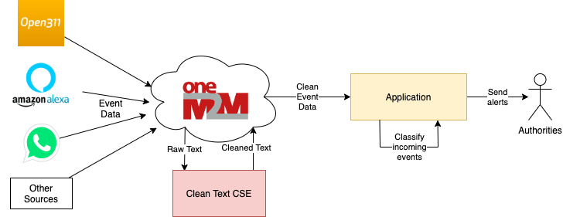
Use Case 3: Language Based sentiment Classification
IoT data can take many forms including numeric and textual.
The aim of this use case is to handle text-format data in a smart cities context.
The use case involves the analysis of crowdsourced text data (e.g. from social networks or specific mobile applications) to detect the occurrence and location of disasters.
UC3: Overview
UC3: Language-based Classification Architecture
Law Enforcement App
Citizen Application
Occurrence Management App
GloVE Vectorization
Deep Neural Network (Long-Short Tem Memory classifier)
CSE
Common Services Layer
Text data cleaning function (typos, URLs, emojis, stop words, html, punctuation etc.)
Language/idiom configuration
API
API
AE
AE
Data
AE
Mobile Device
User feedback (Twitter content or other types of messages)
Database with source data from Kaggle

Slide 6
Use Case 4: Image classification and augmentation
UC4: Overview
In this use case, an IoT module will be prototyped for images classification using machine learning and trained data. The IoT module supports multiple classifiers: predefined and custom models (augment model).
A camera agent will be developed to quickly test the proposed prototype and simplify the integration with real devices within the city.
The camera agent reads periodically images from the disk and push them to oneM2M platform. The images could be provided by a real camera or any other external sources
In the oneM2M the CSF comes with a predefined and pretrained classifier for Object detection, Object tracking, Semantic Segmentation, Instance Segmentation, etc.).
Custom classifier CSF image classification CSF. Allow an application to create its own classifier (augment data) and train it to implement specific visual recognition use case
User
Verify/Test/Validate
Classification
Score
Send
Alerts
Models
Send
classification/augmentation Report
5
4
3
2
1
Perform classification
&
Apply augmentation
(crop, rotate, invert, resize)
Visual Recognition
Service
Camera
Send
Measurement
UC4: image classification and augmentation Architecture
Application
Visual recognition configuration and training
Receive notification related to relevant scenes, objects, and situations.
AE
Accept classification configuration and training data from Aes
Extend data if not enough for training
Perform predefined-classification / Custom classification
Send notification to AEs
MCA
CSE
Common Services Layer
MCA
Data Augment CSF
API
API
AE
AE
Training Data
Camera
Custom/ Predefined Classifier CSF
images

Slide 7
Thank you

