Slide 1
Metaverse IoT discussion
2022-11-08
Andrew Min-gyu Han, Hansung University
(andyhan@hansung.ac.kr)

Slide 2

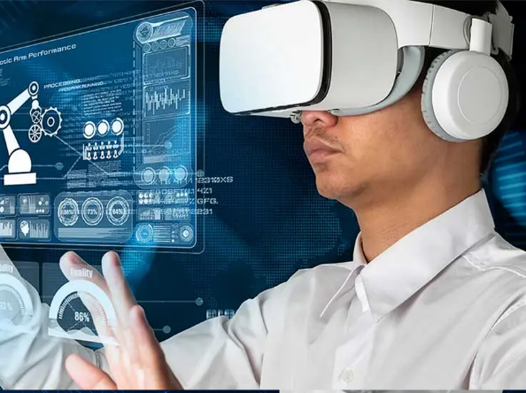
Why oneM2M and Metaverse?
Current Metaverse services are focusing contents. It looks like the early stage of internet.
As the internet has been extended to Internet of Things, the Metaverse will expand its scope to O2O. It means oneM2M could be the connecting point between the Metaverse services and the real world.
oneM2M adopts its new features of IoT now, e.g. AIoT. Metaverse is good keyword as an additional new features.
Metaverse IoT is the one of key features of oneM2M Rel-5.

Slide 3
3GPP Metaverse 5G
WI: Study on Localized Mobile Metaverse Services (FS_Metaverse)
Objective:
  Support of interactive XR media shared among multiple users in a single location, including:
    performance (KPI) aspects; e.g. latency, throughput, connection density
    efficiency and scalability aspects, for large numbers of users in a single location.
  Identification of users and other digital representations of entities interacting within the metaverse service.
  Acquisition, use and exposure of local (physical and digital) information to enable metaverse services, including:
    acquiring local spatial/environmental information and user/UE(s) information (including viewing angle, position and direction);
    Exposing local acquired spatial, environmental and user/UE information to 3rd parties to enable metaverse services.
  Other aspects, such as privacy, charging, public safety and security requirements.
Rapporteur: Erik Guttman (Samsung)
Supporting Members: AT&T, Charter Communications, China Mobile, China Telecom, China Unicom, Convida Wireless, Dish Network, Ericsson, ETRI, FirstNet, Futurewei, Hansung University, Huawei, Intel, InterDigital, Kyonggi University, KDDI, KPN, KT Corp, Lenovo, LG Uplus, Motorola Mobility, OPPO, Orange, Qualcomm, Samsung, Sony, SK Telecom, Tencent, TNO, Verizon UK Ltd., vivo, Xiaomi, ZTE (34)

Slide 4
3GPP Metaverse 5G
Doc: TR 22.856
Use Cases:
  Localized Mobile Metaverse Service Use Case
  Mobile Metaverse for 5G-enabled Traffic Flow Simulation and Situational Awareness
  Spatial Anchor Enabler Use Case
  Spatial Mapping and Localization Service Enabler Use Case
  Mobile Metaverse for Immersive Gaming and Live Shows
  AR Enabled Immersive Experience
  Supporting multi-service coordination in one metaverse
  Synchronized predictive avatars
  Use case on Metaverse for Critical HealthCare Services

Slide 5
IEEE Computer Society SAB SC Metaverse PAR Study Group
IEEE 3079
  Chair: Beom-ryol Lee, ETRI
  PAR
    P3079.3 Standard for a Framework for Evaluating the Quality of Digital Humans
    P3079.3.1 Standard for Service Application Programming Interfaces (APIs) for Digital Human Authoring and Visualization
IEEE Computer Society SAB SC Metaverse PAR Study Group
  Chair: Ming Li, CESI
  Draft PAR
    Standard for Metaverse Reference architecture
    Standard for Digital human Reference architecture

Slide 6
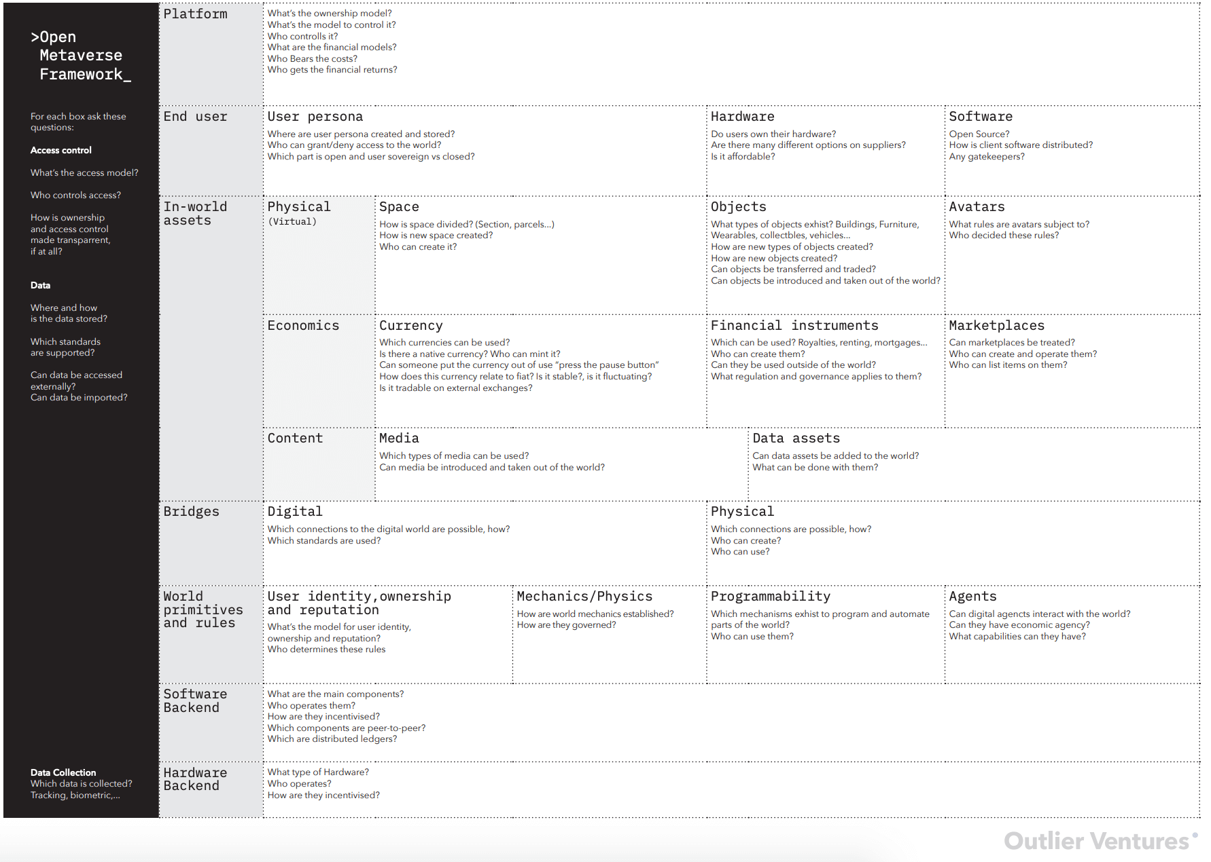
EXAM: Open Metaverse Framework
https://outlierventures.io/research/closer-look-at-the-open-metaverse-os/

Slide 7
oneM2M MetaIoT
WI: Enablement of IoT in the metaverse (MetaIoT)
Objective:
  Definition of “IoT in the metaverse” in the context of oneM2M
  Use cases to show clearly that the metaverse services based on IoT
    Potential Common Service Functions that enable metaverse services based on IoT
    Interworking with considering the status of other SDOs
    Information Model of metaverse devices
    Cooperation with other SDOs, forums, etc., e.g. ETSI ARF, Metaverse Standards Forum
Rapporteurs:
  Andrew Min-gyu Han (Hansung University)
  Shane He (Nokia FR)
Supporters: Hansung University, Nokia, KETI, Sejong University

Slide 8
Discussion points
What is “Metaverse-IoT”?
  virtual device w Properties, e.g. Phy device
  data model, digital twin
  real-virtual world integration (MSF)
What is the key service/technology of Metaverse-IoT?
  integrating different kinds of network
  Translating communications – integrating different device environments (e.g. HMD and Smartphone)
  data modeling
  digital twin
  Personal IoT(3GPP)
How we handle the Metaverse services in the oneM2M world?
  Common Service Element
  Interworking
  Information Model
  domains (inderstrial, home, )
Use case
  system integration level use cases
  virtual store
Future work
  Skeleton TR
  other SDO’s activities
  Event w Metaverse companies (in RDM#57)

Slide 9
Thank you!

