Slide 1
Scope of MetaIoT TR
RDM-2023-0053 MetaIoT Scope
Group Name: RDM
Source: JaeSeung Song (Sejong Univ. )
Meeting Date: 2023-08-16

Slide 2
Main contents of MetaIoT TR
Define MetaIoT concept
  What is Metaverse?
  What are relationships between Metaverse and IoT → Bridging the gap between the real world and virtual world
Gap analysis of existing standards related to Metaverse and IoT
  ITU-T
  JTC1
  IEEE
Collect potential use cases, for example,
  Virtual store in Metaverse
  Manufacturing in Metaverse
  Etc.

Slide 3
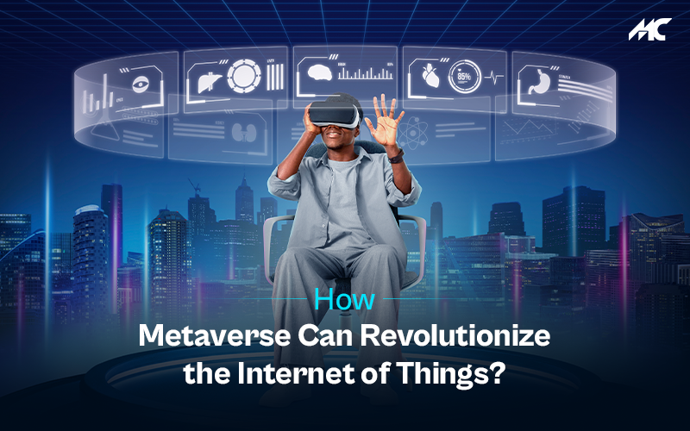

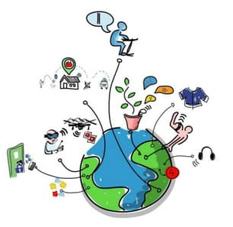
Scope of MetaIoT
Metaverse Services
Virtual actuating & sensing
Actuating
Sensing
IoT
IoT
Modelling
Real actuating & sensing
Actuating
Sensing
Modelling
Physical things (wall, building, etc.)
IoT devices
Physical World

Slide 4
Scope of MetaIoT
Metaverse Services
Virtual actuating & sensing
Out of Scope
Actuating
Sensing
IoT
IoT
Modelling
Real actuating & sensing
Actuating
Sensing
Modelling
Physical things (wall, building, etc.)
IoT devices
Physical World

Slide 5
Thank you!

