Slide 1
Support for
Composite Digital Twins
Group Name: RDM
Source: Bob Flynn, Exacta
Meeting Date: 2024-02-26
RDM-2024-0006-Digital_Twin_Composition

Slide 2
STF 628 – Digital Twins
D2: DTS/SmartM2M-103845 Digital Twins communication requirements
D3: DTS/SmartM2M-103846 Digital Twins: Functionalities and communication Reference Architecture
D4: DTR/SmartM2M-10384723179 Digital Twins communication support in oneM2M

Slide 3
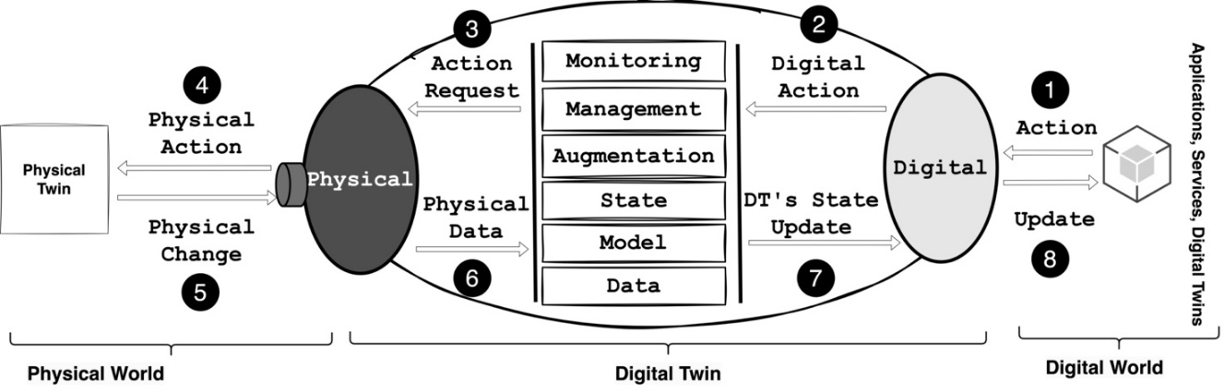
Digital Twin Concept

Slide 4
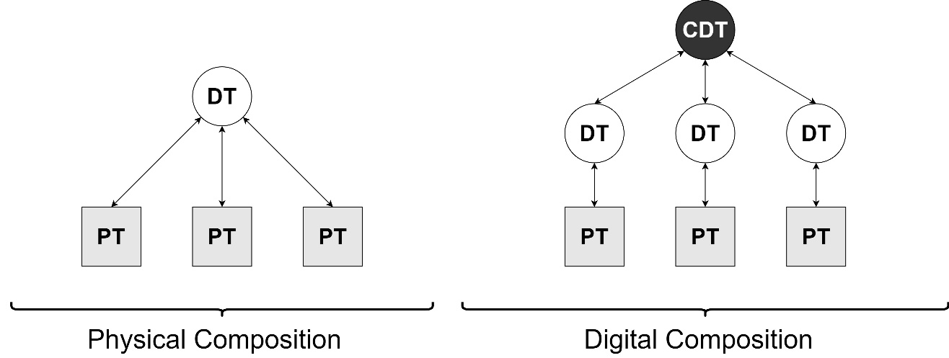
Examples of Composite Digital Twin

Slide 5
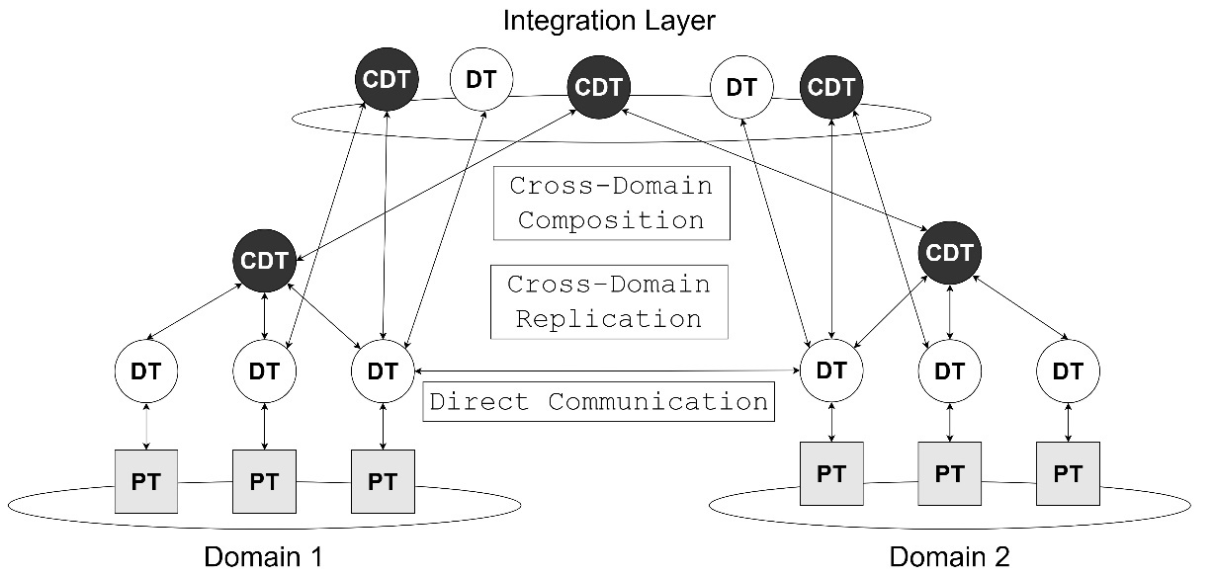
Examples of Composite Digital Twin

Slide 6
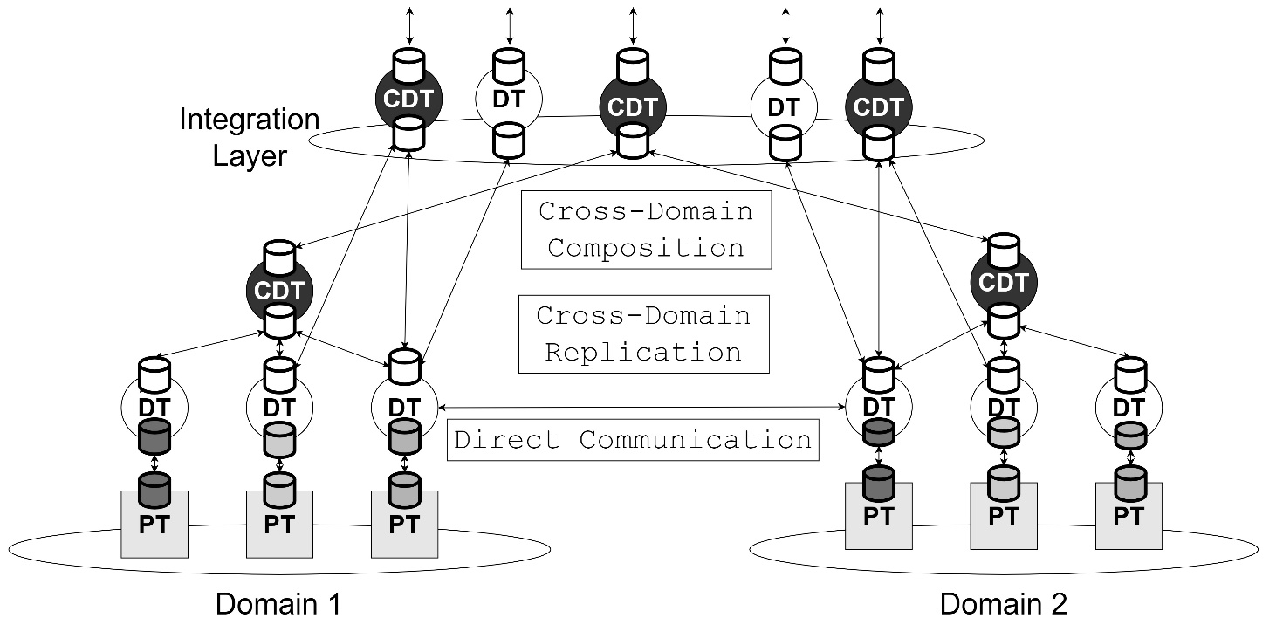
Examples of Composite Digital Twin

Slide 7
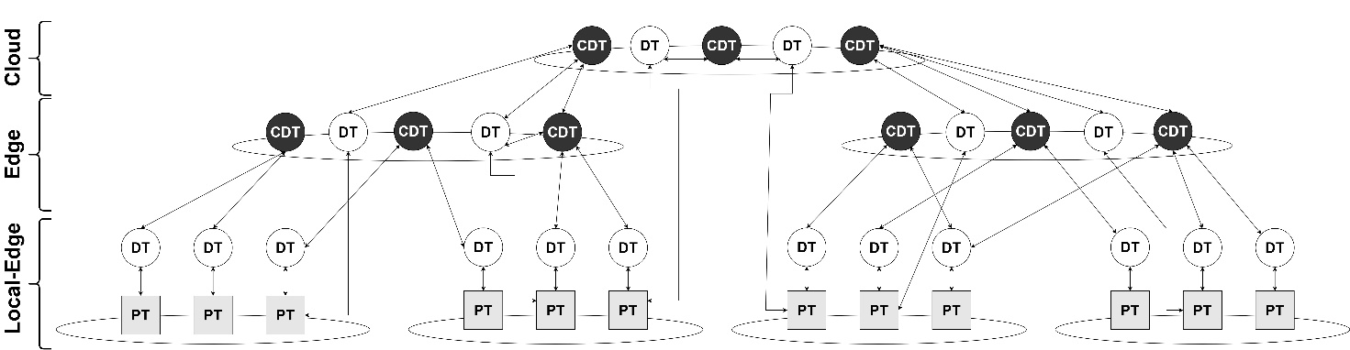
Examples of Composite Digital Twin
CSE 7
CSE 5
CSE 6
CSE 1
CSE 2
CSE 3
CSE 4

Slide 8
How can oneM2M achieve this?
Constraints
  Devices cannot be responsible for this type of distribution of data. It is unrealistic to anticipate all needs of applications that might use the data.
FlexContainer
  Offers the custom attributes that can be used for the CDT
  Lacks Bi-directional synchronization
AnnounceTo
  Offers the Bi-directional synchronization
  Lacks custom definition (we can announce subset of existing resource)
  Lacks support for multiple data sources
Aggregator AEs
  Subscribes to data elements and then creates new composite resources
  Bi-directional synchronization can be challenging
  New composite DT requires new AE
<Group> DT resources to realize CDT

Slide 9
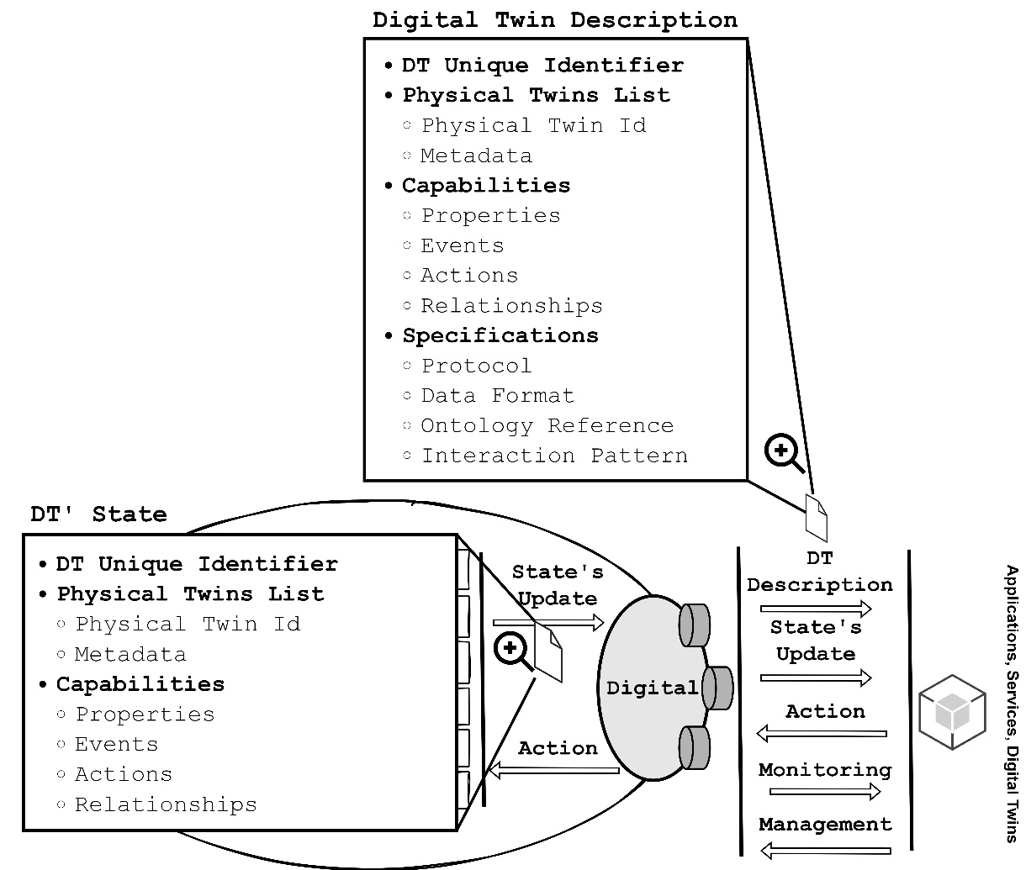
Digital Twin InterOperability
The DT's DCC shall abstract raw data and information from its core model, providing a simplified representation of the DT's state (properties, events, action and relationships), capabilities and actions to external digital entities through the representation through one or multiple format of a Digital Twin Description (DTD) as illustrated in Figure 19.

Slide 10
Thank you!

