Slide 1

Operations on a dynamic set of resources
How to optimize workflow?
ARC-2018-0348-discovery-based_operations_Usecase
Group Name: SDS
Source: mailto: Leila Le Brun (Orange), Cyrille Bareau (Orange), Sébastien Bolle (Orange)
Meeting Date: 2019-xx-xx
Agenda Item: TS-0001 and TS-0004 related

Slide 2
Use cases & issue
Use Case 1: Update a dynamic set of resources
Use-case 1: perform the same request on a dynamic set of resources (e.g. perform an UPDATE request to “switch on” the lights located on the 1st floor)
Current workflow in 3 steps:
Perform a discovery request in order to find out BinarySwitch module FlexContainers matching conditions.
Based on the discovery result, create a new group.
Execute an UPDATE request on all members of the group through group’s fanOutPoint
Issue : performance issue (time and bandwidth)

Slide 3
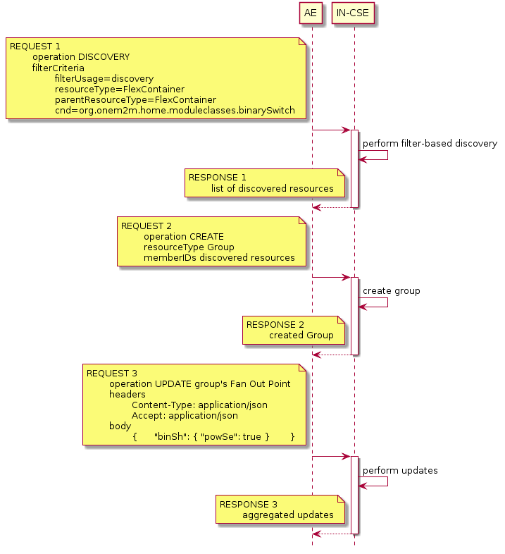
Focus on existing behavior
Current Use Case 1 workflow to update a dynamic set of resources requires
3 steps
Performance issue

Slide 4
Use cases & issue
Use Case 2: Delete a dynamic set of resources
Use-case 2: delete a dynamic set of resources (based on filtering conditions)
Current workflow in 3 steps:
Perform a discovery request in order to find out resources that match conditions.
Based on the discovery result, create a new group.
Execute a DELETE request on all members of the group through group’s fanOutPoint
Issue : performance issue (time and bandwidth)

Slide 5
Possible solution
Discovery-based Operation
Introduce Discovery-Based Requests
Discovery-based Request is a single request to be executed on a set of resources
The set of resources identified by a filter criteria
The set of resources is not a permanent group
A single request instead of 3

Slide 6
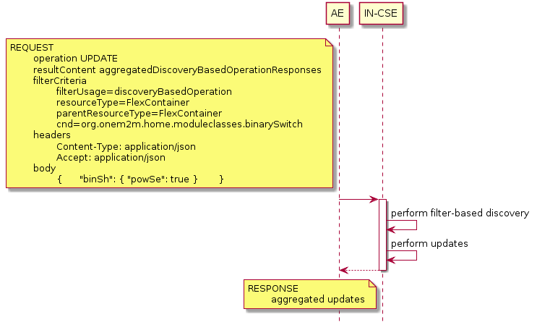
Discovery-based Operation
Use Case 1: Update a dynamic set of resources
    The all in one request proposal

Slide 7
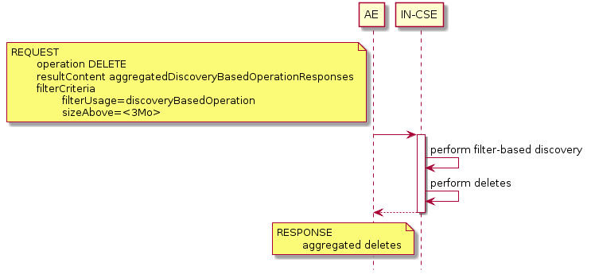
Discovery-based Operation
Use Case 2: Delete a dynamic set of resources
    The all in one request proposal

