Slide 1
Edge/Fog work-scope in oneM2M and ETSI MEC interworking options
Group Name: SDS #40
Source: Convida; Mladin.Catalina@convidawireless.com ; Seed.Dale@convidawireless.com
Meeting Date: 2019-05-18
Notes:
Other suggested titles:
“Benefits of oneM2M Standardization”

Slide 2
Agenda
Discussion on oneM2M E/F work focus
Work Split Proposal
Way Forward

Slide 3
How does oneM2M fit in the Fog/Edge landscape
  oneM2M already supports the concept of decentralized and local services (e.g. MN/ASN-CSE)
    This is very well-aligned with Fog/Edge
  However, oneM2M does not define functionality for managing its decentralized and local services
    E.g. install, remove, start, stop, migrate, etc.
    This is needed for deploying oneM2M in a Fog/Edge manner
    → This is a gap that oneM2M needs to address

Slide 4
What oneM2M should avoid
Re-inventing existing technologies
  E.g. Methods for virtualization & scaling of HW resources and SW services
Instead, oneM2M should be compatible and/or leverage existing technologies
  E.g. NFV, SDN, VMs, containerization, etc.

Slide 5
What oneM2M should focus on
Management of “services” within oneM2M System:
  Dynamic management of complex/ abstracted services (defined at developer/ user/ operator level)
    Provide capability to de-compose “complex/abstracted services” into common or application service elements
    Define APIs for instantiating, deleting, enabling, disabling, resetting, etc. of all oneM2M entities (CSEs/CSFs/AEs) offering services
  Dynamic migration of oneM2M service entities and their context information between nodes
    APIs for migrating oneM2M entities and their context information between nodes while maintaining service continuity

Slide 6
Agenda
Discussion on oneM2M E/F work focus
Work Split Proposal
Way Forward

Slide 7
Proposed Work Split
Split work in 3 parts (details on next slides):
  Native oneM2M functionality
  ETSI MEC interworking (2 aspects)
  Others (e.g. SDN)
High priority
(Rel-4)
Med priority
(Rel-4/Rel-5?)
Lower priority
(Rel-5+)

Slide 8
A. oneM2M Native functionality

Slide 9

What already exists?
Registration
Service Layer
TS-0001 Clause 6.2.1.1
The Application and Service Layer Management (ASM) CSF provides management of the AEs and CSEs on the ADNs, ASNs, MNs and INs. This includes capabilities to configure, troubleshoot and upgrade the functions of the CSE, as well as to upgrade the AEs.
Registration
Discovery
Security
Group Management
Communication Management
Data Management & Repository
Subscription & Notification
Device Management
Application & Service Management
Network Service Exposure
Location
Service Charging & Accounting
Semantics
Transaction Management
TS-0001 Clause 6.2.1.2.0
The ASM CSF utilizes the functions provided by the Device Management (DMG) CSF for interaction with the Management Server:
  • Configuration Function (CF): This function enables the configuration of the capabilities and features of the CSE (e.g. CMDH policies).
  • Software Management Function (SMF): This function provides lifecycle management for software components and associated artifacts (e.g. configuration files) for different entities such as CSE and AE
TS-0001 Clause 6.2.1.2.1
The ASM CSF provides the capability to manage the lifecycle of the Software Packages for a CSE or an AE.
The lifecycle of a Software Package consists of states (e.g. Installing, Installed, Updating, Uninstalling and Uninstalled) that transition when an action (e.g. Download, Install, Update and Remove) is applied to the Software Package.
When a Software Package is installed into an execution environment the software component that is capable of executing in the Execution Environment is called a Software Module. The lifecycle of a Software Module consists of states (e.g. Idle, Starting, Active, Stopping) that transition when an action (e.g. Start, Stop) is applied to the Software Module.

Slide 10
What’s missing?
Normative ASM APIs and procedures for managing CSEs/CSFs/AEs hosted on oneM2M nodes
  E.g. [mgmtObj] specializations to enable:
    instantiating/deleting oneM2M entities on oneM2M nodes
    enabling/disabling oneM2M entities on oneM2M nodes
    monitoring oneM2M entities on oneM2M nodes
    resetting oneM2M entities on oneM2M nodes
    migrating oneM2M entities between oneM2M nodes
    coordinating services across a group of oneM2M entities and nodes (e.g. fog cluster) and redirecting requests to other nodes/entities for particular types of services
  Advanced functionality:
    divide common or application services in tasks that get coordinated
    implement IN functionality at the Edge/Cloudlet (local Breakout)
The only <mgmtObj> that exists today and is relevant is [software] but it is not completely adequate
    → Start with additional [mgmtObj] specializations for managing oneM2M entities

Slide 11
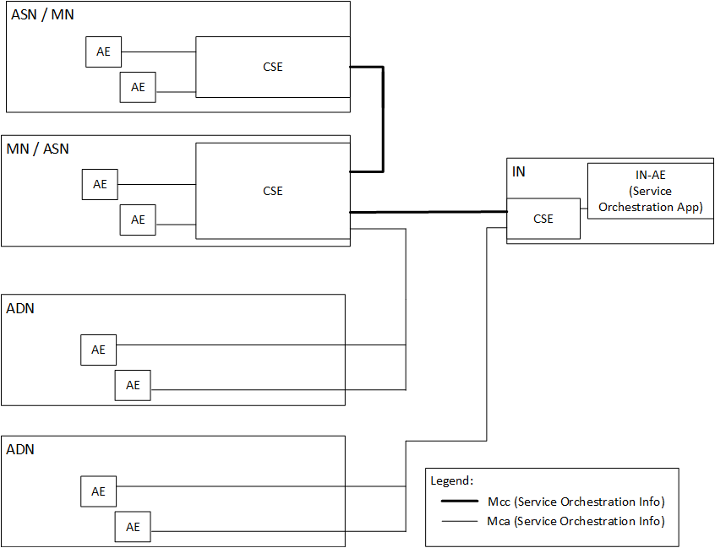
Deployment Example #1 – Native oneM2M
Use a native oneM2M IN-AE to orchestrate the oneM2M service entities (AEs, CSEs, CSFs) hosted on oneM2M nodes
IN-AE interfaces directly to [mgmtObj]s for each node in system to manage the CSE/CSFs/AEs of that node

Slide 12
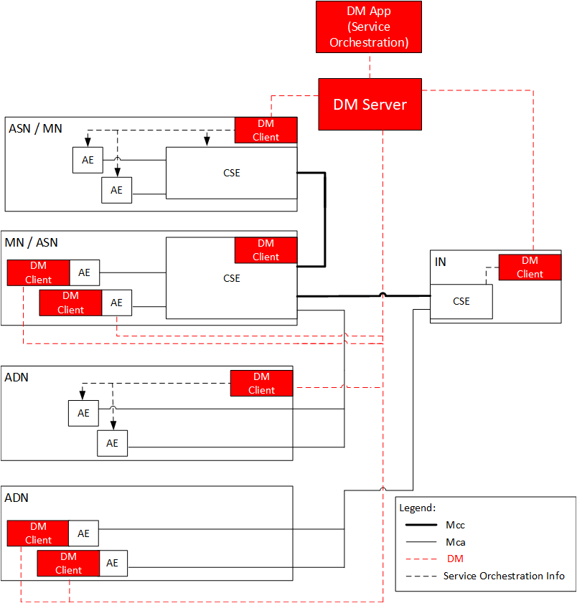
Deployment Example #2 –
Device Management
Use a DM to orchestrate the oneM2M service entities (AEs, CSEs, CSFs) hosted on oneM2M nodes
DM App interfaces indirectly via DM Server to [mgmtObj]s for each node in system to manage the CSE/CSFs/AEs of that node

Slide 13
B. ETSI MEC Interworking

Slide 14
Interworking to use ETSI MEC Orchestration @ Cloud & Cloudlet
Enable Deployments using ETSI MEC for Orchestration
  Use ETSI MEC Orchestration services with IN and/or Cloudlet (MN) implemented on a Mobile Edge Platform that provides orchestration services.
  May be able to reuse/map some oneM2M Native procedures and bind them to MEC interfaces
  Service migration between Fog nodes would (most likely) be oneM2M (via [mgmtObj])

Slide 15
Deployment Example #2 –
Interworking Example
Interwork to external entity to orchestrate the services in the Cloud/ Cloudlet
3rd Party Orchestrator interworks via [mgmtObj]s to manage the CSE/CSFs/AEs of each node in the system

Slide 16
Interworking for Orchestration
Two alternatives briefly discussed with MEC
  Contributor view:
    Mm1 ext: IN provides high-level requirements for orchestration
    Mm3 ext: Allows IN (or MN) to be tightly integrated at the Mobile Edge Platform – longer shot
  Notes:
    IPE interworking option likely not optimal
    ETSI MEC NOT on the same page with this view

Slide 17
Interworking based on ETSI MEC APIs
Contributor view: enable two scenarios:
  Enable ETSI MEC APIs use by oneM2M entities
  Enable ETSI MEC to deploy oneM2M services as Edge Applications.
Notes:
  Scenarios are not alternatives, can decide to support both
  Advantages of ETSI MEC APIS over using 3GPP T8 are FFS
  oneM2M “business case” unclear
  ETSI MEC NOT on the same page with this view?

Slide 18
C. Other interworking and implementation issues

Slide 19
Study other interworking and implementation issues
Use SDN for dynamic deployment of network functions in the fog hierarchy
  oneM2M needs to provide e.g. traffic redirection/ adaption mechanisms
Study impact of virtualization technique choice on oneM2M implementations, e.g.:
  Use of containers and unikernels for virtualization
  Effects of VM use for IN/MN-CSE implementation, scaling up/down impact on capability discovery

Slide 20
Agenda
Discussion on oneM2M E/F work focus
Work Split Proposal
Way Forward

Slide 21
Way forward
oneM2M agrees on 3 tracks/ priorities
  Topic splits and priorities can be adjusted as we go
  Cooperation with ETSI MEC is beneficial for focusing the interworking aspects BUT oneM2M Native functionality will be the priority
The tracks can allow for parallelization of the work offline, with regular check-ins into SDS and TP conf calls, meeting, etc.

