Slide 1
Discussion on
<locationPolicy> resource
oneM2M SDS#40
KETI, SeungMyeong Jeong

Slide 2
Outline
Item1: Whose location is this?
Item2: How does the location info look like?
Features way forward
Testing on <locationPolicy>

Slide 3
Whose location is this? (1/2)
As we know, <locationPolicy> resource is the config/policy to get location info of somebody into a <container> resource
“Whose” is really unclear in the spec.
  it depends on the ‘locationSource’
    Network: can be any underlying network identified device (AE or CSE)
    Device: <locationPolicy> resource Hosting CSE
    Sharing: AND-AE’s location but referring MN-CSE’s, so eventually MN-CSE’s location
  many misunderstands that it is other app’s location
    Location of an AE who creates <locationPolicy> resource, and they believe the AE puts location info as <contentInstance> resources
Let’s put clear texts on this, once we confirm that we’re on the same page

Slide 4
Whose location is this? (2/2)
The parents of <locationPolicy> resource are
  <CSEBase> resource
    “Whose location” depends on the ‘locationSource’ (see the previous slide)
    E.g. get location of MN-CSE on a vehicle is consumed by other apps
    (locationSource = device/GPS or network)
  <AE> resource, which is relatively new (ARC-2018-0214 CR_LocationPolicy_Parent_R4)
    Seems like there should be no impact on “whose location”, but just the allowed resource hierarchy for <locationPolicy> resource creation. Is this correct?

Slide 5
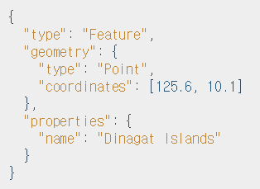
How does the location info look like? (1/2)
We say nothing on location information syntax and semantics for <contentInstance> resource
  Then how does AE1 that creates <locationPolicy> resource, and CSE puts location info as a <contentInstance> resource. What’s the syntax and semantics of the content attribute then?
  For example, among several geometry types, ‘Point’ would be put in the spec. with GeoJSON format
  Note that altitude is optional
    RFC 7946: “Altitude or elevation MAY be included
    as an optional third element”
Option 1
Opt 3
Opt 2
Source: geojson.org

Slide 6
How does the location info look like? (2/2)
Semantics
  Coordination system can be fixed in the spec. e.g. WGS84
  Geometry type can be fixed in the spec. ‘Point’ since this is not the tracking use case but single point geo location retrieval
Syntax
  Since we support XML as well as JSON, we cannot use JSON syntax directly but need to introduce stage 3 complex data type in TS-0004
    Altitude as optional while longitude and latitude are mandatory

Slide 7
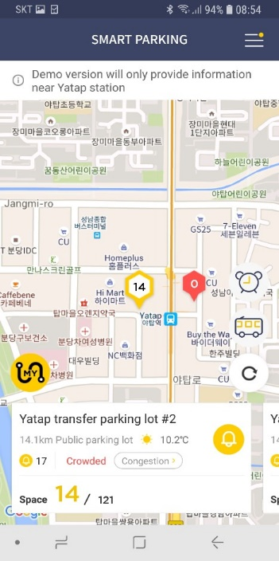
Features way forward
Geospatial functions with extended Filter Criteria
  Among many geo functions, as oneM2M ‘Discovery’ feature, ‘Point’ geometry data of a CSE/AE should be evaluated and be determined as true/false
    E.g. ST_Contains, ST_Intersects, ST_Disjoint
    E.g. give me the vehicle containers on a map (as rectangle Polygon) in mobile app

Slide 8
Testing on <locationPolicy>
Among three ‘locationSource’ modes,
  Network, can be tested but not easy to setup the testing environment since we need network side implementations
  Device, this is easier when we have oneM2M Node with GPS capability
  Sharing, this seems possible either ‘network’ or ‘device’ mode are feasible at the test
Then let’s do the test at least for interoperability
  Conformance could be also tested

