Slide 1
MQTT over Mcc’
oneM2M SDS#44
SeungMyeong Jeong (KETI)

Slide 2
Motivation
There’s the old action item on MQTT over Mcc’, especially the convention of MQTT topic name space

Slide 3
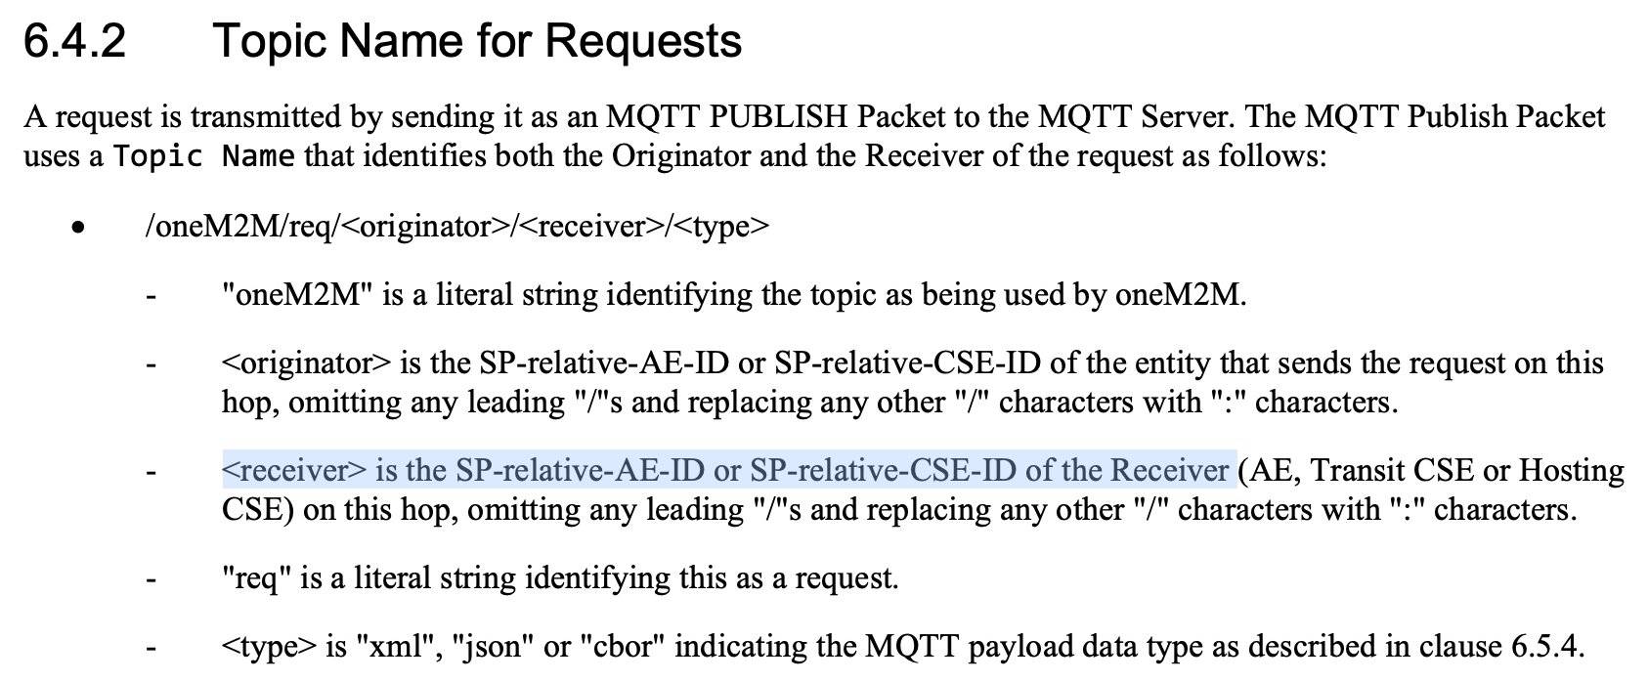
Request for Mcc’
To parameter is not fully mapped into an MQTT topic, but partially
  To parameter consists of receiver (i.e. Hosting CSE) ID and the CSE-relative resource ID
Receiver ID is written in SP-relative ID format

Slide 4
MQTT in oneM2M hop-by-hop comms.
In the same SP-domain communications, an assumption is that there is one broker
orig.
1
broker
1
2
3
recv. 0
4
recv. 1
(ID: in-cse)

Slide 5
MQTT in oneM2M hop-by-hop comms.
Assume that each SP has its own broker
For the Mcc’ between IN-CSEs, a request traverses over different brokers
orig.
1
broker
1
broker
2
2
3
recv. 0
4
5
6
recv. 1
(ID: in-cse)
recv. 2
(ID: in-cse)
<originator> : in-cse
<receiver> : in-cse
<originator> : //sp1.com/in-cse
<receiver> : //sp2.com/in-cse
How do we differenciate those two CSEs in MQTT topic?

Slide 6
Candidate solutions to have SP-ID
Option 1) an extended convention that concatenates SP-ID without ‘//’ and Originator/Receiver (CSE or AE) ID without ‘/’ with a reserved character by RFC3986
  AE-ID and CSE-ID only can use unreserved characters = ALPHA / DIGIT / "-" / "." / "_" / "~”
  it is okay to use a reserved character in MQTT topic name once it is not the MQTT keyword (e.g. ‘+’ and ‘#’)
  e.g. /oneM2M/req/sp1.com:in-cse/sp2.com:in-cse
Option 2) have two more tokens in the end of a topic to represent SP-ID of Originator and Receiver, respectively
  e.g. /oneM2M/req/in-cse/in-cse/json/sp1.com/sp2.com
Option 3) may be other ideas…

Slide 7
Target releases
In general, this change applies to any releases including R2
However, R2 is closed so it seems better to apply from R3

