Slide 1
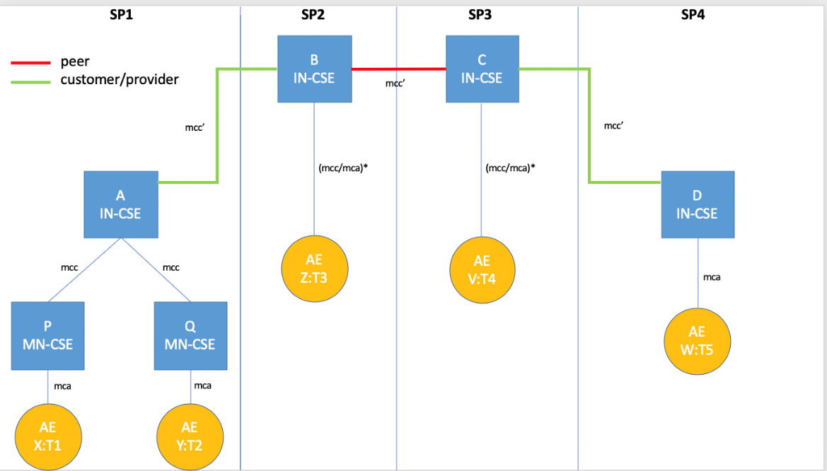
Advanced Semantic Discovery
Luigi Liquori
Inria Sophia Antipolis – Méditerranée
&
STF 589 Team
SDS, 20 July 2020

Slide 2
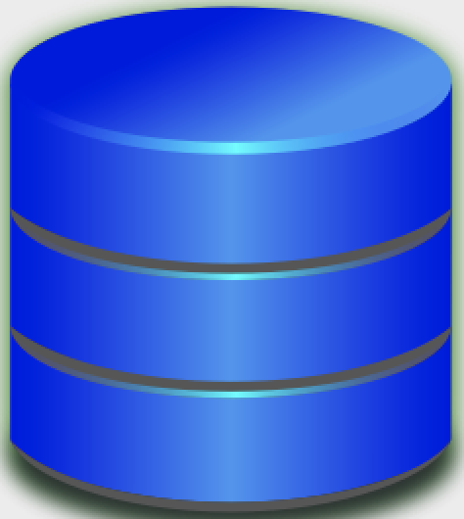
Advanced Semantic Discovery
Advanced Semantic Discovery is an extension of the present oneM2M semantic discovery across a network of CSEs statically connected among them in a tree-like topology inside a single or multiple Service Provider (SP) or Trusted Domains, including non oneM2M ones and in a mesh-like topology between the root of the different SPs.
Luigi Liquori
Notes:
each CSE have a local database

Slide 3

User-defined Types / Extend the oneM2M Ontology
We could access to the URI of one (or many) AE
Just by knowing its TYPE or ONTOLOGY membership!
Can I found the URI of an AE of TYPE T5?
Luigi Liquori

Slide 4
Semantic Discovery Agreements (SDA)
Aims at adding a semantic registering information for the cooperation between CSEs.
CSE 2 is a CUSTOMER and CSE 1 is a PROVIDER
CSE 2 takes advantage of the Infrastructure and AEs registered in CSE 1, and also shares Security Policies and IPR of CSE 1.
CSE 1 and CSE 2 are PEERS
CSE 1 and CSE 2 mutually share Infrastructure, and AEs and shares common Security Policies and IPR.
customer/provider
peer/peer
CSE 1
CSE 3
CSE 2
Luigi Liquori
Notes:
Defining SDA is important in an Advanced Resource Discovery because the discovery routing can pass out of a single Trusted Domains, and therefore, an Advanced Search can walk through many different Trusted Domains with different Access Policies. SDA should be set in advance and should be respected by Trusted Domains to guarantee "fair play" discovery packet forwarding.

Slide 5
Advanced Semantic Query Language
Simple queries composed by AND and OR and ROUTING FILTER CRITERIA
to describe directives to the search routing space
ANY = search in all CSE databases;
CURRENT = search in the CSE local database;
CUSTOMER[N] = search in the databases of N CUSTOMER CSE;
PROVIDER[N] = search in the databases of N PROVIDER CSE;
PEER[N] = search start on the databases of N PEER CSE;
BETWEEN_TIME[SEC] = search should give results in SEC;
BETWEEN_SPACE[METER] = search should give results between METER;
OF_BRAND[NAME] = search should give results of brand NAME.
Luigi Liquori
Notes:
Defining SDA is important in an Advanced Resource Discovery because the discovery routing can pass out of a single Trusted Domains, and therefore, an Advanced Search can walk through many different Trusted Domains with different Access Policies. SDA should be set in advance and should be respected by Trusted Domains to guarantee "fair play" discovery packet forwarding.

Slide 6
Actors: 5 AE + 2 MN-CSE + 4 IN-CSE
Luigi Liquori
Notes:
5 Application Entities (AE) X of type T1, Y of type T2, Z of type T3, V of type T4, and W of type T5.
2 Middle Node Common Service Entities (MN-CSE) P, and Q.
A MN-CSE has a local database containing information on their registered AE. The local database includes location information (where each device is currently located), the device type, etc.
4 Infrastructure Node Common Service Entities (IN-CSE) A, B, C, and D.
A IN-CSE has a local database containing information on their registered MN-CSE and AE. The local database includes location information (where each device is currently located), the device type, etc.
Let P and Q are CUSTOMER of the PROVIDER A.
Let A,B,C, and D are PEERS each others

Slide 7

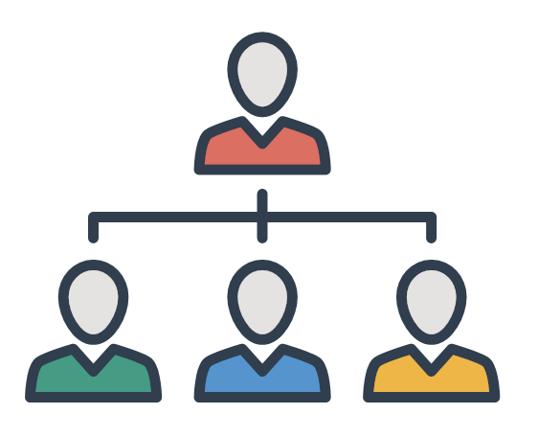
?T2|FC2 AND ?T3|FC3 AND ?T4|FC4 AND ?T5|FC5
?T3|FC3 AND
?T4|FC4 AND
?T5|FC5
?T3|FC3
?T4|FC4
?T4|FC4 AND
?T5|FC5
SDREQ1
?T5|FC5
SDREQ1
?T2|FC2
?T3|FC3
?T4|FC4
?T5|FC5
?T2|FC2
!!START!!
Luigi Liquori
Notes:
A “trace” of the Semantic Discovery Routing (SDR) generated by Example 1 of Clause 6.X is presented, the other examples in the same Clause can be easily traced following the same logic. This trace is inspired to a semantic discovery routing as described in [i.24] and [i.25] and proceeds as follows:
- X sends an Advanced Semantic Discovery Query (ASDQ1) to P
- P verifies the integrity of ASDQ1 and forwards the ASDQ1 to A that starts the Semantic Discovery Routing Protocol (SDPR) into the network of CSE
- ASDQ1 is resolved using the Semantic Query Resolution System (SQRS) locally in A into four subqueries, namely ASDQ2, ASDQ3, ASDQ4, and ASDQ5, where:
ASDQ2 = ?T2|FC2
ASDQ3 = ?T3|FC3
ASDQ4 = ?T4|FC4
ASDQ5 = ?T5|FC5
1.A starts lookups in its local database, trying to solve {ASDQ 2,3,4,5} but fail
2.A down-forwards ASDQ1 to Q via an mcc pointer
3.Q solve the subquery ASDQ2 ?T2|FC2 in its local database returning Y to A
4.A send back Y to P and X
5.A up-forwards ASDQ3 and ASDQ4 and ASDQ5 to B via an mcc’ pointer
6.B solves the ASDQ3 ?T3|FC3 in its local database returning Z to A (and back to P and X)
7.B side-forwards ASDQ4 & ASDQ5 to C
8.C solves the ASDQ4 ?T4|FC2 in its local database returning V to B (and back to A, P and X)
9.C down-forwards ASDQ5 to D
10.D solves the ASDQ5 ?T5|FC5 in its local database returning W to C (and back to B, A, P and X)
Note: When A up-forwards to B, it follows that A respect the CUSTOMER-PROVIDER SDA with B (e.g., A respects the SDA directives of B). When B side-forwards to C, it follows that B and C respect the PEER-PEER SDA directives. When C down-forwards to D, it follows that D respects the PROVIDER-CUSTOMER SDA with C (e.g., D respects the SDA directives of C).
The moral is: B and C should be “acknowledged’’ for their “routing job”.

Slide 8
SDA Table and Semantic Routing Table for a a CSE having x Customers, y Providers and z Peers
CSE CUSTOMERS | CSE PEERS | CSE PROVIDERS
CSE_1 ... CSE_x | CSE_1 ... CSE_y | CSE_1 ... CSE_z
TYPE | URI | CSE CUSTOMERS | CSE PEERS | CSE PROVIDERS
THERMOMETER | URI_1 ... URI_y | (CSE_1, #cu_1) ... (CSE_x, #cu_m) | (CSE_1, #pe_1) ... (CSE_y, #pe_m) | (CSE_1, #pr_1) ... (CSE_z, #pr_m)
WATER_VALVE | URI_1 ... URI_n | (CSE_1, #cu_1) ... (CSE_x, #cu_n) | (CSE_1, #pe_1) ... (CSE_y, #pe_n) | (CSE_1, #pr_1) ... (CSE_z, #pr_n)
AIR_POLLUTION_STATION | URI_1 ... URI_p | (CSE_1, #cu_1) ... (CSE_x, #cu_p) | (CSE_1, #pe_1) ... (CSE_y, #pe_p) | (CSE_1, #pr_1) ... (CSE_z, #pr_p)
Luigi Liquori
Notes:
Defining SDA is important in an Advanced Resource Discovery because the discovery routing can pass out of a single Trusted Domains, and therefore, an Advanced Search can walk through many different Trusted Domains with different Access Policies. SDA should be set in advance and should be respected by Trusted Domains to guarantee "fair play" discovery packet forwarding.

Slide 9
Semantic Routing Table Upgrade and Propagation
TYPE | URI | CSE CUSTOMERS | CSE PEERS | CSE PROVIDERS
THERMOMETER | URI_x | (URIcust1,#2) (URIcust2,#1) | (URIpeer1,#1) | (URIprov,#3)
URI_y
NOTIFY URIcust1 WITH #1 THERMOMETER
NOTIFY URIcust2 WITH #1 THERMOMETER
NOTIFY URIpeer WITH #1 THERMOMETER
NOTIFY URIprov WITH #1 THERMOMETER
Luigi Liquori
Notes:
Note 1. α, β, and γ are protocol specific parameters that can be locally modified in each CSE;
Note 2. if #r=#(m-n-p-q), then we say that the query is exhaustive, and this is in contrast with non-exhaustive routing. Generally, we discriminate two kinds of routing, namely:
“Exhaustive”. As example, in the case that a semantic resource exists somewhere in the CSEs network, then the system will explore the entire distributed network until it will found it.
“Non-exhaustive”. As example, even in the case a semantic resource that exists somewhere in the CSEs network, then the system will explore part of the distributed network until it will be stopped.

Slide 10
Semantic Routing Table Upgrade and Propagation
URI_cust1 TYPE | URI | CSE CUSTOMERS | CSE PEERS | CSE PROVIDERS
THERMOMETER | URIv, URIw | ... | ... | (URIprov, #8+1)
URI_cust2 TYPE | URI | CSE CUSTOMERS | CSE PEERS | CSE PROVIDERS
THERMOMETER | URIz | ... | ... | (URIprov, #8+1)
URI_peer TYPE | URI | CSE CUSTOMERS | CSE PEERS | CSE PROVIDERS
THERMOMETER | URIa | ... | (URIprov, #8+1) | ...
URI_prov TYPE | URI | CSE CUSTOMERS | CSE PEERS | CSE PROVIDERS
THERMOMETER | URIb, URIc, URId | (URIcse, #8+1) | ... | ...
Luigi Liquori
Notes:
Analogously, when a resource unregister on that CSE, a corresponding notify message
NOTIFY URI{cust1,cust2,peer,prov} WITH #-1 THERMOMETER

Slide 11
Semantic Routing Table in the registration phase
Stable Resources (no intermittence)
Stable CSE (solid infrastructure)
But each CSE can increase α, β, and γ replication parameters to improve robustness
And each resource can register on more than one CSE (duplication)
Luigi Liquori

Slide 12
Algorithmic description of the ASD
It extracts the Advanced Semantic Discovery Query;
It reduces the Advanced Semantic Discovery Query into a set of #m Semantic Discovery Queries by means of the Semantic Query Resolution System;
It solve as much Semantic Discovery Queries as it cans, using resources registered in the CURRENT CSE, say #n;
It forwards the remaining #m-n Semantic Discovery Queries to α-CSE Customer "downstream", taken from the CURRENT Semantic Routing Table, resolving say #p;
It forwards the remaining #(m-n-p) Semantic Discovery Queries to β-CSE PEER "sidestream", taken from the CURRENT Semantic Routing Table, resolving say #q;
It forwards the remaining #(m-n-p-q) Semantic Discovery Queries to γ-CSE PROVIDERS "upstream", taken from the CURRENT Semantic Routing Table (SRT), resolving say #r ≤ #(m-n-p-q);
It reconstructs in a reverse order the partial results, sending back to the originator of the Advanced Semantic Discovery Query.
Luigi Liquori
Notes:
Note 1. α, β, and γ are protocol specific parameters that can be locally modified in each CSE;
Note 2. if #r=#(m-n-p-q), then we say that the query is exhaustive, and this is in contrast with non-exhaustive routing. Generally, we discriminate two kinds of routing, namely:
“Exhaustive”. As example, in the case that a semantic resource exists somewhere in the CSEs network, then the system will explore the entire distributed network until it will found it.
“Non-exhaustive”. As example, even in the case a semantic resource that exists somewhere in the CSEs network, then the system will explore part of the distributed network until it will be stopped.

Slide 13
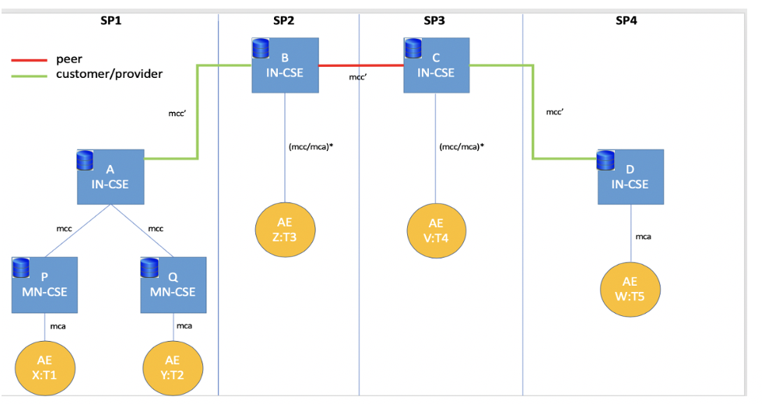
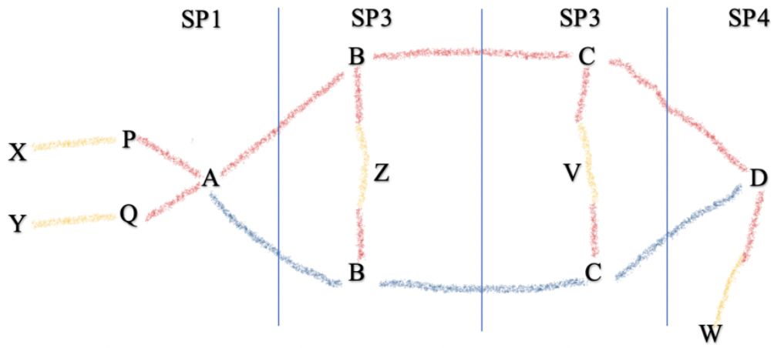
Semantic thank’s
Luigi Liquori
Notes:
It is also possible to consider other restricted semantic routing directives such as (list not exhaustive):

