Slide 1
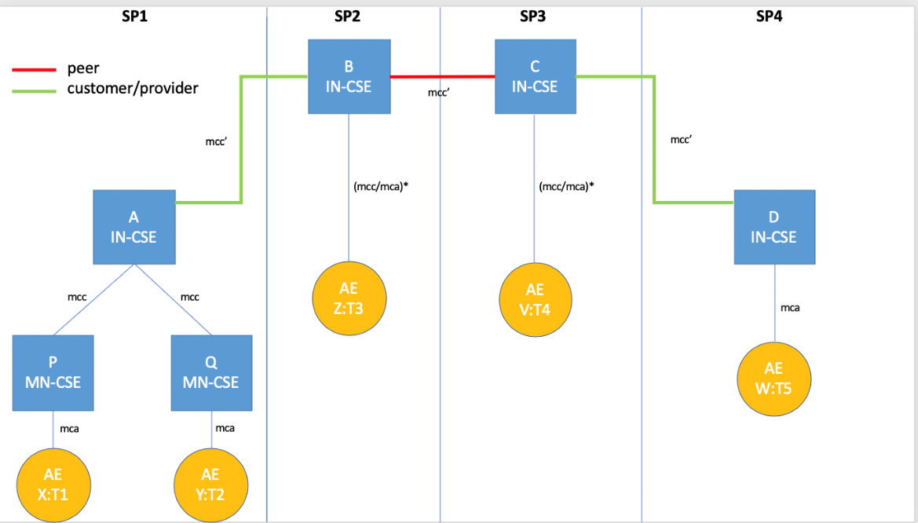
Advanced Semantic Discovery
Luigi Liquori
Inria Sophia Antipolis – Méditerranée
&
STF 589 Team
SDS, 20 July 2020

Slide 2

Advanced Semantic Discovery
Advanced Semantic Discovery is an extension of the actual oneM2M semantic discovery across a network of CSEs statically connected among them in a tree-like topology inside a single or multiple Service Provider (SP), including non oneM2M ones and in a mesh-like topology between the root of the different SPs.
Luigi Liquori
Notes:
each CSE have a local database

Slide 3

Extend the oneM2M Semantic Discovery
We could access to the URI of one (or many) AE
Just by knowing its type-based ONTOLOGY membership!
Can I found the URI of an AE of type T5?
Luigi Liquori

Slide 4
Semantic Discovery Agreements (SDA)
Aims at adding a semantic registering information for the cooperation between CSEs.
ASN-CSE is a CUSTOMER and IN-CSE_1 is a PROVIDER
IN-CSE_1 takes advantage of the Infrastructure and AEs registered in ASN-CSE, and they also shares the same Security Policies.
IN-CSE_1 and IN-CSE_2 are PEERS
They mutually takes advantage of the AEs and the infrastructure of each other and shares compatible Security Policies.
customer/provider
peer/peer
IN-CSE_1
IN-CSE_2
ASN-CSE
Luigi Liquori
Notes:
Defining SDA is important in an Advanced Resource Discovery especially when the discovery routing can pass out of a single Trusted Domains, and therefore, an Advanced Search can walk through many different Trusted Domains with different Access Policies and IPR.
SDA should be set in advance and should be respected by Trusted Domains to guarantee "fair play" discovery packet forwarding. Setting correct SDA intra and inter oneM2M Trusted Domains is necessary to enforce the following oneM2M features.
access control policies between IN-CSE
accounting issues (some spaces can or cannot be searched in)
IPR and licensing issues CC BY*
discovery scoping
discovery pricing
discovery efficiency
discovery load balancing
driving discovery results (some resources could be easily found following the SDA ``no valley paths``)

Slide 5
Routing Filter Criteria (list not hexaustive)
Simple queries (in SPARQL syntax) composed by AND and OR and ROUTING FILTER CRITERIA to describe directives to walk the Search Routing Space
ANY = search all resources matching the criteria;
CURRENT = search in your registered CSE;
PROVIDER = search in your Trusted Domain
PROVIDER[SP1...SPn] = search in SP1 ... SPn Service Providers
TIME[SEC] = search should give the results found in SEC;
SPACE[METERS] = search should give the results within
METERS from a given point
...
Luigi Liquori

Slide 6
Example. 5 AE + 2 MN-CSE + 4 IN-CSE
Luigi Liquori
Notes:
5 Application Entities (AE) X of type T1, Y of type T2, Z of type T3, V of type T4, and W of type T5.
2 Middle Node Common Service Entities (MN-CSE) P, and Q.
A MN-CSE has a local database containing information on their registered AE. The local database includes location information (where each device is currently located), the device type, etc.
4 Infrastructure Node Common Service Entities (IN-CSE) A, B, C, and D.
A IN-CSE has a local database containing information on their registered MN-CSE and AE. The local database includes location information (where each device is currently located), the device type, etc.
Let P and Q are CUSTOMER of the PROVIDER A.
Let A,B,C, and D are PEERS each others

Slide 7


?T2|FC2 AND ?T3|FC3 AND ?T4|FC4 AND ?T5|FC5
?T3|FC3 AND
?T4|FC4 AND
?T5|FC5
?T3|FC3
?T4|FC4
?T4|FC4 AND
?T5|FC5
SDREQ1
?T5|FC5
SDREQ1
?T2|FC2
?T3|FC3
?T4|FC4
?T5|FC5
?T2|FC2
!!START!!
Luigi Liquori
Notes:
- X sends an Advanced Semantic Discovery Query (ASDQ1) to P
- P verifies the integrity of ASDQ1 and forwards the ASDQ1 to A that starts the Semantic Discovery Routing Protocol (SDPR) into the network of CSE
- ASDQ1 is resolved using the Semantic Query Resolution System (SQRS) locally in A into four subqueries, namely ASDQ2, ASDQ3, ASDQ4, and ASDQ5, where:
ASDQ2 = ?T2|FC2
ASDQ3 = ?T3|FC3
ASDQ4 = ?T4|FC4
ASDQ5 = ?T5|FC5
1.A starts lookups in its local database, trying to solve {ASDQ 2,3,4,5} but fail
2.A down-forwards ASDQ1 to Q via an mcc pointer
3.Q solve the subquery ASDQ2 ?T2|FC2 in its local database returning Y to A
4.A send back Y to P and X
5.A up-forwards ASDQ3 and ASDQ4 and ASDQ5 to B via an mcc’ pointer
6.B solves the ASDQ3 ?T3|FC3 in its local database returning Z to A (and back to P and X)
7.B side-forwards ASDQ4 & ASDQ5 to C
8.C solves the ASDQ4 ?T4|FC2 in its local database returning V to B (and back to A, P and X)
9.C down-forwards ASDQ5 to D
10.D solves the ASDQ5 ?T5|FC5 in its local database returning W to C (and back to B, A, P and X)

Slide 8
Semantic Discovery Agreements Table and
Semantic Routing Table for a IN-CSE having
“x” Customers, “y” Providers and “z” Peers
SDA Table
CSE CUSTOMERS | CSE PEERS | CSE PROVIDERS
CSE_1 ... CSE_x | CSE_1 ... CSE_y | CSE_1 ... CSE_z
Semantic Routing Table
TYPE | URI | CSE CUSTOMERS | CSE PEERS | CSE PROVIDERS
THERMOMETER | URI_1 ... URI_q | (CSE_1, #cu_1) ... (CSE_x, #cu_m) | (CSE_1, #pe_1) ... (CSE_y, #pe_m) | (CSE_1, #pr_1) ... (CSE_z, #pr_m)
WATER_VALVE | URI_1 ... URI_r | (CSE_1, #cu_1) ... (CSE_x, #cu_n) | (CSE_1, #pe_1) ... (CSE_y, #pe_n) | (CSE_1, #pr_1) ... (CSE_z, #pr_n)
AIR_POLLUTION_STATION | URI_1 ... URI_s | (CSE_1, #cu_1) ... (CSE_x, #cu_p) | (CSE_1, #pe_1) ... (CSE_y, #pe_p) | (CSE_1, #pr_1) ... (CSE_z, #pr_p)
Luigi Liquori
Notes:
Defining SDA is important in an Advanced Resource Discovery because the discovery routing can pass out of a single Trusted Domains, and therefore, an Advanced Search can walk through many different Trusted Domains with different Access Policies. SDA should be set in advance and should be respected by Trusted Domains to guarantee "fair play" discovery packet forwarding.

Slide 9
Semantic Routing Table Upgrade and Propagation
C S E TYPE | URI | CSE CUSTOMERS | CSE PEERS | CSE PROVIDERS
THERMOMETER | URI_x | (CSEcust1,#_) (CSEcust2,#_) | (CSEpeer,#_) | (CSEprov,#_)
URI_1
...
URI_y
CSEprov
NOTIFY CSEcust1 WITH #y THERMOMETER
NOTIFY CSEcust2 WITH #y THERMOMETER
NOTIFY CSEpeer WITH #y THERMOMETER
NOTIFY CSEprov WITH #y THERMOMETER
C S E
CSEpeer
CSEcust1
CSEcust2
Luigi Liquori
Notes:
Note 1. α, β, and γ are protocol specific parameters that can be locally modified in each CSE;
Note 2. if #r=#(m-n-p-q), then we say that the query is exhaustive, and this is in contrast with non-exhaustive routing. Generally, we discriminate two kinds of routing, namely:
“Exhaustive”. As example, in the case that a semantic resource exists somewhere in the CSEs network, then the system will explore the entire distributed network until it will found it.
“Non-exhaustive”. As example, even in the case a semantic resource that exists somewhere in the CSEs network, then the system will explore part of the distributed network until it will be stopped.

Slide 10
Semantic Routing Table Upgrade and Propagation
CSEcust1 TYPE | URI | CSE CUSTOMERS | CSE PEERS | CSE PROVIDERS
THERMOMETER | URI_v, URI_w | ... | ... | (CSE, #_+y)
CSEcust2 TYPE | URI | CSE CUSTOMERS | CSE PEERS | CSE PROVIDERS
THERMOMETER | URI_z | ... | ... | (CSE, #_+y)
CSEpeer TYPE | URI | CSE CUSTOMERS | CSE PEERS | CSE PROVIDERS
THERMOMETER | URI_a | ... | (CSE, #_+y) | ...
CSEprov TYPE | URI | CSE CUSTOMERS | CSE PEERS | CSE PROVIDERS
THERMOMETER | URI_b, URI_c, URI_d | (CSE, #_+y) | ... | ...
Luigi Liquori
Notes:
Analogously, when a resource unregister on that CSE, a corresponding notify message
NOTIFY URI{cust1,cust2,peer,prov} WITH #-1 THERMOMETER

Slide 11
Algorithmic description of the ASD (sketch)
The CSE receives a query, and ....
It extracts the Advanced Semantic Discovery Query;
It reduces the Advanced Semantic Discovery Query into a set of #m Basic Semantic Discovery Queries by means of the Semantic Query Resolution System;
It solve as much Semantic Discovery Queries as it cans, using resources registered in the CURRENT CSE, say #n;
It forwards the remaining #m-n Semantic Discovery Queries to α-CSE Customer "downstream", taken from the CURRENT Semantic Routing Table, resolving say #p;
It forwards the remaining #(m-n-p) Semantic Discovery Queries to β-CSE PEER; "sidestream", taken from the CURRENT Semantic Routing Table, resolving say #q;
It forwards the remaining #(m-n-p-q) Semantic Discovery Queries to γ-CSE; PROVIDERS "upstream", taken from the CURRENT Semantic Routing Table, resolving say #r ≤ #(m-n-p-q);
It send back to the query originator all the results of the Advanced Semantic Discovery Query.
Luigi Liquori
Notes:
Note 1. α, β, and γ are protocol specific parameters that can be locally modified in each CSE;
Note 2. if #r=#(m-n-p-q), then we say that the query is exhaustive, and this is in contrast with non-exhaustive routing. Generally, we discriminate two kinds of routing, namely:
“Exhaustive”. As example, in the case that a semantic resource exists somewhere in the CSEs network, then the system will explore the entire distributed network until it will found it.
“Non-exhaustive”. As example, even in the case a semantic resource that exists somewhere in the CSEs network, then the system will explore part of the distributed network until it will be stopped.

Slide 12
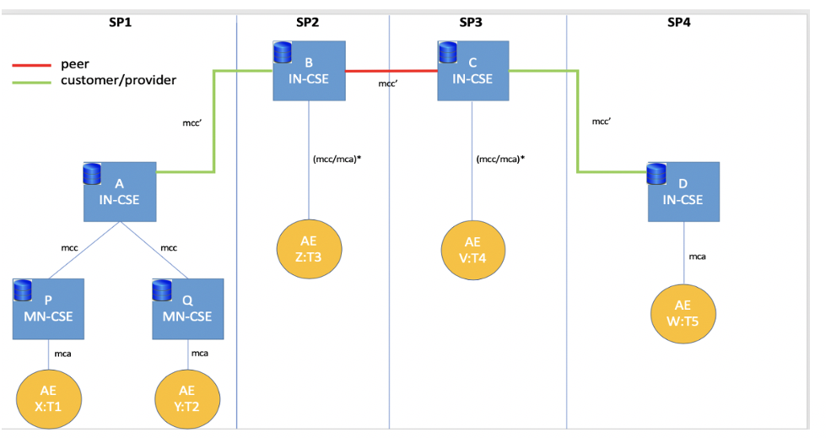
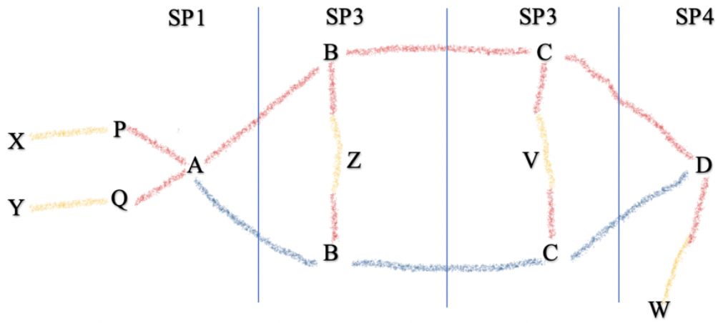
Semantic thank’s
Luigi Liquori
Notes:
It is also possible to consider other restricted semantic routing directives such as (list not exhaustive):

