Slide 1
OGC/SensorThingsAPI IPE or Gateway
Mca vs Mcc Discussion
Ingo Friese, 20.07.2020

Slide 2
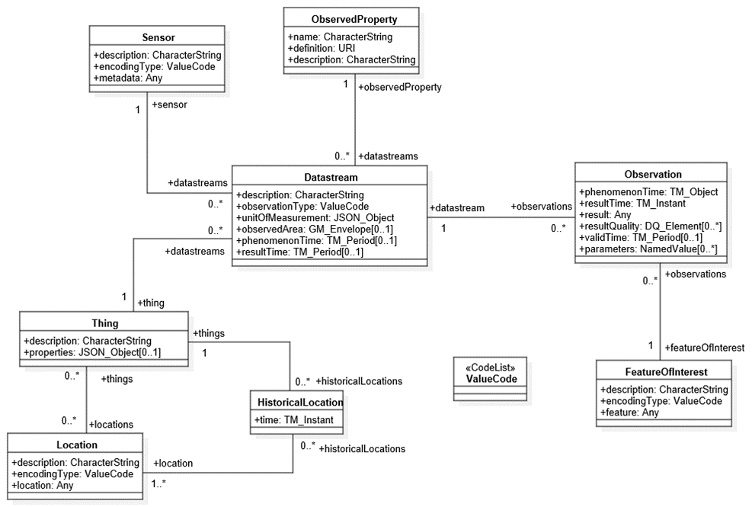
OGC Data Model (ISO 19156)

Slide 3
How to map the OGC data model to oneM2M AE / CNT tree structure
thing
sensor
observedproperty
location
?
datastream
datastream
observation
observation
observation
observation
observation
observation
Assumtion:
Meta (data) model can‘t be mapped directly.
One issue:
There are one-to-many
relationships

Slide 4

No data copies
STA Server
IPE or Gateway
Hosting CSE
Application
Assumtion:
The IPE can‘t build a AE / CNT structure
corresponding to ISO 19156
in the hosting CSE directly
So let STA data stored in STA server
Don‘t try to copy the complete data model to oneM2M
Get the data only when they are needed
or requested

Slide 5
How to get OGC data to oneM2M
STA Server
IPE or Gateway
Hosting CSE
Application
Observation (12345)
CIN / FlexContainer
(Observation(12345))
Get datastream
Get Thing
GET observation(12345)/location“
Get Location
(only when needed)
Approach:
Only forward „observations“ and if additional data needed, request them with observations ID.
e.g. „GET http://ae_or_gw_address/observation(12345)/location“
(now the IPE or GW can do several requests to gather the information)
No data model copy in Hosting CSE (only observations)
But applications only can interact with a data structure in the hosting CSE
Where to send the requests for additional data when there is no data model in the hosting CSE?
The requests are going to be forwarded -> that calls for a remoteCSE

