Slide 1
Issues in AE Registration
Anupama Chopra, C-DOT, anupama@cdot.in
Poornima Shandilya, C-DOT, poornima@cdot.in
Rahul Kumar, C-DOT, krahul@cdot.in
Meeting Date: SDS#48
<number>

Slide 2
Problem
Currently in specs, Service subscription information (SSP-ID, SSN, SSAR) is required by Registrar CSE at AE registration.
It is assumed that the Receiver shall have the subscriber’s profile information preconfigured stored locally or retrieved from the IN-CSE.
This information then shall be used to derive SSN and corresponding check app rules as shown in the next slide.
But at the time of AE registration, it is not clear that how to derive the SSP ID corresponding to that registration request.

Slide 3
TS-0001
The Receiver shall allow the creation of the <AE> resource according to the m2m service subscription validation. Note that access control for resource access (e.g. using <accessControlPolicy> resources) is omitted. To validate the m2m service subscription profile, the Receiver shall check the corresponding <serviceSubscribedNode> resource, by matching the CSE-ID in the m2m service subscription profile against the Receiver owned CSE-ID. Subsequently the Receiver shall check whether the Registree AE is included in the linked (i.e. ruleLinks attribute) <serviceSubscribedAppRules> resource(s).

Slide 4
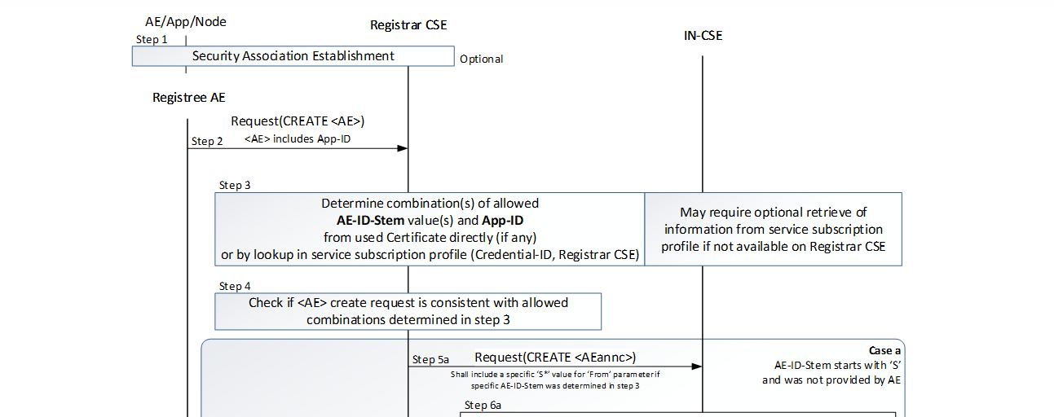
TS-0001

Slide 5
TS-0004

Slide 6
Non security case
With security association, an AE may come with or without an AE-ID as security credentials are used to verify the identity of entity. In this case, SSP information can be mapped with security credentials ([authenticationProfile] resource has mapping of SSP ID).
But in the case of non-security association, only a pre-provisioned AE-ID can help a CSE to check whether this AE is a valid AE or not. (Incase of no security association and no pre-provisioned AE id, a CSE can become vulnerable).
In this case, a [registration] resource containing a pre-provisioned AE-ID and SSP-ID, will help CSE to identify the AE and also to map this AE with its SSP ID.

Slide 7
Solution
This CR proposes to add attribute M2M-Sub-ID in [registration] resource in order to provide the ID of the Service Subscription profile to which this [registration] belongs to. This will enable a CSE to map an AE registration info with its service subscription ID.
When MN/ASN is registrar CSE then [registration] resource for an AE can be announced to MN/ASN to update them with its registree information.

Slide 8
Use at IN Node
Incase for system operations it is required to fetch all the entities (AE and CSE) at IN which belong to a particular service subscription profile , it can be easily fetched.
Secondly , to get the Service subscription id associated with an entity at IN following has to be done : (For non-security case
  Parent id of registration resource -→ will get id of node resource --- > Will get corresponding node id for that resource
  and then search in all SSN resources ( which can be in millions) and get where that node id matches ( which might fetch duplicate ssn)
  Registration -a parent node of registration – ssn node id a parent id of ssn resource will be SSP id .
This is how we will get it. Though this mapping can be stored at IN as per implementation , but still the issue exists for MN and ASN , which do not have SSP id .

Slide 9
Use at MN node
There is no way at MN to know the service subscription id to which an AE/CSE belongs to, therefore cannot retrieve any of the resources associated with Service subscription id , which it might need for its validations of Allowed Appids, Allowed AEid etc.

Slide 10
AE Registration helps the M2M Service Provider to offer its services only to authorized AEs and to protect its platform from malicious AE.
An AE-ID check can be done post registration but how do we ensure the validity of entity coming for registration in case of non-security.

