Slide 1
Discussion on Support for Optimistic Locking
Andreas Kraft – Deutsche Telekom
Andreas Neubacher – Deutsche Telekom

Slide 2
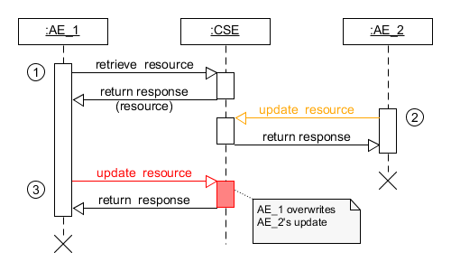
Issue
How can an AE be sure that the state of a resource on a CSE is as expected when, for example, updating the resource?
Usual procedure:

Slide 3
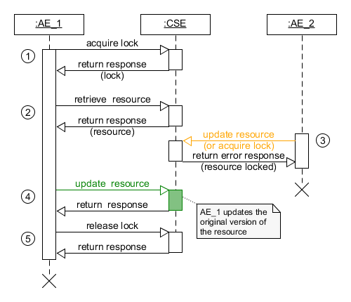
Issue
Common solution:
lock the resource

Slide 4
Discussion
Lock
A mechanism to ensure that only one thread, node or transaction can access a resource, and anyone else who wants to access the same resource must wait (or retry) until the lock is released.
Introducing locking in a RESTfull system is hard
  Many aspects of locking depend on the use case and are application-specific.
  Not realy stateless.
  It also puts more load on the CSE to handle stale locks etc.

Slide 5
Discussion
Sometimes it is enough just to do the „Right / Expected Thing“ instead of acquiring a lock
Introducing Optimistic Locking:
A strategy where one reads a record, takes note of a version number, checksum etc, and checks that the version hasn't changed before the record is written back.
Optimistic Locking with HTTP REST
  The REST server returns a eTag (entity tag) with a version, hash etc of a resource.
  Also used for resource caching.
  The “If-Match” header field in a PUT request makes the request optional: Execute the operation only when the provided (eTag) value matches a resource’s current eTag value on the server.

Slide 6
Possible Solution
Introduce a new “IfMatch” request parameter that can optionally be provided by an AE/CSE when sending an CREATE, UPDATE, and DELETE request.
Introduce a new Response Status Code “Precondition failed” (4012).
Some oneM2M resource types already have a „stateTag“ attribute that could be used as version number for the “IfMatch” request parameter
  We might want to allow the “stateTag” attribute for more resource types.
Procedure: If, for example, an UPDATE request has an “IfMatch” request parameter, then the CSE compares the provided value with the “stateTag” of the target resource, and only executes the request if the “IfMatch” value and the “stateTag” value match.
The impact to the CSE should be minimal

Slide 7
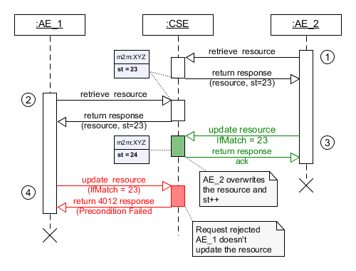
Possible Solution

Slide 8
Thank you

