Slide 1
Machine Learning
Dataset Preparation
oneM2M SDS#52
SeungMyeong Jeong (KETI)
Il-Yeup Ahn (KETI), Jonghong Park (KETI), Chungjae Choe (KETI)

Slide 2
Motivation
Rel-5 WI: WI-0105-System enhancements to support AI capabilities
oneM2M platform gets data from different sources so they have different characteristics (e.g. event data vs. periodic data)
ML inferencing data typically needs all feature data for a timestamp
ML inferencing dataset can be prepared by the platform and used by different ML applications
oneM2M platform does the job instead of ML app
  ML app requests ML training dataset preparation with options
    simple join different data, OR fill up empty ones by policies

Slide 3
Concept
Preparing ML model training dataset
t, flowrate
03:05, 20.2
03:45, 30.3
flow meter
give me training dataset for flowrate, temp and turbidity from 03:00 to 04:00
Water Data
Platform
t, temp
03:00, 20.3
04:00, 18.7
weather API
ML app
t, turbidity
03:03, 2.3
03:13, 2.5
waterQuality sensor
t, flowrate, turbidity, temp
03:00, NaN, NaN, 20.3
03:03, NaN, 2.3, NaN
03:05, 20.2, NaN, NaN
03:13, NaN, 2.5, NaN
03:45, 30.3, NaN, NaN
04:00, NaN, NaN, 18.7
t, flowrate, turbidity, temp
03:00, NaN, NaN, 20.3
03:03, NaN, 2.3, 20.3
03:05, 20.2, 2.3, 20.3
03:13, 20.2, 2.5, 20.3
03:45, 30.3, 2.5, 20.3
04:00, 30.3, 2.5, 18.7
    < simple join different data >
< fill up empty ones by policies >

Slide 4
Interface Design
Target resource
  one of Data Sharing Resources (e.g. container) and provide other DSR list in the parameter
  <MLTrainingData> virtual resource and provide all DSRs to join
Join key
  timestamps like ct, lt, et or any timestamps in application data (e.g. “t” in “con”)
Null value policy
  leave empty, OR
  fill with latest, fill with avg, etc.
Serialization
  XML, JSON, CBOR
  CVS
Response for this RETRIEVE request
  serialized dataset

Slide 5
Concept
Preparing inferencing dataset for a given ML model
t, flowrate
03:05, 20.2
03:45, 30.3
create inferencing dataset for flowrate, temp and turbidity then put it somewhere
flow meter
oneM2M Platform
t, temp
03:00, 20.3
04:00, 18.7
weather API
1. dataset request
3. subscribe cnt
ML app
(inferencing)
4. notify new cin
t, turbidity
03:03, 2.3
03:13, 2.5
waterQuality sensor
2. create a container
inferencingDataset <cnt>
{
"m2m:cin": {
"con": {
"t": "03:13",
“flowrate": 20.2,
“turbidity": 2.5,
"temp": 20.3
}
}
}
{
"m2m:cin": {
"con": {
"t": "03:45",
“flowrate": 30.2,
“turbidity": 2.5,
"temp": 20.3
}
}
}
…

Slide 6
Interface Design
new <MLDatasetPolicy> resource
  similar to <locationPolicy> resource behavior
  when <MLDataset> resource is created, a <container> resource gets created also to store dataset
Subscription/notification can be leveraged
  when subscribe the <container> resource, new inferencing input data can be received over noti.
Join key
  timestamps like ct, lt, et or any timestamps in application data (e.g. “t” in “con”)
Null value policy
  leave empty, OR
  fill with latest, fill with avg, etc.
Serialization
  XML, JSON, CBOR
  CVS

Slide 7
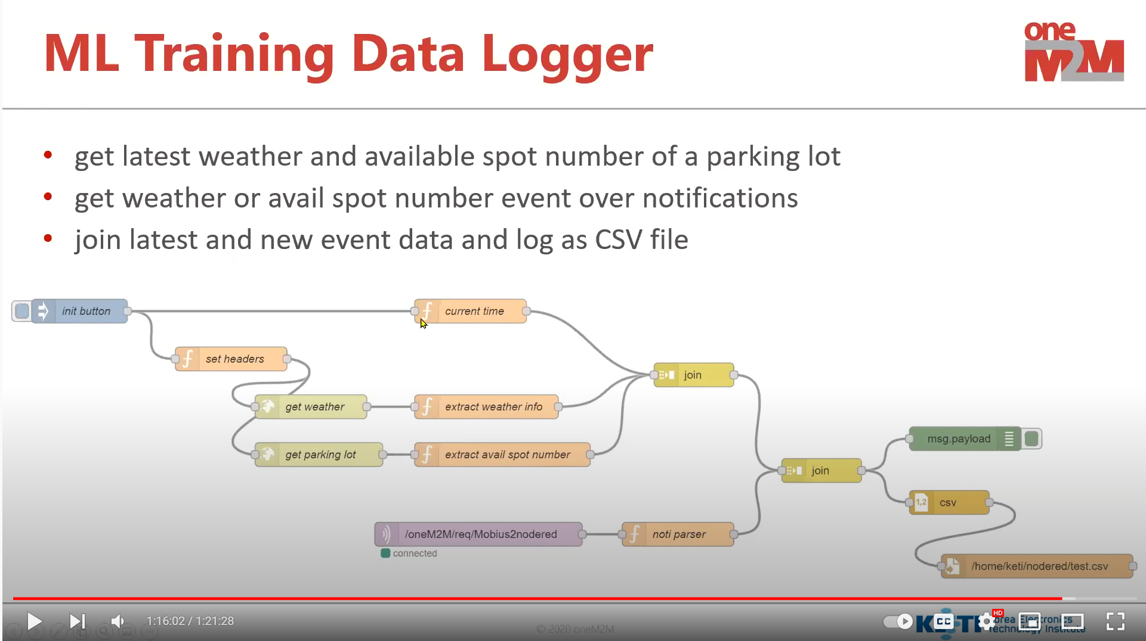
Implementation
Training dataset can be made joining multiple container data
Simple tool like Node-RED can be used for PoC (to be demonstrated soon)
https://www.youtube.com/watch?v=BkJS9qFviSo

