Slide 1
Process proposal for making contributions using GitLab
Andreas Kraft – Deutsche Telekom
Bob Flynn – Exacta GSS
Miguel Angel Reina Ortega - ETSI
1

Slide 2
Background
/
The oneM2M GitLab is being used for hosting specs related code such as:
Schema definitions (xml, XSD, etc …)
TTCN-3 code
It was proposed to use GitLab for drafting base specs (for which they need to be converted into markdown) in order to:
Concentrate on the content of the specs (not format, styles or so)
Facilitate rapporteur tasks
Making contribution more easily
Be able to automate some tasks
To complete above proposal, contributions handling procedure using GitLab needs to be defined

Slide 3
Contribution handling procedure proposal
/
This procedure have been drafted in the following GitLab project:
https://forge.etsi.org/rep/etsi-cti-admin/forge-contributions-documentation/-/blob/master/diagrams/simplified-process.md
  In short, 2 kind of branches in the repository
    Release branches: containing the main stream for a particular release
    Contribution branches: containing the changes proposed by the contribution
  Submission of contribution:
    Creation of a Merge-request: from a contribution branch to a release branch
    Contribution = Merge-request
    Note: Merge-request is the GitLab term for Pull-request in GitHub

Slide 4
Contribution handling procedure proposal
/
The contributor creates a contribution branch based on the latest release branch tag where changes are to be submitted (drafting stage)
  Note: release branch tags will represent spec baselines
2) When all changes are submitted, the contributor creates a “merge request” from contribution branch to the release branch tag that the contribution branch was based on.
All details about the contribution are to be provided within the Merge-request
3) The contribution (Merge-request) is reviewed by the WG:
- if contribution is approved, Merge-request is accepted
- if contribution needs revision, Merge-request is updated and new changes submitted to the contribution branch to implement comments/modifications. Repeat step 3)
  Note: The Merge-request is automatically updated when the contribution branch is updated
4) Rapporteur tags the release whenever a new baseline is needed (for example, after a plenary meeting)

Slide 5
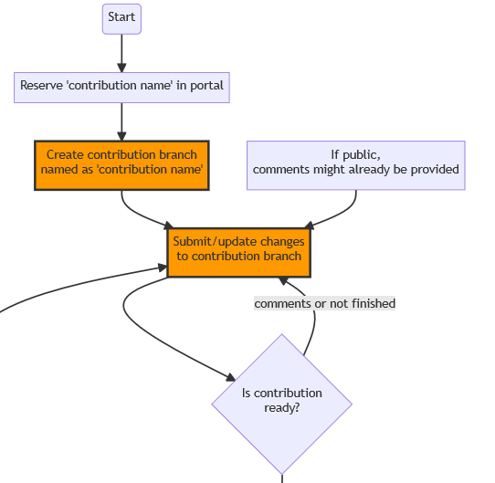
Contribution handling procedure details:
Drafting contribution
/
Contribution branch creation:
  The contributor books a number in the portal for a contribution
  The contributor creates a contribution branch based on the desired release branch and names it as the name assigned by the portal in previous step
  The contributor updates the contribution branch with the desired changes.

Slide 6
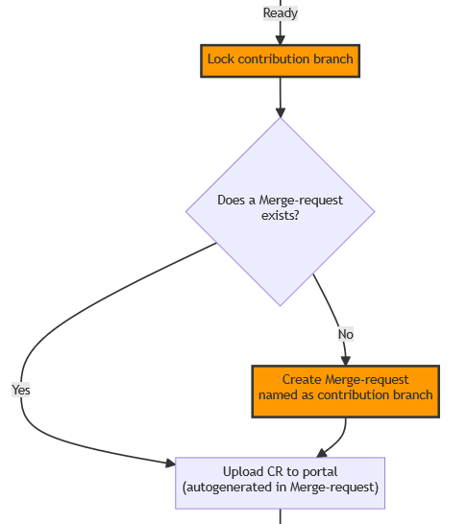
Contribution handling procedure details:
Submit contribution
/
Submission of Merge-request:
  Lock the contribution branch so that no further commits can be submitted
  Create a Merge-request from contribution branch to the release branch tag and name it as the contribution branch
  Add contribution details into the Merge-request description
  A CR docx is autogenerated and can be submitted to the portal

Slide 7
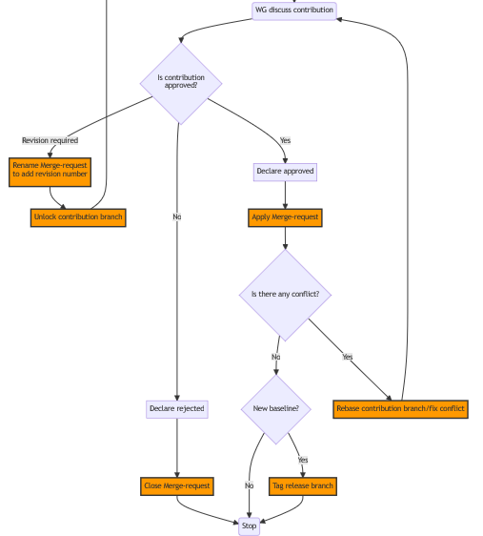
Contribution handling procedure details:
Review contribution
/
Contribution (Merge-request) review:
  Approved:
    Declare approved
    Apply Merge-request
  Rejected:
    Declare rejected
    Close Merge-request
  Revision needed:
    Unlock contribution branch
    Merge-request is renamed in order to add the revision tag (R01, R02, …)
    Go to Drafting: Contribution branch is updated with the desired modifications
    Go to Submit contribution: A new CR docx (R0x) is autogenerated and can be submitted to the portal
  Note: The new CR docx generated in step 4) contains the final changes compared to the release branch tag. Details about the contribution history (modifications between different revisions) can be seen in the Merge-request

Slide 8
Thank you

