Slide 1
CoAP options
Peter Niblett – IBM

Slide 2
Background
There are 3 possible places that we could put oneM2M primitive parameters in a CoAP message:
  In the Uri-Query CoAP option (this is like the query string in an HTTP URL)
  In custom CoAP options (these are the CoAP equivalent of HTTP headers)
  In the payload itself
Today’s TS-0008 specifies that some parameters are serialized in the Uri-Query and the remainder as custom CoAP options
CoAP options have numeric identifiers and to avoid conflict they should be registered with IANA.
  We made an initial allocation of identifiers in TS-0008 v1 and have added new ones since then. TS-0008 was published with a note saying that the identifiers were subject to agreement with IANA and might change.
  We attempted to register the identifiers we had chosen a few years ago but IANA raised concerns that these identifier values were not consistent with requirements of the CoAP specification.
  We changed the values at SDS 56 (e.g. SDS-2020-0065R04) and resubmitted to IANA.
  IANA experts are now questioning whether our use of custom CoAP options is appropriate at all.

Slide 3
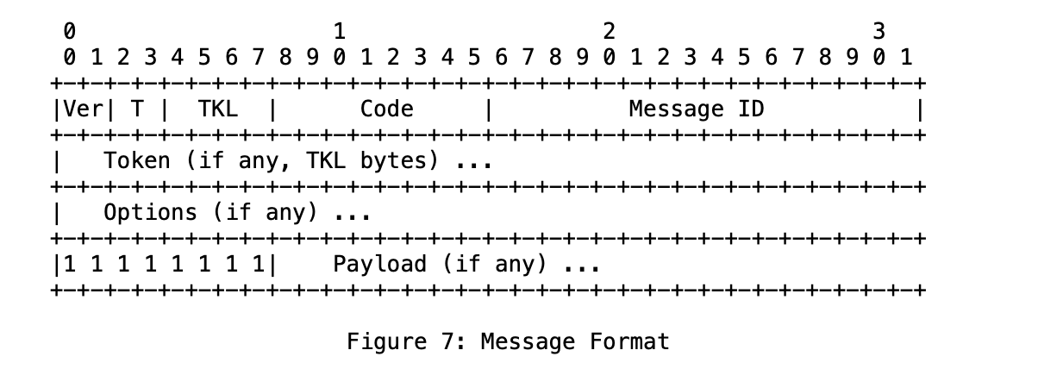
Background - CoAP message format and size
4 bytes fixed header
0 to 8 bytes Token
Each option has an overhead of between 1 and 5 bytes and a maximum length, specified as part of the option definition)
CoAP specification clause 4.6 says:
Messages larger than an IP packet result in undesirable packet fragmentation. A CoAP message, appropriately encapsulated, SHOULD fit within a single IP packet (i.e., avoid IP fragmentation) and (by fitting into one UDP payload) obviously needs to fit within a single IP datagram. If the Path MTU is not known for a destination, an IP MTU of 1280 bytes SHOULD be assumed; if nothing is known about the size of the headers, good upper bounds are 1152 bytes for the message size and 1024 bytes for the payload size.

Slide 4
Background – CoAP lengths
The “Co” in CoAP is short for “Constrained” and CoAP is intended for sending small amounts of data.
The absolute maximum size for a CoAP message is around 65,000 bytes (IP packet size) however CoAP spec clause 4.6 recommends that the total message size is less than the smallest MTU length being used on any network hop between client and server, to avoid IP packet fragmentation. It suggests using a max message size (Header + Payload) of 1152 bytes if you don’t know the actual MTU lengths.
  For IPv6 each MTU length must be at least 1280 bytes
  For IPv4 each MTU length must be at least 576 bytes
To send bigger payloads you can use CoAP blockwise transfers to split the payload (but not the Options) into multiple blocks and transmit each block in a separate CoAP message.
  Allowable blocksizes are 16, 32, 64, 128, 256, 512 or 1024 bytes
The CoAP-defined options have the following length restrictions:
  Uri-Host, Uri-Path and Uri-Query are limited to a maximum of 255 bytes each.
    We map the To parameter to Uri-Path
    We map 16 parameters into Uri-Query, though they aren’t likely all to be present of course.
  Many of the custom options defined in TS-0008 have a maximum of 255 bytes (one has a max of 512)
    There’s a risk that we could exceed the 1152 bytes before we even get to the payload.

Slide 5
Custom CoAP options and their lengths
No | C | U | N | R | Name | Format | Length | Default
279 | X | X |  |  | oneM2M-FR | string | 0-255 | (None)
283 | X | X |  |  | oneM2M-RQI | string | 0-255 | (None)
259 | X | X |  |  | oneM2M-OT | string | 15 | (None)
291 | X | X |  |  | oneM2M-RQET | string | 15 | (None)
295 | X | X |  |  | oneM2M-RSET | string | 15 | (None)
299 | X | X |  |  | oneM2M-OET | string | 15 | (None)
263 | X | X |  |  | oneM2M-RTURI | string | 0-255 | (None)
303 | X | X |  |  | oneM2M-EC | uint | 1 | (None)
307 | X | X |  |  | oneM2M-RSC | uint | 2 | (None)
311 | X | X |  |  | oneM2M-GID | string | 0-255 | (None)
267 | X | X |  |  | oneM2M-TY | uint | 2 | (None)
319 | X | X |  |  | oneM2M-CTO | uint | 2 | (None)
323 | X | X |  |  | oneM2M-CTS | uint | 2 | (None)
327 | X | X |  |  | oneM2M-ATI | string | 0-255 | (None)
271 | X | X |  |  | oneM2M-RVI | string | 1-2 | (None)
331 | X | X |  |  | oneM2M-VSI | string | 0-255 | (None)
335 | X | X |  |  | oneM2M-GTM | string | 0-512 | (None)
339 | X | X |  |  | oneM2M-AUS | string | 0-255 | (None)
275 | X | X |  |  | oneM2M-ASRI | string | 0-255 | (None)
343 | X | X |  |  | oneM2M-OMR | string | 0-255 | (None)
347 | X | X |  |  | oneM2M-PRPI | string | 0-255 | (None)
351 | X | X |  |  | oneM2M-MSU | string | 0-255 | (None)
NOTE 1: C, U, N, R means Critical, Unsafe, NoCacheKey and Repeatable respectively [1]. Table 6.2.2.4.0-1 follows the template used in clause 5.10 Option Definitions of CoAP specification [1]. NOTE 2: CoAP Option numbers specified in table 6.2.2.4.0-1 are subject to change after review by IANA registration.
If all these parameters were included and had their maximum lengths, we they would consume around 3,400 bytes.
In practice the amount consumed is much smaller

Slide 6
IANA Comments
“I have read part of the spec about the "CoAP Protocol Binding", in particular section 6.2.2.4. It seems to propose CRUD operation mapping to request/response, but instead of using specific semantic information carried for example on the URI or on the payload, it is carried as a CoAP option.
In general large options do not work, and at least some of information described there is usually carried as CoAP payload. It would be possible to build one specific option for oneM2M on a draft (or documented in a OneM2M spec) and have only 1 oneM2M option of variable length to carry this additional information.”
My summary:
CoAP options are primarily intended as a way to extend the CoAP protocol itself, not as a way of passing application-specific information (oneM2M being an “application” as far as CoAP is concerned). They are also a way of communicating intent to application-unaware intermediaries, such as proxies.
The more data you put in options, the less room there is for the payload. This means you get driven to use small block sizes and have to split a request or response into more CoAP messages – increasing the overall number of bytes being used.

Slide 7
Options
Stick with the approach of mapping parameters to Uri-Query and custom Options.
Three sub-options:
  Abandon IANA registration and go back to the original option numbers
  Abandon IANA registration and proceed with the SDS-56 plan (support both old and new option numbers)
  Push on with IANA registration and say that we want to use the new numbers regardless of their concerns
Proceed with IANA registration, changing TS-0008 to use the single custom Option approach
Change TS-0008 to map all the Primitive Parameters (except for To) into the payload, like we do in TS-0010 and TS-0020.
Abandon TS-0008 altogether
  …if we aren’t targeting the kinds of network or device that need small packets

Slide 8
Options – pros and cons
Stick with the approach of mapping parameters to Uri-Query and custom Options.
  + Minimal change to implementations
  + Efficient encoding of those parameters that are mapped to CoAP options
  - Might not get IANA registration
  - Possibility that we will encounter issues with CoAP length limits. Have we seen any of these in practice?
    Overall protocol data unit exceeding MTU size (1280 bytes or less), leading to IP fragmentation.
    Uri_Query length limit exceeding 255, leading to inability to send the oneM2M primitive
    One or more Primitive Parameters exceeding the length defined for the corresponding option in TS-0008
Proceed with IANA registration, changing TS-0008 to use the single custom Option approach
  + Lets us set a maximum size for the total of the option-mapped Primitive Parameters which would be smaller than today (the sum of 22 separate maxima). We would have to make this around 512 bytes to leave space for the payload.
  + Might be easier to get IANA registration, if we aren’t cluttering up the registry with 22 new options.
  - Won’t remove the possibility of the Uri_Query length being exceeded.
  - We would have to devise a method of encoding the Primitive Parameters into the single custom Option
Change TS-0008 to map all the Primitive Parameters (except for To) into the payload, as in TS-0010 / TS-0020.
  + No need for IANA registration, as no custom options are needed.
  + No risk of the Uri_Query limit being exceeded
  + No risk of CoAP options getting too big, allowing effective use of Block-wise transfer to keep messages smaller than the MTU size
  - Each message is likely to be bigger than it would be under option 1.

