Slide 1
Issues with WebSocket Binding Specification – TS-0020
Andreas Kraft – Deutsche Telekom
Bob Flynn, Exacta GSS
Miguel Ortega, ETSI
Andreas Neubacher – Deutsche Telekom

Slide 2
TS-0020 - WebSocket Binding
TS-0020 defines a binding for the WS protocol.
WS is a communication protocol that adds a two-way communication channel over TCP/IP and on top of http(s), including the common TLS security mechanisms.
A connection is initiated by a client to a server, and is kept alive until closed, or the connection is interrupted by other means.
Communication is fully transparent – both client and server are required to implement an application level protocol on top of WS.
WS connections are supposed to be permanent, or at least long-living, but can also be opened and closed at any time.
In TS-0020 the WS Connection is only initiated by an AE, or by a registree CSE

Slide 3
Issue 1 - Identification
When a WS connection is established the client cannot be identified by the CSE until a first oneM2M request is sent by the client.
  There is no oneM2M identity passed in a WS connection.
The CSE must wait until a first request arrived to associate a WS connection with an AE or CSE.
  Until then the client entity appears to be unreachable and cannot receive requests.

Slide 4
Issue 2 - Notifications
A WS connection cannot be established by a registrar CSE and must wait until a connection is established by an AE or registree CSE.
TS-0020 defines to store notifications:
  “If no WebSocket connection with a client exists when a Notify request primitive for this client becomes available at the server side, it should be stored and sent when the WebSocket connection is opened again by the client.”
  How is it stored? oneM2M defines multiple ways to buffer requests for non-reachable entities (e.g. PollingChannel), but it seems that TS-0020 defines a new, own procedure without specifying the details.
  What about other requests, e.g. between CSEs?
Issue 1 also affects this procedure because even if there is a WS connection the CSE cannot know the oneM2M entity on the other side of the connection.

Slide 5
Issue 3 – Undefined ws:// Scheme
TS-0020 does not define a WebSocket URL scheme for AEs (in ”poa”), and other resource types (e.g. subscription’s “nu”, direct URLs).
Without a scheme it is not possible to specify a WS target.

Slide 6
Issue 4 – Limitation of who can establish a WebSocket connection
TS-0020 only allows the establishment of a WebSocket connection from an AE or a registree CSE.
Is this a meaningful limitation?
In some deployments the receiver might be reachable and capable of hosting a WebSocket server, especially in case of another CSE.

Slide 7
Proposal 1 – Add X-M2M-Orgin Header
Add the extra http header “X-M2M-Origin” from TS-0009 when opening a WS connection. The WS standard allows for extra headers during a “WS open” request
  The header SHALL be added by registered AEs and registree CSEs when they are already be registered to the target CSE and opening a connection.
  The header SHALL NOT be used as a replacement for the “from” request parameter.
  If the request is received via Mca and the header has a different value to the value of the “from” request parameter of the request sent over the WebSocket connection the CSE SHALL return a “CONFLICT” response status code.
  The header SHALL NOT be added when a non-provisioned AE opens a WS connection because the originator (AE-ID) is not known. If the AE has a pre-provisioned AE-ID, then the AE SHALL add the header.
  The CSE associates the WS connection with the newly registered AE after it finished the registration procedure and the (new) AE-ID is known. If there is already a WS connection associated with the AE-ID / originator, then the previous WS connection is closed.
  The header SHALL be added when registering a registree CSE, because in this case the orignator (CSE-ID) is known in advance.

Slide 8
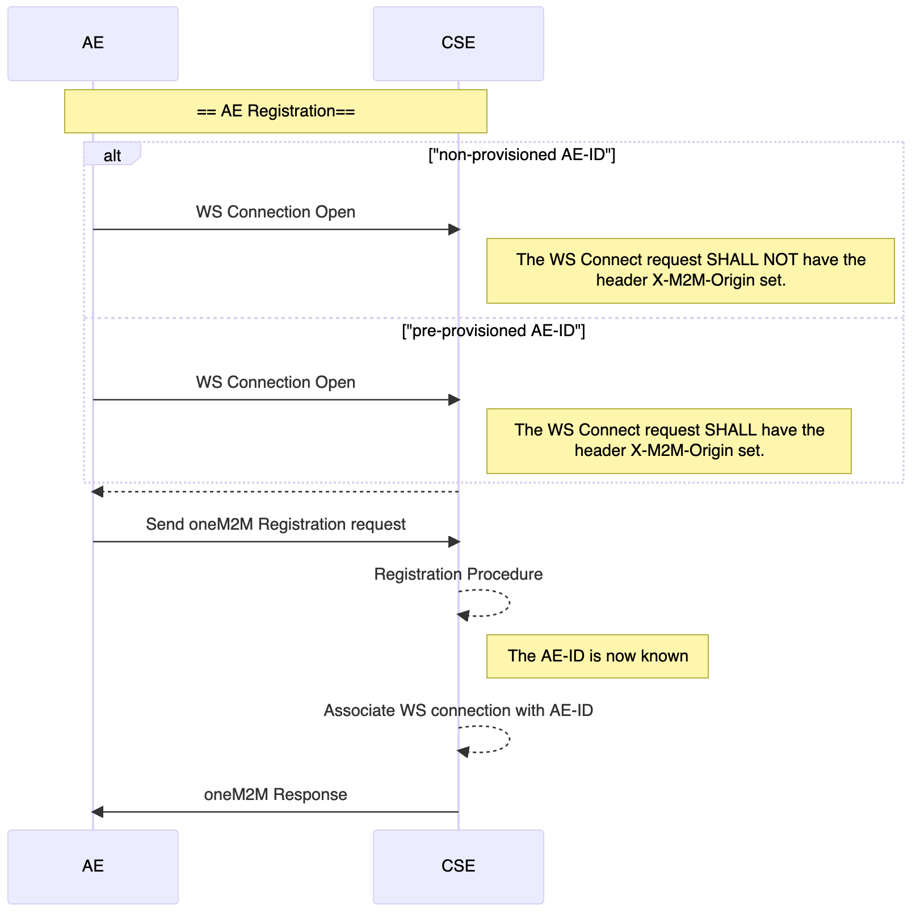
Proposal 1 – Add X-M2M-Orgin Header
AE Registration

Slide 9
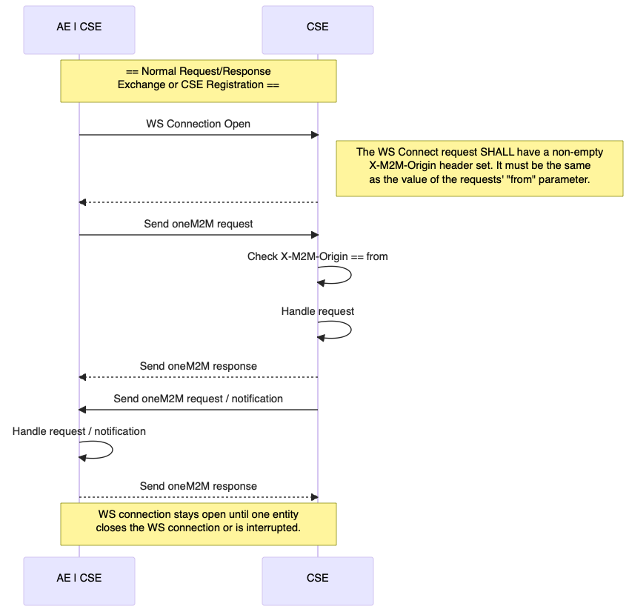
Proposal 1 – Add X-M2M-Orgin Header
Normal Request/Response Exchange

Slide 10
Proposal 2 – Define ws:// Scheme
Add additional text to TS-0020 6.2.1 saying something about other uses of WS schemes.
Normally the URIs (as URL) define domain, port, path etc. This is also the case for WebSocket URIs that target receiver that host a WebSocket server and are network reachable.
  If such a URL is defined in a ”poa” and there is NO established connection to the receiver then the CSE will connect to the specified WebSocket server and establish a connection. After the request/response exchange the originator or the receiver MAY close the connection.
However, in cases where the receiver cannot host a WebSocket server and/or is not network reachable, the special URI “ws://unreachable” is used.
  If this value is set in a POA and and there is an established connection, then that connection will be used to send the request. If there is NO established connection, then the “poa” URI selection procedure is continued.

Slide 11
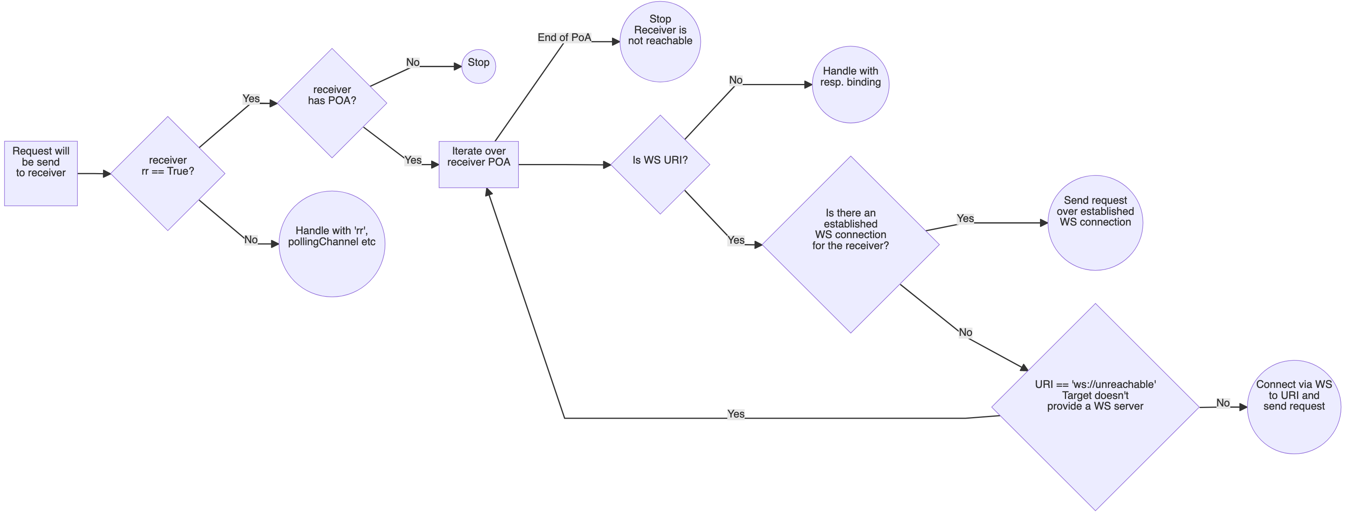
Proposal 2 – Notification Procedure for WebSocket Connections

Slide 12
Proposal 3 – Closing Connections
When an AE or registree CSE unregisters itself or is unregistered by other means the WS connection cannot stay open and must be closed by the CSE:
  The association between the WS and the AE / registree CSE is based on the ”X-M2M-Origin” header.
  But this header can only be applied when opening a WS connection in the original “connect” request. It cannot be changed afterwards.
Add a procedure to the WS Binding specification:
  When an AE or registree CSE unregisters itself, either through the WS connection or another protocol binding, or is unregistered by other means, an open and associated WS connection SHALL be closed by the registrar CSE.

Slide 13
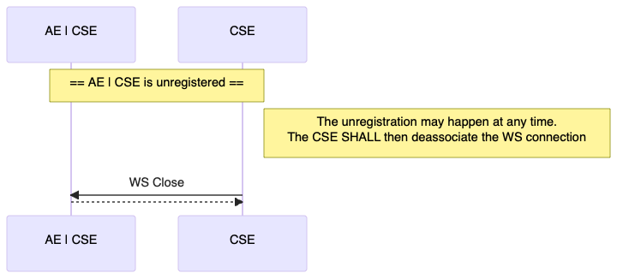
Proposal 3 – Closing Connections
Closing Connections

Slide 14
Thank you

