Slide 1

Using Git for contributing to oneM2M
Miguel Angel Reina Ortega
ETSI CTI (Center for Testing and Interoperability)

Slide 2
Agenda
  Gitlab environment
    Gitlab environment
    Basic operations
      Create branches
      Create merge request
  Web IDE
    Switch branch
    Search and edit
    Diff and commit
  Generation of the Word CR automatically
  Run a pipeline for a Merge Request
  Advanced user tips
    Rebase
© 2023 oneM2M Partners
2

Slide 3
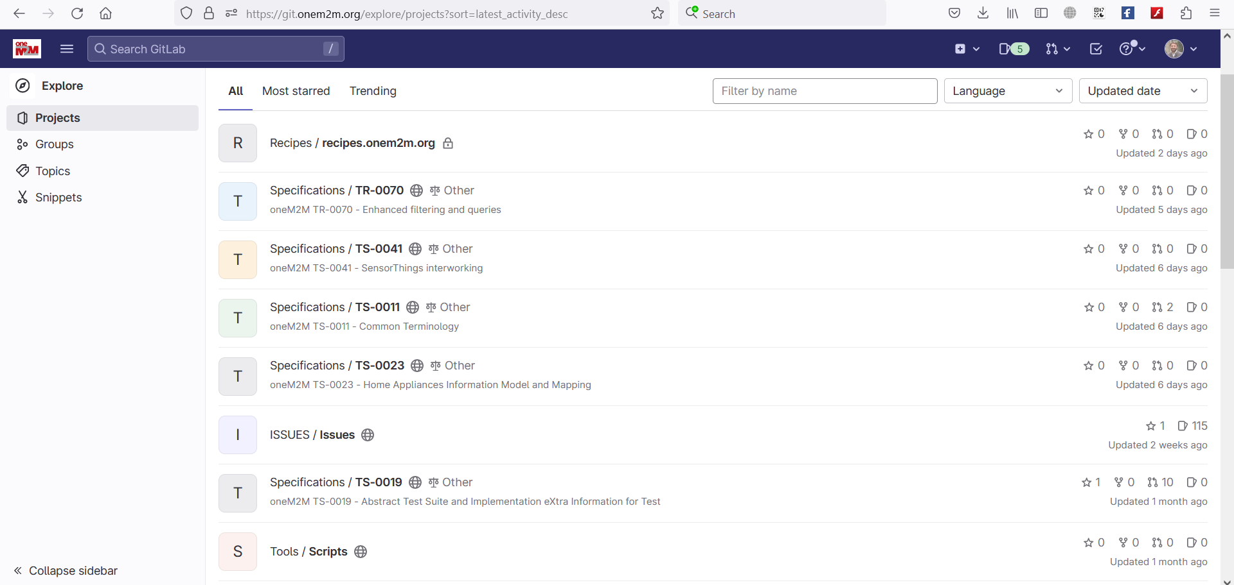
Gitlab environment
Recipes repository (automated publication of recipes.onem2m.org)
Specifications repositories
GitLab Community Edition.
Using Gitlab requires understanding of basic knowledge of git. More material could be found here:
  Git (git-scm.com) or
  Index · User · Help · GitLab (git.onem2m.org)
Issues repository
Common scripts used for automated tasks
© 2023 oneM2M Partners
3

Slide 4
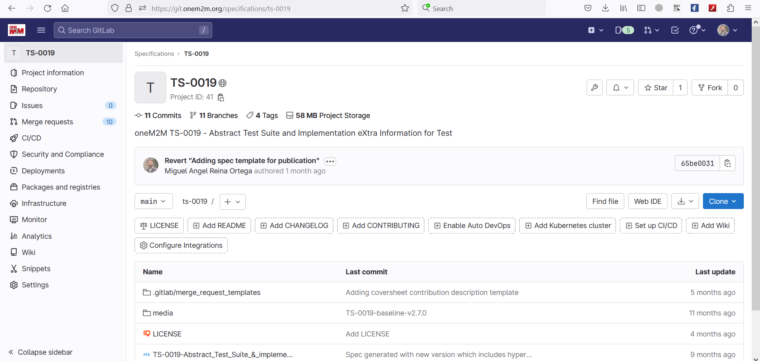
Gitlab environment: project
“Repository” is to find branches/commits/tags
There are plenty of links to go directly where you need: commits, branches, tags, Web IDE, …
The “Web IDE” is very powerful tool for code changes/review on the web
“+” is to add new file/create branches
Indicates which branch is, could select branch/tag to switch between branches
Images contained in the spec
Specification in markdown
© 2023 oneM2M Partners
4

Slide 5
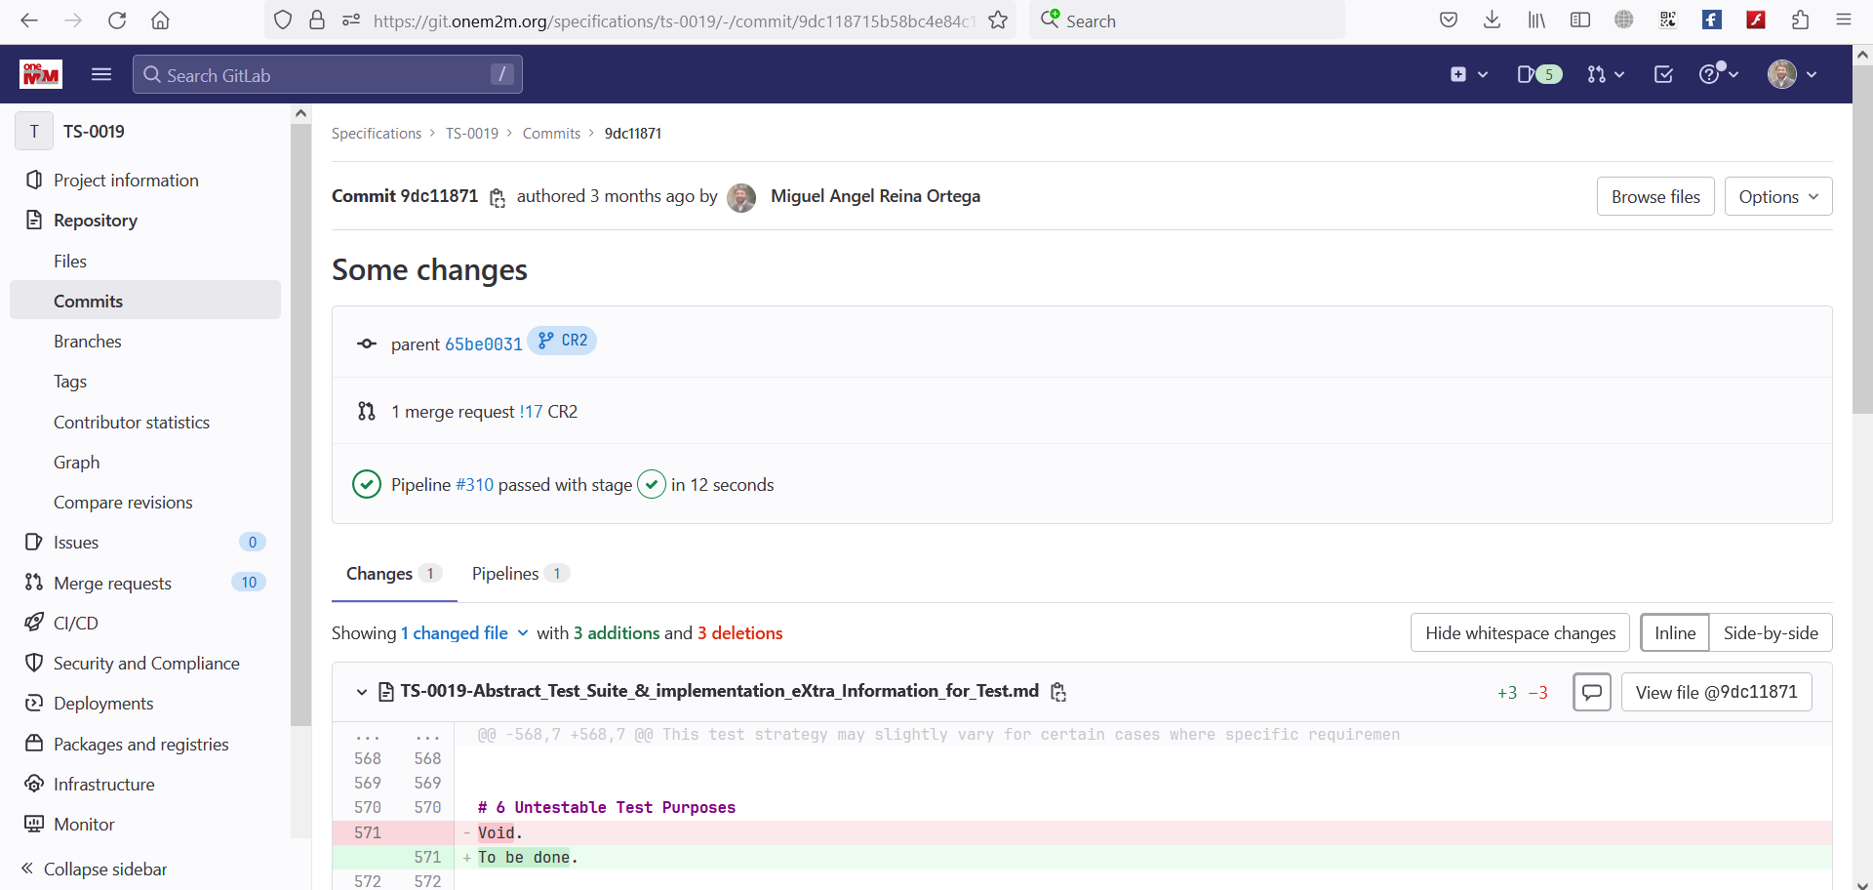
Gitlab environment: commit
target branch
Corresponding merge request (if any)
Green V indicating pipeline run successfully
Change details: line by line
Summary of total changes in this commit
© 2023 oneM2M Partners
5

Slide 6
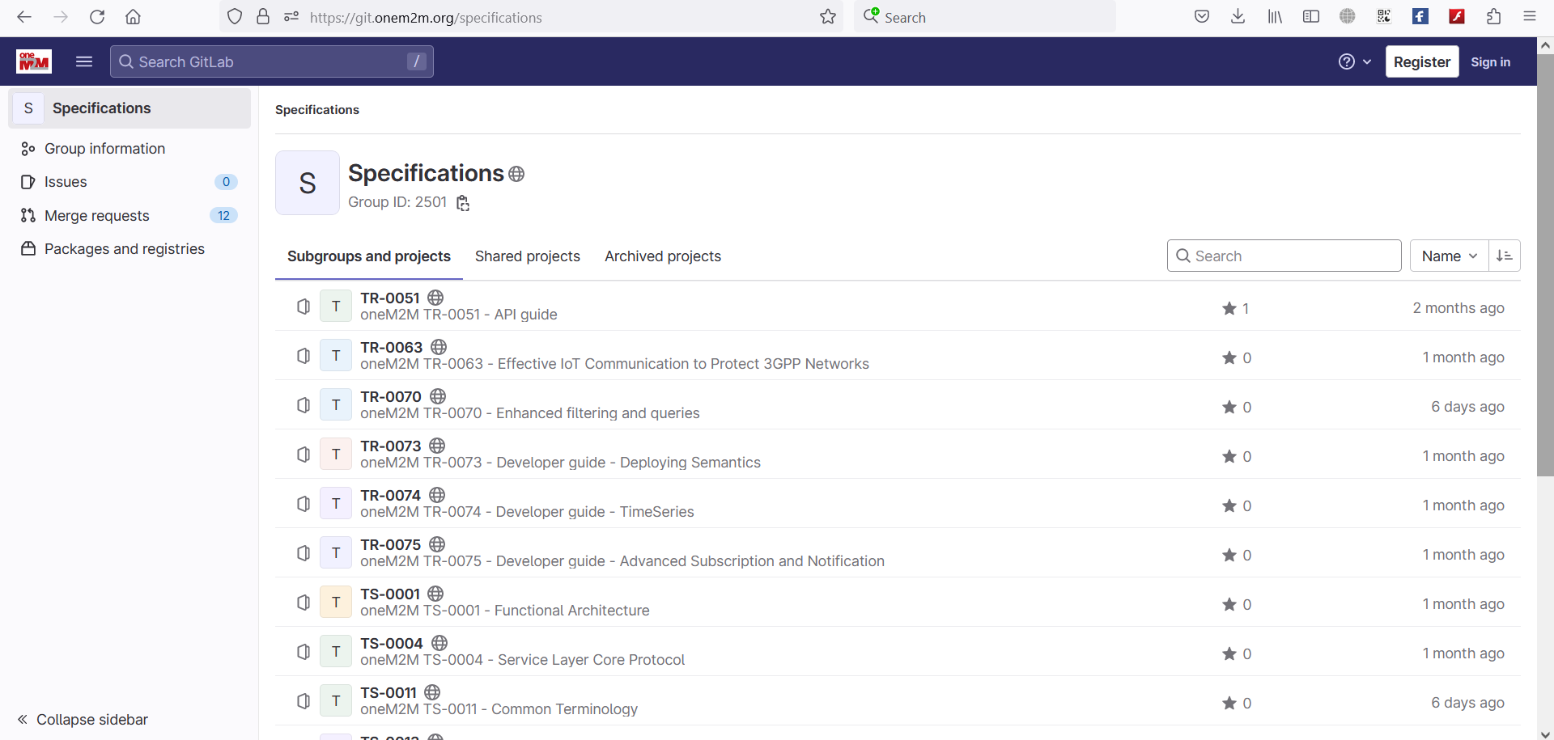
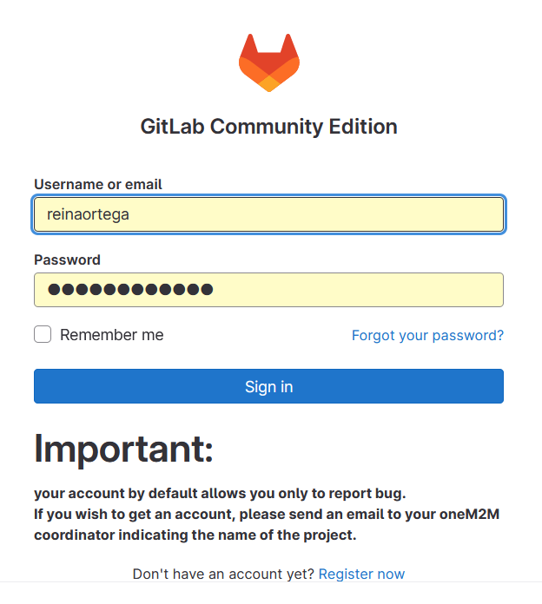
Operations: login
Direct Link to Specifications repository : https://git.onem2m.org/specifications/
Register your account, login, select your project, then your branch or create a CR branch, then code change by using the Web IDE tool (or work locally by cloning the project)
Note: if you do not have the write access (e.g., can not see the new branch button), request access to the project
© 2023 oneM2M Partners
6

Slide 7
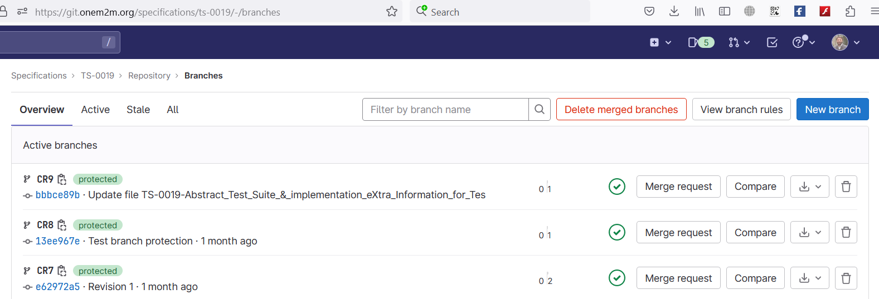
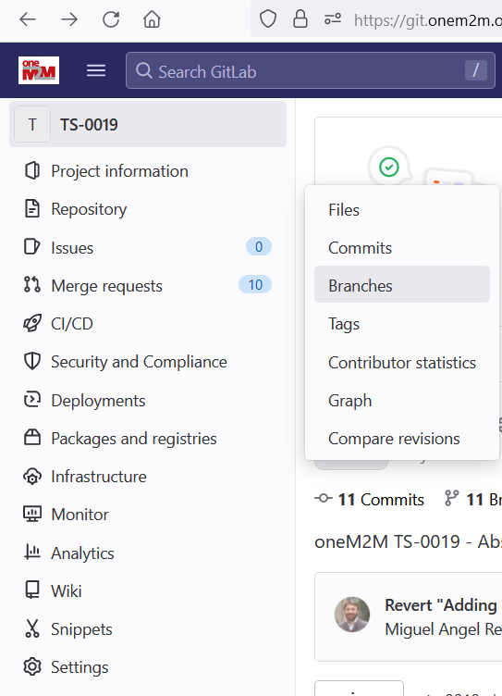
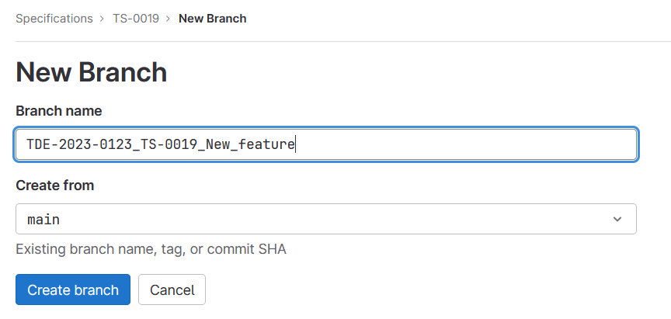
Operations: create a branch
3
1
2
4. Follow the branch name rules (in contribution procedure) for a branch name.
naming rule of the branch: name given by oneM2M portal when reserving a new contribution
5. Select the right base branch, normally from release branch
6
© 2023 oneM2M Partners
7

Slide 8
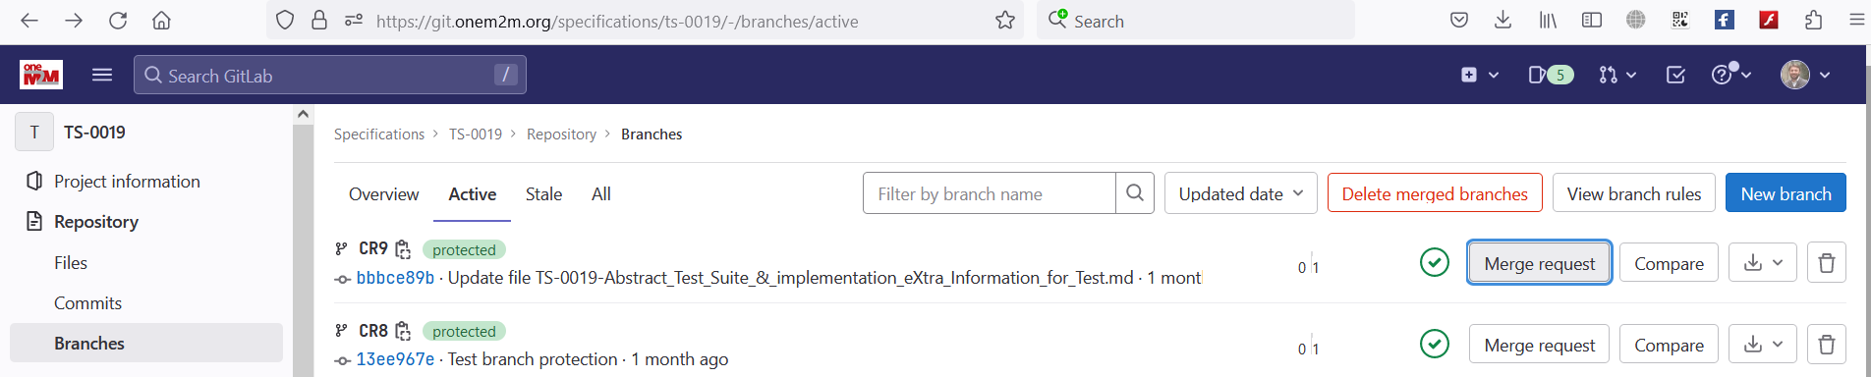
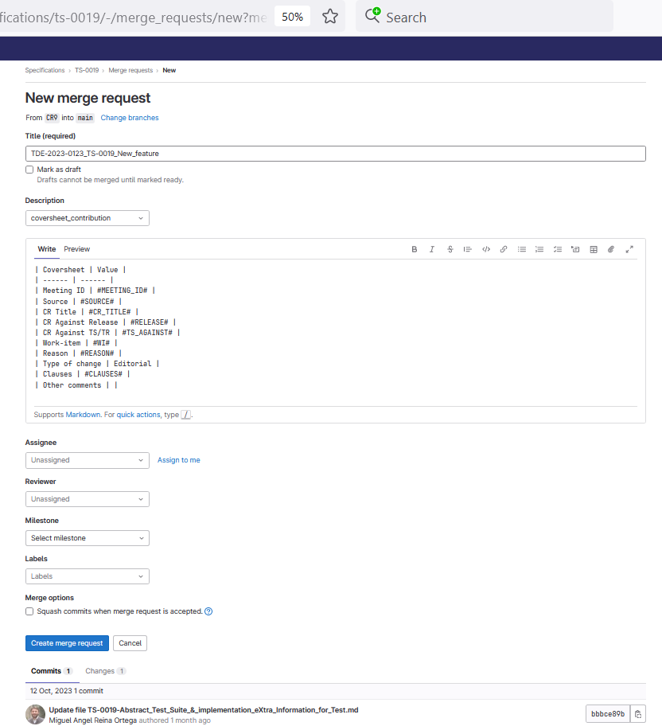
Operations: create merge request
Step 1: Find you Branch with part (or full) of the branch name
Step 2: Click Merge Request button
Step 3: Update target Branch (if not correct): normally target branch should be a release branch: R2,R3, etc..
Step 4: Select the coversheet template and fill in the required fields about contribution (that will be used for the coversheet of the autogenerated CR).
Step 5: If you have several commits, check this option if you would like to see your changes as just one single commit
Note: Main contribution author creates a merge request towards the release branch before meeting start. The MR Gitlab link(s) will be added to the MS Word CR introduction automatically. Any co-authors need to be added as MR reviewers.
Step 6: click "create merge request", then you are done
© 2023 oneM2M Partners
8

Slide 9
Gitlab workflow
Contribution handling: what action needed and when (for detail, check contirbution procedure)
Spec base branch, normally release branch (i.e., R2)
Base branch with latest release 2 baseline
CR author to create CR development branch from latest release branch. CR author creates a merge request once CR finalised
1CR1 branch
CR2 branch
CRn branch
Rapporteur to handle merge request: merge the request if CR is approved, or
unblock source branch and rename merge request if CR needs revision
Release branch
Rapporteur to tag the release branch as new baseline once all approved MRs have been merged
© 2023 oneM2M Partners
9

Slide 10
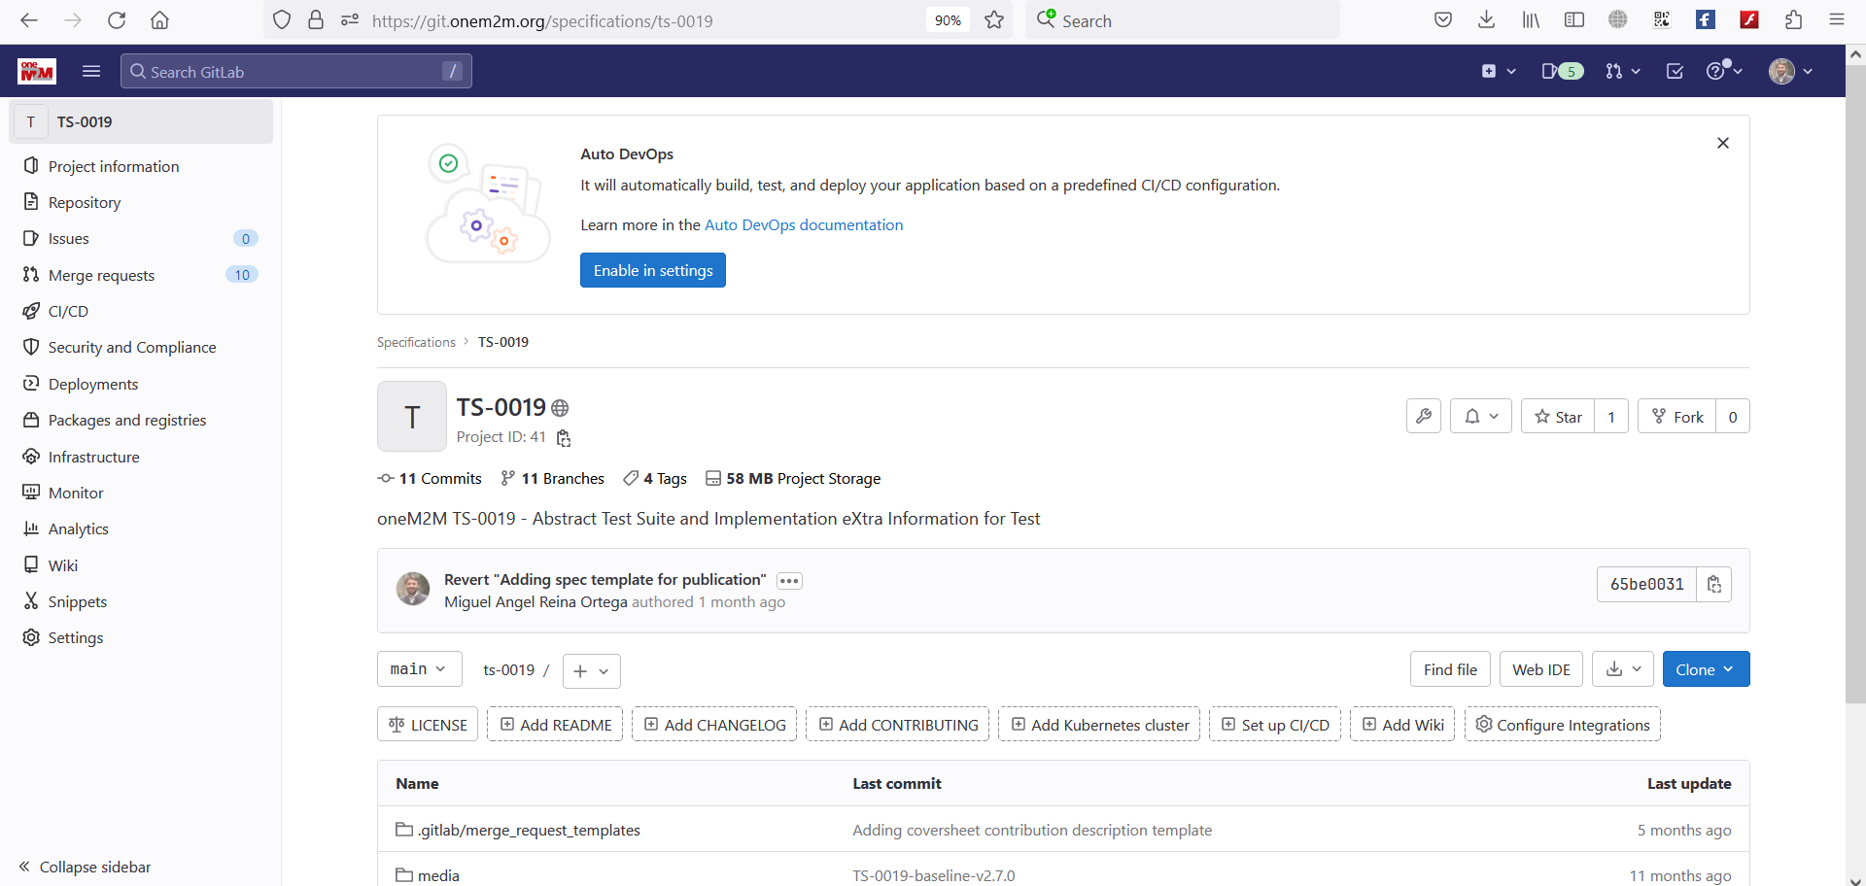
Web IDE overview
You can use the Web Editor to make changes to a single file directly from the GitLab UI. To make changes to multiple files, see Web IDE.
In the Web Editor, you can:
Create a file
Edit a file
Upload a file
Create a directory
Create a branch
Create a tag
Switch Branch
Commit changes
Create Merge request
And more: Web IDE | GitLab
Click “web IDE” button to active Web IDE
© 2023 oneM2M Partners
10

Slide 11
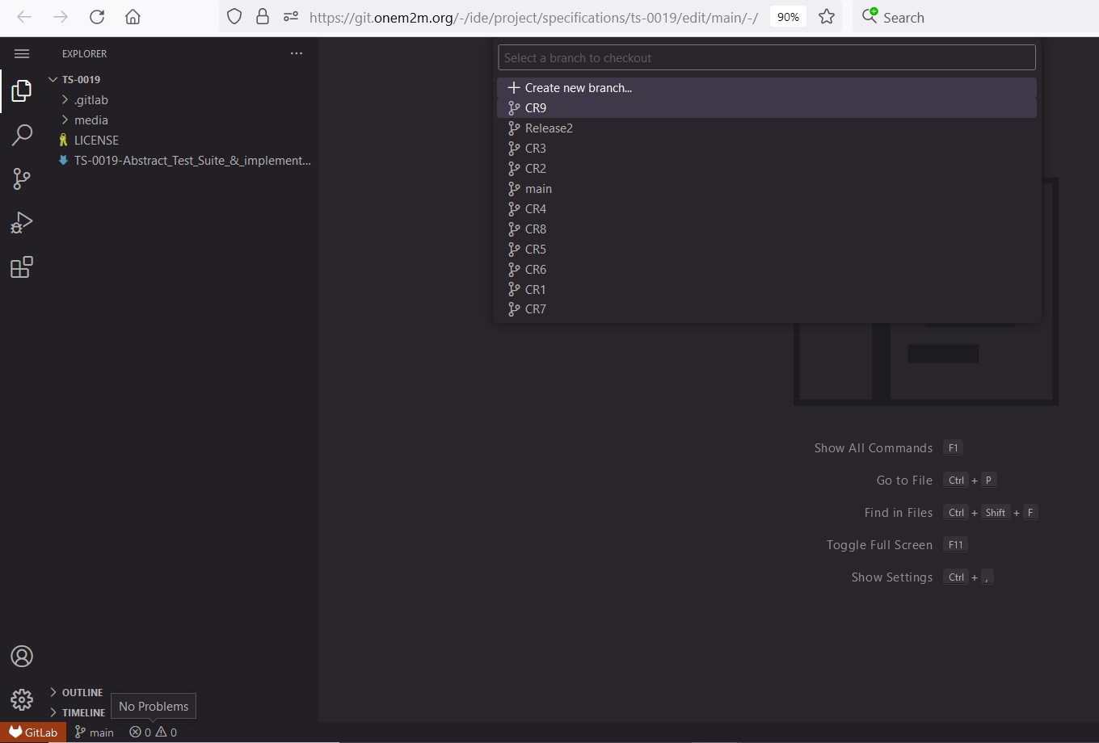
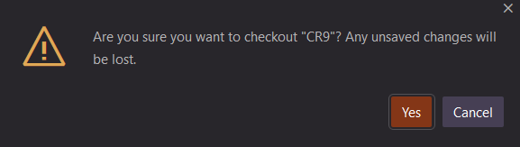
Web IDE: switch branch
Switch from current working branch to another branch (existing or a new branch)
Step2: In new pop-up window, to:
> Select “+ Create new branch” to create a new branch, or
> Input the target branch name (part of the name or full branch name) you would like to switch to
Step3: Click “yes” to checkout the target branch (to make it editable). Just to make sure you have saved the changes in the current branch.
Step1: Click current branch name button to switch to another branch or create a new branch
© 2023 oneM2M Partners
11

Slide 12
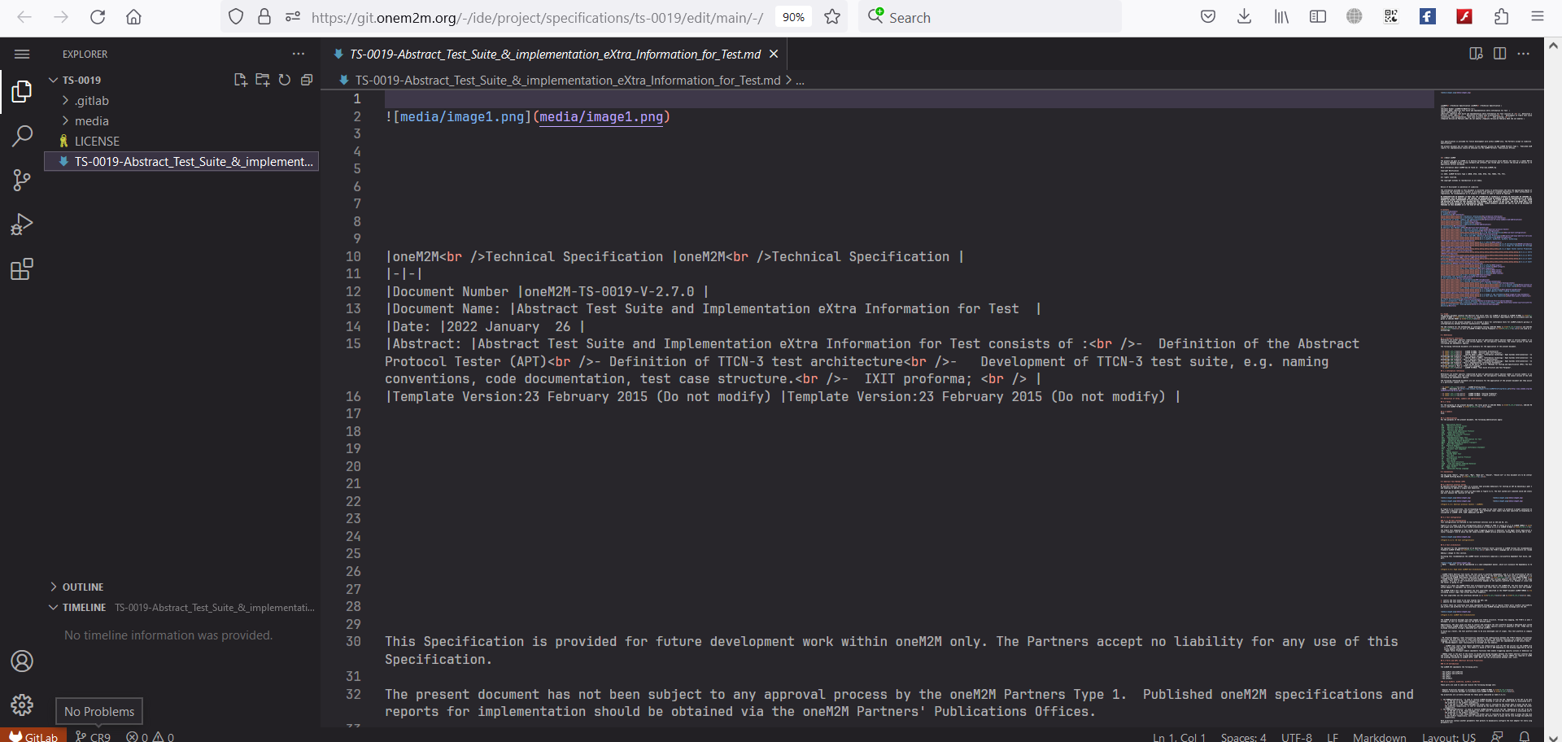
Web IDE: search and edit
Step 1: Make the changes into the specification (or media) file
This area is so-called miniMap of your file. It’s kind of full screenshot of the whole file
You could use the grey bar to quickly move around your editing area (in case the file is huge).
© 2023 oneM2M Partners
12

Slide 13
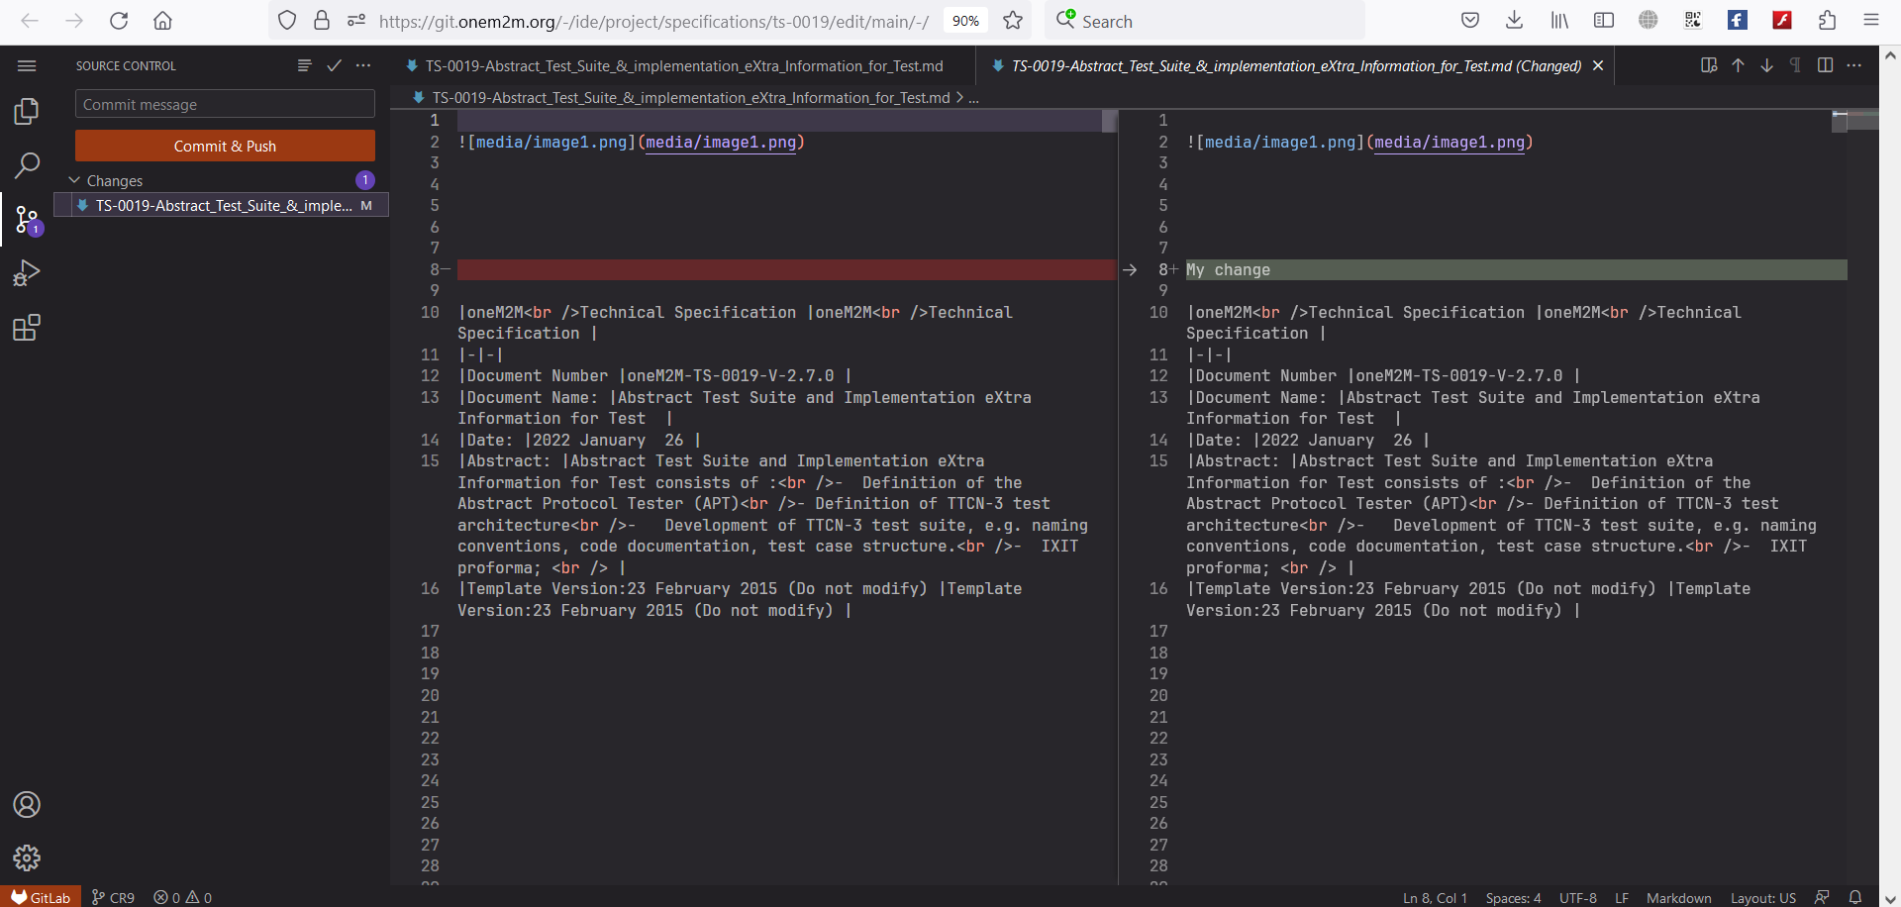

Web IDE: diff and commit
Step 3: Input commit name
Step 4: click “Commit & Push” button. This is to commit the change and push to Gitlab server.
Step 5: Confirm the commit to your CR branch or create a new CR branch following the naming convention
Step 1: Select this button to check the total changes (per file).
Step2: each highlight indicates a change. You could see the line-by-line difference (against original file, which is in the left part)
© 2023 oneM2M Partners
13

Slide 14
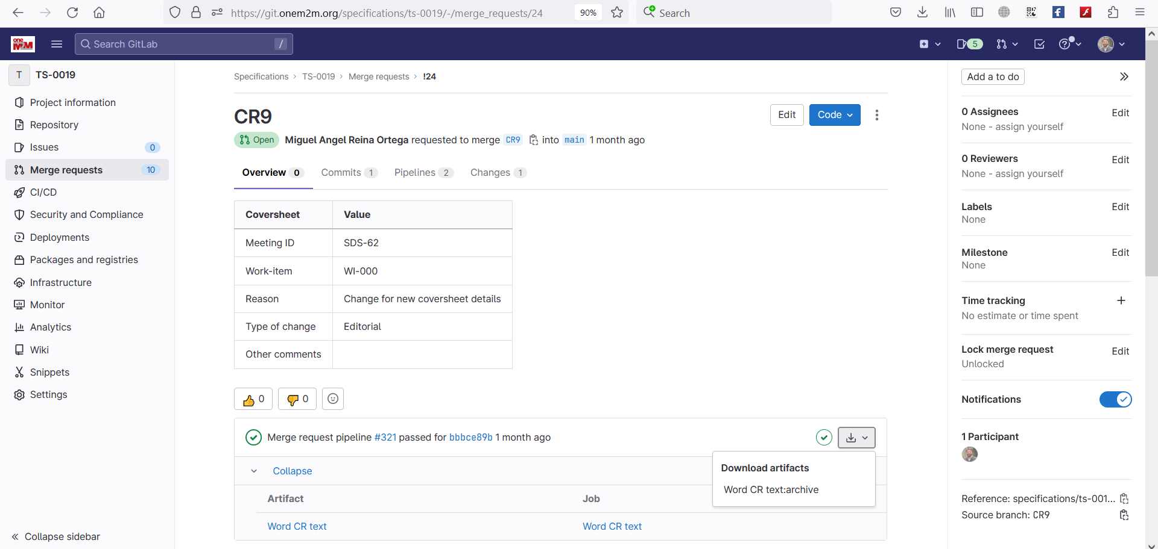
Gitlab: Generating Word CR
You can see all changes of your MR by clicking Changes tab
Note 1: Contribution author creates a merge request towards a release branch before meeting start. The MR Gitlab link is added to the MS Word CR introduction section."
Step 1: Open your merge request
Step 2: Click first option (“Download Word CR text:archive artifact)
The automatically generated word artifact is a Word file with line-by-line track change including the CR cover page. Word CR can now be uploaded into the oneM2M portal.
Note 2: Before MR is approved in the corresponding meeting, the merge request will not be merged into the target release branch. When MR is approved, Rapporteur can proceed with the merge of the MR.
© 2023 oneM2M Partners
14

Slide 15
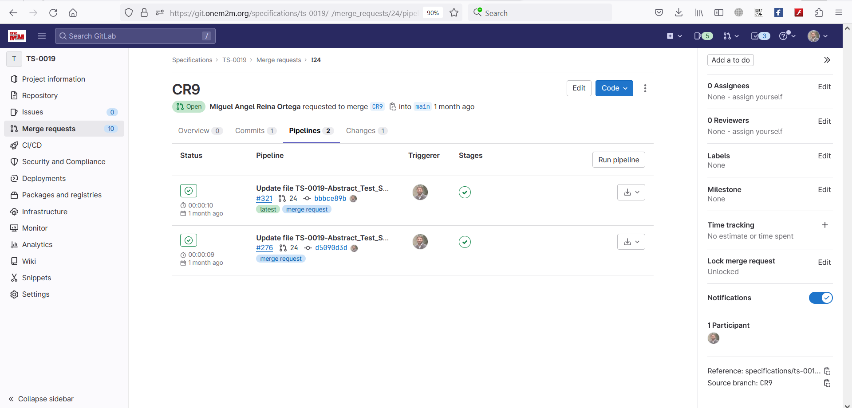
Gitlab: Run a pipeline for a MR
Step 3: Click on run pipeline button
Step 2: Click on pipelines tab
Step 1: Open your merge request
The automatically generated word artifact is a Word file with line-by-line track change including the CR cover page. Word CR can now be uploaded into the oneM2M portal.
Note: Once the pipeline is finished, the new Word CR (revision CR) is generated and can be uploaded to the oneM2M portal.
© 2023 oneM2M Partners
15

Slide 16
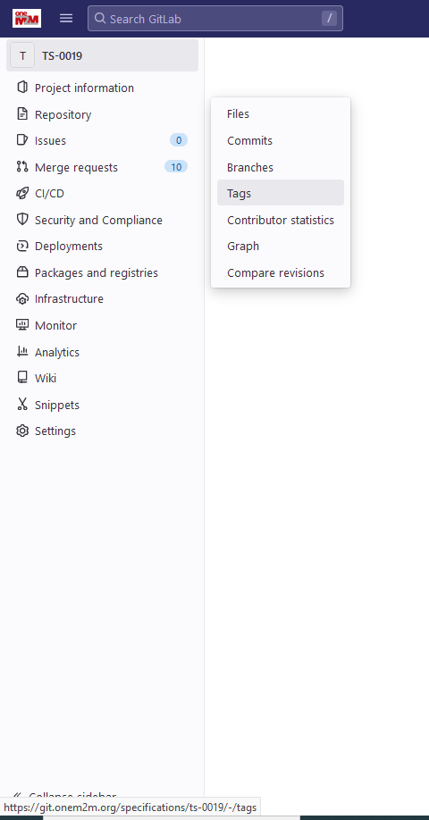


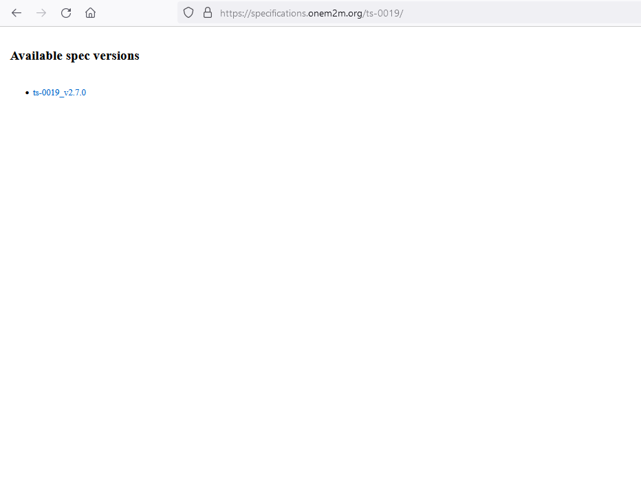
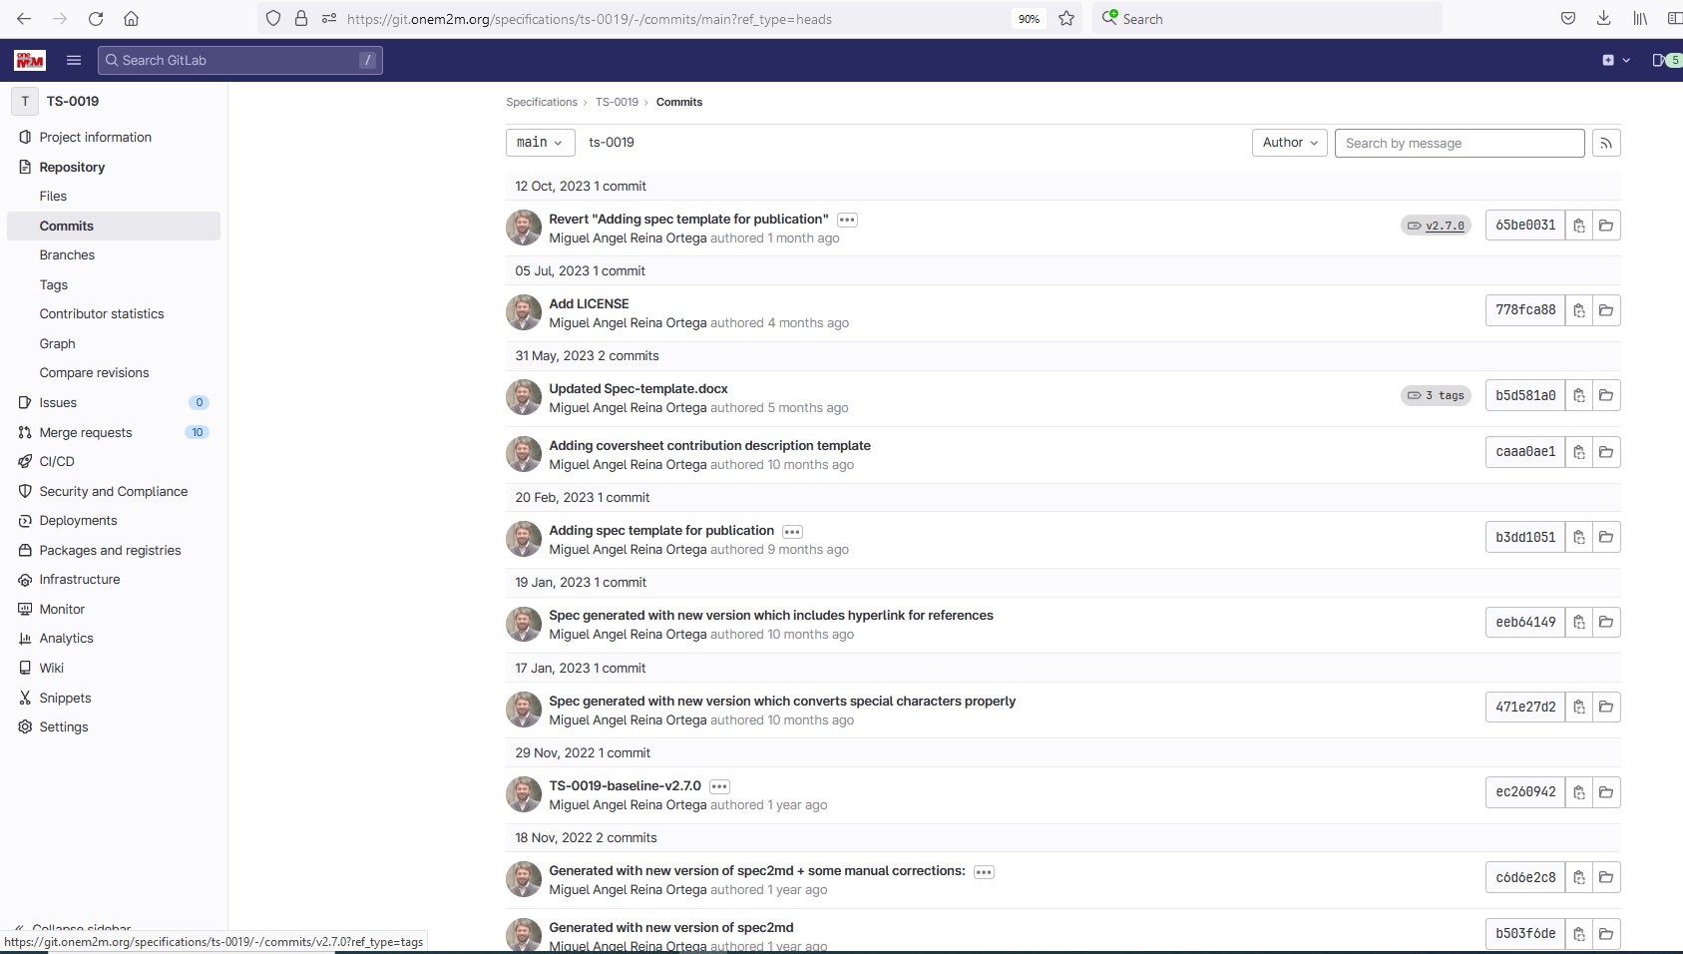
Gitlab: Create new baseline
Step 1: Open tags
Step 2: Click on New tag button
Step 3: Name the tag as the new version number of the baseline
Step 4: Select the right release branch for the new baseline
Step 5: Click on Create tag
Note 1. After creation of the new tag, a new baseline is generated as Word document and made publicly available at specifications.onem2m.org/<project-name>
Note 2: In the repository commits, a tag is added to the latest commit which indicates that it is the baseline version x
© 2023 oneM2M Partners
16

Slide 17
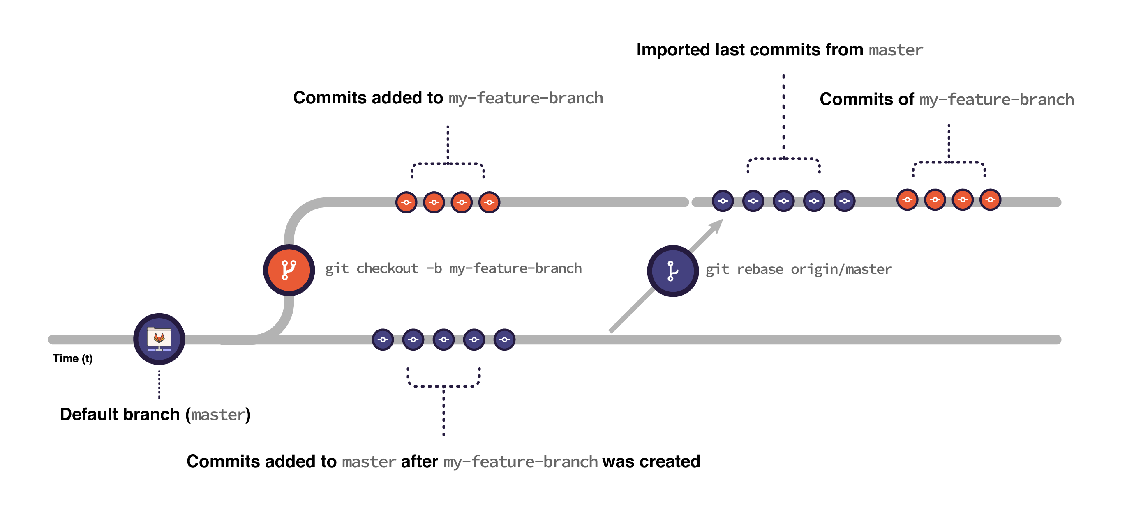
Advance user tips: Rebase
When you rebase:
Git imports all the commits submitted to target branch from the moment you created your feature branch to the present moment.
Git puts the commits you have in your feature branch on top of all the commits imported from target branch.
Figure is from: Introduction to Git rebase and force-push | GitLab
Command line example for rebase
git fetch origin
git checkout “CR9"
git pull
git rebase "origin/R3"
git push origin “CR9"
During rebase, there might be conflicts that need to be resolved locally
This command is to push commit (rebase) in local branch to remote repo
© 2023 oneM2M Partners
17
Notes:
It’s safer to back up your branch before rebasing to make sure you don’t lose any changes. For example, consider a feature branch called my-feature-branch:
Open your feature branch in the terminal:
>> git checkout my-feature-branch
Checkout a new branch from it:
>> git checkout -b my-feature-branch-backup
Go back to your original branch:
>> git checkout my-feature-branch
Now you can safely rebase it. If anything goes wrong, you can recover your changes by resetting my-feature-branch against my-feature-branch-backup:
Make sure you’re in the correct branch (my-feature-branch):
>> git checkout my-feature-branch
Reset it against my-feature-branch-backup:
>> git reset --hard my-feature-branch-backup
Note that if you added changes to my-feature-branch after creating the backup branch, you lose them when resetting.

Slide 18

Q&A
© 2023 oneM2M Partners
18

