Slide 1
Action Item Review
Bob Flynn - Exacta
1

Slide 2
Action Items
A-SDS-50.1-01 | In TS-0004 clause 7.3.2.1 we need to agree how a Registrar or Hosting CSE determines the relevant service subscription resources and accesses these resources and what privileges are required if they are not provisioned and stored locally. | Exacta & C-DOT | First part has been done -see SDS-2022-0027R01-TS-0004_SSP-AEID-Link Still need to address the second part (privileges required). In R4 we can implement with the INCSE as the registrar and the privileges issue can then be deferred to R5. Contribution needed for Rel-5

Slide 3
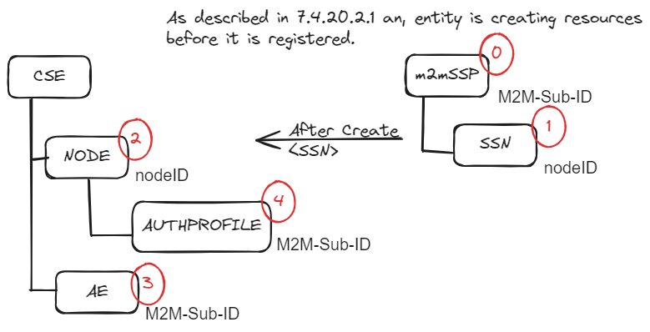
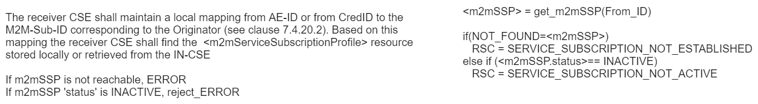

Slide 4
Action Items
A-SDS-39-01 | TS-0004, clause 8.4.3 – investigate example 3 when an intermediary resource doesn’t have access privilege | Peter | SDS-2019-0344 SDS-2019-0302 SDS-2019-0186 Bob & Peter will go through these contributions and report back

Slide 5
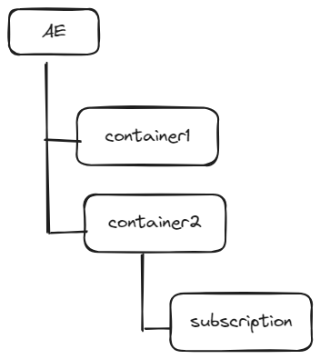
Case 1: <ACP> for all resources
{
"m2m:ae": {
"rn": "appname",
"aei": "CAE01",
"ct": "20160404T132648",
"et": "20160408T004648",
"lt": "20160404T132648",
"pi": "ONET-CSE-02",
"ri": "REQID1",
"ty": 2,
"m2m:cnt":[{"rn":"container1", "ty":3, …},
{"rn":"container2", "ty":3, … ,
"m2m:sub":[{"rn":"sub1", "ty":23, …}]}
]
}
}

Slide 6
Case 2: <ACP> for all resources except ‘container2’
{
"m2m:ae": {
"rn": "appname",
"aei": "CAE01",
"ct": "20160404T132648",
"et": "20160408T004648",
"lt": "20160404T132648",
"pi": "ONET-CSE-02",
"ri": "REQID1",
"ty": 2,
"m2m:cnt":[{"rn":"container1", "ty":3, …},
{"rn":"container2", "ty":3, … ,
"m2m:sub":[{"rn":"sub1", "ty":23, …}]}
]
}
}

Slide 7
Case 3: <ACP> for all resources except ‘ae’
{
"m2m:ae": {
"rn": "appname",
"aei": "CAE01",
"ct": "20160404T132648",
"et": "20160408T004648",
"lt": "20160404T132648",
"pi": "ONET-CSE-02",
"ri": "REQID1",
"ty": 2,
"m2m:cnt":[{"rn":"container1", "ty":3, …},
{"rn":"container2", "ty":3, … ,
"m2m:sub":[{"rn":"sub1", "ty":23, …}]}
]
}
}

Slide 8
Thank you

