Slide 1
Discussion on supporting virtual devices
SeungMyeong Jeong (KETI)
SDS#63
2024.02.24

Slide 2
Where do we need virtual sensors?
Digital twins which need a number of sensors, but cannot cover all with real sensors due to cost (e.g., smart city)
Hazardous places where sensor installation is difficult
and many more systems or applications

Slide 3
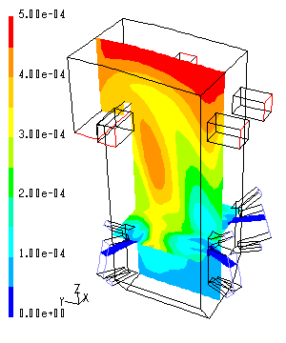
How virtual sensors work?
ML/AI
  Prediction models to estimate the number of available parking spots
  Classification models to count the number of cans in a box with radar sensing
Data fusion
  Multi-sensor data fusion
Physical modeling
  CFD (Computational Fluid Dynamics)
source: wikimedia

Slide 4
What do we have for virtual sensors?
By any means physical sensing data is used to generate virtual sensing data
TR-0068 (AI enablement)
  Dataset management is needed for ML/AI based virtual sensors
  ➔ inference input from physical sensors
  ML/AI model inference generates virtual sensing data
  ➔ inference output from virtual sensors
Relationship between physical and virtual sensor/data is needed
TS-0001
  contentRef of a <contentInstance> resource
  ➔ relationship between data
  location common attribute can relate sensors with geo-graphical location data
  <semanticDescriptor> resource
  ➔ relationship between physical-virtual sensors (and data)

Slide 5
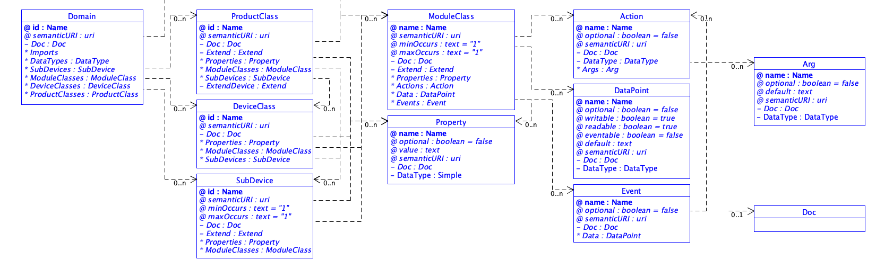
What should we have more?
Do we differentiate real vs. virtual device?
In SDT, to represent a virtual device or sub-device, a “isVirtual” common property could be defined
  however, TS-0023 does not define universal or common attribute

Slide 6
What should we have more?
Relationship for physical-virtual sensors
  relationship types (e.g., sourcePhysicalDevice)
  representation in common attributes or ontology class?
Use of those virtual device tag and relationships
  data quality or accuracy of virtual sensing
  query to get original source data from virtual sensing data
  data provenance, data lineage
  more when we dig into more use cases (e.g. digital twin) of virtual sensors in oneM2M

