Slide 1
Discussion on MQTT URL convention
SeungMyeong Jeong (KETI)
SDS#63
2024.02.24

Slide 2
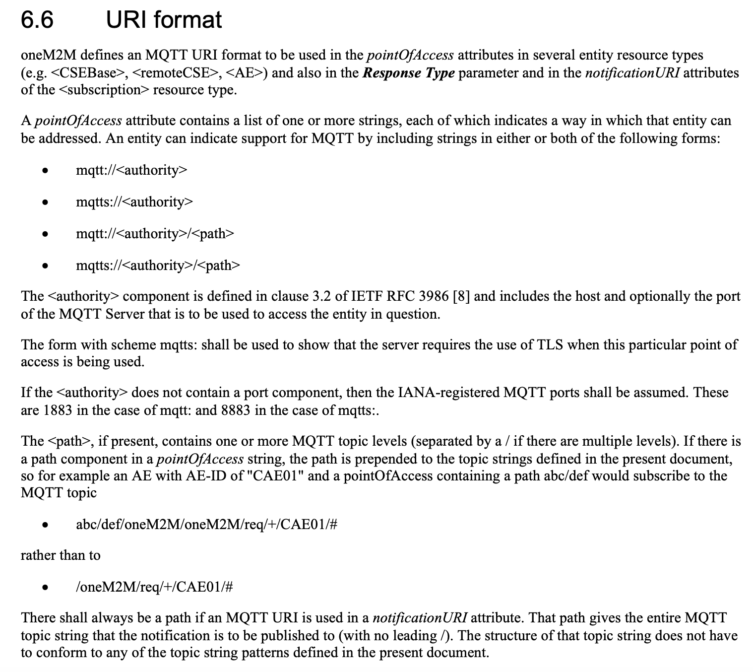
MQTT URL convention in oneM2M
For poa and nu attribute, we have URL convention for MQTT binding
  both are for inbound request to AEs
MQTT topic is carried in the path
TS-0010 specifies not to use leading slash(‘/’) in the path
A path is decided by applications, however why it shall NOT be present by the spec?

Slide 3
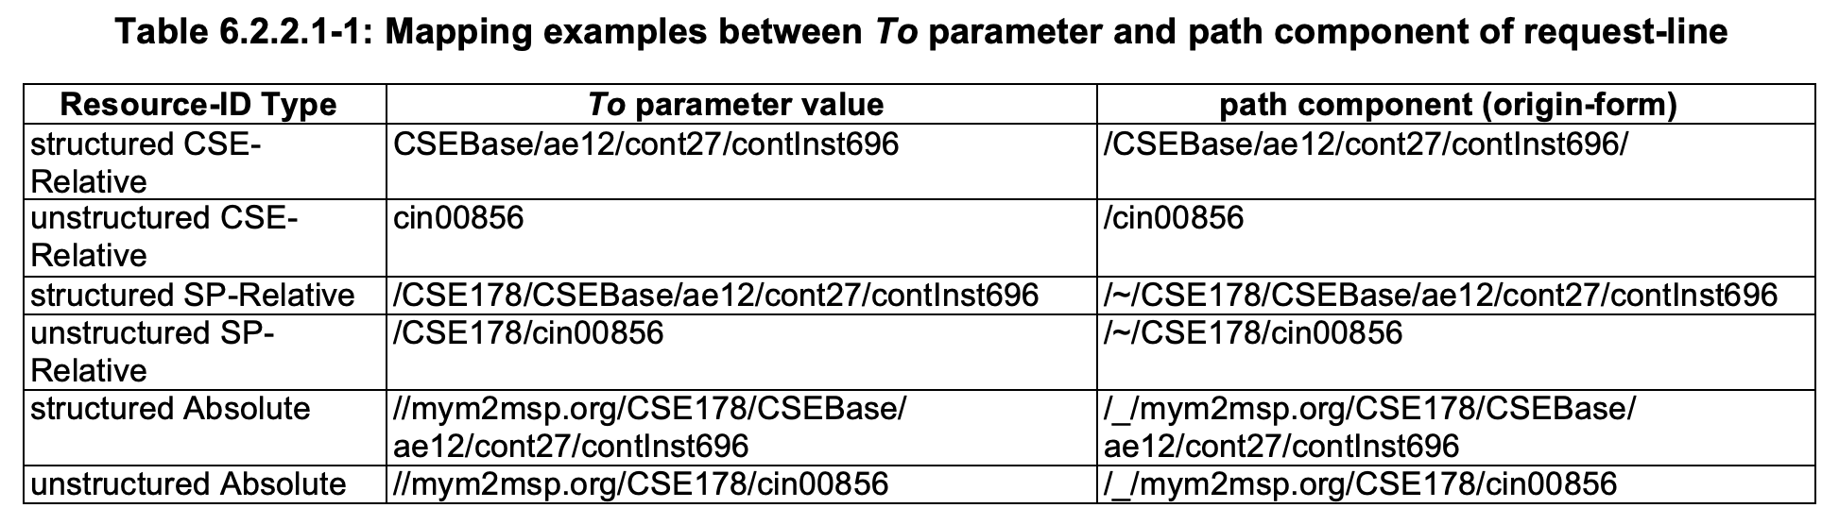
Special path handling in HTTP
In HTTP binding, for different scopes of To parameter (target resource ID), we have special handlings, because the HTTP path always starts with single slash

Slide 4
MQTT topic for oneM2M and MQTT URL
For oneM2M primitives
  /oneM2M/req/originator/receiver
  /oneM2M/resp/originator/receiver
For MQTT URL (currently specified in TS-0010)
  E.g. parking/parkingLot1/spot001 (no leading slash)
Then what if an app wants to use the leading slash? (which is allowed by MQTT)
The URL would be…
  mqtt://mybroker:1883//parking/parkingLot1/spot001
this is NOT incorrect since that is not part of MQTT spec, but generally (in HTTP point of view) this is totally weird

Slide 5
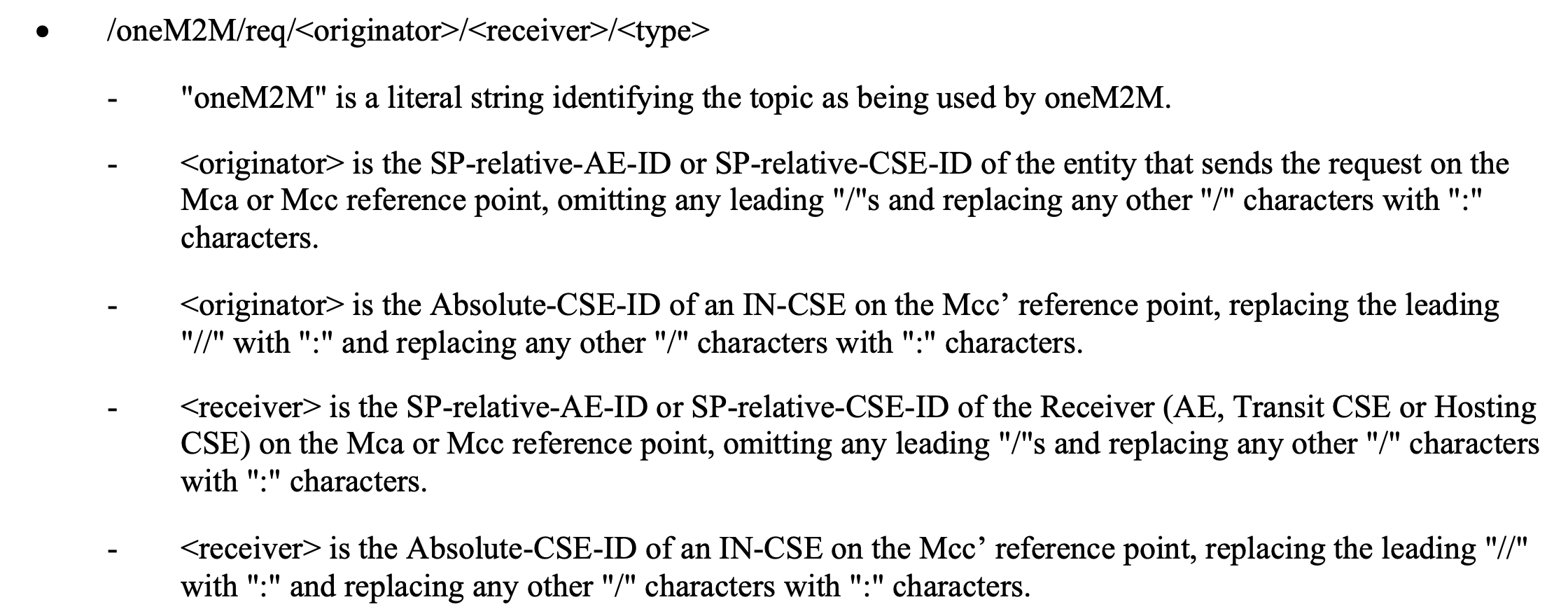
Alternative options
Requirement: For MQTT URL, included topic is allowed to have leading slash
Options for MQTT URL convention
  Opt. 1) mqtt://mybroker:1883//parking/parkingLot1/spot001?ct=json
    THE path includes double slash
    small implementation updates necessary
  Opt. 2) mqtt://mybroker:1883?topic=/parking/parkingLot1/spot001?ct=json
    NO path included/used
    topic is carried in query component in the URL as we already use for content type
  Opt. 3) mqtt://mybroker:1883/:parking/parkingLot1/spot001?ct=json
    replace leading slash into a special character as we do for originator and receiver IDs in the topic

