Slide 1
SDS-2024-0049
Conceptual Introduction to NGSI-LD
Martin Bauer,
22 April 2024

Slide 2
Table of Contents
Misconceptions about NGSI-LD – to be discussed AFTER
NGSI-LD concepts are clear
Warehouses Analogy – to show differences in a more graspable form
NGSI-LD Introduction and Design Goals
NGSI-LD Information Model
NGSI-LD API
Data Models for NGSI-LD (outside scope of ETSI ISG CIM)

Slide 3
Misconceptions about NGSI-LD – to be discussed AFTER concepts are clear
“Both oneM2M and NGSI-LD have REST interfaces, so they are conceptually very similar.”
“ETSI ISG specifies domain-specific data models for NGSI-LD.”
“There are Smart Cities using oneM2M, so obviously there is no need for NGSI-LD.”
“Since you have Brokers, you should compare yourself with MQTT (rather
than use them in your implementations).”
“NGSI-LD data can also be stored in oneM2M resources, so this should be sufficient for
NGSI-LD applications.”

Slide 4
Warehouses Analogy
Beware: The analogy is far from perfect and cannot cover all aspects.
The main goal is to make differences in view more graspable by moving
to the physical domain.

Slide 5





IoTians
IoTians love puppets and figures
They order them in large quantities
Two Warehouses offer different services
(**)
(*)
(*)
(*)
(*)
*AI generated by Microsoft Image Creator, ** AI generated by ImageFX

Slide 6
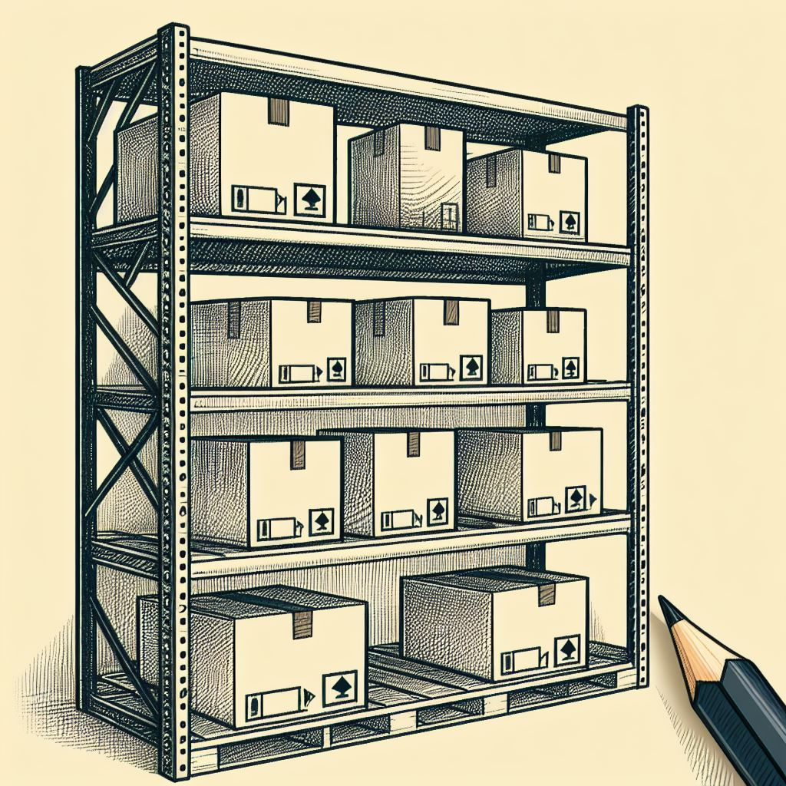
Warehouse oneM2M-Service
Figures and statues are packaged in boxes
Each box has a unique identifier
9876
Each box has a uniform label describing
certain aspects of the content
*AI generated by Microsoft Image Creator

Slide 7
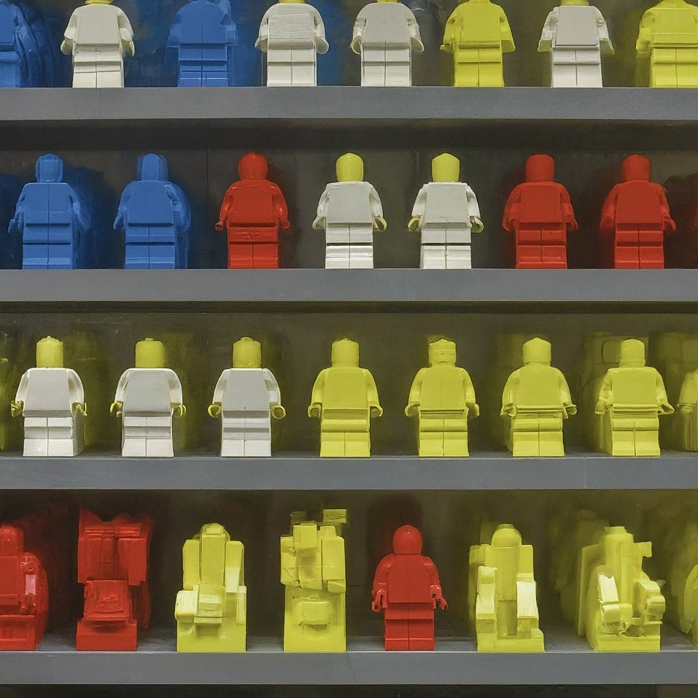

Warehouse NGSI-LD-Service
All figures have the same structure and
general features, but differ in colours and
accessories
2345
Figures are not packed into boxes
** AI generated by ImageFX
Figures can be identified and are
described regarding their
features and accessories
** AI generated by ImageFX

Slide 8




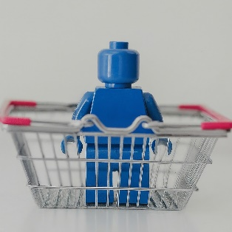
Ordering based on identifier
Warehouse oneM2M-Service
Warehouse NGSI-LD-Service
Customer orders based on
identifier of the box
Customer orders based on
identifier of the figure
(*)
(*)
(**)
(**)
(**)
Customer receives box
Customer receives figure
*AI generated by Microsoft Image Creator, ** AI generated by ImageFX

Slide 9
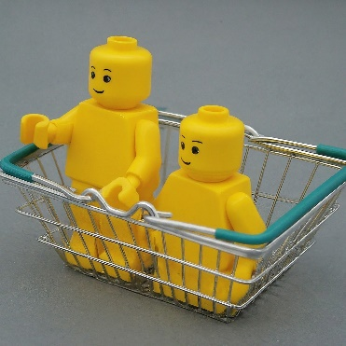

Ordering based on description
Warehouse oneM2M-Service
Warehouse NGSI-LD-Service
Customer discovers based
on description matched
against the label of the box
Customer orders based on
a description the figures
have to match
9876 …
1235 …
6235 …
5271 …
(*)
(**)
Customer receives list of
fitting boxes with their identifiers
(**)
Customer orders
separately based
on each identifier
(as on previous slide).
Customer receives figures
(**)
*AI generated by Microsoft Image Creator, ** AI generated by ImageFX

Slide 10

Mapping to oneM2M / NGSI-LD
It should have become clear that
  for oneM2M, boxes map to resources
  for NGSI-LD, (Lego) figures map to NGSI-LD entities
Analogy has too many limitations, so it is better to stop here –
even though we could have gone a bit further, explaining that oneM2M Service introduced boxes specially fitted to certain
figures (flex resources) or transparent boxes (json content) or extended labels (semantic descriptors) …

Slide 11
NGSI-LD Introduction and Design Goals

Slide 12
Introduction to NGSI-LD (ETSI ISG CIM)
European Telecommunications Standards Institute (ETSI)
  ETSI produces globally-applicable standards for Information and Communications Technologies (ICT)
  It is officially recognized by the European Commission as a European Standards Organization
  Industry Specification Groups (ISG) allow participation of non-ETSI-members
ETSI ISG for cross-cutting Context Information Management (ETSI ISG CIM)
  Established in 2017 – extended until 2025
  Currently about 30 supporting organizations
  https://www.etsi.org/committee/cim
  Evolution of NGSI Context Interfaces →NGSI-LD – currently v1.8 (April 2024), v1.9 planned for late 2024
https://www.etsi.org/deliver/etsi_gs/CIM/001_099/009/01.08.01_60/gs_CIM009v010801p.pdf
2010 OMA NGSI
2012-2016: NGSI v1/v2
2019: NGSI-LD
Context API
in Open Mobile
Alliance (OMA)
FIWARE project develops binding and evolves OMA NGSI standard
Evolution as ETSI
ISG CIM specification
based on JSON-LD

Slide 13
High-Level Design Goals of NGSI-LD
Evolution of OMA/FIWARE NGSI Context Interfaces
Put NGSI-LD Information Model on a solid conceptual grounding
  Property graph model
  Enable semantic concept definitions
  Enable linking to existing information
Enable applications to specify WHAT information they require (based on the NGSI-LD Information Model) – including geographic scoping and temporal interface → keep application simple!
Support central as well as distributed and federated NGSI-LD system architectures with arbitrary information distribution
Linked Data

Slide 14
NGSI-LD Information (Meta) Model

Slide 15
Logical NGSI-LD Information Model
+ Meta Information
hasRelationship
Relationship
hasSubject
hasSubject
hasRelationship
hasRelationship
Entity
id, type
hasSubject
Value
hasProperty
hasProperty
Property
hasValue
hasObject
hasSubject
hasProperty
speed
80
inFrontof
source
speedometer

Slide 16
NGSI-LD Information Model – Some More Details
NGSI Entity → Physical or virtual object.
  It has at least (one) Entity Type.
  Uniquely identified by an Entity Id (URI)
Entity has zero or more attributes identified by a name
  Property --> Static or dynamic characteristic of an entity
    GeoProperty (geospatial context)
    TemporalProperty (time context)
  Relationship → Association with a Linked entity (unidirectional)
Properties have a value
  Can be a single value (Number, String, boolean), or complex (Array, Structured Value)
Relationships have an object
  A URI pointing to another entity (target of the relationship).
Properties and Relationships can again have properties and relationships

Slide 17
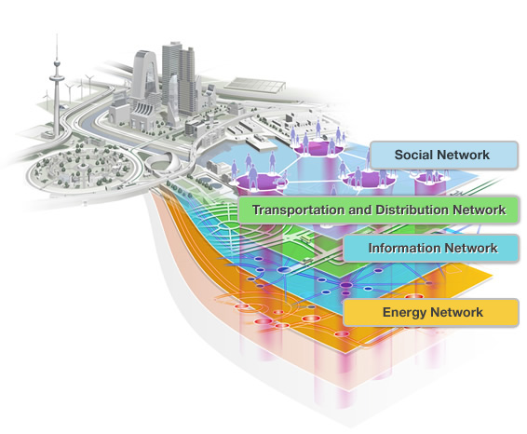


NGSI-LD Information Model (Instance →Property Graph)
Entity (type, identifier)
Advantages of
NGSI-LD Entity Graph
= knowledge graph
~ index structure,
follow relationships
to find relevant entities
retrieve relevant
subset of entities and
use advanced graph
tools
Property
location
Attributes
isAttached
Relationship
location,
speed
speed
livesAt
location
address
owns
link to
3D model
link to
video
Note: the actual entity types
and which properties, and
relationships instances with these
entity types can have, are
out-of-scope of ETSI ISG CIM.
<situation id="GU
ID2A22530C-D4
52-4ae8-B942-9
93BC2923D13" v
ersion="1">
<overallSeverity>
high<
/overallSeverity>
a foaf:Person ; foaf:name "Jimmy Wales" ; foaf:mbox <mailto:jwales@bomis.com> ; foaf:homepage <http://www.jimmywales.com>
"contextRegistration": [
{ "entities": [ { "id": "E1",
"type": "T1",
“ isPattern": "false" },
{ "id": "E2",
"type": "T2", “
isPattern": "false" } ],
asNDAGAINqwq
Ajksajasdfahdsjfk
ASD2348FNA;W
Asdafnasd;fmasd
ASwt5iqwerjsfg43
<buildingA>
<room5>
<occupancy>1
10</...>
All clipart is under Creative Commons BY 4.0 Licence from https://www.svgrepo.com

Slide 18



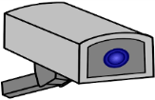
Example: NGSI-LD conceptual property graph
Vehicle
LegalEntity
StreetFurniture
Sensor
rdf:type
rdf:type
rdf:type
rdf:type
providedBy
urn:ngsi-ld:
Org:Officer123
urn:ngsi-ld:
Vehicle:
A4567
urn:ngsi-ld:
SmartLamppost:
Downtown1
urn:ngsi-ld:
Sensor:
Cam1
inAccident
hasAttached
brandName
observedAt
location
location
accuracy
trafficFluidity
“Mercedes”
2017-07-29T12:00:00Z
[8.672, 49.398]
[8.672, 49.398]
5%
0.9
Entity Type
Entity Instance
Relationship
Property
Value

Slide 19
NGSI-LD API

Slide 20

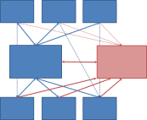
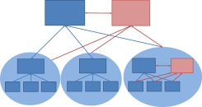
Architectural Roles and Deployment Architectures
Enables Evolution
of Deployments
e.g. Smart City/Smart Country
→ future-proof
Context
Consumer
Context
Consumer
Context
Consumer
Discover
Subscribe/
Notify
Discovery
Query
Subscribe/
Notify
Central
Deployment
Broker
Discover
Subscribe/
Notify
Discovery
Registry
Server
Create
Update
Delete
Distributed
Deployment
Query
Subscribe/
Notify
Register
Context
Producer
Context
Source
Context
Producer
Context
Source
Federated
Deployment

Slide 21
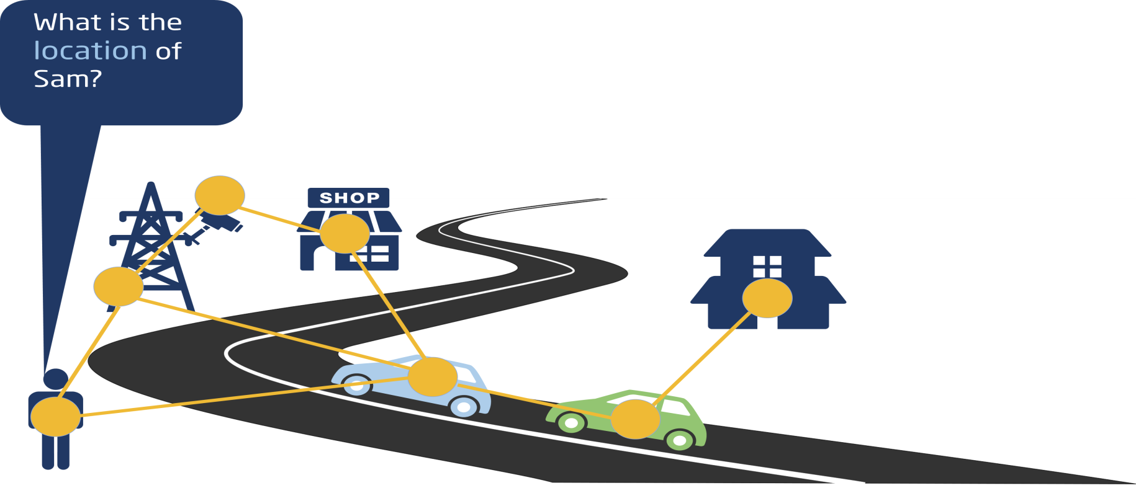
NGSI-LD API – Example: Retrieve Specific Entity
What do applications need to know:
Base URL: http://localhost:9090/ngsi-ld/v1/entities/
Entity Id: urn:ngsi-ld:Person:Sam
Data Model: location property
Security credentials (orthogonal aspect, not shown on following slides)
No need to know:
Where the information is stored

Slide 22

NGSI-LD API – Example: Retrieve Specific Entity
GET /ngsi-ld/v1/entities/urn:ngsi-ld:Person:Sam?attrs=location HTTP/1.1
Host: localhost:9090
Accept: application/ld+json
Response: (NGSI-LD Entity)
{"@context": [{"Person":"https://forge.etsi.org/gitlab/exampleOntology/Person",
"location":"https://forge.etsi.org/gitlab/exampleOntology/location"},
"http://uri.etsi.org/ngsi-ld/v1/ngsi-ld-core-context.jsonld"],
"id": "urn:ngsi-ld:Person:Sam",
"type": "Person",
"location": { "type": "GeoProperty",
"value": {
"type": "Point",
"coordinates": [-8.5, 41.2]
}
}

Slide 23
NGSI-LD API – Example: Create Specific Entity in Broker
What do applications need to know:
Base URL: http://localhost:9090/ngsi-ld/v1/entities/
Entity: {"id": "urn:ngsi-ld:Person:Sam",
"type": "Person",
"location { "type": "GeoProperty",
"value": {
"type": "Point",
"coordinates": [-8.5, 41.2]
}
}
Sam

Slide 24
NGSI-LD API – Example: Create Specific Entity
POST /ngsi-ld/v1/entities/
HTTP/1.1
Host: localhost:9090
Content-Type: application/ld+json
Body
{"@context": [{"Person":"https://forge.etsi.org/gitlab/exampleOntology/Person",
"location":"https://forge.etsi.org/gitlab/exampleOntology/location"},
"http://uri.etsi.org/ngsi-ld/v1/ngsi-ld-core-context.jsonld"],
"id": "urn:ngsi-ld:Person:Sam",
"type": "Person",
"location { "type": "GeoProperty",
"value": {
"type": "Point",
"coordinates": [-8.5, 41.2]
}
}

Slide 25
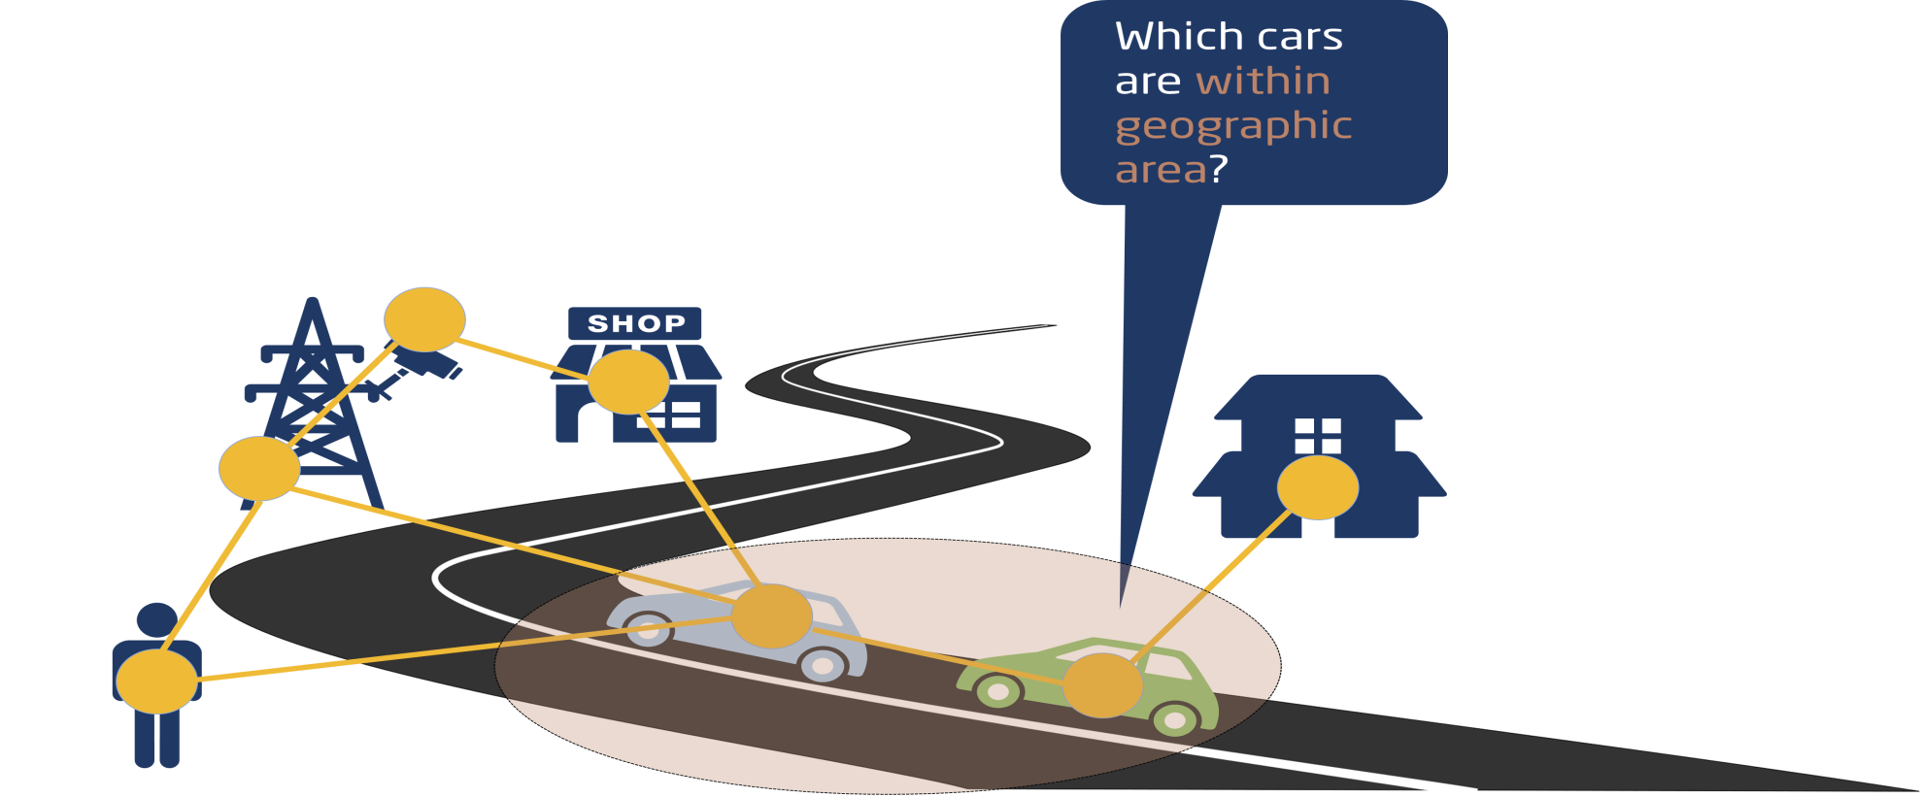
NGSI-LD API – Example: Geographic Query
What do applications need to know:
Base URL: http://localhost:9090/ngsi-ld/v1/entities/
Data Model: car type
Geographic location
No need to know:
Where the information is stored

Slide 26

NGSI-LD API – Example: Geographic Query
GET /ngsi-ld/v1/entities?type=https://forge.etsi.org/gitlab/primerContext/StoreOntology/Car&geoproperty=location&georel=near;minDistance==1500& geometry=Point& coordinates=%5B57.4874120%2C20.2845608%5D
HTTP/1.1Host: cema.nlehd.de:3001
Accept: application/ld+json
GET /ngsi-ld/v1/entities?type=https://forge.etsi.org/gitlab/primerContext/StoreOntology/Car&geoproperty=location&georel=near;minDistance==1500& geometry=Point& coordinates=%5B57.4874120%2C20.2845608%5D
&q=speed>50
HTTP/1.1Host: cema.nlehd.de:3001
Accept: application/ld+json
Query: filter according to speed
…
"id": "urn:ngsi-ld:Car:HDB1234",
"type": “Car",
"location { "type": "GeoProperty",
"value": {
"type": "Point",
"coordinates": [57.48765, 20.284567]
}
...

Slide 27
NGSI-LD API – Example: Subscription / Notification
“Notify me, if any new cars are detected in the specified geographic area“
Two cases to be monitored at the same time:
new car added to the system with location in the area
location of existing car has changed and
is now within specified area.
What do applications need to know:
same as in previous example

Slide 28
NGSI-LD API Structure (1)
API | Functionality | Clauses
Core API | Context Information Provision | 5.6.1 Create Entity 5.6.2 Update Entity Attributes 5.6.3 Append Entity Attributes 5.6.4 Partial Attribute Update 5.6.5 Delete Entity Attribute | 5.6.6 Delete Entity 5.6.7 Batch Entity Creation 5.6.8 Batch Entity Upsert 5.6.9 Batch Entity Update 5.6.10 Batch Entity Delete
 | Context Information Consumption | 5.7.1 Retrieve Entity 5.7.2 Query Entities 5.7.5 Retrieve Available Entity Types 5.7.6 Retrieve Details of Available Entity Types | 5.7.7 Retrieve Available Entity Type Information 5.7.8 Retrieve Available Attributes) 5.7.9 Retrieve Details of Available Attributes 5.7.10 Retrieve Available Attribute Information
 | Context Information Subscription | 5.8.1 Create Subscription 5.8.2 Update Subscription 5.8.3 Retrieve Subscription | 5.8.4 Query Subscription 5.8.5 Delete Subscription 5.8.6 Notification
Temporal API | Temporal Information Provision | 5.6.11 Upsert Temporal Representation 5.6.12 Add Attributes to Temporal Representation 5.6.13 Delete Attributes from Temporal Representation | 5.6.14 Partial Update Attribute instance 5.6.15 Delete Attribute Instance 5.6.16 Delete Temporal Representation
 | Temporal Information Consumption | 5.7.3 Retrieve Temporal Evolution of Entity 5.7.4 Query Temporal Evolution of Entities
Notes:
Slide 16 – quickly jump back to Slide 8

Slide 29
NGSI-LD API Structure (2)
API | Functionality | Clauses
Registry API | Context Source Registration | 5.9.2 Register Context Source 5.9.3 Update Context Source Registration (CSR) | 5.9.4 Delete CSR
 | Context Source Discovery | 5.7.1 Retrieve CSR | 5.7.2 Query CSRs
 | Context Source Registration Subscription | 5.11.2 Create CSR Subscription 5.11.3 Update CSR Subscription 5.11.4 Retrieve CSR Subscription | 5.11.5 Query CSR Subscription 5.11.6 Delete CSR Subscription 5.11.7 CSR Notification
JSON-LD Context API | Storing, managing and serving @contexts | 5.13.2 Add @context 5.13.3 List @contexts | 5.13.4 Serve @context 5.13.5 Delete and Reload @context
Recommendation:
Brokers that implement an internal Temporal Component with Temporal API should consider updating the Temporal Evolution of an Entity whenever the "current state" is modified via the Core API.

Slide 30
Data Models for NGSI-LD
(outside scope of ETSI ISG CIM)

Slide 31
NGSI-LD Information (Meta) Model
Entity (type, identifier)
What entity types are there?
What entity types are there?
Property
location
Relationship
What properties can
instances of a certain
entity type have?
isAttached
What properties can
instances of a certain
entity type have?
location,
speed
speed
What relationships can
instances of a certain
entity type have?
livesAt
What relationships can
instances of a certain
entity type have?
location
address
owns
link to
3D model
link to
video
→ Data Models
→ Data Models
<situation id="GU
ID2A22530C-D4
52-4ae8-B942-9
93BC2923D13" v
ersion="1">
<overallSeverity>
high<
/overallSeverity>
a foaf:Person ; foaf:name "Jimmy Wales" ; foaf:mbox <mailto:jwales@bomis.com> ; foaf:homepage <http://www.jimmywales.com>
"contextRegistration": [
{ "entities": [ { "id": "E1",
"type": "T1",
“ isPattern": "false" },
{ "id": "E2",
"type": "T2", “
isPattern": "false" } ],
asNDAGAINqwq
Ajksajasdfahdsjfk
ASD2348FNA;W
Asdafnasd;fmasd
ASwt5iqwerjsfg43
<buildingA>
<room5>
<occupancy>1
10</...>

Slide 32
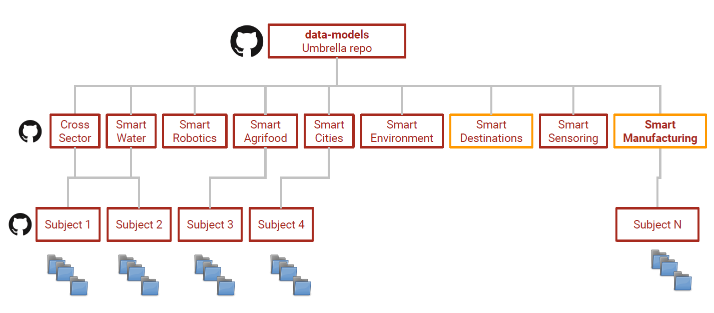

Smart Data Models Initiative structure: domains and subjects
“The new service for the generation of externally referenced @context has now the mapping of the 13 SAREF ontologies available.”
DOMAINS
REPOSITORIES
SUBJECTS’
REPOSITORIES
DATA MODELS
The Smart Data Models initiative is an example of a 3rd party grouping of organizations relying on the NGSI-LD specification.
Source: FIWARE Foundation

